Slide 1

Final Public Hearing to Adopt the
2025 – 2026
Millage Rates and Budget
St. Johns County School District
September 11, 2025 @ 5:30 p.m.
Notes:
Good afternoon, School Board Members and Dr. Asplen. We requested and received your approval in July to advertise in the newspaper the tentative millage rates and budget for the new fiscal/school year. The advertisements were placed in The St. Augustine Record on Monday, July 28.
The meeting today includes the final presentation of the state required millage rate, the additional voter approved rates and the 25-26 budget, followed by any public comments and board discussion and your vote to approve the final millage rates and final budget for the 2025-2026 school year.

Slide 2

Truth in Millage (TRIM) Calendar
Date | Activity
July 23 | Tentative Budget sent to the Board
July 24 | Board approved the Tentative Budget for advertising purposes
July 28 | Tentative Budget was advertised in The St. Augustine Record
July 30 | First Public Hearing on the 2025-2026 Tentative Millages and Budget
September 11 | Final Public Hearing on the 2025-2026 Final Millages and Budget
Notes:
What is TRIM? The Truth in Millage legislation was enacted in 1980, and the requirements are detailed in Florida Statute Section 200.065. The TRIM method is the process government entities use to levy ad valorem/property taxes.
~Taxing authorities in Florida, which includes county governments, school districts, water management districts, special districts and municipalities are governed by the Florida Constitution and Statutes.
The TRIM process is housed within the Florida Department of Revenue’s Property Tax Oversight department. The Property Tax Oversight department works with Florida taxing authorities to make sure the taxing entities are following the requirements of the mandated guidelines.
~Public hearings such as this one, invite taxpayers and the community to participate in the process.
~Following these requirements, we placed our legal advertisements in The St. Augustine Record, on Monday, July 28. School districts must hold the first public hearing on the tentative millage rates and budget 2-5 days after publishing the advertisements in the newspaper. The statute also mandates the newspaper notice requirements, form, size and placement of the budget ads.
~Following the presentation, public input and Board discussion, the tentative millage rates are adopted first, followed by the tentative budget.
~After the first public hearing which was held on July 30, we as the taxing authority reported to the property appraiser the approved information regarding the current year proposed millage rates, the current year rolled-back rate, the prior year millage rates, and the date, time and meeting place of our Final Public Hearing. Once the Property Appraiser collects the certifications from the various taxing authorities, they mail out the Notice of Proposed Property Taxes. Florida Statutes are very specific in defining the process and timetable that must be followed to adopt the millage rates and budget.

Slide 3
History of Millages
Notes:
The St. Johns County Property Appraiser certified the 2025-26 estimate of the tax roll that is the basis for determining the Required Local Effort (RLE) millage rate in the Florida Education Finance Program (FEFP). Also, certified were final tax rolls for prior year, which are used to calculate the Prior Period Funding Adjustment Millage. Districts are required to levy the Prior Period Funding Adjustment Millage in addition to the RLE millage. The Prior Period Funding Adjustment Millage offsets the unrealized RLE revenue resulting from a tax roll decrease that occurs when the certified final tax roll is less than the tax roll used in the FEFP state funding calculation.
~The millage rates we are highlighting today include the Required Local Effort (RLE), A Prior Period Adjustment, the Basic Discretionary Millage, our New Additional Millage and the Capital Outlay Millage. The New Additional Millage is the rate that we generally refer to as our Referendum dollars, but for the purposes of this meeting, we are using the terminology provided by the Florida Department of Revenue and shown on the Budget Summary of our advertisement.
Walk through the history starting with 2014-15 and then focus on the 2025-2026 millage rates. Per State Law – the RLE 3.024 mills, The Basic Discretionary Local Effort is 0.748 mills, the Additional Millage is 1.000 mills and the Capital Outlay millage is 1.500 mills. For a total of 6.272 mills, although this factors out to an increase – there is a decrease in the total RLE from last years rates of (0.006).
~The proposed Required local effort at 3.024 Mills will generate $184,785,554
~ Discretionary millage rate of 0.748 mills will generate $45,707,538.
~The proposed Additional Millage rate of 1.000 will generate $61,106,334
~The proposed Capital Outlay Millage rate of 1.500 mills will generate: $91,659,501. (91 million, 659 thousand, 501 dollars.)

Slide 4
Property Values
Notes:
The property assessment values chart for St. Johns County begins in the 2014-2015 school year (at the bottom). As you can see, year over year the growth of property values in St. Johns County. These values have increased even during the pandemic.
~The current year property tax rolls were certified at $63,652,430,917 billion (63 billion, 652 million, 430 thousand, 917 hundred dollars)… this is an increase in property values of 7.55% over last year.

Slide 5
Proposed Millage Rates for 2025-2026
State Required Local Effort (RLE) | 3.0240
Basic Discretionary Millage | 0.7480
Subtotal | 3.7720
Capital Outlay Millage | 1.5000
Additional Voted Millage (not to exceed four years) | 1.0000
Total 2025-2026 Millage Levy | 6.2720
Notes:
The total proposed millage rates related to school funding for 2025-26 equals 6.272 mills. This rate will generate dollars for the General Operating fund and Capital Outlay fund. The State RLE of 3.0170 & Prior Period Funding Adjustment Millage of .0070 totals 3.0240 mills or 48% of the total millage rate of 6.2720 mills. The Basic Discretionary millage rate is 0.748 mills and 12% of the total rate and the capital outlay millage rate is 1.500 mills or 24% of the total. The additional millage rate of 1.000 mills is 16% of the total.
~Based on the 2025 tax roll provided by the Florida Dept. of Revenue and certified by the Commissioner of Education, the above millage rates are to be levied. Again, the Florida DOE and Florida Statutes direct the amount of State RLE for each school district. This amount is determined as a sum of money, and then the estimated millage rate needed to raise that sum is specified. The initial estimate is used in the preliminary budget.
~This rate is what our school board MUST levy to participate in the FEFP. The school board cannot levy more than the rate specified. Each taxing authority provides to the department of revenue and property appraiser what they have approved at their public hearings.

Slide 6
What is Millage?
Taxable Value | 63,652,430,917
Divide by 1,000 | 1,000
Collection Rate by Florida Statute | 96%
Value of One Mill | $61,106,334
Notes:
A Millage rate is a tax rate or taxation defined as the dollars assessed for each $1,000 of property value. The equation above shows the Taxable Property Value divided by / 1,000 X 96% collection rate = equals the value of one mill. In general, one mill is one-tenth of one cent, or a one mill levy is a property tax of $1.00 per $1,000 of assessed valuation of property.
A mill refers to the rate of property tax commonly paid on the assessed value of a home and/or business properties.
For the above calculation we divide the St. Johns County taxable property values of $63,652,430,917 (63 billion, 652 million, 430 thousand, 917 dollars) by 1,000 and then multiply by 96%. Why 96%? It’s the collection rate set-aside of 4% for the possibility of uncollected property taxes. This is the most we can use in the budget per state law. By using the example above, one mill will generate $61,106,334 (61 million, 106 thousand, 334 dollars) in St. Johns County.

Slide 7
2025-2026 Rolled-Back Rate
 | (1) | (2) | (3)
 | 2024-2025 | Rolled-Back Rate | 2025-2026
Taxable Value | $ 59,183,696,626 | $ 61,274,000,815 | $ 63,652,430,917
Millage Rate | 5.2780 | 5.0979 | 6.2720
Dollars Generated (Yield) | $ 312,371,551 | $ 312,368,729 | $ 399,228,047
Current year total proposed rate as a percent change of rolled-back rate is 23.03%
Notes:
What is the “Rolled-Back Rate?” The RBR is the millage rate that would provide the same amount of revenue as the previous year’s millage rate if applied to the current property tax roll or tax values. Florida Statute 200.065 states that when the current proposed State required Millage rates exceed the RBR the legal advertisement must be a “Notice of Proposed Tax Increase”. Let’s review.
~In column 1 the taxable value for property in St. Johns County in July 2024 was $59,183,696,626 billion (59 billion, 183 million, 696 thousand, 626 dollars), the millage rate for the school district portion of taxes was 5.278 and generated $312,371,551: $312 million,371thousand, 551 dollars.
~In column 2, the taxable value calculation includes the property values less new construction plus any , and/or additions for purposes of the RBR. This amount is $61,274,000,815 (61 billion, 274 million, 815 dollars.) So, the millage rate, when rounded would need to be 5.0979 to generate the same amount of dollars as last year? Remember that rate: 5.0979
~In column 3 the certified property values this year are $63,652,430,917 (63 Billion, 652 million, 430 thousand, 917 dollars); then the state required millage rates of 6.272 (which includes the additional voted 1 mill) for total dollar amount generated of $399,228,047 (399 million, 228 thousand, 047 dollars) (SEE NEWSPAPER ADVERTISEMENT). As the state required millage rates are higher than the RBR, we now have a property tax increase.
~Please remember: What you will be assessed for your property taxes is a function of the value of your property. If your property was assessed or worth more this year than last year, you will pay more in taxes. For example, a St. Johns County citizen could be paying more in school board taxes if your property is valued more or assessed higher this year than last year.
The proposed Millage rate for 2025-26 is 6.272. Read into minutes of the meeting this is an increase of 23.03% more than the current year RBR, as noted on the DR-420S (this information can be found in the budget book on page 278)

Slide 8
2025-2026 Rolled-Back Rate
Notes:
The prior slide is the format in which you are used to seeing in this presentation for the rolled-back rate. In an effort to be transparent and in celebration of our Additional Voted Millage Rate – I have provided a breakdown showing what the millage would have generated without the additional voted millage and what it generates with it included. Which is the 6.2720 that you are voting to approve tonight. These values are at 100%.

Slide 9
How Millage Works – Scenario #1
Assumes no increase in $360,000 home
2024-25 millage = 5.278 mills
2025-26 millage = 6.272 mills
Last year’s taxes were $1,768.13
This year’s taxes will be $2,101.12
Increase of $332.99 or 18.83%
Assessed Value | $360,000
Less – Homestead Exemption | - $25,000
Taxable Value | $335,000
Notes:
Let’s look at how a property owners’ taxes are computed slide?
~The taxable value of a homeowners’ property equals the assessed value, as determined by the St. Johns County Property Appraisers office, less a $25,000 homestead exemption, if applicable. (If you feel that the value of your property is inaccurate or does not reflect fair market value, or if you are entitled to an exemption or classification that is not reflected on your property valuation statement, please contact your local property appraisers’ office of the county in which the property is located.)
~What is a Homestead Exemption? A homestead exemption is probably the most common tax exemption. It reduces from the value of your primary residence property an amount that should not be taxed, if you have filed for the exemption.
To review the slide box: The portion of property tax related to school funding equals the taxable value, divided by 1,000 multiplied by the School District Millage Rate. Under the proposed rate, a homeowner of a $360,000 home, less the homestead exemption deduction of $25,000 has a Taxable value of $335,000 and will pay $2,101.12 of ad valorem (property) taxes to St. Johns County related to school funding for the new year. This is an increase of 18.83% or $332.99 more than last year.

Slide 10
How Millage Works – Scenario #2
Assumes 3.0% increase assessed property value to $370,800
2024-25 millage = 5.278 mills
2025-26 millage = 6.272 mills
Last year’s taxes were $1,768.13
This year’s taxes will be $2,168.86
Increase of $400.73 or 22.66%
Assessed Value | $370,800
Less – Homestead Exemption | - $25,000
Taxable Value | $345,800
Notes:
Before we cover scenario 2 a bit of history, in 1995 the “Save our Homes” amendment passed and added to the Florida Constitution and Statutes. This amendment ensures that the assessed value of property with a homestead exemption cannot increase more than 3% or the percent change in the Consumer Price Index (CPI) whichever is less.
~Again, the portion of property tax related to school funding equals the taxable value, divided by 1,000 multiplied by the School District Millage Rate.
~Under the proposed rate, a homeowner of a $370,800 home, after the homestead exemption deduction of $25,000 has a Taxable value of $345,800 and will pay $2,168.86 of ad valorem (property) taxes to St. Johns County related to school funding. This is an increase of $400.73 or 22.66% more than last year.

Slide 11
School Property Taxes (15 Years)
Notes:
I’ve added this slide as a reminder that even with the voted-on 1.00 mill, the total millage rate this year is still less than it was 15 years ago – even only 7 years ago in 2018-2019 the millage rate was 6.278.
Now, for most, property taxes have gone up over time due to the assessed value of the home going up – but school districts keep getting rolled back year over year.

Slide 12
Revenues and Millages Over Time
Notes:
I wanted to introduce some analysis of how the millage has been going down year over year and how that affects our funding.
So in this example – keeping the certified tax roll as it is today and calculating what the district would have received in revenue had the millage remained while property taxes increased. You can see how much we would have generated. We as a school district continue to grow and we need our funding to grow with us. By our community supporting the additional millage – we can guarantee that all of the $61 M it generates stays right here in St. Johns County.

Slide 13
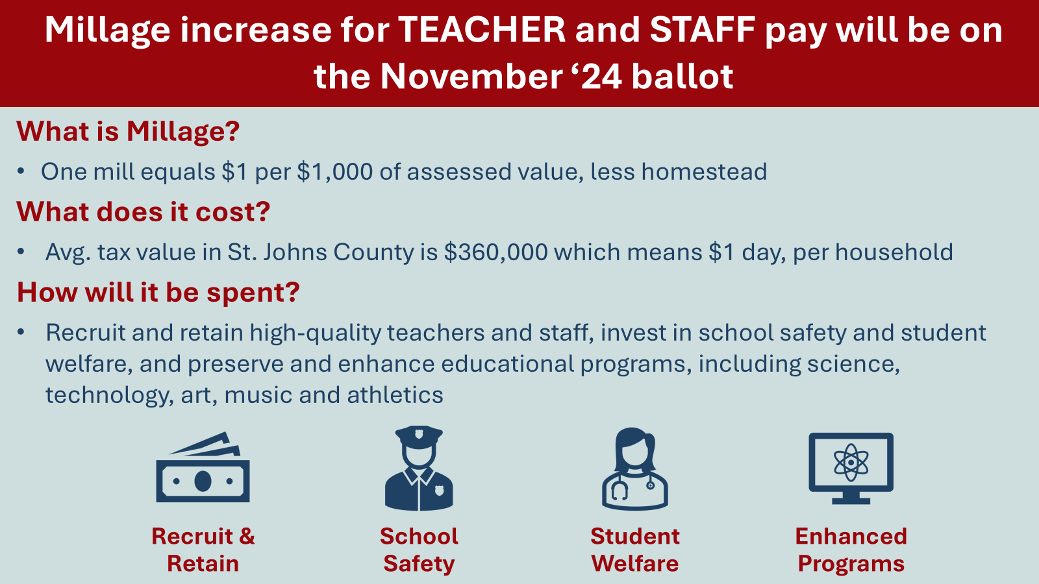
Notes:
As a reminder – this is a slide right out of our presentation last year as we went out and spoke to the community. We discussed how the increase would affect their property taxes. AND, we presented how we would spend these dollars.
Today – 85% of these projected funds are going into the paychecks of our amazing staff. Staff will receive between $4,500 and $8,200 for this school year. We are able to pay for additional nursing staff and the additional cost to have a YRD in our schools. And we are enhancing programs at our schools by supporting basketball programs at our Title I elementary schools and arts programs at our high schools.

Slide 14
Total Budget for 2025-2026
Notes:
The next item we will review is the school district budget. The budget is detailed by funding sources.
~The General Operating Fund equals $626,974,282 (626 million, 974 thousand, 282 dollars) or 41% of the total. The main source of funding for the General Fund comes from the FEFP (this is a combination of state sales tax and local property taxes.)
~The Special Revenue Fund equals $50,629,474 (50 million, 629 thousand, 474 dollars). (This includes Student Food Services, and Federal dollars for the various Title grants, the Individuals with Disabilities Education Act (IDEA) grant, and the Head Start grant to name a few). 3%
~The Debt service fund equals $57,265,018 (57 million, 265 thousand, 018 dollars) or approximately 4% of the total budget
~The Capital Project Fund equals $662,290,945 (662 million, 290 thousand, 945 dollars) and makes up 43% of the total budget.
~The Internal Services Fund is $141,421,082 ($141 million, 421 thousand, 082 dollars) and equals 9% of the total budget (This fund includes the Health insurance for Medical, Dental & Vision programs along with the workers compensation program funds.)
~The total budget equals $1,538,580,801 (1 billion, 538 million, 580 thousand, 801 dollars).

Slide 15
General Fund Revenue
Notes:
~The General Fund (Fund 100)Revenue dollars include Federal, State and Local.
~Federal dollars are estimated at $260,000 for our County wide JROTC program, or less than half a percent. ((JROTC: the military branches provide course content, curriculum teaching aides and any other supplies associated with the conduct of the program including uniforms, equipment (replica weapons, air rifles, and sabers) as authorized. Each of the military branches retain ownership of the items they provide. Additionally, meals, travel & lodging costs for students & instructors are covered for activities away from the school. We must provide technology, classrooms, & office space.))
~State Revenue includes the Florida Education Finance Program funds at $244,351,526 or 43%
~Local dollars are a combination of required local effort, discretionary millage, fees, field trips, etc.) are $300,349,880 or 53%. ~Transfers are 4% and come from the capital outlay fund and the student food service fund. (Capital =$21.8 million and SNS $2.8 million totaling $24.6 million.)
~The major portion of the General Fund or Operating Budget dollars are used to maintain our educational programs offered to the children, families and citizens of St. Johns County.
~(This does not include Fund Balance). For a total estimated revenue of $569,570,410.

Slide 16
General Fund Appropriations
Classroom Teaching:
K-12 Basic Programs
K-12 ESE Programs
At Risk Programs
Career Tech
Adult Education Programs
Teacher Support:
Student Services
Instructional Media Services
Instructional & Curriculum Develop.
Instructional Staff Training
Instructional Related Technology
School Operations & Maintenance of Schools:
School Administration
Operation of Plant
Maintenance of Plant
Community Services
Operational Services:
General Administration
Facilities & Acquisition
Fiscal Services
Central Services & Transportation
Board of Education
Administrative Technology Svs.
Notes:
General Fund expenditures detailed by category:
~The largest category of expenses in the general fund are for the students and teachers. The Classroom Teaching employees are those who work with our students. This category includes Grades K-12 Basic Education programs, Grades PreK-12 Exceptional Student Education programs, At Risk Programs, Career Tech & Adult Education programs. 62% (or $ 351,721,495 of our general operating expenditures reside here. This include salaries, employee benefits, purchased services, materials and supplies.
~The Teacher Support team is next and includes Student Services, Instructional Media Services, Instruction & Curriculum Development, Instructional Staff Training, & Instructional Related Technology (this category goes hand in hand with the Direct Instruction group). The Teacher Support category totals 13% or $72,113,436 of the general fund expenses. When the Classroom Teaching and Teacher Support categories are added together, they equal 75% of the total budget.
~The School Operations & Maintenance of Schools section equals 15% of the general fund expenses and includes School Administration, Operation of Plant, Maintenance of Plant and Community Services. (($88,770,475 of the general fund expenditures.))
~The Operational Services category includes General Administration, Facilities, Student Transportation, Central Services, Administrative Technology Services, Human Resources, Financial Services and school board and equals 10% of the general fund expenses. ($56,965,004).
The total estimated appropriations equal $569,570,410.

Slide 17
Additional Millage (1 Mill): $61,106,334
Notes:
Our newest addition to our tentative budget presentation is the introduction of the expenditures of our Additional Millage. For the 2025-2026 School year the expenditures are identified as noted in the graph.
R & R at 85% - this is the money that is going to staff in the form of a supplement. These started with the July 15, 2025 paychecks.
S & W at 10% - this includes the additional costs outside of the state allocation for our wonderful YRDs along with nurses and safety monitors and ESE interventionists.
P & E at 4% - this is to support Technology in the district, along with athletics and the arts.
Charters 1% - and as per the law, we will provide a proportionate share to our charters as required.
AS this is our first year with these funds, we will continuously monitor and evaluate the best use of this resource for our students.
And, a reminder to the public that the application is out for those that would like to apply to fill one of the seats on our Citizens Advisory Committee. The application closes on September 17.

Slide 18
Capital Outlay Revenue
Notes:
Capital Outlay Fund has Revenue from local dollars including: property taxes, half-cent sales surtax collections, & impact fees.
~Our estimate from the state for Capital outlay and debt service (CO&DS) equals less than half a percent or $1.8 million.
~The Half-cent sales surtax is projected at $26.5 million or 4% of the capital fund.
~Our projected collection from the Capital Outlay Local millage 1.500 mills is $91.7 million or 14% of the capital budget.
~The impact fees are approximately $15 million or 2% of the fund.
~The fund balance or carry forward balance makes up the remaining dollars to be used for our maintenance projects, construction, and renovation projects.
~The total capital fund equals $662,290,945

Slide 19
Capital Outlay Appropriations
Notes:
The Capital Outlay expenditures are:
~Buildings & Fixed Equipment - $456.7 million or 69%
~Furniture, Fixtures & Equipment - $15.8 million or 2%
~Motor Vehicles (including 25 school buses) - $13.9 million or 2%
~Improvements Other Than Buildings - $26.8 million or 4%
~Remodeling & Renovations - $95.7 million or 15%
~Transfers - $53.4 million or 8%
For a total of $662,290,945 million

Slide 20
Debt Service Revenue
Notes:
The revenue dollars for the debt service fund includes:
~Federal dollars for the Qualified School Construction Bonds - $745,347.20 interest and payments or 1.0%.
~Local dollars of 10% from the Half-Cent Sales Surtax of $5.5 million
~Transfers In totals 55% or $31.6 million for payments
~Estimated Fund Balance/carry forward of 34% or $19.29 million.
~For a total estimated Revenue amount of $57,265,018

Slide 21
Debt Service Appropriations
Notes:
Expenses for Debt Service include principal payments, interest payments and associated fees.
~Principal payments are $18.5 million (Certificates of Participation, and Half-Cent Sales Surtax Revenue Bonds – Series 2016)
~Interest payments of $18.5 million
~Dues & Fees of $23,750
Fund Balance (Sinking Fund) equals $20.2 million or 35%
~For total estimated appropriations of $57,265,018

Slide 22
Student Food & Nutrition Services Revenue
Notes:
The Student Food and Nutrition Services Fund earns dollars from two sources.
~We receive 32% from the National School Lunch Program administered through the Department of Agriculture
~68% of revenue comes under the local category and are generated from a la cart sales.
~The total estimated revenue (not including fund balance) equals $21,732,000 adding in carry forward we have revenue of $34,653,283

Slide 23
Student Food & Nutrition Services Appropriations
Notes:
The Student Food & Nutrition Services expenditures include:
Salaries/Benefits =$10,314,837 million or 43%
Capital Outlay =$587,835 or 2%
Purchased Services =$197,250 or 1%
Energy Services = $123,000 or 1%
Materials & Supplies = $9,727,000 or 41%
Other Expenses = $20,000 or less than one percent
Transfers = $2.8 million or 12% to the General Fund to cover every day operating expenses. And reserves of $10M.
For an estimated total of $34,653,283.

Slide 24
Special Revenue Fund – Federal Projects
Notes:
The special revenue fund contains federal funds that are typically provided for specific programs and populations of students. Currently we are projecting the school district to be awarded approximately $15,976,191 in Federal grants (this does not include our student food service program).
Other grants are expected during the year, however, if we have not received the Grant Award Notice, we do not include it in the budget. The above listed Grants include Title I, IDEA, & HEAD START. The expenses include curriculum, materials & supplies and salaries and benefits. We are waiting on the reinstatement of the funds from Title II, III and IV for a value of approx. $1.3M. Along with some additional revenue for our Adult Education programs at FCTC.

Slide 25
Internal Service Fund
Notes:
The Internal Services Fund includes the medical insurance programs of medical, vision, dental and the workers compensation program. The projected revenue and estimated carry forward equals $141,421,082
The Expenditures include claims, fees and reserves and totaling $141,421,082.

Slide 26
2023-2024
School and District Operating Expenditures
Notes:
This is a report that is put out by the Florida Department of Education and this is the most recent report since district are still closing out 2024-2025.
This shows a comparison of our surrounding counties and expenses within the 4 walls of the school vs. district expenditures. As you can see that we are the lowest in district expenditures when reviewing our surrounding area with 97.32% spent in our schools and only 2.68% spent for the district.

Slide 27
2023-2024
School and District Operating Expenditures
Notes:
An I also wanted to show were we are in comparison to all Florida School district and as you can see we are the 6th lowest school district in the state as far as expenditures go for district expenses.

Slide 28
Proposed Millage Rates for 2025-2026
State Required Local Effort (RLE) | 3.0240
Basic Discretionary Millage | 0.7480
Subtotal | 3.7720
Capital Outlay Millage | 1.5000
Additional Voted Millage (not to exceed four years) | 1.0000
Total 2025-2026 Millage Levy | 6.2720
Notes:
In conclusion - The total proposed millage rates related to school funding for 2025-26 equals 6.272 mills. This rate will generate dollars for the General Operating fund and Capital Outlay fund. The State RLE of 3.0170 & Prior Period Funding Adjustment Millage of .0070 totals 3.0240 mills or 48% of the total millage rate of 6.2720 mills. The Basic Discretionary millage rate is 0.748 mills and 12% of the total rate and the capital outlay millage rate is 1.500 mills or 24% of the total. The additional millage rate of 1.000 mills is 16% of the total.
~Based on the 2025 tax roll provided by the Florida Dept. of Revenue and certified by the Commissioner of Education, the above millage rates are to be levied. Again, the Florida DOE and Florida Statutes direct the amount of State RLE for each school district. This amount is determined as a sum of money, and then the estimated millage rate needed to raise that sum is specified. The initial estimate is used in the preliminary budget.
~This rate is what our school board MUST levy to participate in the FEFP. The school board cannot levy more than the rate specified. Each taxing authority provides to the department of revenue and property appraiser what they have approved at their public hearings.

Slide 29
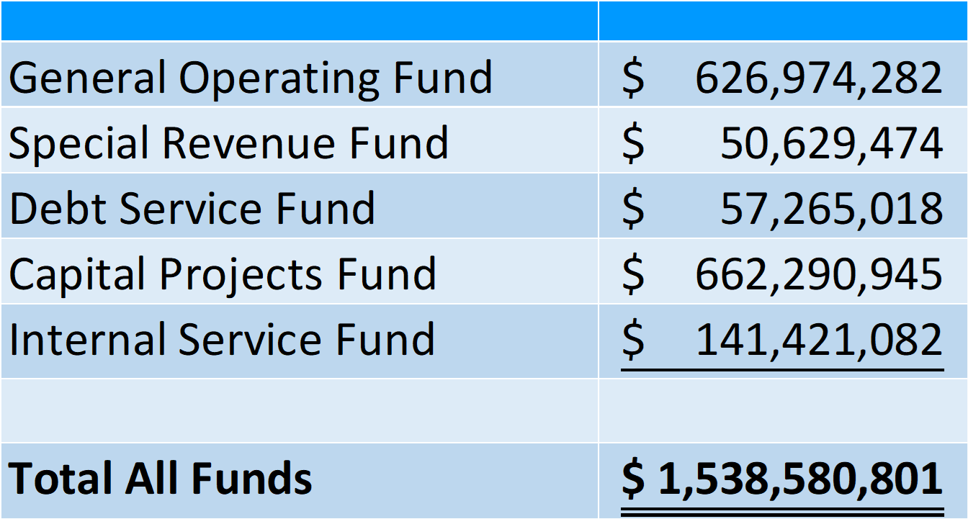
Total Budget for 2025-2026
Notes:
General Operating Fund of $626,974,282 million.
~Special Revenue Fund (Federal/SNS) fund = $50,629,474 million
~Debt Service Fund = $57,265,018 million
~Capital Projects Fund = $662,290,945 million
~Internal Services Fund = $141,421,082
For a total of all Funds / Checkbooks = $1,538,580,801 (1 billion, 538 million, 580 thousand, 801 dollars)

Slide 30
St. Johns County School District
Thank you

