Slide 1

DRILLS

Slide 2

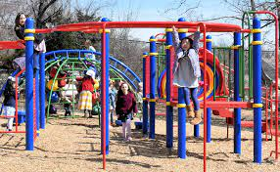

Today we are going to look at
Lockdown Drills
We want you to know that our school is very safe, and you are very safe being here. But lets talk about a few things that can make our school even safer.
Today we will learn what to do in a lockdown drill.
We will talk about what to do and ALWAYS listening to your teacher.

Slide 3



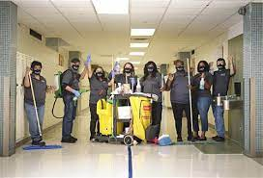

Speaking of ALWAYS, lets look at the ALWAYS rules.
Always LISTEN to the School Teachers, Administrators or Trusted Adults.
Teachers, Para’s and Substitutes
Custodians, Lunch Room Staff and Law Enforcement
Principals, Counselors and other Safe Adults

Slide 4




Try and remain calm and quiet as possible. When you are calm you will listen and react better.
Sometimes this can be difficult but really try
Quiet as a mouse, like playing hide and seek with your friends
Take some deep breaths

Slide 5

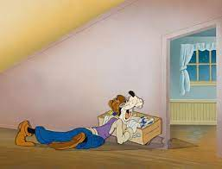
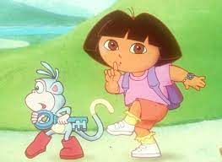

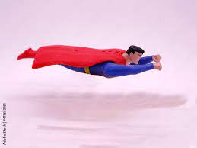
Be prepared to be still and quiet for a long period of time.
Be prepared this may last a long time
Lie on the floor close to your
“Safe Wall” like Superman
Remember to be very quiet
Like a game of hide and seek with your friends

Slide 6


Move quickly and Quietly to the Closest and Safest location following directions from a trusted adult
Move as quickly as possible when you hear the lockdown signal.
Move as quietly as possible and to the closest, safest area with an adult.

Slide 7

A
L
E
R
T
Assess: What do you hear and see?
Lockdown: When the lockdown occurs follow your trusted adult.
Evade: If you cannot lockdown then follow your trusted adult away from danger.
Resist: If you cannot lockdown or run away, listen to your teacher.
Tell: If you see anyone or anything unusual, tell an adult immediately.

Slide 8

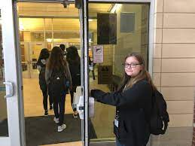
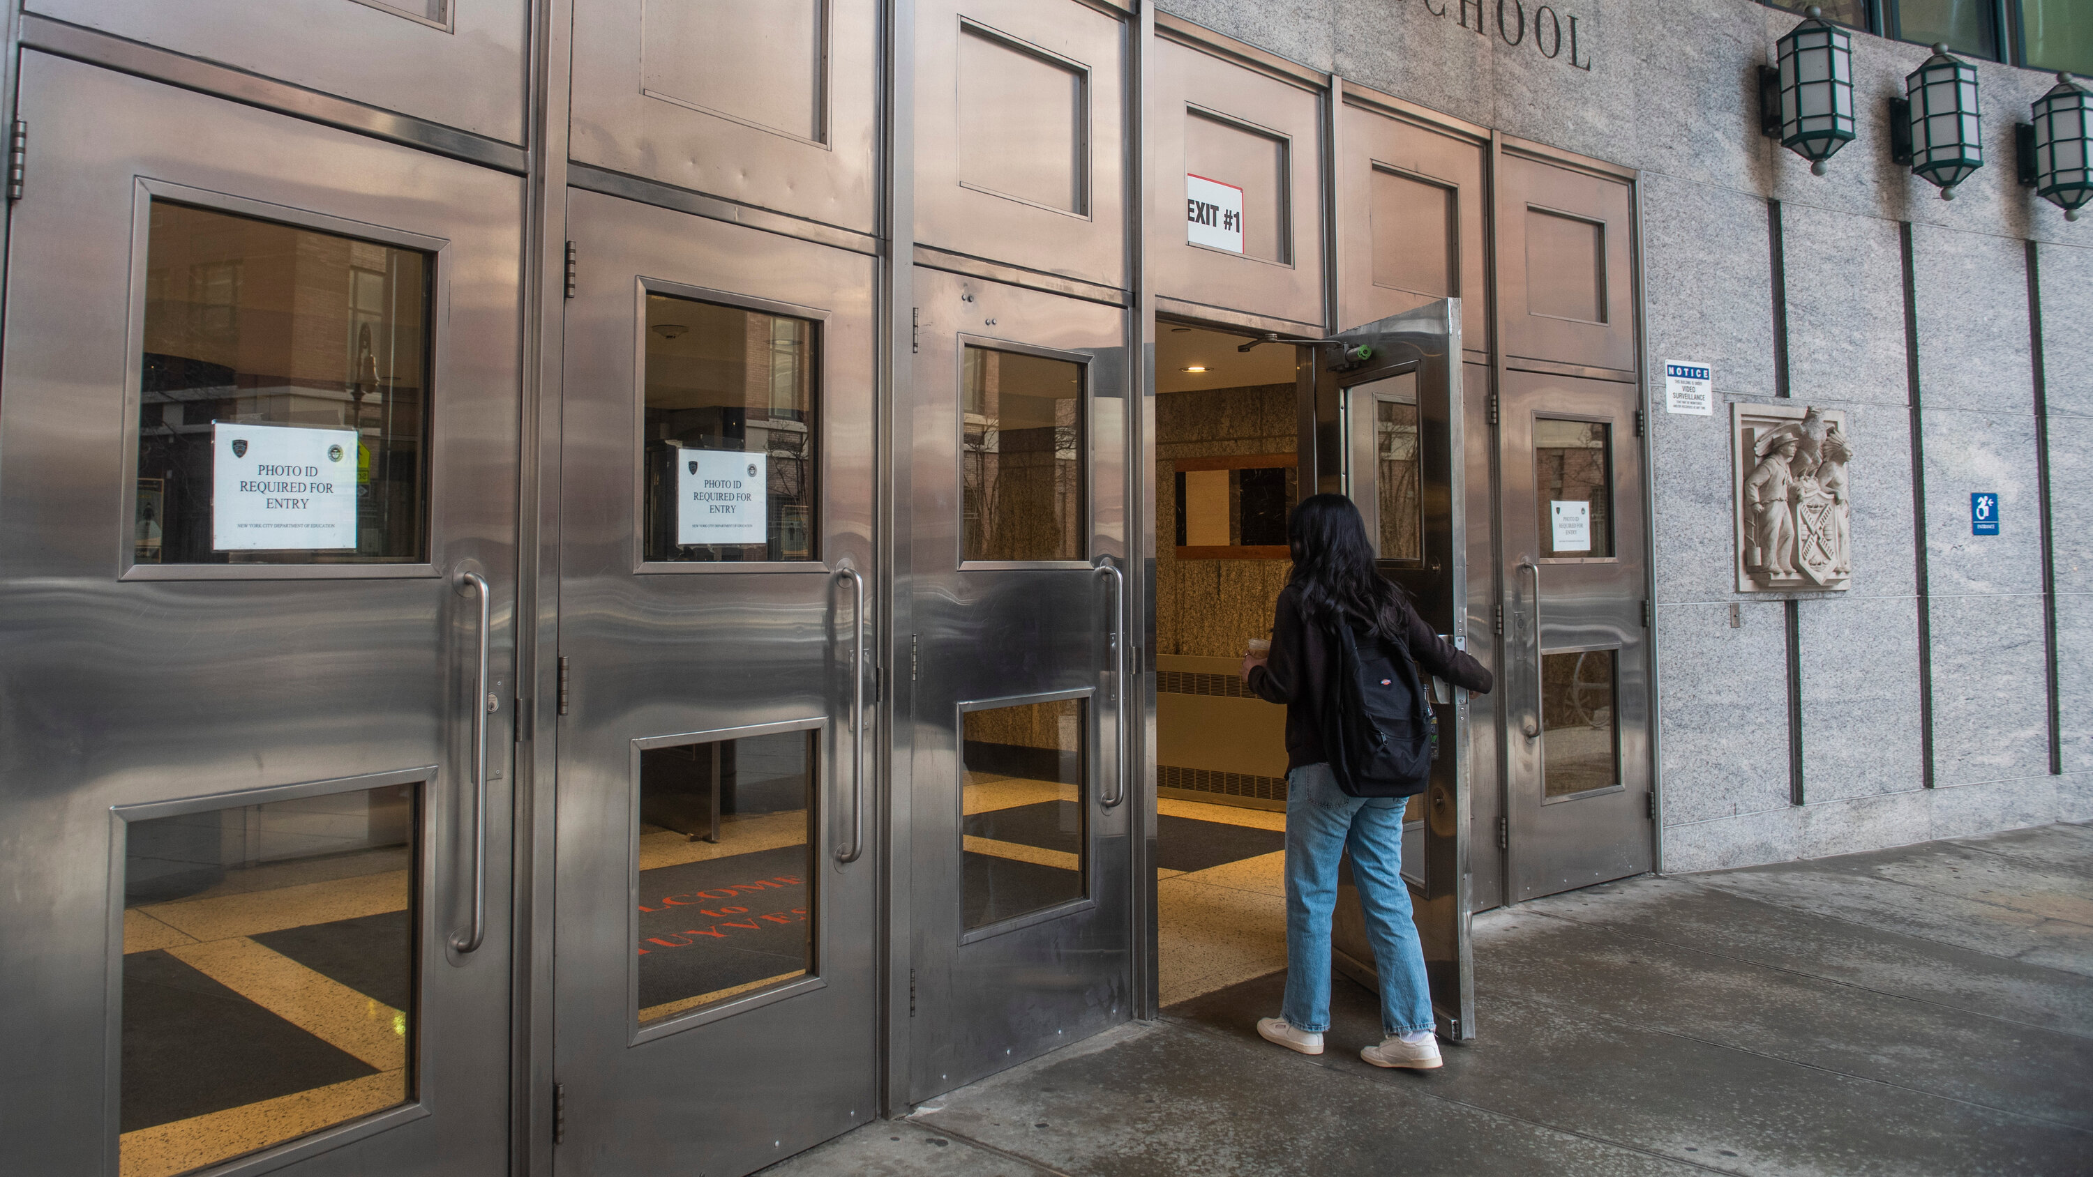
Never open a door!!!
Never open a door for anyone. Let the person on the other side find the correct door to enter. This is one of your times it’s ok to ignore an adult or stranger. We know you are being nice but they need to go in the correct door to check in.

Slide 9



Please, Please, Please if you see something say something.
If you see, hear or read anything that could be alarming or something that does not sound right please tell an adult.

Slide 10


When a tip is submitted on the FortifyFl app it will go directly to the School Officials and Law Enforcement of the school you selected
Anyone can place a tip on the FortifyFl app to include Students, Parents, Concerned Citizens.
If you see or hear something please say something. FortifyFl is your way of saying something 24hrs a day 7 days a week.

Slide 11




