Slide 1


Active Assailant Training

Slide 2

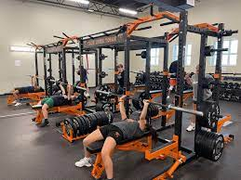
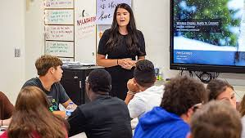
Today we are going to look at
Lockdown Drills
We want you to know that our school is very safe, and you are very safe being here. But lets talk about a few things that can make our school even safer.
Today we will learn what to do in a lockdown drill.
We will discuss good practices around the school.
We will talk about the importance of ALWAYS listening to your Teacher.

Slide 3

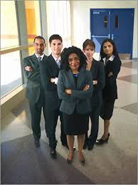

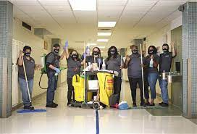
Speaking of ALWAYS, lets look at the ALWAYS rules.
Always LISTEN to the School Teachers, Administrators or Trusted Adults.
Teachers, Para’s and Substitutes
Principals, Deans, Counselors and other Administrative Adults
Custodians, Lunch Room Personal and Law Enforcement

Slide 4

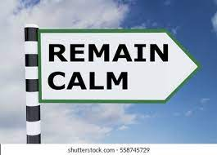

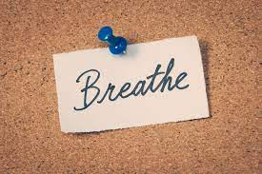
Try and remain calm and quiet as possible. When you are calm you will listen and react better.
It is important to stay silent for the purposes of hearing and staying concealed
Remain calm and focus on your surroundings
Take some deep breaths and start planning your options

Slide 5

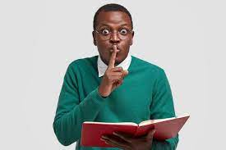
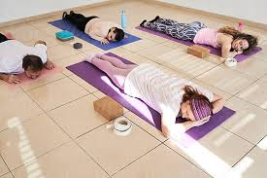

Be prepared to be still and quiet for a long period of time.
Be prepared this may last a long time
Remember to be very quiet
this is important to stay concealed
Lie flat on the floor close to your
“Safe Wall”

Slide 6

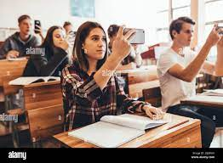
Stay off your cell phones and put them in silent mode, if you have one.
Staying off of your cell phone will allow you to pay attention to the adult in the area.
By silencing your device it allows you to stay concealed.
Taking videos or pictures will distract you and cause you to lose focus and clarity on your immediate surroundings.

Slide 7

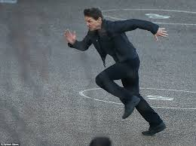
Move quickly and Quietly to the Closest and Safest location with a trusted adult
Move as quickly as possible when you hear the lockdown signal.
Move as quietly as possible and to the closest, safest area with an adult.

Slide 8


Who can
Call for a

Slide 9
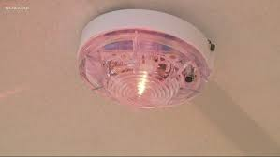
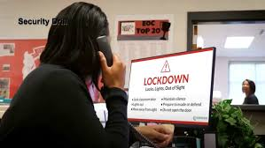
The New: Centegix Crisis Alert System
When the Lock Down is activated the following warnings will occur.
A RED strobe light will flash around the campus
A Lock Down Message will appear on computer screens
A message will be heard on the P.A. system
These are your warnings that a Lock Down has been initiated and you are to follow your Lock Down procedures

Slide 10
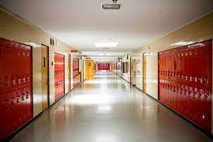
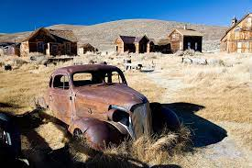
When the lockdown
is given it should
look like a
Ghost
Town

Slide 11

A
L
E
R
T
Assess: What do you hear and see?
Lockdown: When the lockdown occurs move quickly and quietly to the closest area preferably with an adult.
Evade: If you cannot lockdown then evade (run away) away from danger.
Resist: If you cannot lockdown or evade, a last resort is to resist. Work together for best results.
Tell: If you see anyone or anything unusual, tell an adult immediately.

Slide 12
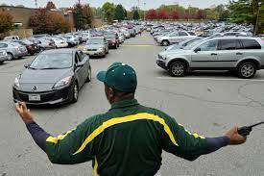
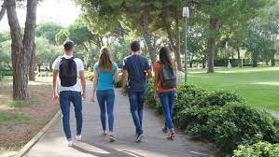
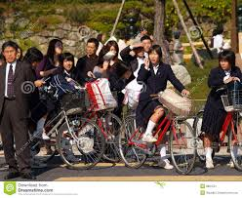
What if you are arriving or departing when a lockdown occurs?
If you are driving, biking, walking or parent pick up/drop off and a lockdown occurs your actions will be the same.
If you can safely turn around and leave the campus, do so. Return home and stay there. Notify your parents that you are safe
If the threat is in the immediate area of where you are then use your ALERT. Assess, Lockdown, Evade, Resist and Tell.
Do not enter the building unless it is necessary to avoid the threat outside.

Slide 13

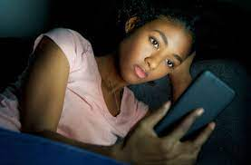
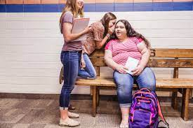
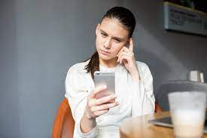
Please, Please, Please if you see something say something.
If you see, hear or read anything that could be alarming or something that does not sound right please tell an adult.

Slide 14
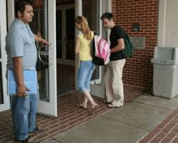
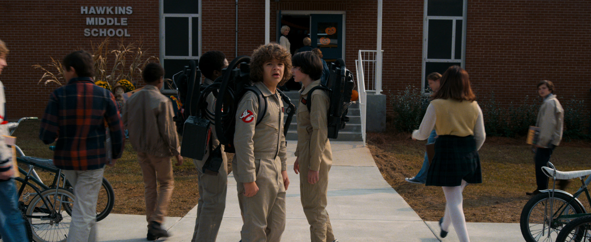
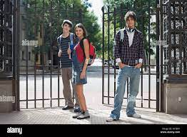
All schools will have a main entry point (front desk). Never open a door or gate for someone. Always direct them towards the front desk so they may check in properly. This is a crucial part of keeping our school safe.

Slide 15


When a tip is submitted on the FortifyFl app anonymous or non-anonymously it will go directly to the School Officials of the school you selected.
Law Enforcement will also get a copy of the tip with State Level Officials. Local Law Enforcement will coordinate with School Officials to investigate and follow through on the tip. State Level Officials will follow up to assist or over see the tip was followed through.
Anyone can place a tip on the FortifyFl app to include Students, Parents, Concerned Citizens.
If you see or hear something please say something. FortifyFL is your way of saying something 24hrs a day 7 days a week.

Slide 16



