Slide 1
www.cpalms.org
CPALMS and CPALMS Charter
Hands-On:
Use of Tools and Resources to Support Standards-Driven Teaching and Learning

Slide 2
Workshop Goals
Become familiar with overall purpose and key features of CPALMS
Understand how CPALMS supports the implementation of the Florida Standards
Navigate CPALMS and explore resources and tools to support standards-driven instruction

Slide 3
Dissemination of Resources
On state requirement pages: standards and course descriptions
On average, a resource is downloaded 1,000 times within the first three month of it’s release
Via e-mail, web-widgets, RSS, and website notifications:
Customized based on teacher’s interests and courses they teach
Recognizes the busy teacher schedule
Within iCPALMS tools
Just-in-Time based on when & what they are working on
Provide resource to students and parents just-in-time based on teacher’s schedule

Slide 4
Resource Review Process
A review process designed for providing professional development for submitters and dedicated for creating high-quality resources for use by our educators.
Review Areas
Expert teachers
Content accuracy
Effective presentation
Pedagogy
+
Subject area experts
An average of
5 reviews
per resource
Standards- alignment
Appropriateness for target audience
Specialty

Slide 5
Resources
5,700+
Math
12,400+ available resources
85% original
Each vetted by educators and subject area experts
Standards-aligned
Created by educators
Resources for teachers, parents, and students
Complete custom authoring and review system
FREE
4,600+
Grades K-5
3,600+
English Language Arts
3,800+
Grades 6-8
4,400+
Science
4,300+
Grades
9-12
Notes:
Updated 1/2018

Slide 6
Variety of Resource Types
Lesson Plans and Units
Math Formative Assessments
Standards aligned and vetted
MEA STEM Lessons & Activities
Text Complexity
Problem-solving Tasks
Data Sets
Lesson Study Resource Kits
Virtual Manipulatives
Perspectives Video Series
Educational Games
Student Resources
Professional Development Modules

Slide 7
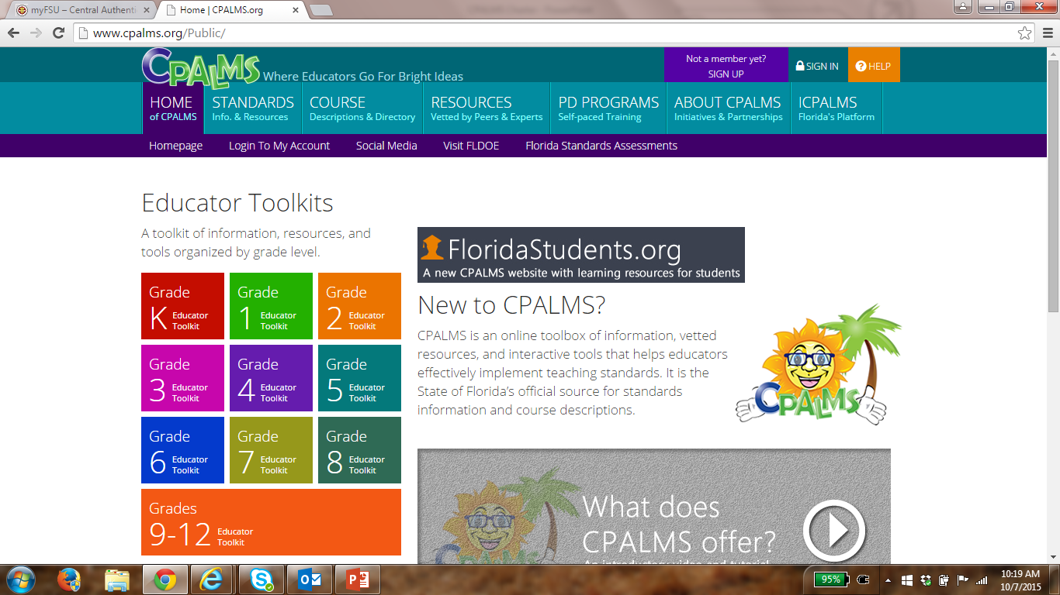
Live Site Demonstration

Slide 8
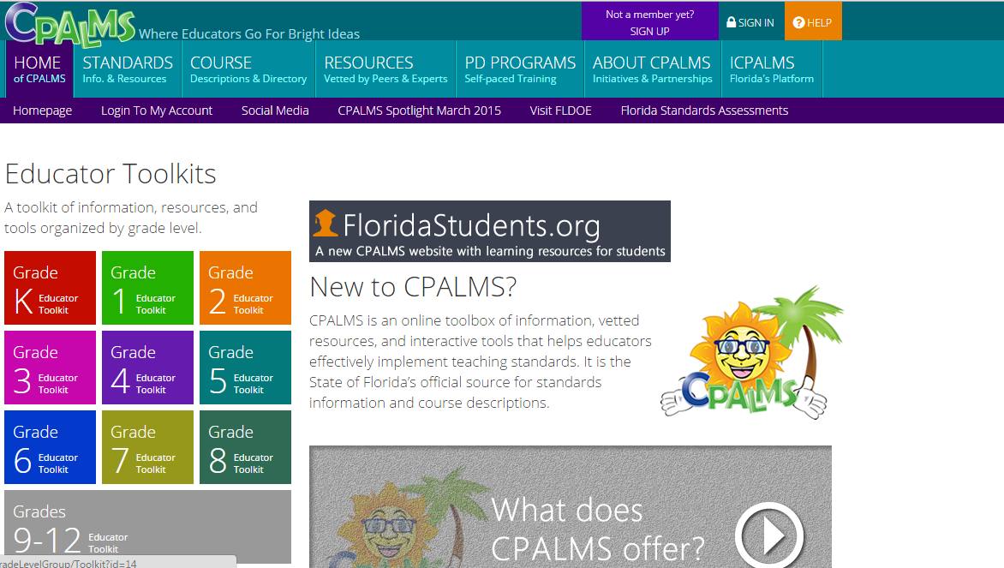
CPALMS Home

Slide 9
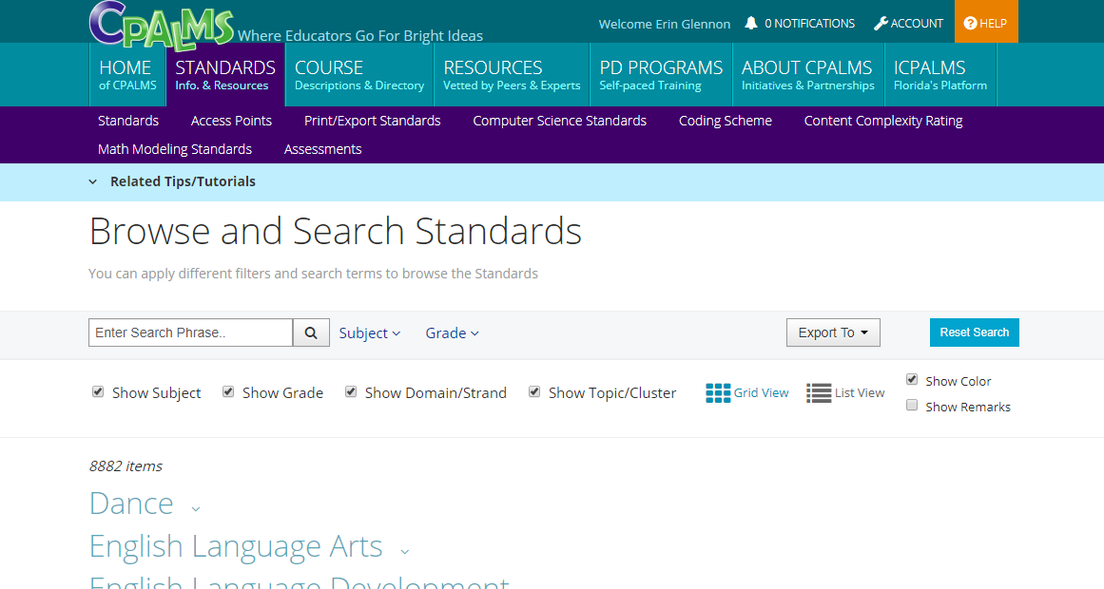
Notes:
Updated 1/2018

Slide 10
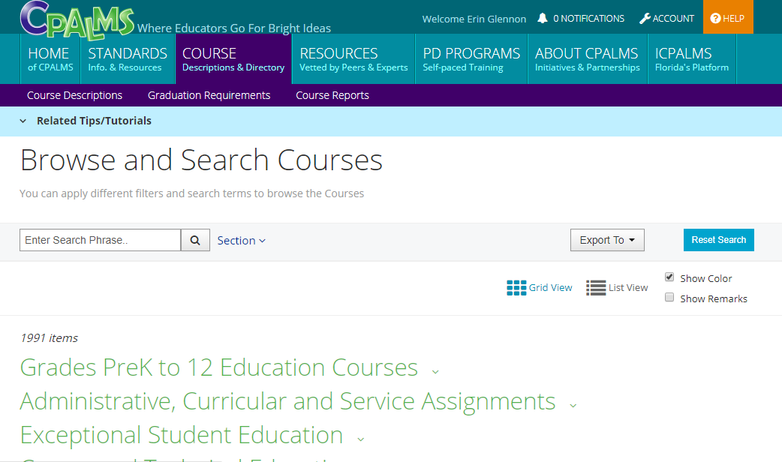
Course Descriptions
Notes:
Updated 1/2018

Slide 11
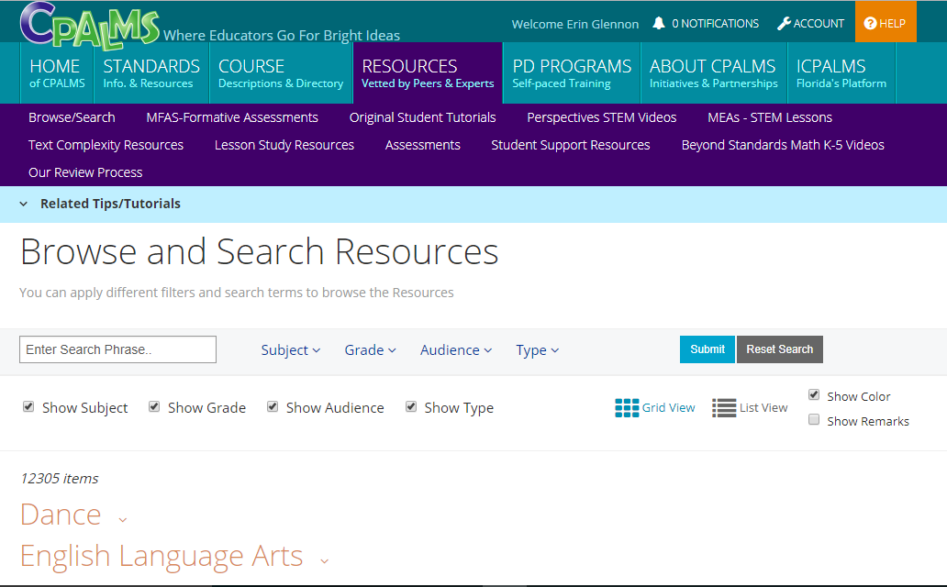
Resources
Notes:
Updated 1/2018

Slide 12
Sample original lesson plans
Grade
K-2
3-5
6-8
9-12
Math
How Many? 46496
What Are They Thinking? Understanding Division 40001
Alas, Poor Pythagoras, I Knew You Well! 35738
Crafty Circumference Challenge 47042
Science
Day and Night Sky 29487
Experiment or Investigation 26705
Back to the Past with the Geologic Time Scale 43470
Conductors vs. Insulators: An Inquiry Lab 45852
ELA
Text Detectives Investigate Meat Eating Plants 39614
Which Do You Prefer? Understanding an Author's use of Text Features in a Non-Fiction Text 50736
User Beware: Foreshadowing and Morals in “The Monkey’s Paw” 29082
Show Me a Hero, and I Will Write You a Tragedy- Part 1 43290

Slide 13
Sample Resources by CTE Areas
 | Perspectives | Text Complexity | MEAs
Agriculture | A viticulture scientist explains grape expectations for medicine and society. | Why are Bees Vanishing? (64382) | Zoo Animal Diets (66222)
Engineering | Get in gear with robotics as this engineer explains how the quadratic formula is used in navigation. | The Quest for a Clean Drink (66607) | 3-D Printers: Cost Effective for the Quantity? (68168)
Culinary | Where have you bean? Didn't you know that chocolate is a delicious topic for discussing phase change? | Infected Cutting Boards (65318) | HOORAH!! Pizza for Lunch! (70332)
Health Science | Advances in 'big data' are leading to rapid changes in personalized medicine. Learn more! | Deploying the Body’s Army (70383) | Diabetic Dilemma (48626)
Notes:
Perspectives:
Short standards aligned videos
Highlight experience and thoughts in math and science
Viewpoints from teachers, professionals, and enthusiasts
Text Complexity:
Text complexity analysis completed for you; Aligned to standards and grade-band; Text-dependent questions included!
MEAs:
Open-ended, problem-based lesson plans embedded with realistic activities
Students work in teams using math and science skills to solve open ended problems

Slide 14
After reading a selected resource:
List 3 things that you like about this resource.
  1.
  2.
  3.
Share 2 connections to something similar you’ve done with your students.
  1.
  2.
List 1 way you might modify the resource for your classroom/students.
  1.

Slide 15
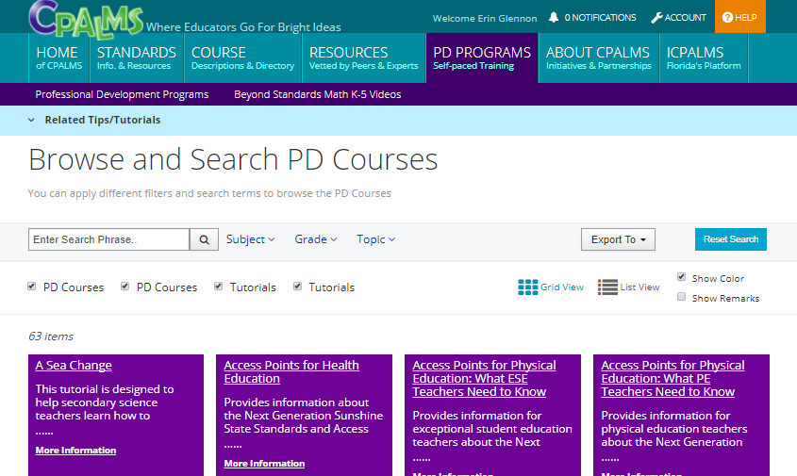
Professional Development Programs

Slide 16
Few of the Tools on iCPALMS
Currently only available to FL educators
CMAP Curriculum Planner
More than 700,000 curriculum plans have been created using the CMAP
Lesson Study Support System
Standards Visualizer
Almost every Florida educator
has an account
My Resources Center
Professional Development System
Several others

Slide 17
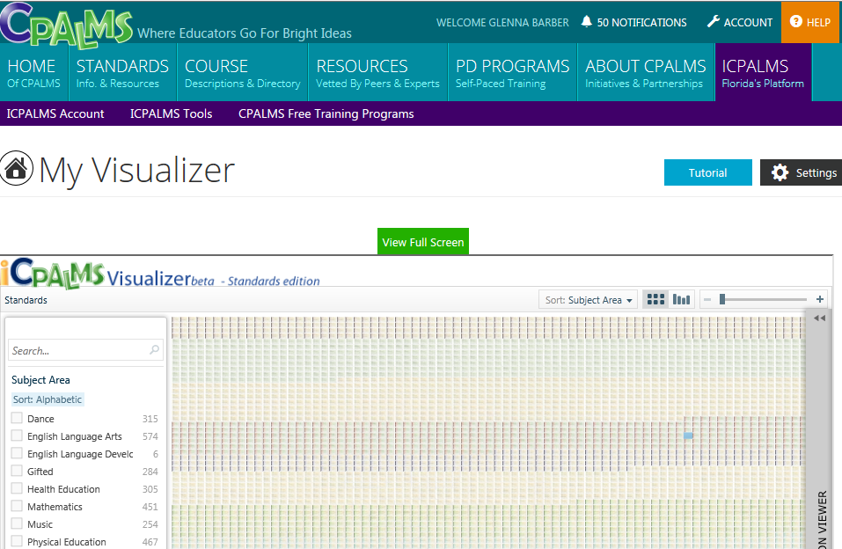

Slide 18
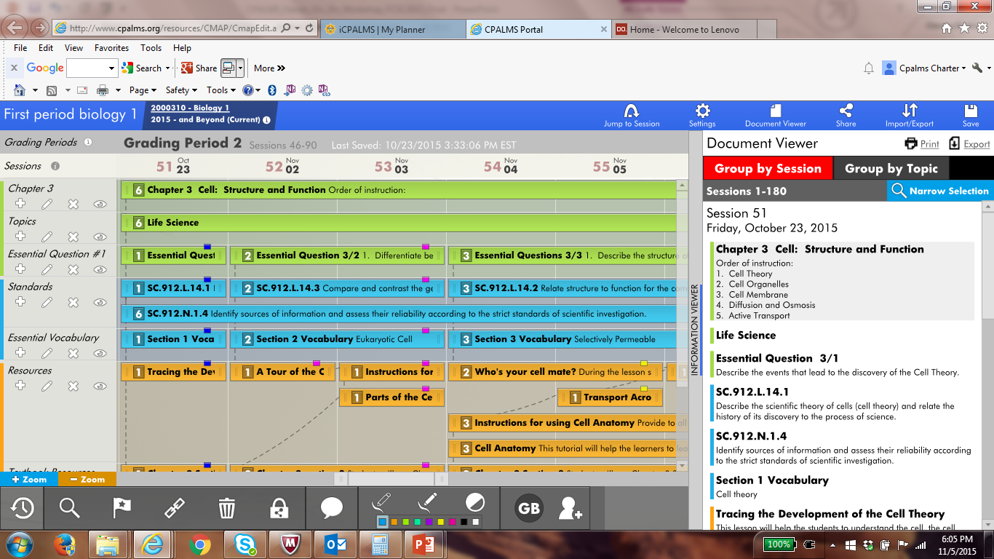
Live CMAP Demonstration

Slide 19
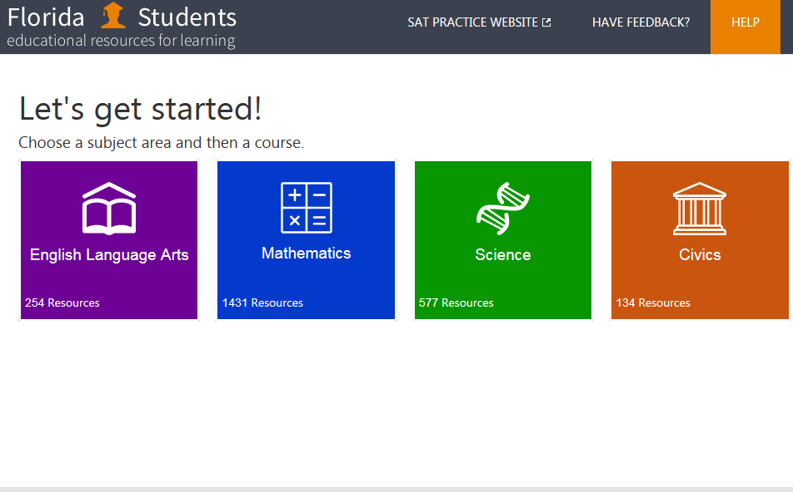
http://www.floridastudents.org/#

Slide 20
Next Steps
  Locate and export your course descriptions
  Explore the resources on CPALMS
  Get ready for a Great Year!

Slide 21



Connect with CPALMS via Social Media
 | www.facebook.com/icpalms
 | @tweetcpalms
 | pinterest.com/icpalms
 | Standard/Benchmark lookup by SMS! Text a standard number (e.g., SC.8.N.1.2) to 850-846-6868 and CPALMS will text you back with the description.

