Slide 1
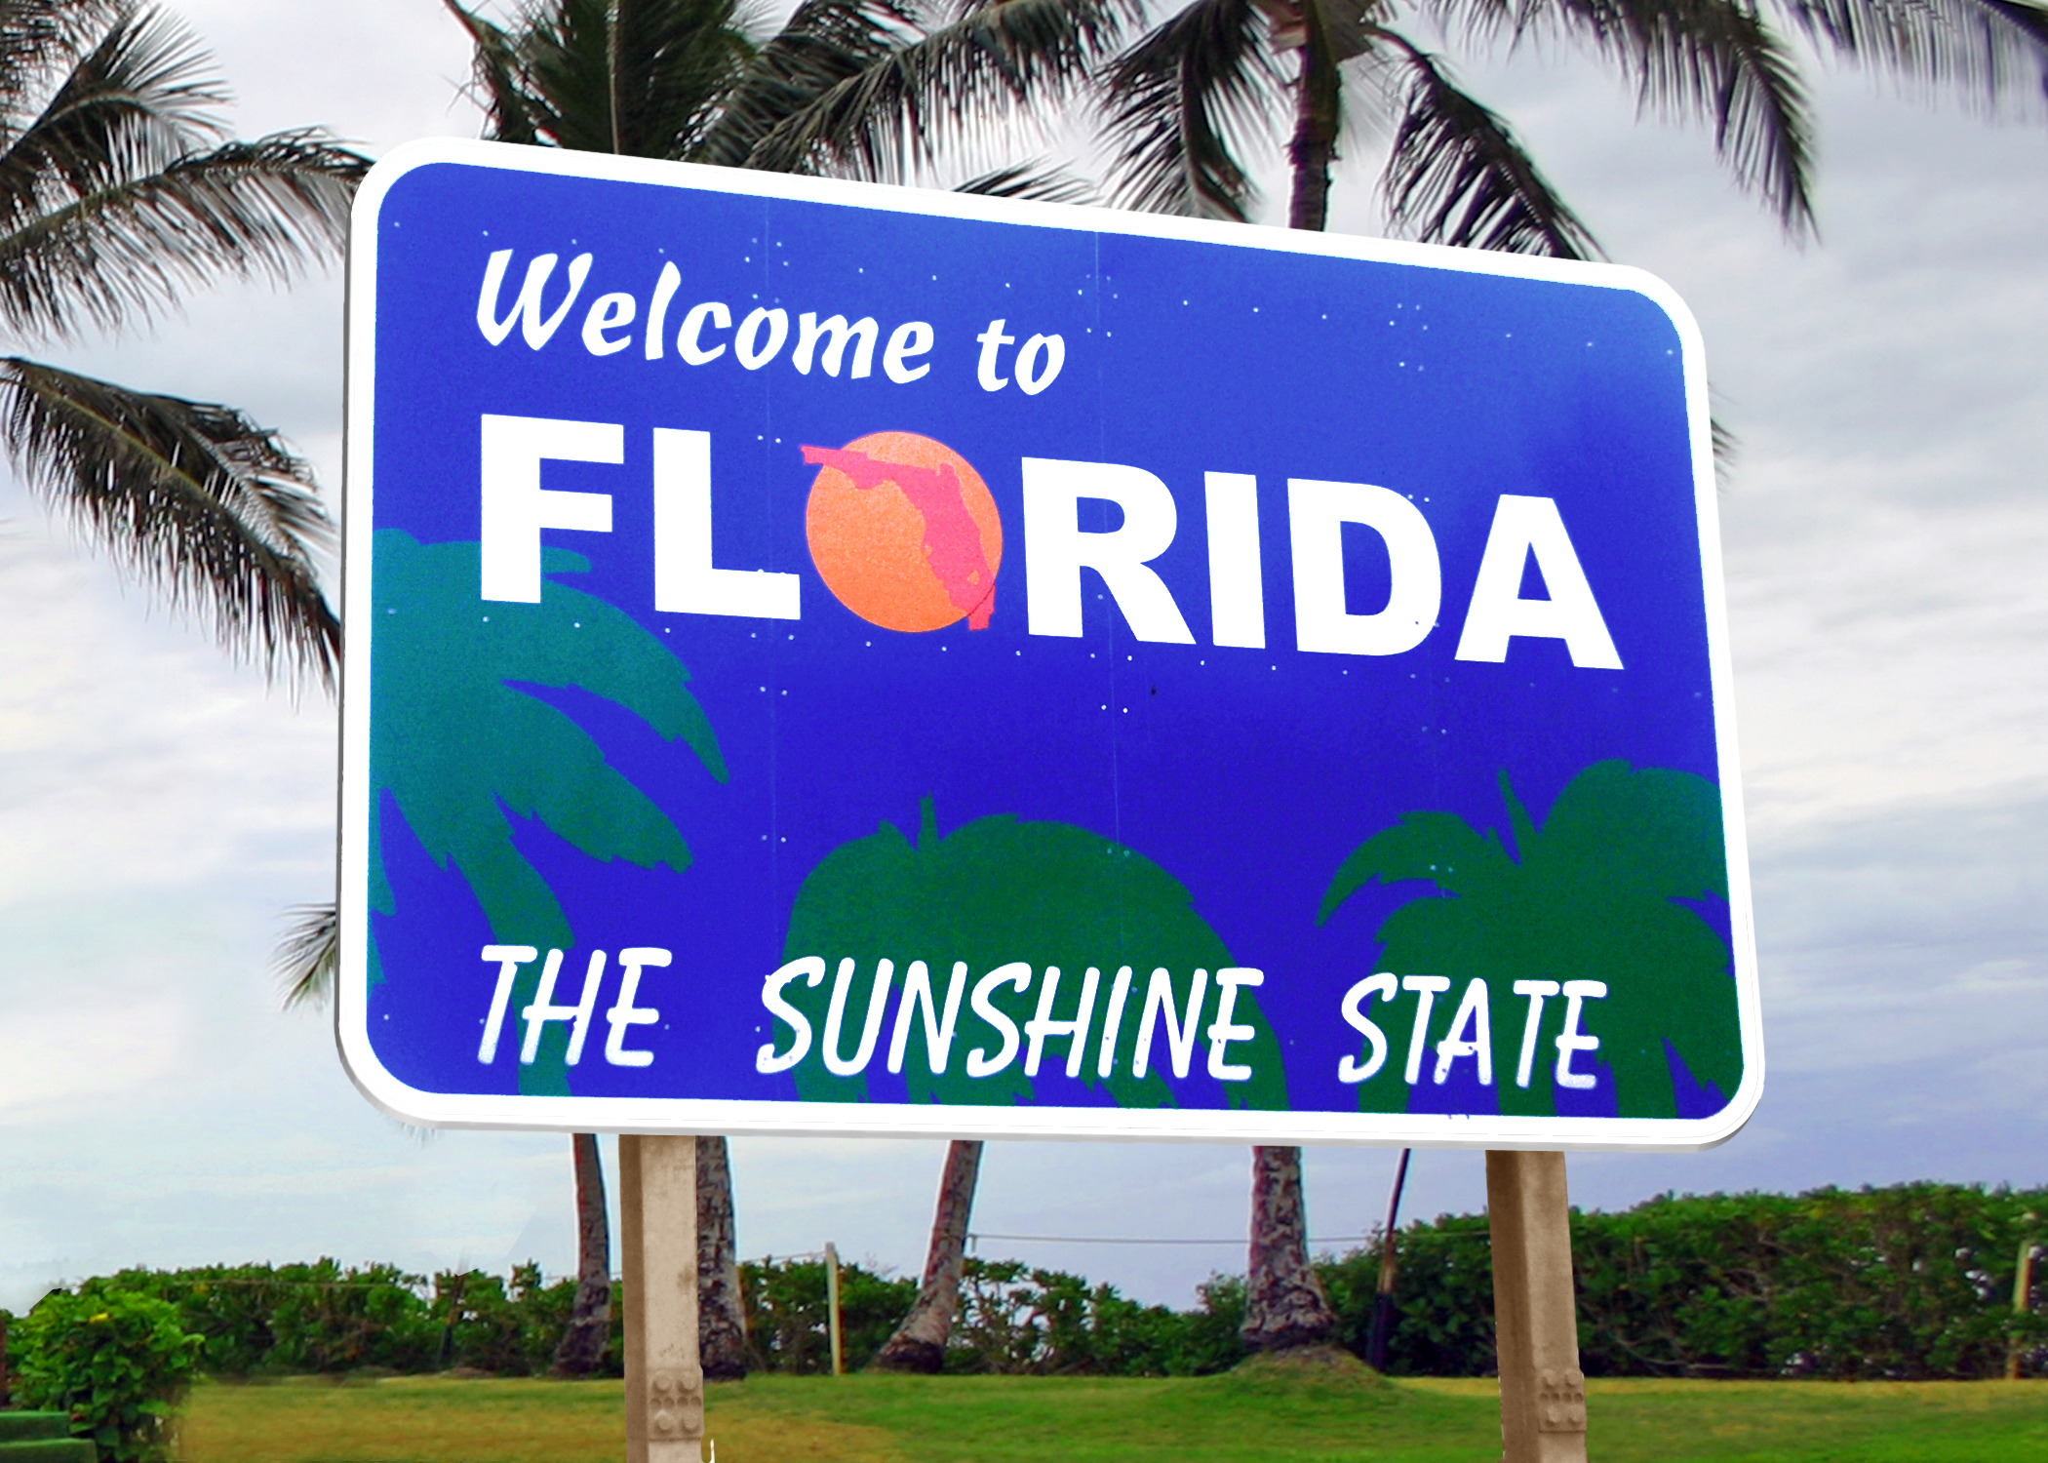

Career Exploration for 8th Grade
Notes:
Welcome to career exploration for 8th grade! In this brief presentation, we’re going to discuss several things that have to do with your success in high school and beyond. Please listen closely but know that this presentation will also be available on the St. Johns County School District Guidance & Programs of Choice website if you would like to watch it again later.

Slide 2
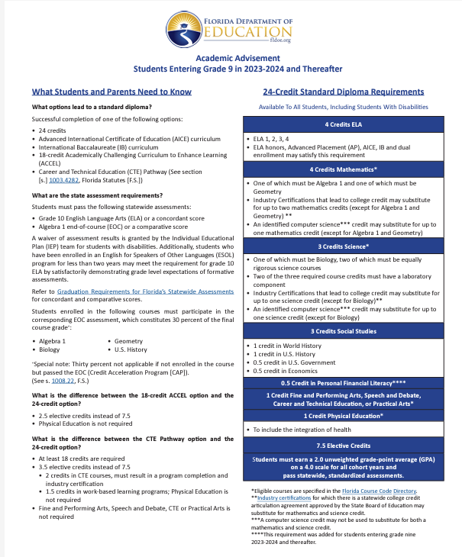
High School Graduation
Requirements
4 Credits in English
4 Credits in Math (including Algebra 1 & Geometry)
3 Credits in Science (including Biology)
3 Credits in Social Studies (including World History, US History, Government and Economics)
0.5 Credit in Personal Financial Literacy
7.5 Credits in Electives
1 Credit Performing Art, Speech & Debate, Career & Technical Education, or Practical Art
1 credit HOPE (Health & PE)
Pass the Algebra 1 End of Course (EOC) Exam
Pass the 10th Grade ELA Florida Standards Assessment (FSA)
2.0 Unweighted GPA (Grade Point Average)
Notes:
Your next step after 8th grade is 9th grade and the beginning of high school. In order to graduate from high school in Florida, you must meet the following course requirements: 24 credits including:
4 Credits in English
4 Credits in Math (including Algebra 1 & Geometry)
3 Credits in Science (including Biology)
3 Credits in Social Studies (including World History, US History, Government and Economics)
0.5 Credit in Personal Financial Literacy
7.5 Credits in Electives
1 Credit in a Performing Art, Speech & Debate, Career & Technical Education, or Practical Art
1 Credit in HOPE (Health & PE)
Passing the Algebra 1 End of Course (EOC) Exam
Passing the 10th Grade ELA Florida Standards Assessment (FSA) and
Having a 2.0 Unweighted GPA (Grade Point Average)

Slide 3
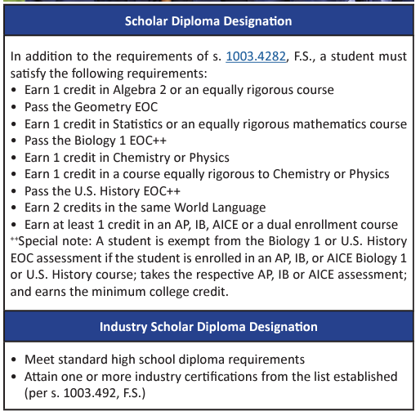
High School Diploma Designation Requirements
Notes:
When you graduate from high school, you have the opportunity to earn a diploma designation. These include the Scholar Diploma Designation and the Industry Scholar Diploma Designation. This information can be located on the FLDOE Graduation Requirements Flyer.

Slide 4

Florida Bright Futures Scholarship Eligibility Criteria
Academic
Medallion
Gold Seal
Notes:
Next, we’ll be talking about something called an automatic scholarship. This means that if you meet all of the scholarship requirements and fill out the application, you automatically get the scholarship. In Florida, the most prevalent example of this scholarship is the Bright Futures Scholarship. There are 3 categories of the scholarship with different eligibility criteria: the Academic, Medallion and Gold Seal.

Slide 5
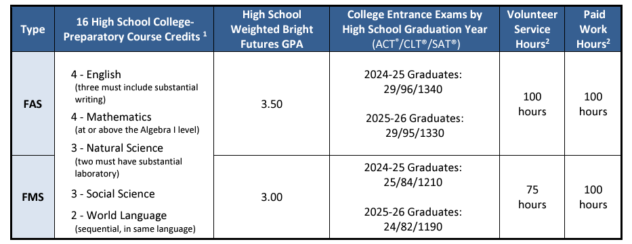
Bright Futures Academic & Medallion Scholarships
Notes:
If you look at FAS and FMS on the left side of the screen, those abbreviations refer to the Bright Futures Florida Academic and Medallion Scholarships. As you can see, for the Bright Futures Scholarship, only 16 of your high school credits are used. Additionally, there are different GPAs, test scores, and community service hours required for each level of the scholarship.

Slide 6
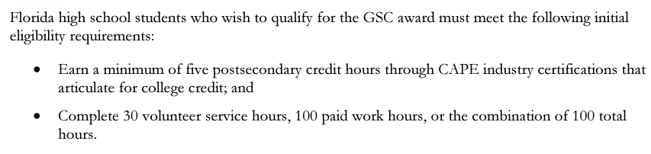
Bright Futures Gold Seal CAPE Scholarship
Notes:
For the Gold Seal CAPE Scholarship, you are completing 30 volunteer service hours, 100 paid work hours, or a combination of 100 total hours and earning at least 5 college credit hours through CAPE industry certifications.

Slide 7
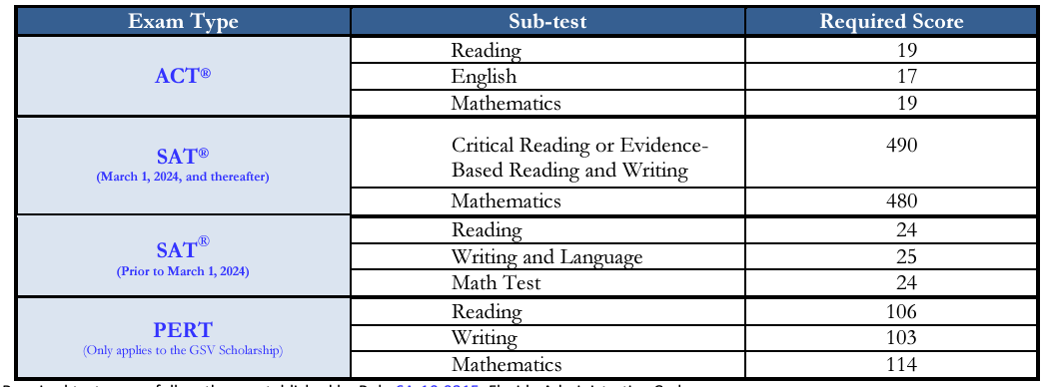
Bright Futures Gold Seal Vocational Scholarship
Notes:
And finally, for the Gold Seal, there are test score, GPA, and community service hour requirements as well as taking 3 full credits in a Career and Technical Education Program. This is a lot of information, but it helps to know now that test prep, making good grades, and doing community service can set you on the path to attaining one of these scholarships.

Slide 8
Community Service Hours
Not a graduation requirement but a requirement for the Bright Futures Scholarship
Can be earned beginning the summer after 8th grade
Goal for 25 hours a year to have 100 by the end of high school
See the District Guidelines for the types of activities that are accepted
https://www.stjohns.k12.fl.us/guidance/community-service/
Notes:
We’ve mentioned community service hours for the Bright Futures Scholarship several times during this presentation. You can start earning hours the summer after you finish 8th grade. Check out the website link on this slide for more information about what counts and what doesn’t.

Slide 9
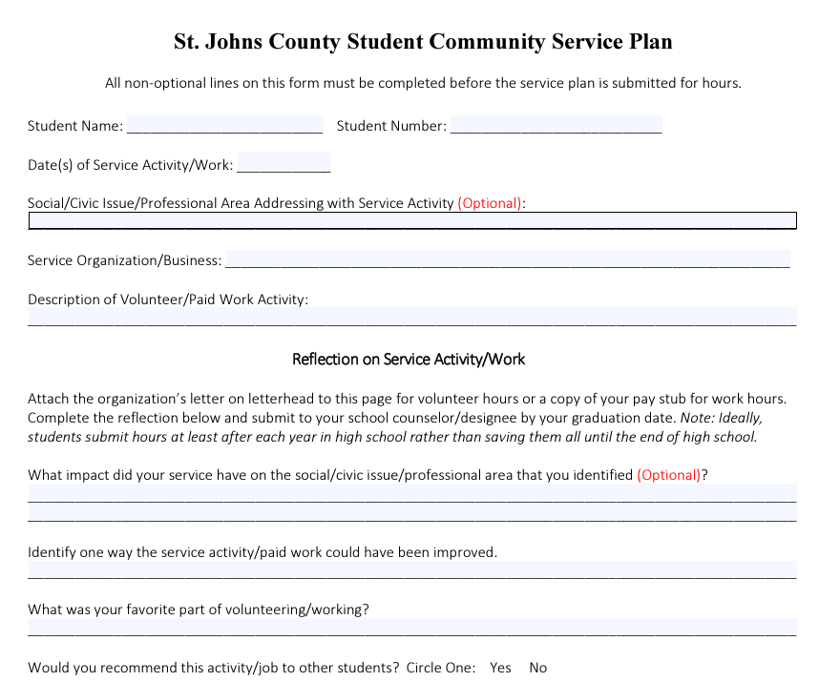
Notes:
Students’ Bright Futures eligibility will now be based either on paid work hours, volunteer service hours, or a combination of both. Students must have either 100, 75, or 30 volunteer and/or paid hours for each respective Bright Futures scholarship. For paid hours, students must turn in their pay stubs from a for-profit organization and for volunteer hours, the service must be done for a non-profit organization. Both volunteer and paid work hours must include the reflection form from the district website to meet statutory requirements.

Slide 10
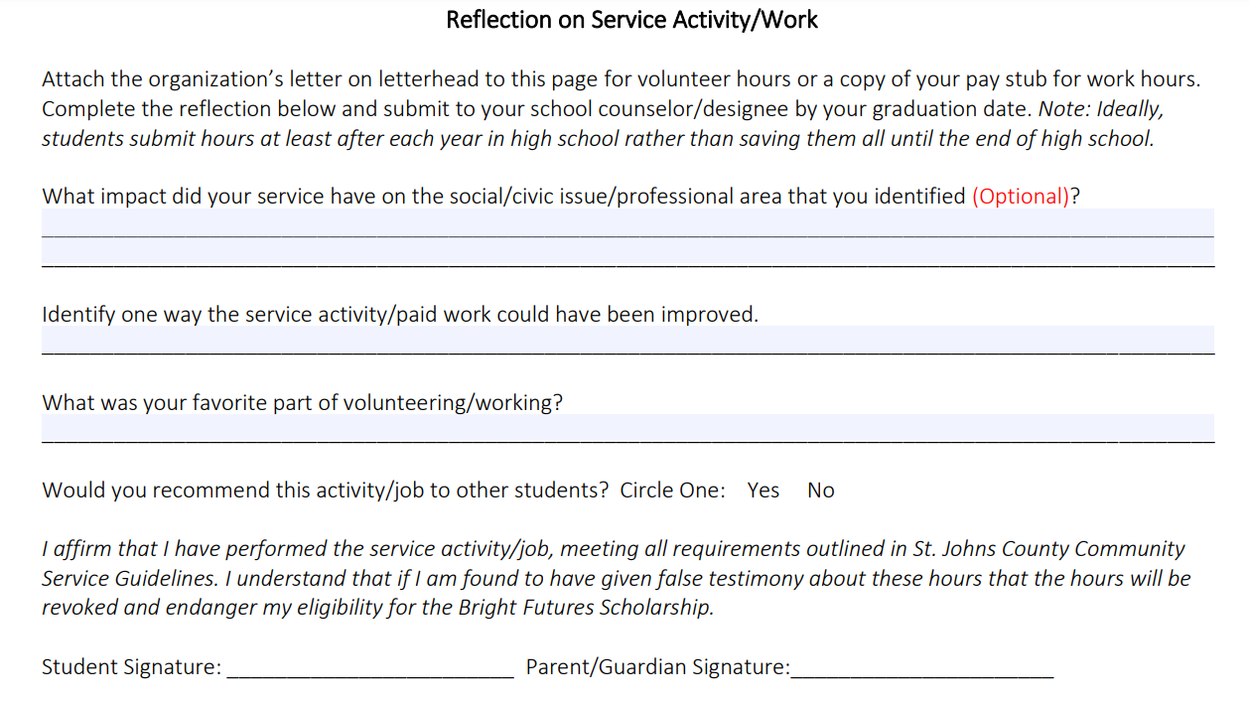
Notes:
Each high school has a different designee, so talk to your high school counselor to find out who takes hours or visit the high school website for more information on their process. Turn in hours as you complete them each year of high school rather than waiting until just before graduation that way you can track your status towards Bright Futures eligibility.

Slide 11
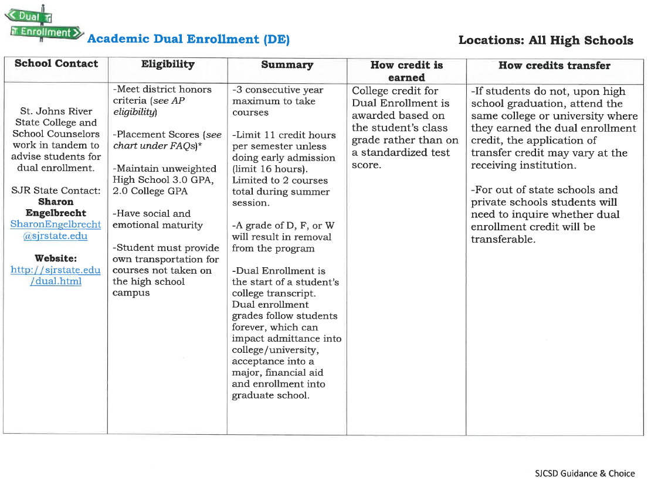
Advanced High School Programs
https://www.stjohns.k12.fl.us/guidance/wp-content/uploads/sites/142/2024/09/High-School-Advanced-Programs-24-25.pdf
Notes:
So how do you prepare for college or university in high school? One route is by taking courses in one or more of the advanced high school programs offered in St. Johns County School District. By going to the link shown on this slide, you can view a full breakdown of all the programs available to you.

Slide 12










Course Sequences Leading to Industry Certification
https://cte.stjohns.k12.fl.us/
Notes:
Recalling the Bright Futures Gold Seal & CAPE scholarships, you can attain requirements for those by participating in one of our high school academies. One of the best ways to learn about these is to attend High School Showcase and by visiting the CTE website, listed at the bottom of this screen.

Slide 13
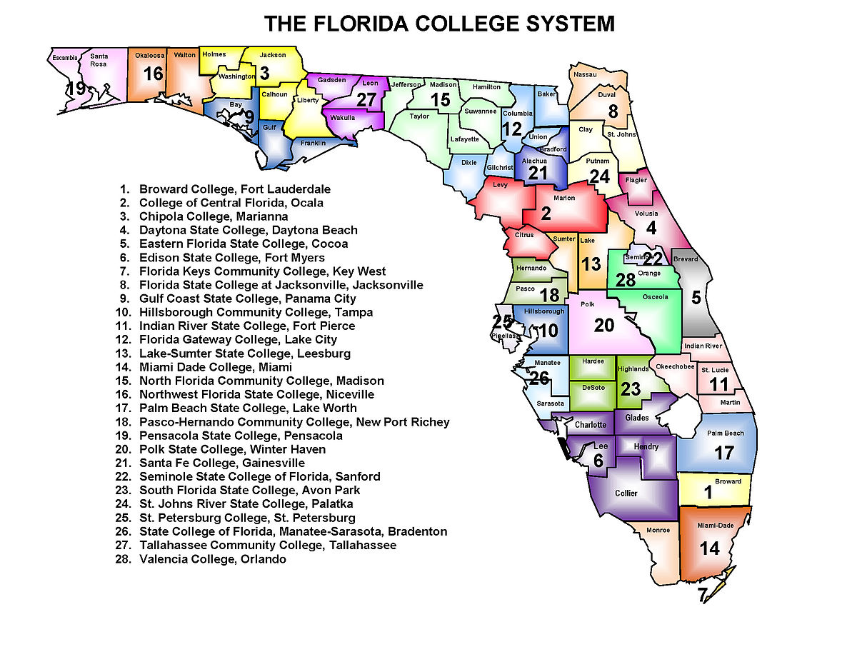
Florida College System Admissions Requirements
All Florida College System institutions have open-door admissions for students who earned a standard high school diploma or an equivalent diploma or successfully earned college credit.
Notes:
The Florida College System has 28 colleges in it. Our local college is St. Johns River State College. To be admitted to a state college, you must have earned a standard high school diploma or an equivalent diploma or successfully earned college credit.

Slide 14
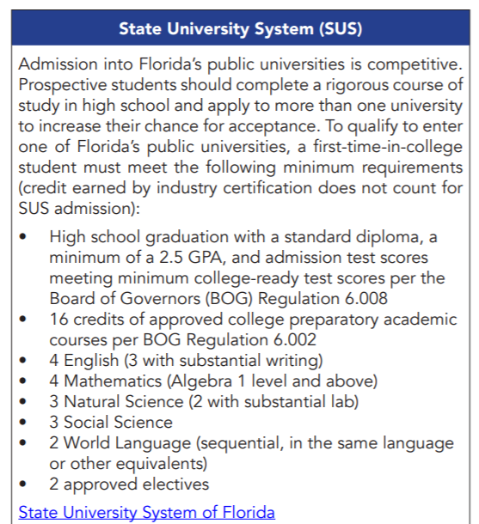
State University System
Notes:
For state university admissions, there are other test score and GPA requirements. If you know the university you would like to attend, visit their website and look at information on the Admissions page. This will provide information on the types of test scores, GPA, and other requirements for admission to the university. Also, taking a campus tour can be highly beneficial to know if the school is where you feel most comfortable attending.

Slide 15
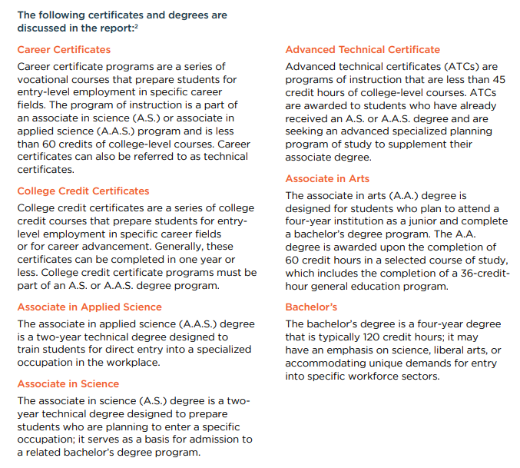
Degree Definitions
Notes:
Degree definitions. All of these degrees are different and lead to different pathways. For instance, state colleges offer 2 year Associate’s degree programs and some 4 year Bachelor’s degree programs. State Universities all offer Associate’s degree programs and many Bachelor’s degree programs. More information can be seen in the descriptions of the degrees. Different jobs require different levels of degrees, so by knowing what career is most interesting to you, you can begin to think about which degree and institution will best suit your needs.

Slide 16
2022 Economic Security Report-Measuring the Economic Success of Florida’s Graduates
Report: https://lmsresources.labormarketinfo.com/special/ESR.pdf
The top three industries that expect to add the most jobs in Florida are professional, scientific, and technical services (128,315 jobs), Food Services (84,293 jobs), and ambulatory health care services (82,175 jobs). The projected growth is between 10% to 19%, These industries are expected to add over 290,000 new jobs between 2022 and 2030.
Most students with a college degree in Florida completed a 4 year Bachelor’s degree from a state university or a 2 year associate in arts or science degree
Many of the top 20 fastest occupations are related to Healthcare Practitioners, Healthcare Support Occupations, Computer and Mathematical Occupations, Business and Financial Operations Occupations, and Arts, Design, Entertainment, Sports, and Media Occupations
Notes:
Let’s talk about the Economic Security Report from 2022. This report is relevant to you in that it gives lots of information on how successful Florida high school graduates are in their careers, college, and how much they get paid in their jobs. The report from 2022 showed several interesting facts, listed on this slide. So, why are we telling you all of this? We want you to make the most of your high school experiences so that you can have success like these other graduates have. We want you to know what types of degrees will give you the highest income, are in the greatest demand, and will cause the least debt. All important things to think about right? If you want to read the full report, just go to the link listed at the top of this slide. Most important to note are the top projected careers in Florida leading up to 2030. These careers are food services, professional/technical services, and ambulatory health care services. Many of the fastest growing occupations are related to Healthcare, Business/Computer Operations, and Media Occupations.

Slide 17
Entrepreneurship & Employability Skills
Self awareness – in relation to interests, abilities, values, and skills
Career awareness – knowing what career opportunities exist and what is required to pursue them
Career decision-making skills
Team-working
Problem-solving
Presentation skills
Ability to learn new ways of doing things
Job search skills including resume writing, preparing job applications, and interviewing
Notes:
Regardless of what career you choose, there are some skills every employer wants their employees to have. If you think of school as your current job and your teachers as your employers, you can begin to practice all of these skills. First of all, employers want self-aware employees, meaning you know the impact you have on others around you with your actions. Employers also want people who have career awareness. This means that you read and learn about the career you’re interested in. You talk with people who work in your career of interest to find out how they got their job and what you can be doing to get a similar job eventually. Employers also want team players who can work with other people and get along with them. Having problem solving skills and good presentation skills are also worthwhile. All of these skills are beneficial no matter what type of job you have.

Slide 18
Thank you!
Notes:
Thank you for your time watching this, and if you have any questions, please speak with your school counselor.

