Slide 1
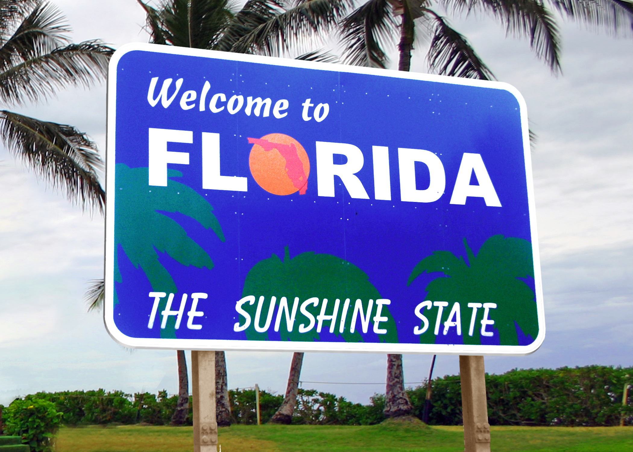

Career Exploration for 8th Grade
Notes:
Welcome to career exploration for 8th grade! In this brief presentation, we’re going to discuss several things that have to do with your success in high school and beyond. Please listen closely but know that this presentation will also be available on the St. Johns County School District Guidance & Programs of Choice website if you would like to watch it again later.

Slide 2
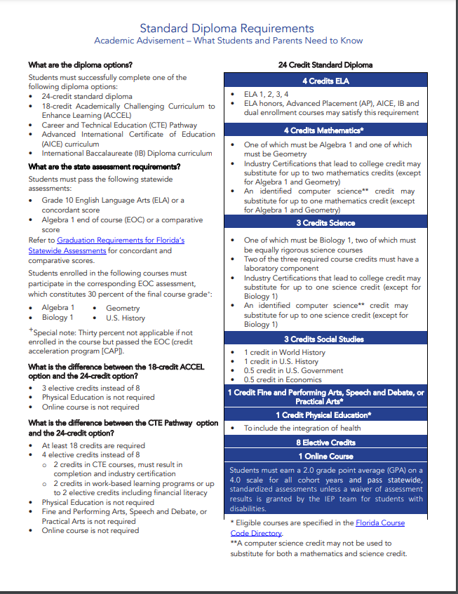
High School Graduation
Requirements
4 Credits in English
4 Credits in Math (including Algebra 1 & Geometry)
3 Credits in Science (including Biology)
3 Credits in Social Studies (including World History, US History, Government and Economics)
8 Credits in Electives
1 Credit Performing Art, Speech & Debate, or Practical Art
HOPE (Health & PE)
1 Virtual Course
Pass the Algebra 1 End of Course (EOC) Exam
Pass the 10th Grade ELA Florida Standards Assessment (FSA)
2.0 Unweighted GPA (Grade Point Average)
Notes:
Your next step after 8th grade is 9th grade and the beginning of high school. In order to graduate from high school in Florida, you must meet the following course requirements: 24 credits including:
4 Credits in English
4 Credits in Math (including Algebra 1 & Geometry)
3 Credits in Science (including Biology)
3 Credits in Social Studies (including World History, US History, Government and Economics)
8 Credits in Electives
1 Credit Performing Art, Speech & Debate, or Practical Art
HOPE (Health & PE)
1 Virtual Course
Passing the Algebra 1 End of Course (EOC) Exam
Passing the 10th Grade ELA Florida Standards Assessment (FSA) and
Having a 2.0 Unweighted GPA (Grade Point Average)

Slide 3
What is GPA?
Standard Quality Points
A=4
B=3
C=2
D=1
F=0
Honors Quality Points
A=4.5
B=3.5
C=2.5
D=1
F=0
AP, Dual Enrollment, AICE, IB Quality Points
A=5
B=4
C=3
D=1
F=0
Notes:
Your Grade Point Average, or GPA, is the average of quality points you earn in your high school courses divided by the total number of courses taken per semester. Each grade is given a point amount. For instance, A=4, B=3, C=2, D=1, F=0. If you take an honors course, each of those gets an additional .5 added weight, so A would be 4.5, B 3.5, and so on. These additional weighted points are calculated into your weighted GPA, which is used for things like class rank and college admissions. The only exception to this are D’s and F’s and for that, no matter the course, you always get the same amount of points. For courses enabling you to earn college credit, like AP, Dual Enrollment, AICE and IB, each letter grade has a whole point added to it. So, an A would be 5 points, a B 4 points, etc. If you want to remember the difference between weighted and unweighted GPA, think of a weighted blanket that is used to help calm people compared to an unweighted blanket. A weighted blanket is heavier, like in more points for your GPA, while an unweighted or regular blanket is lighter, like nothing extra added for your GPA.

Slide 4

How is GPA calculated?
GPA=Total Quality Points/Total Number of Courses Taken Per Semester
For example:
 | English 1 | World Cultural Geography | Physical Science Honors | Algebra 1 Honors | TV Production 1 | Spanish 1 | HOPE
Semester 1 | B | A | A | A | A | B | A
Semester 2 | B | B | A | B | A | A | A
Quality Points | 3 + 3 = 6 | 4 + 3 = 7 | 4.5 + 4.5 = 9 | 4.5 + 3.5 = 8 | 4 + 4 = 8 | 3 + 4 = 7 | 4 + 4 = 8
Weighted GPA
53 Quality Points/14 Semesters
3.79 Weighted GPA for 9th grade
Notes:
How is GPA calculated? GPA is the number of total quality points divided by the total number of courses taken per semester. The table shows the first year of grades for a student in 9th grade. On a side note, if you are taking a course like Algebra 1 that has an end of course exam, you will not be able to calculate your GPA until you receive your EOC score. At that time, the EOC score is factored in to be 30% of your final grade. For our example though, we’ll keep it simple. This student took English 1, making B’s both semesters, worth 3 points each according to our quality points table on the previous slide. The student also took World Cultural Geography making an A and a B. The A is worth 4 points. The B is worth 3 points. Next, the student took Physical Science Honors. Remember for honors courses there is the .5 extra weight. So since the student got an A both semesters, that would equate to 4.5 points for each semester. Then, the points continue with the other courses. When we add all of the quality points we get a total of 53. The student took 7 courses, at 2 semesters for each course, so 7 times 2 equals 14 course semesters. Now, we divide total quality points, 53, by total number of courses taken per semester, 14, for a weighted GPA of 3.79.

Slide 5

What happens to my GPA when I make low grades?
 | English 1 | World Cultural Geography | Physical Science Honors | Algebra 1 Honors | TV Production 1 | Spanish 1 | HOPE
Semester 1 | B | A | A | A | A | B | C
Semester 2 | B | B | A | B | A | A | F
Quality Points | 3 + 3 = 6 | 4 + 3 = 7 | 4.5 + 4.5 = 9 | 4.5 + 3.5 = 8 | 4 + 4 = 8 | 3 + 4 = 7 | 2 + 0 = 2
Weighted GPA
47 Quality Points/14 Semesters
3.35 Weighted GPA for 9th grade
Notes:
9th grade or really any grade level when you begin to take high school courses is important because you are beginning to build your high school GPA. This group of grades demonstrates how a couple of low grades can seriously damage your GPA. For this student, all of the grades are the same with the exception of the HOPE grades. For this class, the student made a C the first semester for 2 quality points, and an F the second semester for 0 quality points. This changed the total number of quality points to 47 and of course the number of course semesters remained the same at 14. When averaged together, the student’s GPA went from a 3.79 to a 3.35. That may not seem significant now, but if this student continues to get C’s, D’s or F’s in a class or two throughout high school, then their GPA is in danger of dropping even more. Let’s consider another factor that also helped this student. By taking honors courses, the student received extra weighting, adding to their total quality points. Had the courses all been standard, the student’s GPA would have been much different as we see in the next two slides.

Slide 6

Unweighted (Graduation) GPA
 | English 1 | World Cultural Geography | Physical Science Honors | Algebra 1 Honors | TV Production 1 | Spanish 1 | HOPE
Semester 1 | B | A | A | A | A | B | A
Semester 2 | B | B | A | B | A | A | A
Quality Points | 3 + 3 = 6 | 4 + 3 = 7 | 4 + 4 = 8 | 4 + 3 = 7 | 4 + 4 = 8 | 3 + 4 = 7 | 4 + 4 = 8
Weighted GPA
51 Quality Points/14 Semesters
3.64 unweighted GPA for 9th grade
Notes:
Let’s talk about your unweighted or graduation GPA. Remember that 2.0 GPA requirement to graduate from high school? That’s where this GPA comes in. To calculate a student’s unweighted GPA, weighting considerations are removed from quality points, and all classes are treated as if they are standard level. So all A’s are 4 points, all B’s 3 points and so on. So, for this student, their quality points would be 51 and their courses semesters would be 14. 51 quality points divided by 14 course semesters means this student’s unweighted GPA is 3.64.

Slide 7

Unweighted GPA (continued)
 | English 1 | World Cultural Geography | Physical Science Honors | Algebra 1 Honors | TV Production 1 | Spanish 1 | HOPE
Semester 1 | B | A | A | A | A | B | C
Semester 2 | B | B | A | B | A | A | F
Quality Points | 3 + 3 = 6 | 4 + 3 = 7 | 4+ 4 = 8 | 4 + 3 = 7 | 4 + 4 = 8 | 3 + 4 = 7 | 2 + 0 = 2
Weighted GPA
45 Quality Points/14 Semesters
3.21 unweighted GPA for 9th grade
Notes:
These are the same grades, with the exception of the HOPE grades and all of the classes being unweighted. After this calculation, the student’s unweighted GPA is 3.21.

Slide 8
Comparing GPAs
 | Student 1 (Good Grades) | Student 2 (Not so Good Grades)
9th Grade Weighted GPA: | 3.79 | 3.64
9th Grade Unweighted GPA: | 3.35 | 3.21
Notes:
Now that we’ve totaled the weighted and unweighted GPA for both of these students, we can see the difference that taking advanced courses can make as well as the impact of making a few low grades. There are opportunities to recover low grades in high school, but if you do your best the first time you take a course, it’ll save you a lot of time from having to repeat the course later. The most important thing to remember with all of this is to ask for help when you are first struggling in a course. You can always ask your teacher about tutoring opportunities and other ways to improve your grade.

Slide 9
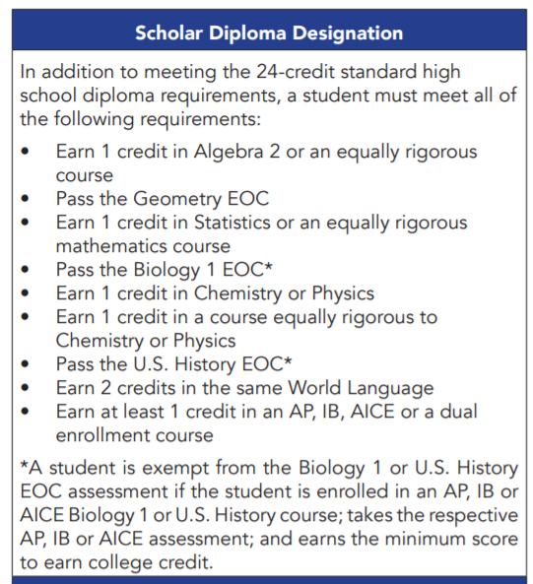
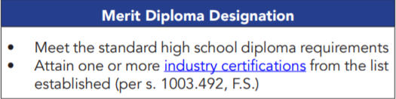
High School Diploma Designation Requirements
Notes:
When you graduate from high school, you have the opportunity to earn a diploma designation. These include the Scholar Diploma Designation and the Merit Diploma Designation. Both designations require you to meet the 24 credit high school graduation requirements as well as additional components. This information can be located on the FLDOE Graduation Requirements Flyer.

Slide 10

Florida Bright Futures Scholarship Eligibility Criteria
Academic
Medallion
Gold Seal
Notes:
Next, we’ll be talking about something called an automatic scholarship. This means that if you meet all of the scholarship requirements and fill out the application, you automatically get the scholarship. In Florida, the most prevalent example of this scholarship is the Bright Futures Scholarship. There are 3 categories of the scholarship with different eligibility criteria: the Academic, Medallion and Gold Seal.

Slide 11
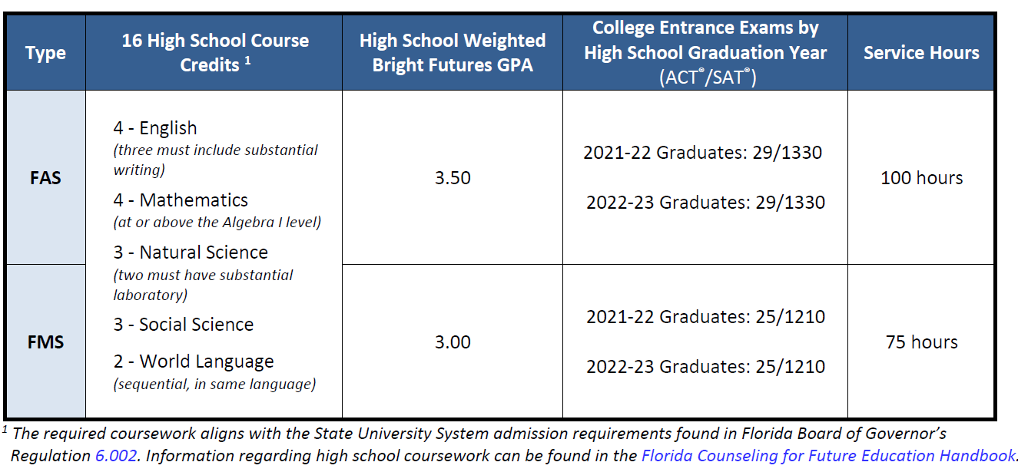
Bright Futures Academic & Medallion Scholarships
Notes:
If you look at FAS and FMS on the left side of the screen, those abbreviations refer to the Bright Futures Florida Academic Medallion Scholarships. As you can see, for the Bright Futures Scholarship, only 16 of your high school credits are used. Additionally, there are different GPAs, test scores, and community service hours required for each level of the scholarship.

Slide 12
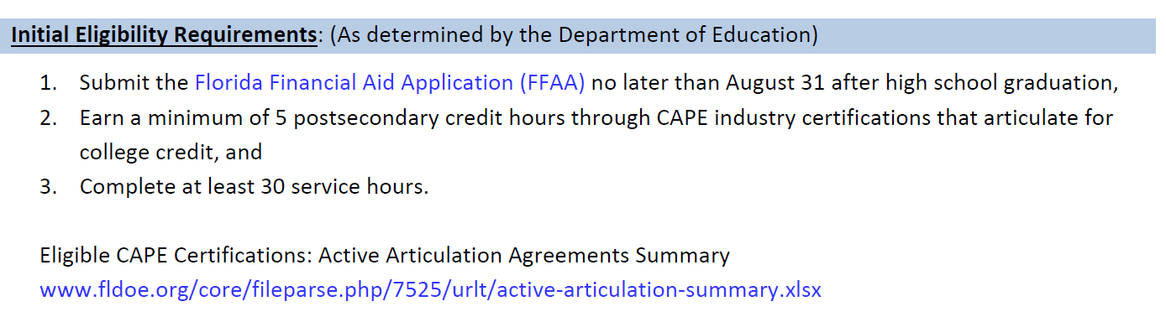
Bright Futures Gold Seal CAPE Scholarship
Notes:
For the Gold Seal CAPE Scholarship, you are completing at least 30 service hours and earning at least 5 college credit hours through CAPE industry certifications. The link for that is listed below.

Slide 13
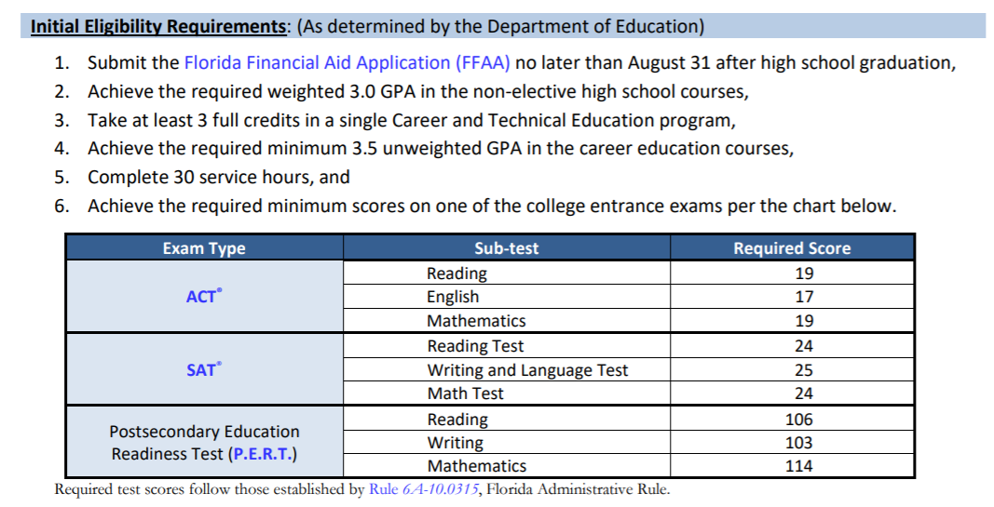
Bright Futures Gold Seal Vocational Scholarship
Notes:
And finally, for the Gold Seal, there are test score, GPA, and community service hour requirements as well as taking 3 full credits in a Career and Technical Education Program. This is a lot of information, but it helps to know now that test prep, making good grades, and doing community service can set you on the path to attaining one of these scholarships.

Slide 14
Community Service Hours
Not a graduation requirement but a requirement for the Bright Futures Scholarship
Can be earned beginning the summer after 8th grade
Goal for 25 hours a year to have 100 by the end of high school
See the District Guidelines for the types of activities that are accepted
https://www.stjohns.k12.fl.us/guidance/community-service/
Notes:
We’ve mentioned community service hours for the Bright Futures Scholarship several times during this presentation. You can start earning hours the summer after you finish 8th grade. Check out the website link on this slide for more information about what counts and what doesn’t.

Slide 15
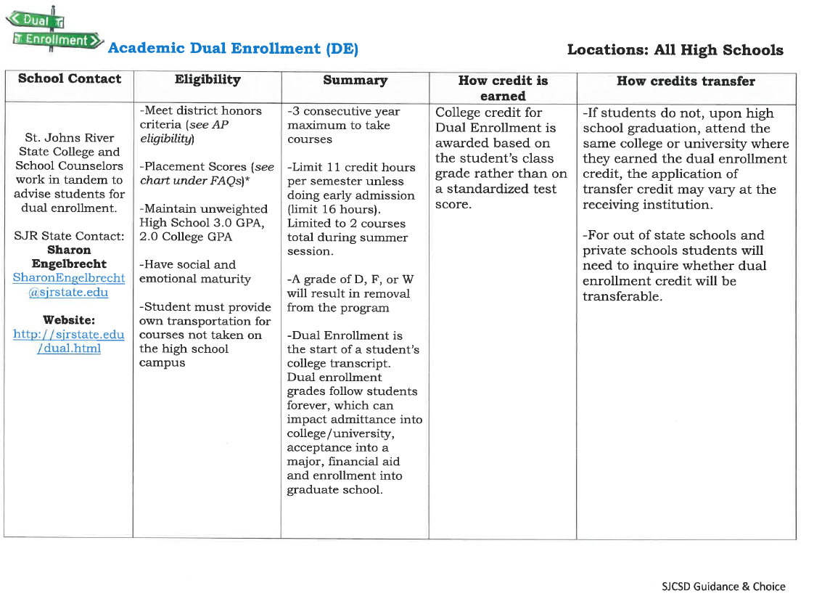
Advanced High School Programs
http://www.stjohns.k12.fl.us/guidance/wp-content/uploads/sites/142/2021/12/High-School-Advanced-Programs-12.15.21.docx
Notes:
So how do you prepare for college or university in high school? One route is by taking courses in one or more of the advanced high school programs offered in St. Johns County School District. By going to the link shown on this slide, you can view a full breakdown of all the programs available to you.

Slide 16










Course Sequences Leading to Industry Certification
https://cte.stjohns.k12.fl.us/
Notes:
Recalling the Bright Futures Gold Seal & CAPE scholarships, you can attain requirements for those by participating in one of our high school academies. One of the best ways to learn about these is to attend High School Showcase in the spring and by visiting the CTE website, listed at the bottom of this screen.

Slide 17
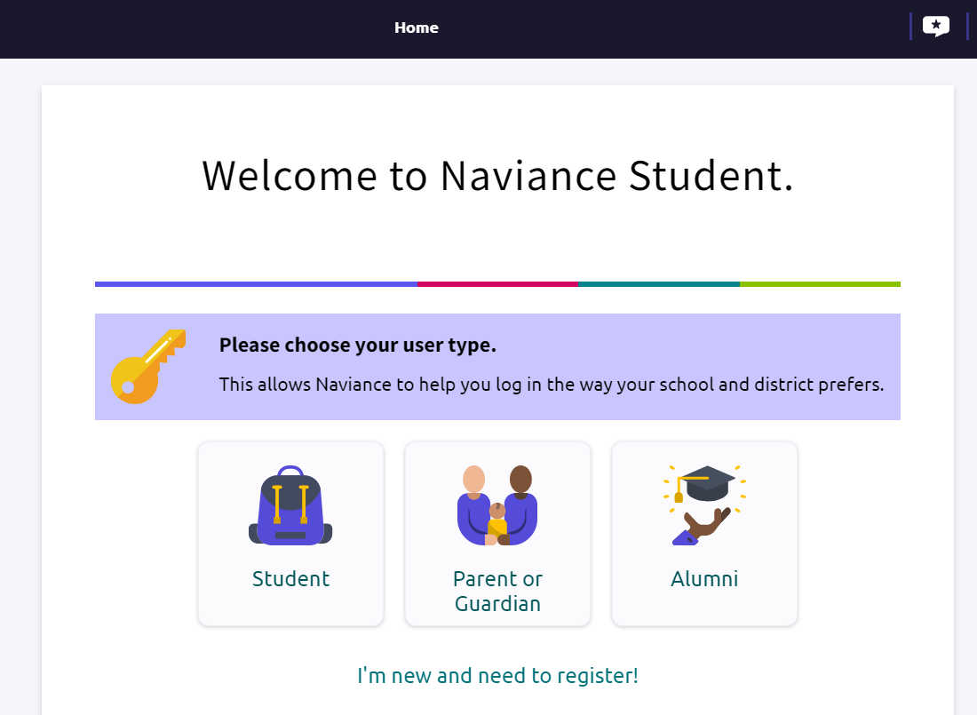
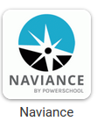
Naviance logo on school Student Links page
Notes:
Before you determine what college you want to attend, it is helpful to have an idea of what you want your career to be in so you know what major you are most interested in. Not every college or university offers every major, so it’s important to know if you career interests and college plans match up. By taking career assessments on Naviance, you can start to determine your career interests. Naviance is a college and career exploration tool, available to all students grades 6-12 in the school district. To login to Naviance, go to your school’s Student Links page and click on the Naviance icon. This will take you to the Naviance login page. Here, click on Student, even if it is your first time logging in.

Slide 18
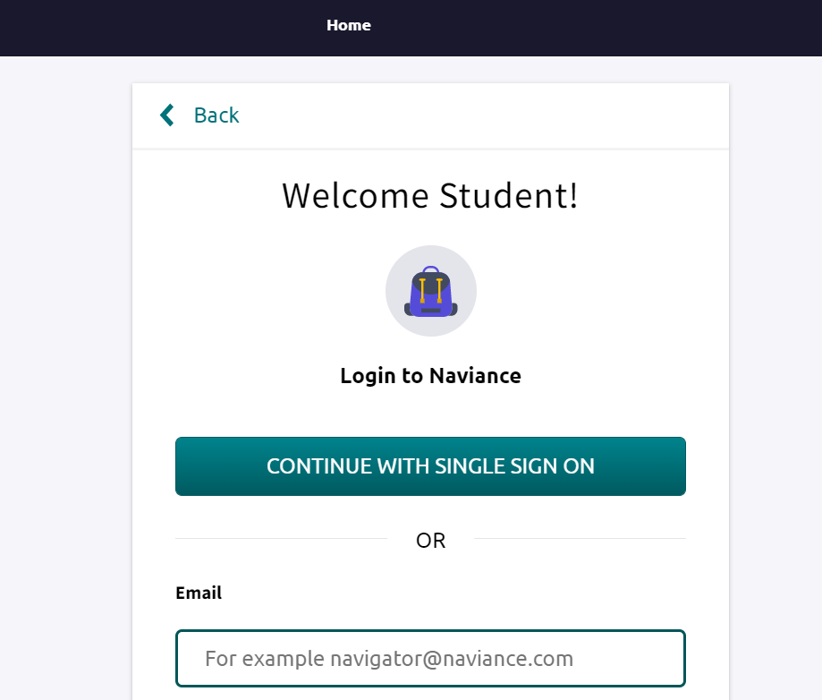
Notes:
Click on “Continue with Single Sign On”.

Slide 19
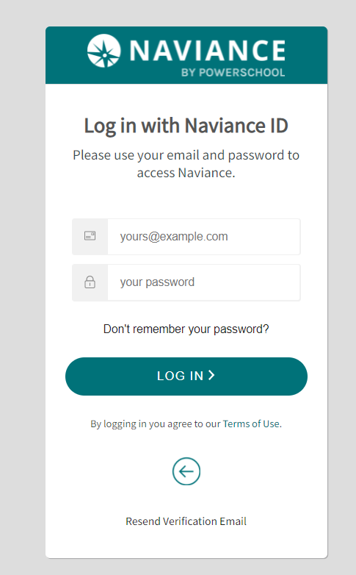
Notes:
Enter your typical district username, which is your student number email, and password here. Do not click “remember password” if you are accessing the site from a public computer. Then click “login”.

Slide 20
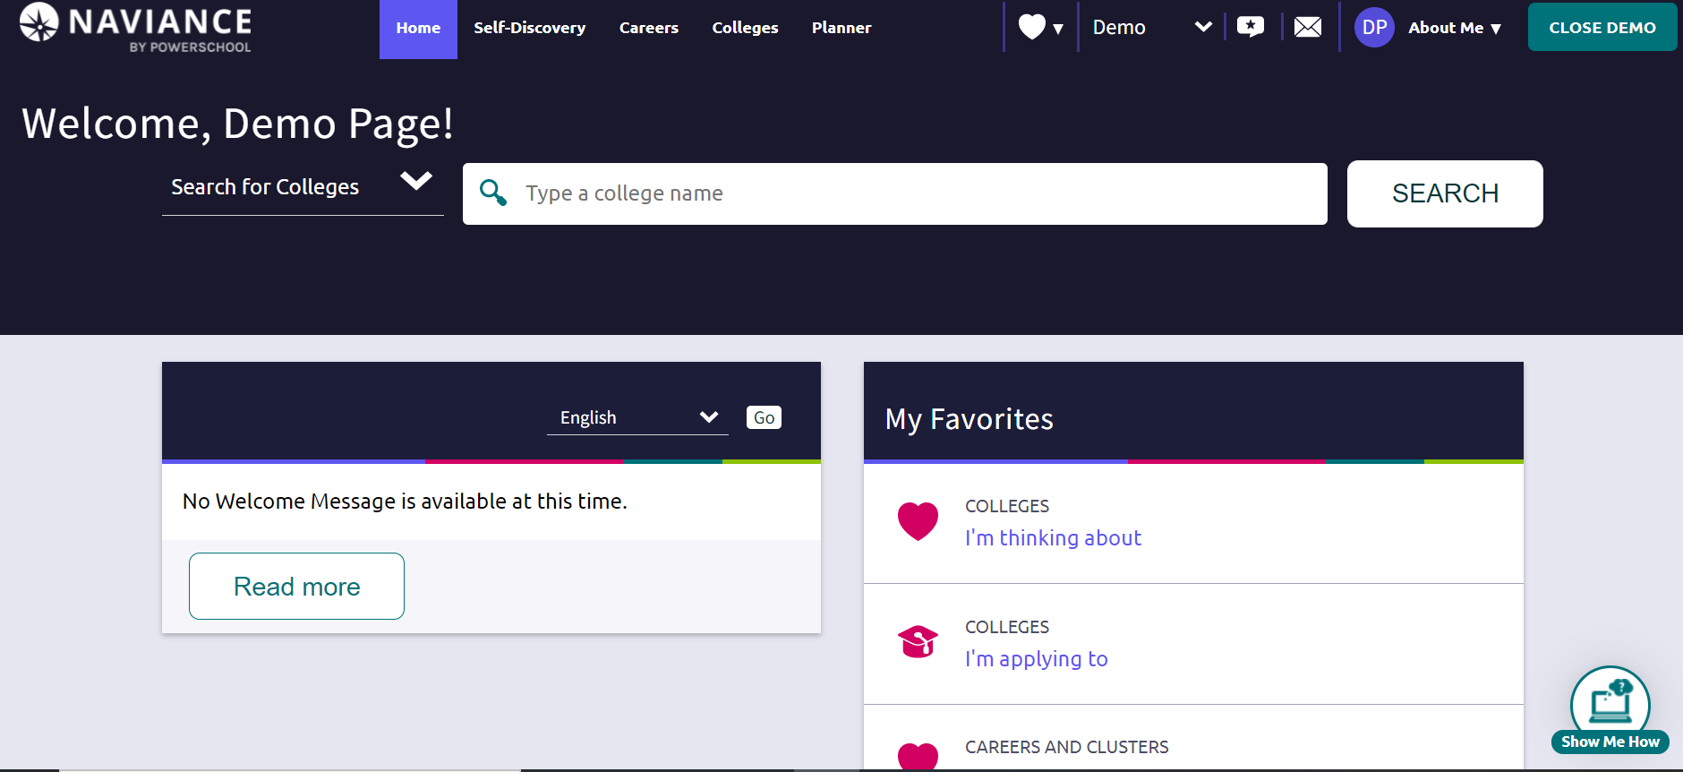
Notes:
Once you login, you will be brought to a page with your name at the top left. For the purposes of this presentation, you are being shown the Naviance website in the demonstration mode. There are lots of tools and features to explore in Naviance to help you find the colleges and careers related to your interests. For today, we are going to focus on careers. Today, you will take the Career Clusters Finder.

Slide 21
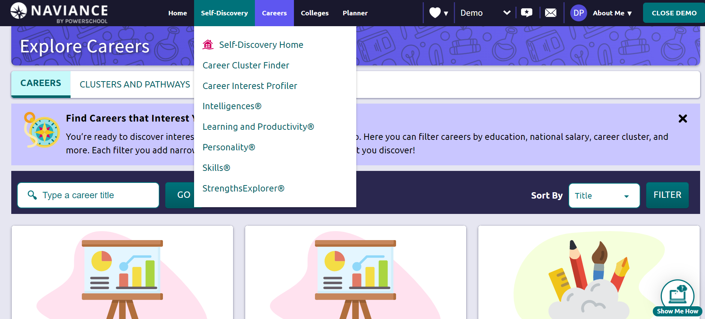
Notes:
Click on the Self-Discovery tab at the top, then click on Career Cluster Finder.

Slide 22
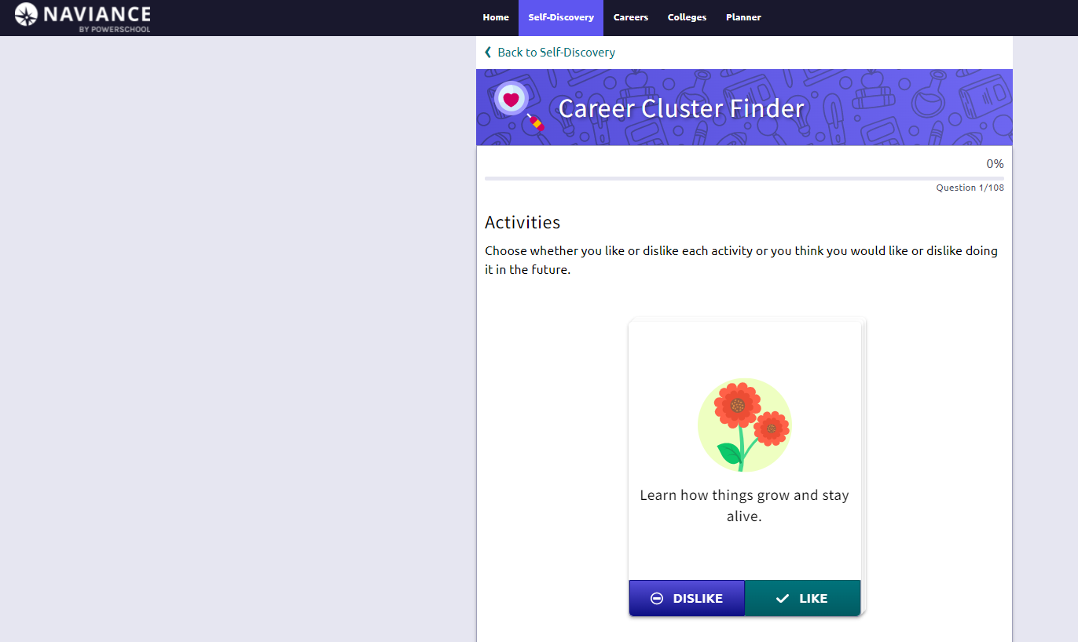
Notes:
In the Career Cluster Finder, you’ll indicate activities and school subjects that you like or dislike and personal qualities that you possess. In your results, you’ll learn how well each of the 16 National Career Clusters fits your current interests and qualities. The assessment should take you about 15-20 minutes to complete. You can retake the assessment at any time. Remember, your interests will likely change between now and graduation and that is perfectly normal. Exploration is key to narrowing down what interests you the most.

Slide 23
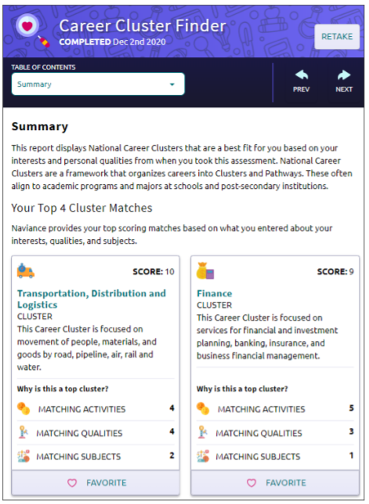
Notes:
Once you complete the assessment, your top 4 Career Cluster matches are displayed. For clusters that sound like something you are interested in, click “Favorite” at the bottom to save them to your profile to explore later. You can access Naviance from home, and we strongly encourage you to look at all careers you scored highly in. Talk to your school counselor if you’d like to discuss your career plans more.

Slide 24
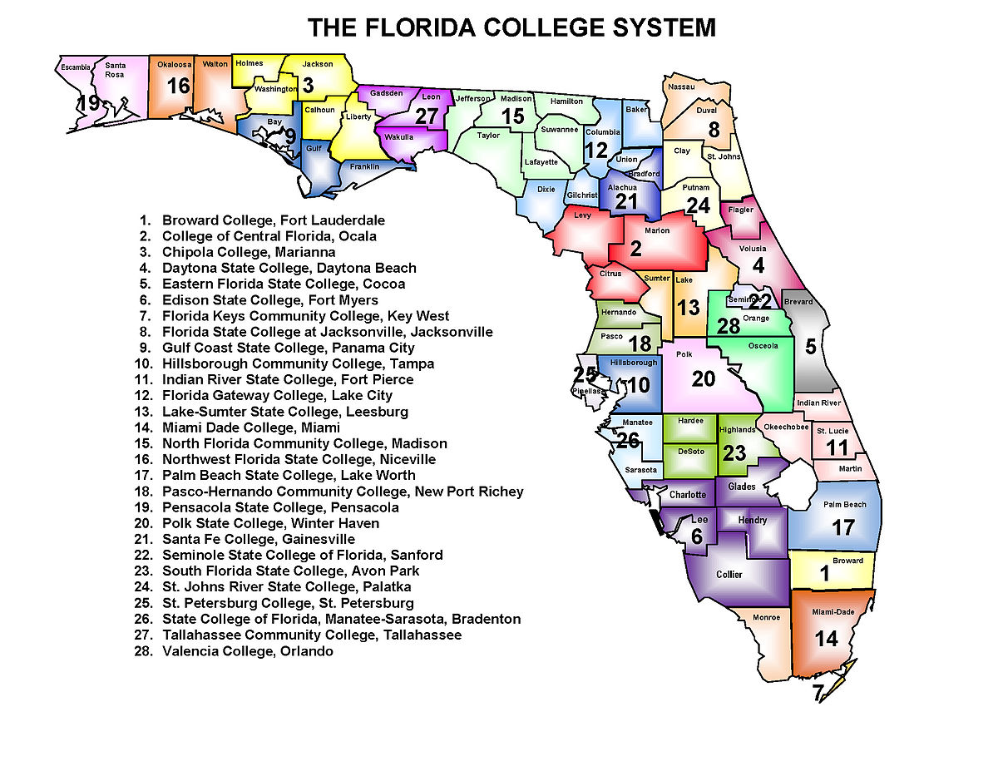
Florida College System Admissions Requirements
All Florida College System institutions have open-door admissions for students who earned a standard high school diploma or an equivalent diploma or successfully earned college credit.
Notes:
The Florida College System has 28 colleges in it. Our local college is St. Johns River State College. To be admitted to a state college, you must have earned a standard high school diploma or an equivalent diploma or successfully earned college credit.

Slide 25
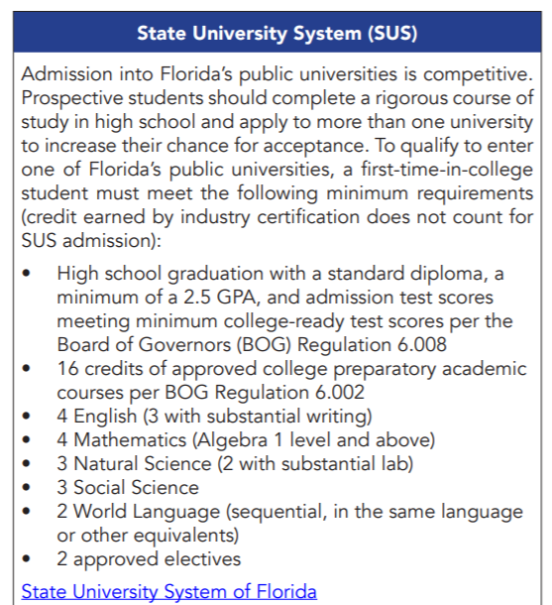
State University System
Notes:
For state university admissions, there are other test score and GPA requirements. If you know the university you would like to attend, visit their website and look at information on the Admissions page. This will provide information on the types of test scores, GPA, and other requirements for admission to the university. Also, taking a campus tour can be highly beneficial to know if the school is where you feel most comfortable attending.

Slide 26
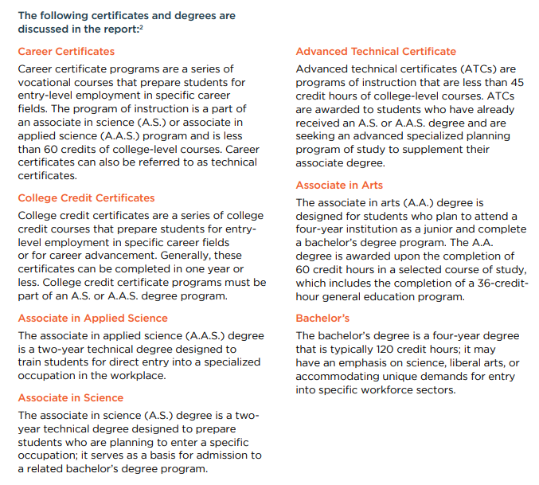
Degree Definitions
Notes:
Degree definitions. All of these degrees are different and lead to different pathways. For instance, state colleges offer 2 year Associate’s degree programs and some 4 year Bachelor’s degree programs. State Universities all offer Associate’s degree programs and many Bachelor’s degree programs. More information can be seen in the descriptions of the degrees. Different jobs require different levels of degrees, so by knowing what career is most interesting to you, you can begin to think about which degree and institution will best suit your needs.

Slide 27
2020 Economic Security Report-Measuring the Economic Success of Florida’s Graduates
Report: https://www.stjohns.k12.fl.us/guidance/wp-content/uploads/sites/142/2021/03/Economic-Ssecurity-Report-_Summary-2020.pdf
The top three industries that expect to add the most jobs in Florida, after food services (which was significantly impacted by COVID-19), are administrative and support services (102,829 jobs), ambulatory health care services (95,850 jobs), and professional, scientific, and technical services (83,304 jobs). With projected growth between 14% and 17%, these industries are expected to add a significant number of new jobs between 2020 and 2028.
Most students with a college degree in Florida completed a 4 year Bachelor’s degree from a state university or a 2 year associate in arts or science degree
Notes:
Let’s talk about the Economic Security Report from 2020. This report is relevant to you in that it gives lots of information on how successful Florida high school graduates are in their careers, college, and how much they get paid in their jobs. The report from 2020 showed several interesting facts, listed on this slide. So, why are we telling you all of this? We want you to make the most of your high school experiences so that you can have success like these other graduates have. We want you to know what types of degrees will give you the highest income, are in the greatest demand, and will cause the least debt. All important things to think about right? If you want to read the full report, just go to the link listed at the top of this slide. Most important to note are the top projected careers in Florida leading up to 2028. These careers are food services, administrative services, ambulatory health care services, and technical services.

Slide 28
Entrepreneurship & Employability Skills
Self awareness – in relation to interests, abilities, values, and skills
Career awareness – knowing what career opportunities exist and what is required to pursue them
Career decision-making skills
Team-working
Problem-solving
Presentation skills
Ability to learn new ways of doing things
Job search skills including resume writing, preparing job applications, and interviewing
Notes:
Regardless of what career you choose, there are some skills every employer wants their employees to have. If you think of school as your current job and your teachers as your employers, you can begin to practice all of these skills. First of all, employers want self-aware employees, meaning you know the impact you have on others around you with your actions. Employers also want people who have career awareness. This means that you read and learn about the career you’re interested in. You talk with people who work in your career of interest to find out how they got their job and what you can be doing to get a similar job eventually. Employers also want team players who can work with other people and get along with them. Having problem solving skills and good presentation skills are also worthwhile. All of these skills are beneficial no matter what type of job you have.

Slide 29
Thank you!
Notes:
Thank you for your time watching this, and if you have any questions, please speak with your school counselor.

