Slide 1
Transition Planning for Ages 18 – 22
Welcome Avery Greene
The Center for Autism & Related Disabilities (CARD) (florida-card.org) Brett Walden
APD - Agency for Persons with Disabilities - State of Florida (myflorida.com) Sheryl Dick-Stanford
Florida Division of Vocational Rehabilitation (rehabworks.org) Kim Houghton
The Arc of the St Johns | Community Campus (arcsj.org) Lynne Funcheon
Transition Services – Exceptional Student Education (ESE) (stjohns.k12.fl.us)
  Life Work Overview Jennifer Argentina
  Project SEARCH Overview Byron Pennington
Home - First Coast Technical College (FCTC) Jillian Patterson
Youth & Young Adult Empowerment, Leadership, & Learning (YELL) Lab » » University of Florida (ufl.edu) Dr. Jessica Kramer and Elizabeth Kennelly

Slide 2

Center for Autism and Related Disabilities
College of Medicine – Jacksonville
Neurodevelopmental Pediatrics Center
6271 St. Augustine Rd., Suite 1
Jacksonville, FL 32217
Phone: 904 633-0760
Fax: 904 633-0751
http://www.hscj.ufl.edu/pediatrics/autism

Slide 3
Mission:
"Our mission is to provide support and assistance with the goal of optimizing the potential of people of all ages with autism and related disabilities."

Slide 4
CARD offices throughout the state

Slide 5
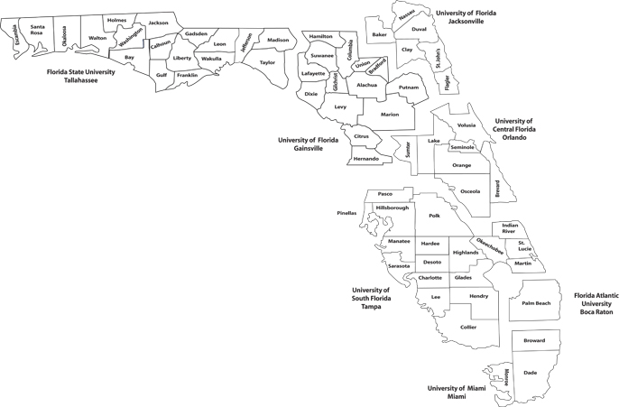
UF Jacksonville CARD serves six counties
  Baker
  Clay
  Duval
  Flagler
  Nassau
  St. Johns

Slide 6
Who is eligible for CARD services?
Individual with a Qualifying diagnoses:
  Autism Spectrum Disorders: previously:
    Autistic Disorder
    Asperger’s Syndrome
    Pervasive Developmental Disorder (PDD)
    Rett Syndrome, Angelman Syndrome and other genetic manifestations with related social communication difficulties.
  Related Disabilities:
    Dual-sensory impairment: Individuals with both a significant hearing and vision impairment
    Sensory impairments with other disabling conditions
    Social Communication Disorder
    Individuals of all ages from our 6 counties
Individuals who are screened eligible while awaiting a diagnostic evaluation.
Services are provided via a grant at no cost to the family.

Slide 7
UF Health Neurodevelopmental Pediatric Center Programs
Grant-Funded Programs
Center for Autism and Related Disabilities (CARD) Dr. David Childers, Jr. – Executive Director Jeannie Potthast – Asst. Director Karen Auger – Clinical Office Manager | Florida Diagnostic &Learning Resources System Multidisciplinary Center (FDLRS-MDC) Dr. David Childers, Jr. – Executive Director Jeannie Potthast – Asst. Director School Psychology Team –Staci Routman, Johanna Lopez, Lotoya Odom Karen Auger – Clinical Office Manager
Works with children and adults with an autism spectrum disorder, dual sensory impairment or sensory impairment combined with another disabling condition. Parent/Caregiver Consultations Family Support: counseling, support groups and Sibshops. Teacher consultations and trainings. Technical Assistance for functional behavioral assessment and behavior support plans. Public Awareness Events Annual Statewide Conference | Psychoeducational, psychological, speech and/or language, and neurodevelopmental evaluations for children 3 to 22 years, providing they are still in high school, who are struggling in school due to complicated medical, behavioral, developmental and/or social histories. Feedback session and report detailing findings and diagnoses made. Consultations with families to assist in planning for the child’s educational and psychological needs. Social Groups and Sibling Support Groups. Educational consultation and support services, including collaboration with school personnel to facilitate provision of intervention services. Trainings for teachers, students, family and other professionals. Public Awareness Events

Slide 8
UF Health Neurodevelopmental Pediatric Center Programs
Medical Evaluation Clinics Self-Pay Clinic
Neurodevelopmental Pediatrics Dr. David Childers, Jr. Dr. Rohan Dial Jeannie Potthast - Administrator Karen Auger – Clinical Office Manager | Behavioral Pediatric Clinic Dr. Eugene Hershorin Jeannie Potthast – Administrator Karen Auger – Clinical Office Manager | Pediatric Assessment and Intervention Program (PAIP) Jeannie Potthast – Administrator Karen Auger – Clinical Office Manager
Neurodevelopmental/Developmental Evaluations This division brings together various specialists to work with children at risk for learning, behavioral or developmental delays. They serve children with a variety of disorders, ranging from developmental delays that may be overcome with early care and treatment to lifelong conditions that may be alleviated with ongoing support and appropriate care regimens. | Behavioral Evaluations Our behavioral pediatric evaluations serve school-age children and adolescents with attention, behavior, and developmental disorders. Services are extended to those concerned with Anxiety, Depression, and AD/HD, or previously diagnosed with Autism Spectrum Disorder. The clinic’s focus lies in areas related to behavior, socialization and overall adjustment and performance within the natural environment (home, community or school). Training and education is provided to caregivers in order to support the generalization of concepts introduced during appointments. | Educational, Academic Assessment and Consultation Food Over-Selectivity Clinic Targeted Parent Training Behavior Boot camp Study and Organizational Strategies Theme-based social skills groups PEERS Social Skills Group Too SCARED To Try

Slide 9
CARD Services to Families Include:
Family-driven Consultations
  Transition IEP review; design family support plan; goal-setting
• Referrals to service providers, community resources, support groups, etc.
Parent Workstation for various types of visual supports
Support groups
Trainings offered to parents/caregivers/teachers
Transition Services
Webinars
Lending Library

Slide 10
CARD Support and Social Skills Services
  Social Skills Groups
    Social Skills for Adolescents and Young Adults
      Pokémon Go Outside
      Retro Diner
    Social Skills for Older Adults
      Retro Diner
  Support Groups
    Adult Support Group
    SibShops
    Parent Support Group

Slide 11
CARD Transition Services
Individual Consultation Visits
Includes discussions about
  School
  Work
    Resume writing & Interview training
  Financial Literacy
  Healthcare training and planning
  Other concerns
We will review community resources that may be useful to you during the transition process.
  Agencies include:
    Vocational Rehabilitation & Employment Network Resources
    Post Secondary Education Opportunities
    Social Service Benefit Programs
    Housing Programs
    Public Transportation Services
    Recreation and Leisure

Slide 12

CARD Services to Schools
School Requested Consultations
•Student observations and recommendations
Technical assistance in designing instructional programs
Trainings
Summer Institute and multiple yearly trainings
Teachers
Paraprofessionals
  Opportunities to receive continuing education credits
Resources in library and online
• Florida DOE/CARD PEPSA Teacher Partnership Program

Slide 13

CARD Services in the Community
Awareness events pertaining to autism and related disabilities for local groups and agencies upon request.
Training events and workshops on topics pertaining to autism and related disabilities (Autism Symposium, Tools for Success, Connecting the Dots).
Dissemination of informational brochures on autism
and related disabilities.
Annual statewide CARD Conference
First Responder/Law Enforcement trainings
Seasonal family events held at CARD
Annual Toy Drive
Seasons of Hope Dinner
Autism Friendly Business Training

Slide 14
Clarification of CARD Services
CAN DO…
Model good practice and teach you how to facilitate your child’s skill development
Provide consultation and family support
Make referral for diagnosis
Refer to additional service providers, inform parents on ways to evaluate treatment options and provide information on an array of methods
Advocate in the best interest of the individual with autism and/or related disability
CAN’T DO…
Provide therapy or direction instruction to your child
Diagnose
Endorse specific programs or providers
Duplicate services
Handle crisis situations
Provide funding for professional services
Advocate for school, parent or other agency

Slide 15

What do we need?
Keep your child’s records intact.
Keep us updated on your child’s progress, change of address, phone number, email, and upcoming meetings (advance notice).
Be proactive – we ask that you contact us when you need assistance.
**E-mail is a good way to request support.
Follow through on family support plans
Check weekly update and website regularly for
upcoming events and other important information
Attend educational and community events

Slide 16
Preparing for your First Family Support Appointment
Make a list of the top areas of concern as related to yourself or your loved one.
  Examples: Educational planning, behavior management, social skills, communication and functional play skills, adaptive/self help skills.
Reply to the Clinician and Family Introduction Email which confirms your attendance at CARD 101 requesting an appointment with your clinician to begin using CARD services.
Check your email inbox and spam on Monday afternoons for the Weekly Update.
Begin gathering diagnostic or evaluation documents in preparation of your first Family Support Appointment.

Slide 17
Consent Forms
Any consent forms that have not been completed prior to this orientation will be sent via email to the parent/guardian/individual using services. Consent forms must be completed fully before using CARD groups or services.

Slide 18

Our Team:
Jeannie Potthast, M.B.A.
Division Administrator/Assistant Director
Jeannie.Potthast@jax.ufl.edu
Chanél Baldwin, M.Ed.
Education and Training Specialist
Johanna Lopez, Ed.S., NCSP
School Psychologist
Diego Castillo, MS
Education and Training Specialist
Gwenivere Mauro, M. Ed.
Education and Training Specialist
Bernardo Cuadra, BA, CWCM
Education and Training Specialist
Jennifer O’Brien, MA, CCC-SLP
Speech/Language Pathologist
Sarah Falls, MS, CCC-SLP
Speech/Language Pathologist
Lotoya Odom, SSP, BA
Licensed School Psychologist
Amy Lane, MS
Education and Training Specialist
Brett Walden, M.P.H
Education and Training Specialist
For the CARD Weekly Update
Anthony Rhodes

Slide 19



Center for Autism and Related Disabilities
Visit our website
http://www.hscj.ufl.edu/pediatrics/autism/
https://www.facebook.com/AutismJacksonville

Slide 20
Employment Enhancement Project
Ron DeSantis Governor
Barbara Palmer
Director

Slide 21
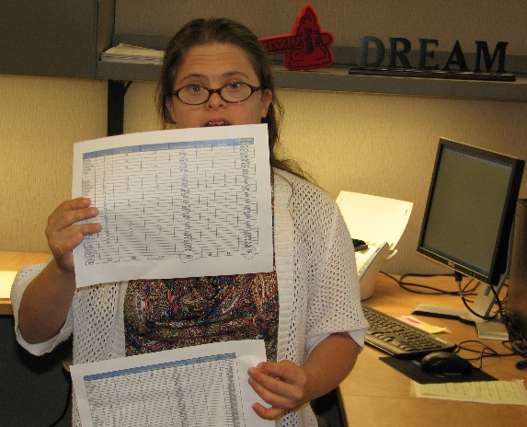
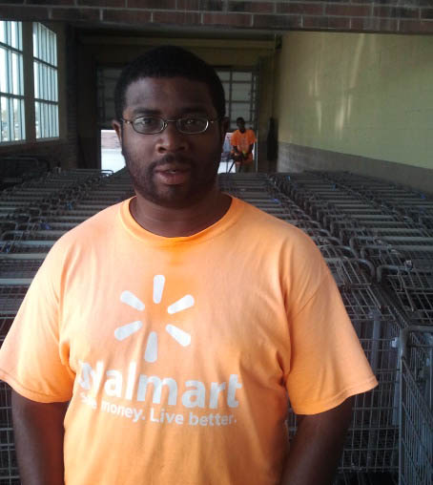
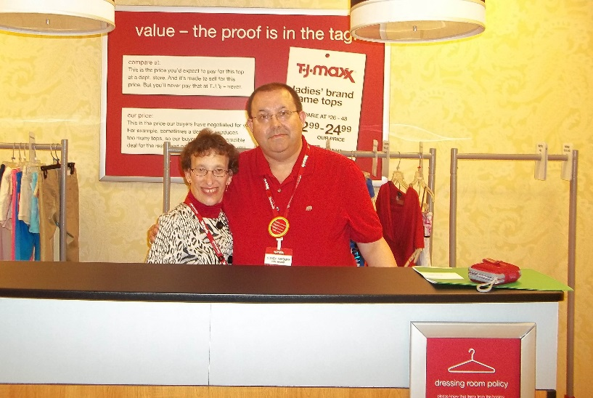
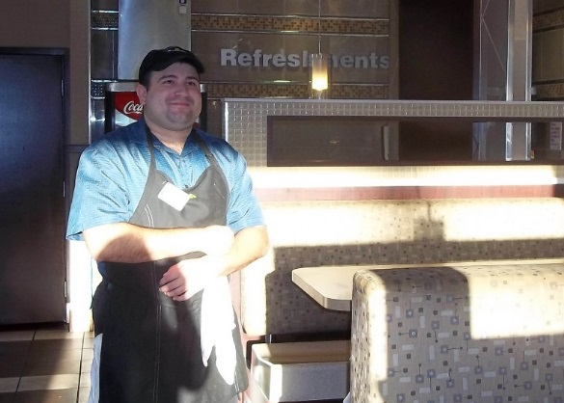
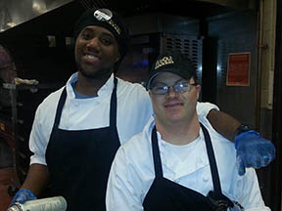
The Agency’s
Mission
The Agency Supports Persons with Developmental Disabilities in Living, Learning, and Working in Their Community
Notes:
21

Slide 22
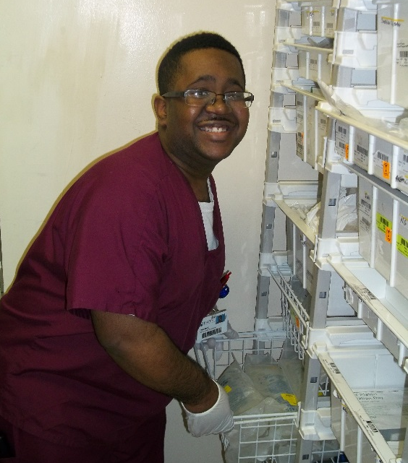
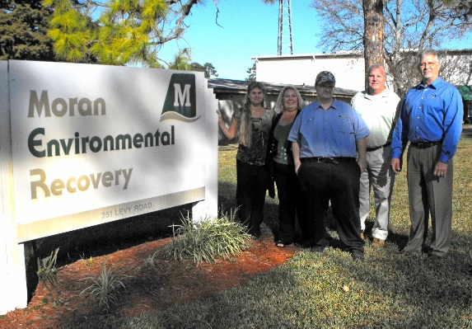
Employment Facts
  According to the U.S. Census Bureau, the unemployment rate for Floridians with disabilities ages 16 to 64 is about 63 percent—much higher than the state average for the general population
  Employees with disabilities are typically very reliable
  According to a DuPont study, on average, people with disabilities have better attendance records than other workers, equivalent or better productivity, and better job-retention rates
22
Notes:
22

Slide 23
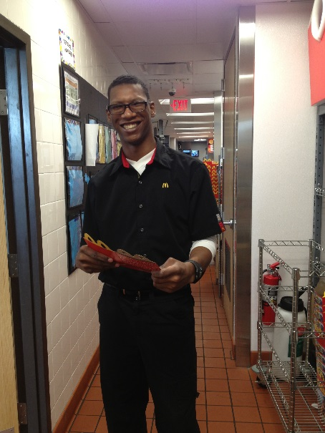
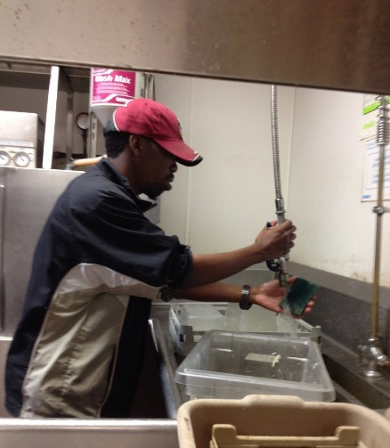
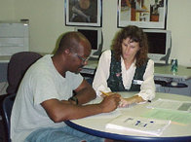
Employment Facts
  A Harris survey indicates that almost 70 percent of adults with disabilities who work or want to work do not need special equipment or technology
  For people who do need special equipment or technology, two-thirds of accommodations cost less than $500, with nearly 25 percent costing nothing at all, according to the federal Job Accommodation Network
  In Florida, the costs of workplace accommodations may be covered by Vocational Rehabilitation
Notes:
23

Slide 24
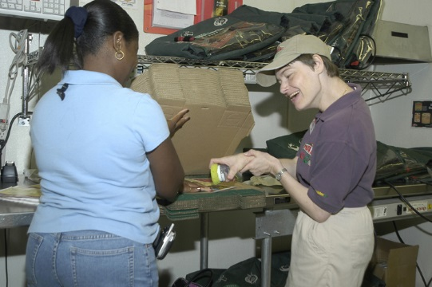
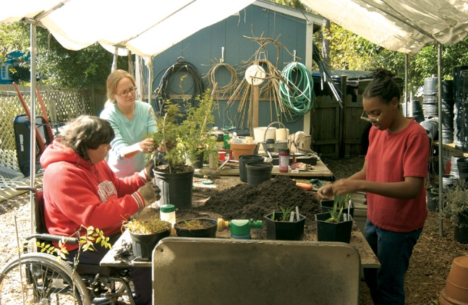
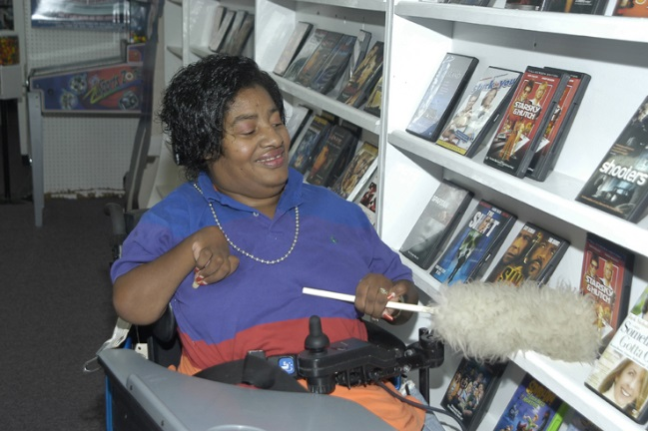
People Want to Work
  Employment is a vital way for people with developmental disabilities to become contributing members of their community
  APD provides:
  Assistance to get the job a person wants
  Supports for as long as needed
  Services to individuals on the Medicaid waiver and people waiting to enroll into the waiver
  Help with ongoing supports to ensure the employee and the employer have their needs met and remain satisfied with their employment choices
Notes:
24

Slide 25


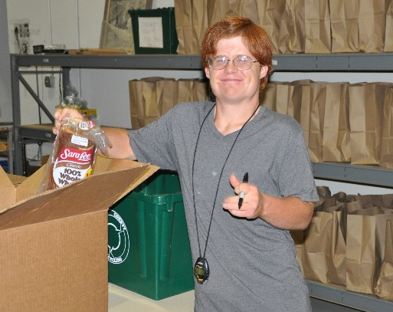
Employment Enhancement Project
  Purpose: Provide employment opportunities to people on the APD Waiting List who want jobs
  when leaving high school
Notes:
25

Slide 26
Employment Enhancement Project
  $500,000 from the Florida Legislature to assist individuals to go to work
  Highest priority - people leaving school to begin working in competitive employment
  Funds allotted on individual basis, averaging $2,500 per person
Notes:
26

Slide 27
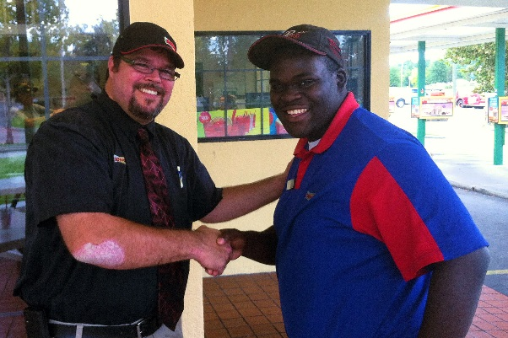
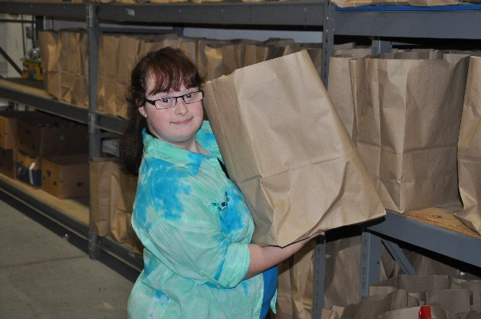
Participants Must Be:
  Job seekers on APD’s Waiting List
  18 years of age or older (if in high school, in final year)
  Job seekers who do not have an active case with VR
Notes:
27

Slide 28
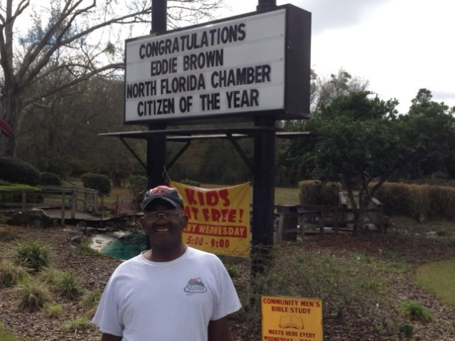
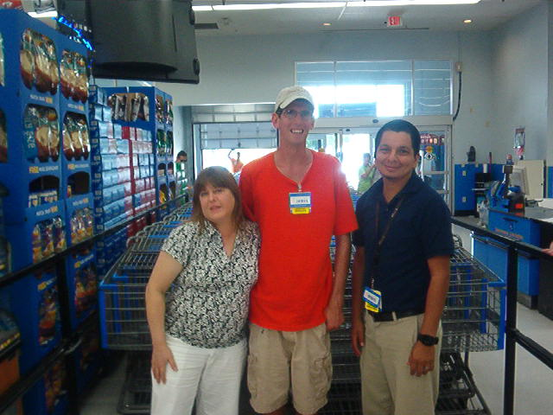
Provider Requirements
  Active Medicaid waiver provider with Supported Employment as approved service or General Revenue provider with SE as approved service
  Successful completion of two APD courses: Social Security Work Incentives and Supported Employment Best Practices
  Submission of W-9
  Enrollment in ABC for General Revenue billing
Notes:
28

Slide 29


Provider Requirements
  Proof of current Level 2 background screening
  Fingerprinting
  Executed Affidavit of Good Moral Character
Notes:
29

Slide 30
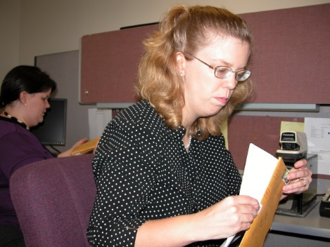
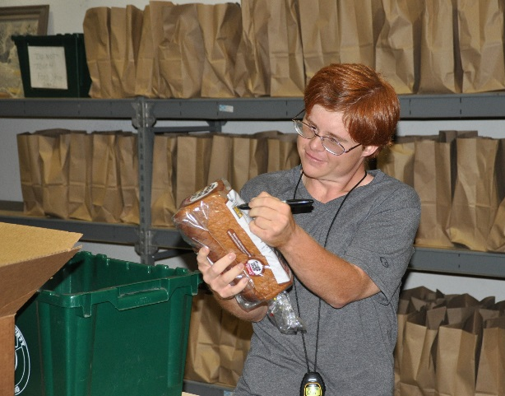
Provider Requirements
  Under $35,000 of services:
    Completion of EEP Client Services Agreement
    Exhibit A
    Business Associate Agreement
  $35,000 or more of services:
    New Standard Contract
    Attachment I – Revised
    Exhibit A – EEP Schedule of Rates and Services
    Contract Business Associate Agreement
Notes:
30

Slide 31
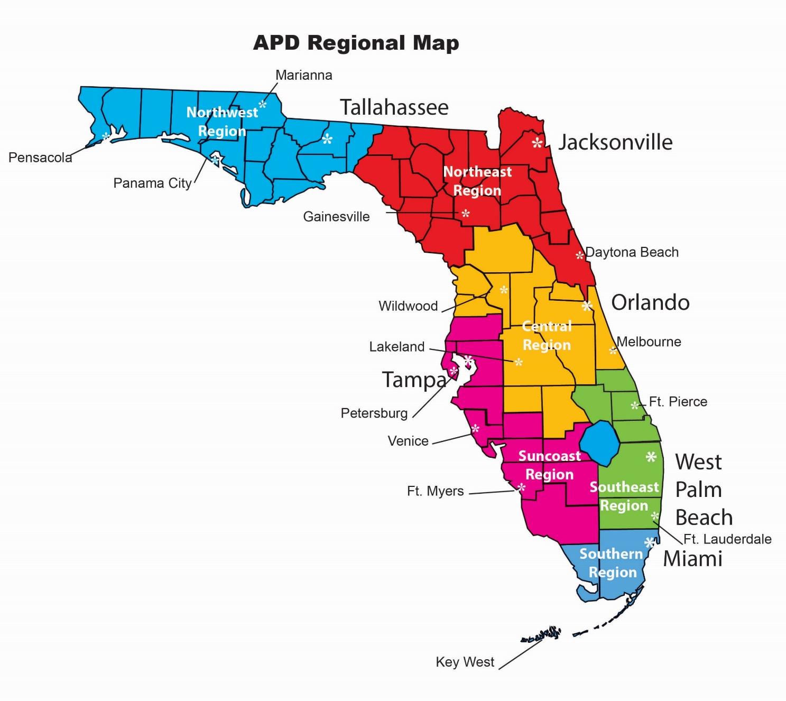
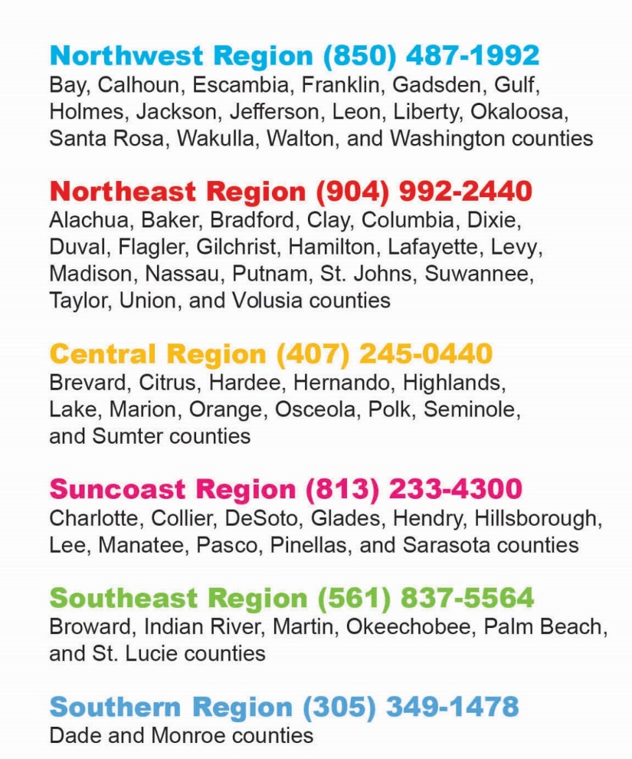
Notes:
31

Slide 32
Resources
  Florida Vocational Rehabilitation: www.rehabworks.org
  Florida Blind Services: http://dbs.myflorida.com/
  Florida Alliance for Assistive Services and Technology: www.faast.org
  U.S. Business Leadership Network: www.usbln.org
  APD Resource Directory: http://resourcedirectory.apd.myflorida.com/resourcedirectory/
  Florida Family Care Council: http://fccflorida.org/fccmain.htm
  Florida Developmental Disability Council: www.fddc.org
  Employ Florida Marketplace:
  https://www.employflorida.com/vosnet/Default.aspx
  Able Trust: www.abletrust.org
Notes:
32

Slide 33
Thank You!
For more information about APD:
  Sheryl Dick-Stanford: Sheryl.Dick-Stanford@apdcares.org, 352-955-5768
  Call 1-866-APD-CARES (1-866-273-2273)
  Visit APDCares.org
33
Notes:
33

Slide 34

Vocational Rehabilitation and the Pathways to
Pre-Employment Transition Services
Help Students Successfully Transition Out of High School

Slide 35


What is Vocational Rehabilitation?
An agency that helps people with disabilities enhance their independence through employment and prepare for, find, and maintain employment
Independence
Notes:
VR is a state agency that provides services to individuals with disabilities to help them prepare for, find, and once employed maintain employment – leading to independence.

Slide 36


What does Vocational Rehabilitation do for students?
We help students with disabilities transition from high school to:
  career/technical school
  college or university
  or directly into employment
and…
Notes:
For students with disabilities, our services help them transition to postsecondary education or training which might be a career or technical education program, college or university or directly into the world of work.

Slide 37

What does Vocational Rehabilitation do for students?
We provide:
  Networking opportunities
  Hands-on training in a community setting
  Social and work readiness skills
Notes:
Provide students with disabilities an opportunity to network which means getting to know, working along side with, and building relationships with those people they meet during their work experiences.
Provide opportunities for these students to receive hands-on training which is needed to practice skills and get a sense if the work is something they really want and like to do.
Provide opportunities for these students to develop skills that they can use in any work setting.
We are here to help students be successful.

Slide 38

How can VR be beneficial to students?
We can help students:
  Explore strengths, abilities, and interests
  Identify and develop a career pathway
  Learn valuable skills that will help them reach their educational and career goals
  Experience the benefits of employment
  Increase their independence
Notes:
We can help students with these things by offering Pre-Employment Transition Services to them outside of school time – after school, evenings, weekends, school breaks, and during the summer.

Slide 39
What services are available to students?
Pre-Employment Transition Services (Pre-ETS)
  Job Exploration Counseling – reviews options that are best suited to your skills, abilities, aptitudes, and interests
  Work Readiness Training – focuses on employability and related skills that prepare you to work
  Self-Advocacy Training and Peer Mentoring* – teaches you how to speak up for yourself and make decisions about your own life to become more independent
  Postsecondary Educational Counseling* – provides an awareness of career pathway options with job and career information
  Work-Based Learning Experiences – provides practical hands-on training for employability skill
*Services are being added
Notes:
Pre-ETS are career exploration services identified in the Workforce Innovation and Opportunity Act (WIOA) that reveal specific employment-related information and address specific employment-focused skills that students need to be successful in any job or career pathway. These are Job Exploration Counseling, Work Readiness Training, Self-Advocacy Training and Peer Mentoring, Postsecondary Educational Counseling, and Work-based Learning Experiences.
Job Exploration Counseling – includes career assessments such as interest and aptitude assessments, comprehensive vocational evaluations, and discovery
Work Readiness Training is a 20-our course that includes topics not limited to resume writing, interviews skills, searching and applying for jobs online, finding and completing job applications, managing employer contacts, handling conflict, navigate public transportation and if necessary, reviewing employee benefits
Self-Advocacy Training and Peer Mentoring are services that focus on self-awareness, knowing one’s rights, requesting reasonable accommodations, setting goals and developing an action plans to accomplish those goals, and learning how to advocate and be self-determined
Postsecondary Educational Counseling provides information that help students to understand what they need in regards to obtaining their employment goal. This service is about making informed decisions.
Work-based Learning Experiences provide students an opportunity to apply and practice soft and social skills. They are able to develop a sense of work. Through these paid or unpaid work experiences, students develop work skills and gain experience that is helpful on a resume, build relationships leading to job references, and help them identify any needed work accommodations to be successful on the job.
Currently, all the services listed except for Peer Mentoring and Postsecondary Counseling are available state-wide.
Pre-ETS are free for students.

Slide 40

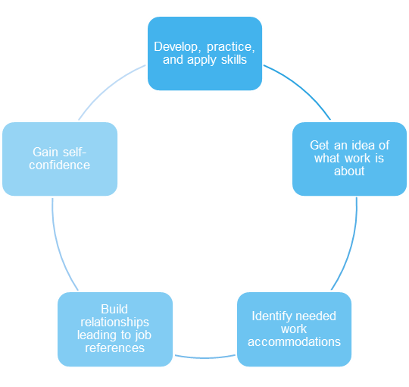


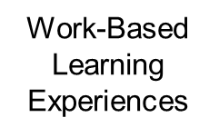
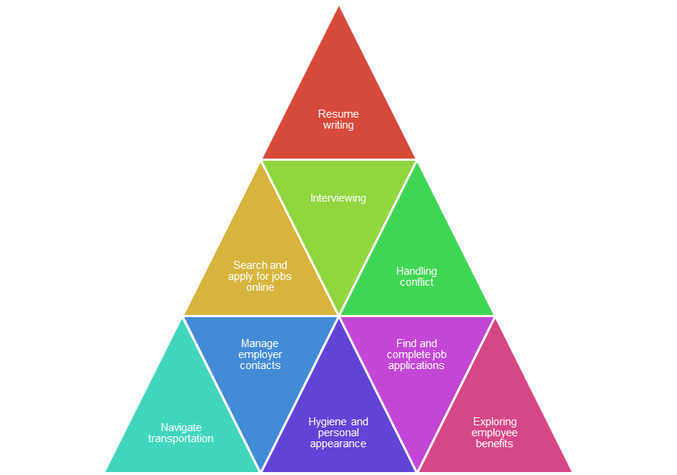

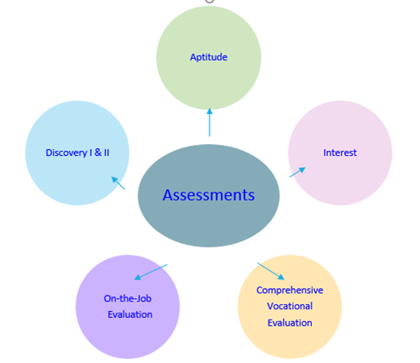

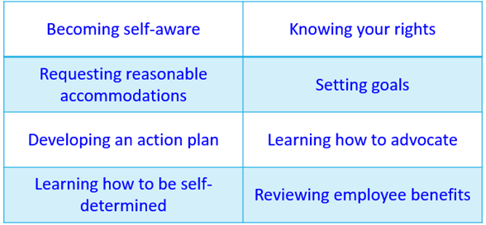
What are the benefits of
Pre-Employment Transition Services?
Notes:
It is important to understand why you are doing something, to see the relevance, the importance, and the benefits. This slide provides additional information on the Pre-ETS and includes activities and/or skills that may be included in each Pre-Employment Transition Service.
Notice Job Exploration Counseling and the types of Career Assessments this service includes. These assessments are different from the assessments you may have received in school as provide employment related information.

Slide 41

What are the requirements for students to receive Pre-ETS?
  Ages 14 through 21
  In middle school, high school, trade school, college, or university
  Have a current IEP, 504 Plan, or other school documentation indicating your status as a student with a disability
Notes:
To participate in Pre-ETS, students must be at least 14 years of age but not more than 21 years of age.
They must be enrolled in secondary or postsecondary education or training program which could be a CTE certificate program or 2 or 4 year degree program. Notice middle school is not listed however, it is possible that you may find that a 14, 15, 16 or older student is still completing his/her middle school requirements. Its not the grade, but the age that we must take into consideration when offering these services.
And students must be identified as a student with a disability by the school. This typically includes an IEP or 504 Plan but other documentation from the school may suffice if it clearly states that the individual is a student with a disability.

Slide 42
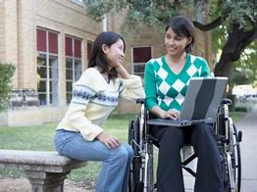
How long may students receive Pre-ETS?
Students may continue to receive Pre-ETS until they:
  Turn 22
  Decide services are no longer needed
  Graduate, exit high school trade school, college, or a university program
Notes:
Students may receive Pre-ETS up through the age of 21.
Pre-ETS may continue as long as students are in school.
And students may continue to receive Pre-ETS as long as they are actively participating in the services.
If students exits (drops out), graduates without intending to go on to postsecondary education or training or turns 22, Pre-ETS will end however, services for those who have applied and been found eligible may continue as “adult” services.

Slide 43


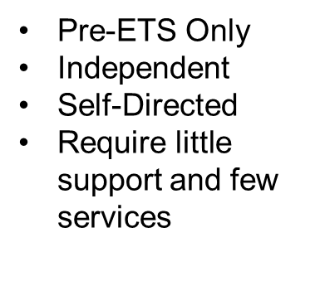

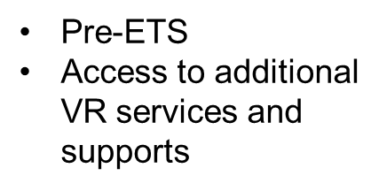
What are the pathways to receiving
Pre-Employment Transition Services?
Pre-ETS Referral
VR Referral
Application and eligibility required
Notes:
Students may receive Pre-ETS through two pathways. Students may be referred for Pre-ETS through the Student Transition Activities Record (STAR) portal. Students who choose to have Pre-ETS referral made through the STAR portal receive only Pre-ETS. Since these services are limited, typically students who choose this pathway are more independent and self-directed. These students would not require additional services or supports to access or participate in the Pre-ETS.
Students who would be referred for VR would also be able to receive Pre-ETS but may also have additional VR services and supports available to them if they apply and are found eligible for services. These students would typically require supported employment services such as job placement, job coaching, job retention services, may be in ESE Access classes, have a 1:1 or small group para in school and will likely need more services and additional supports to be successful.
If unsure about the best pathway, please speak with your ESE teacher and/or guidance counselor and your local VR staff to make the best choice. Students can always be referred through the STAR portal to receive Pre-ETS and if additional services and supports are required students can apply at any time.

Slide 44

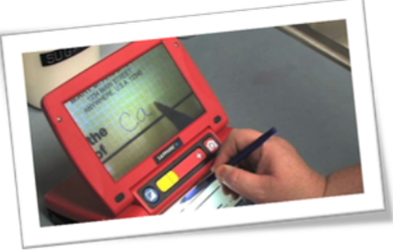
What services, in addition to Pre-ETS, may students receive if they apply to and are found eligible for VR services?
Potential services may include:
  Job Placement
  Supported/Customized Employment
  Time-limited Medical or Mental Health Treatment
  Support Services
  Postsecondary Education and Training assistance
Notes:
VR is able to provide a number of services and supports to students who apply and are found eligible for VR. These services and supports are identified on an Individualized Plan for Employment (IPE) that help you reach your employment goal.

Slide 45

What are the next steps for students and families?
Discuss your interest in receiving Pre-ETS
Decide which pathway would be the best for receiving Pre-ETS
Inform your ESE Teacher or Guidance Counselor that you would like to have a Pre-ETS or VR Referral made for you
What if we are still unsure about the best pathway to services?
Notes:
If you are unsure about which pathway may be best for you to receive Pre-ETS, speak with you local VR staff.

Slide 46
What can students expect will happen next?
Pre-ETS Referral
VR Referral
Referral will be entered into the Student Transition Activities record (STAR) Portal
An initial meeting will be scheduled with VR Staff to review Pre-ETS and available providers
Students and/or parents/guardians will make service and provider choices
Students will participate in services
A follow-up meeting will be scheduled to review completed services and determine next steps
Referral will be submitted to your local VR Staff
An orientation to VR will take place
Students and/or parents/guardians make the decision to apply to VR
An initial meeting will be scheduled with VR Staff to review Pre-ETS and available providers
Students will participate in services
A follow-up meeting will be scheduled to review completed services and determine next steps
Notes:
Once a Pre-ETS referral is made there is a process leading to you receiving those services…..

Slide 47
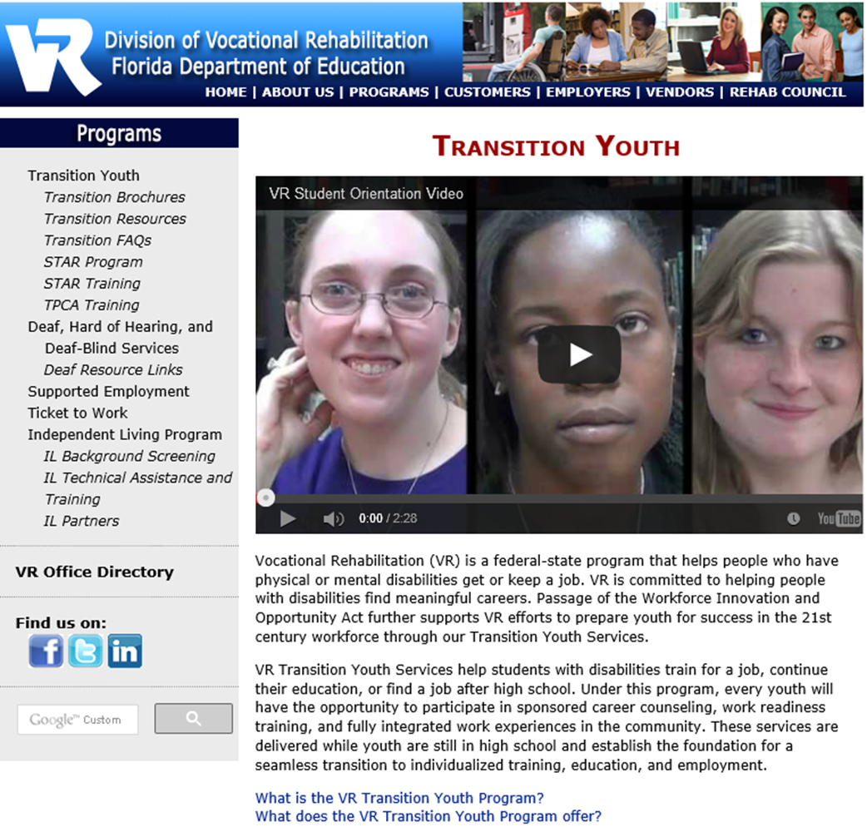
Where can students and families go for more information about VR and Pre-ETS?
www.RehabWorks.org
VR Transition Youth Page
VR Office Directory
Notes:
VR has its own website that is a wealth of information and provides many resources for students and their families. To access our website, please go to www.rehabworks.org. For services specific to students, you will want to go to our Transition Youth Page. This link can be found on the left-hand side of the main page. Once on the Transition Youth Page, there is a short video and a link to our transition brochures that can be accessed in English, Spanish, and Creole.
If you would like to speak with someone from your local VR office, you will want to access our VR Office Directory. This link shown on your screen will open up a map of Florida. Click on your area and all the offices that serve that area will appear with contact information for each office.

Slide 48

.
Program Requirements:
Be an Exceptional Education Student with an IEP and reside within the school district of St Johns County
Be between the ages of 18-22 (students 16 and up may be eligible under certain circumstances)
Be able to ride school transportation without the need of a bus aid.
Demonstrate consistent school attendance and punctuality

Slide 49

Encouraging Independence through:
Vocational training
Community Based Work Experience
Social Interests and Interactions
Participation in the Arts Programs
  Dance
  Music
  Theatre
Encouraging participation in clubs and community events
Community Safety Training
Self Advocacy and self determination

Slide 50


Slide 51
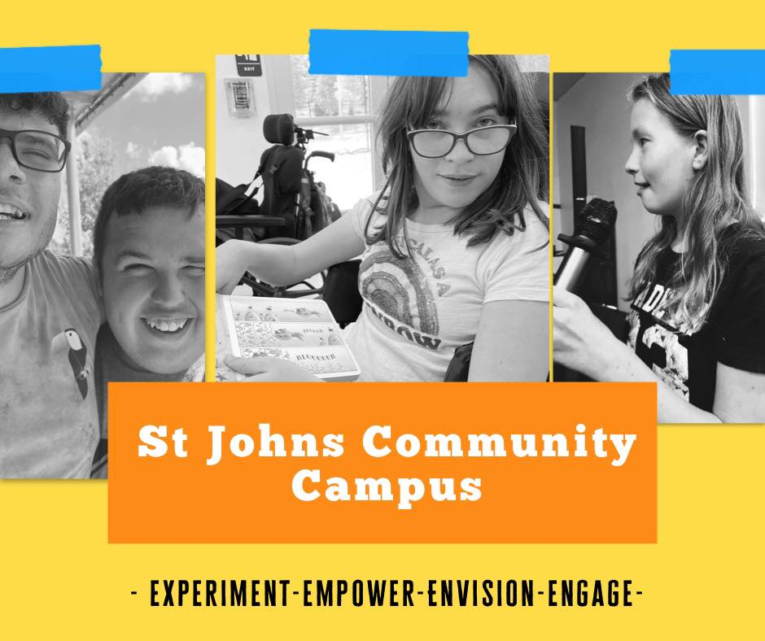

Slide 52
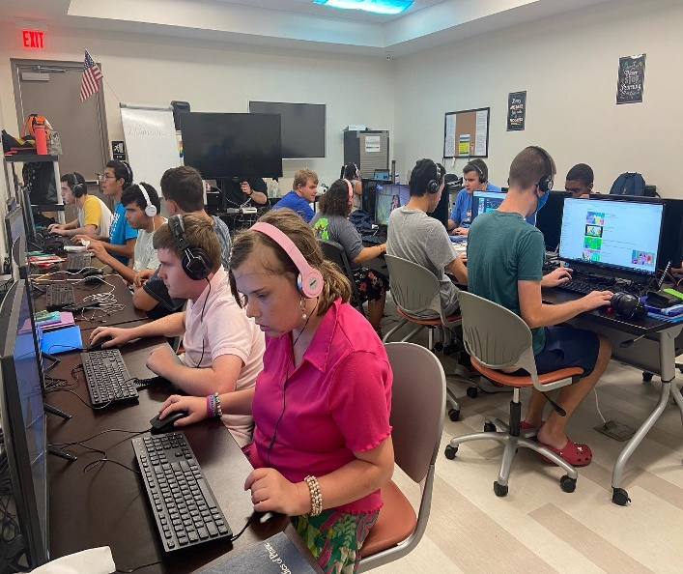

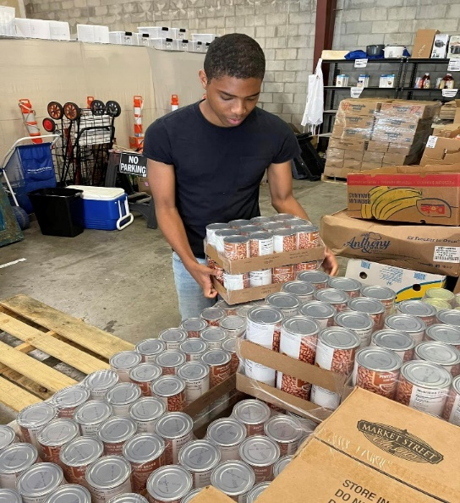
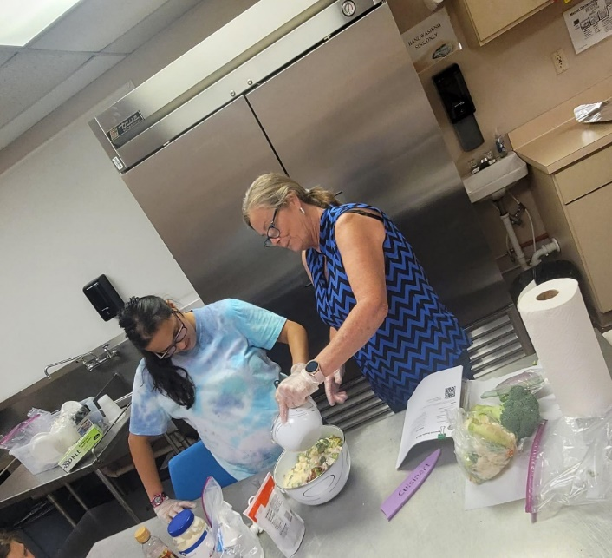
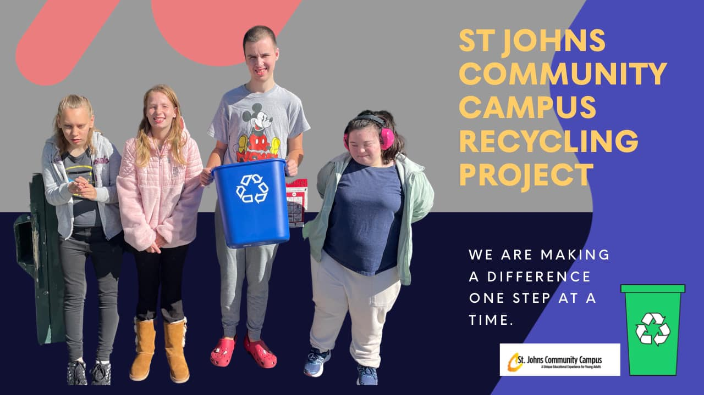
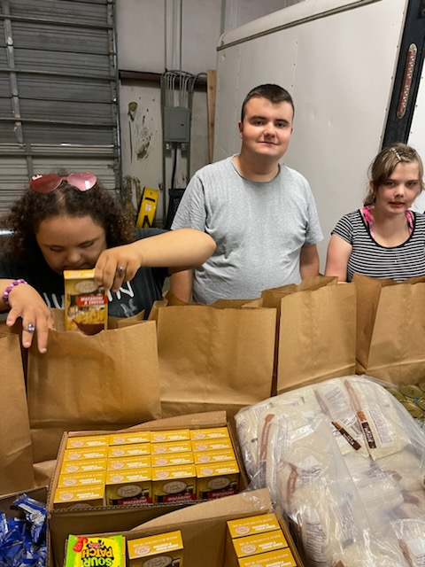
2165 Arc Dr. St. Augustine, Florida 32084
Lynne Funcheon, Program Director
Lfuncheon@arcsj.org
(904) 824-7249

Slide 53


Slide 54
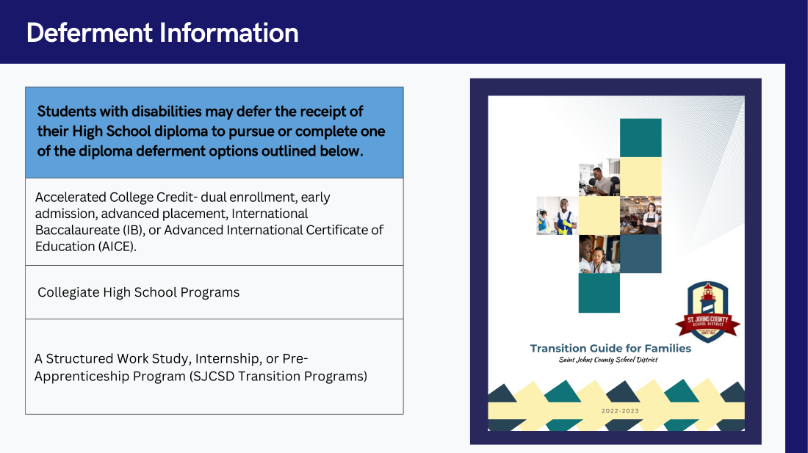

Slide 55
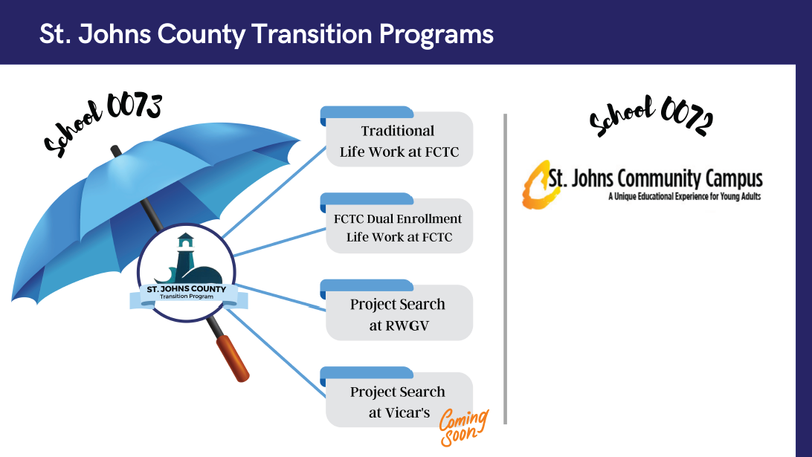

Slide 56
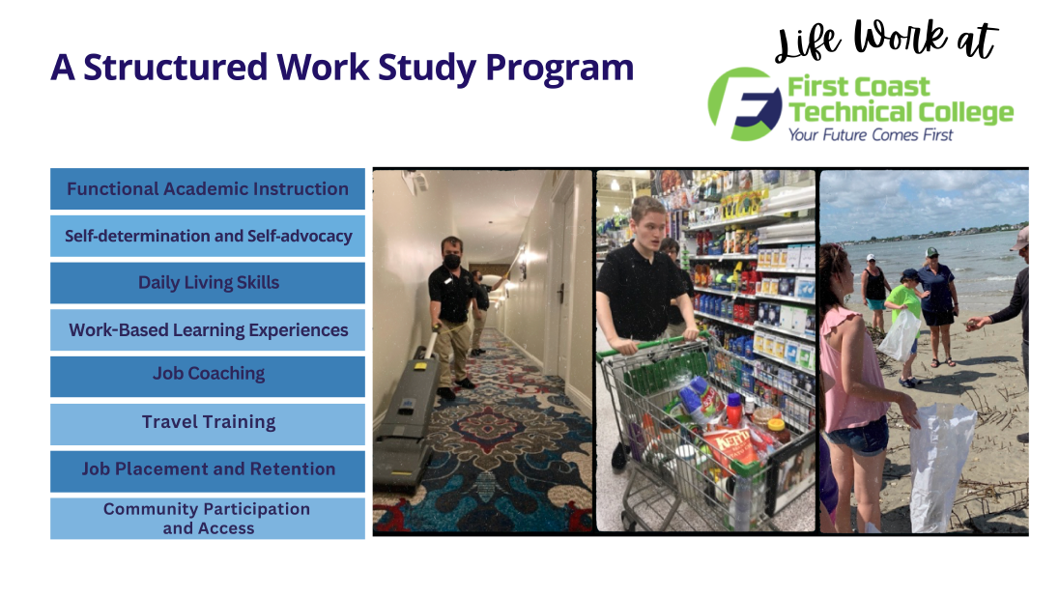

Slide 57
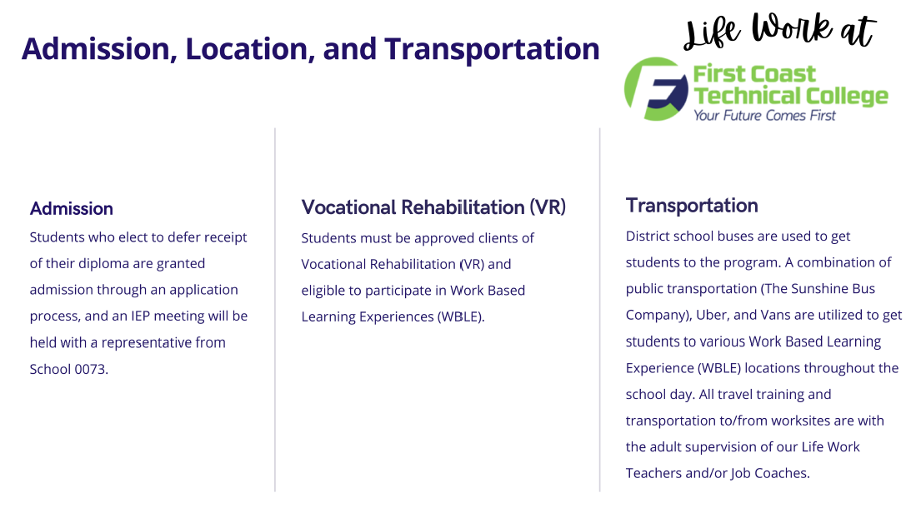

Slide 58
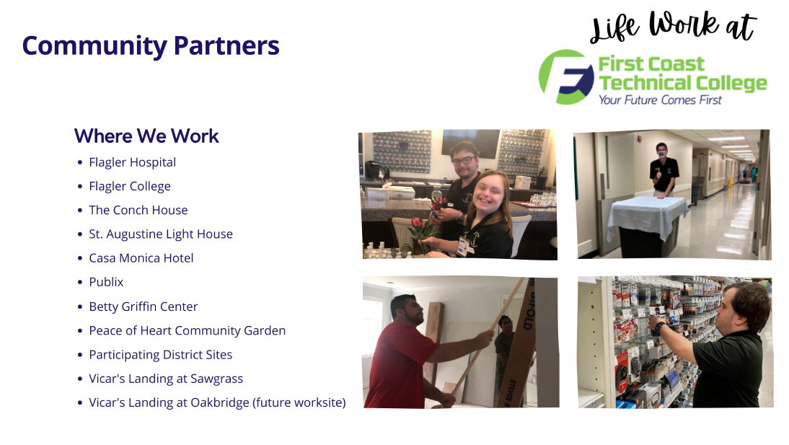

Slide 59
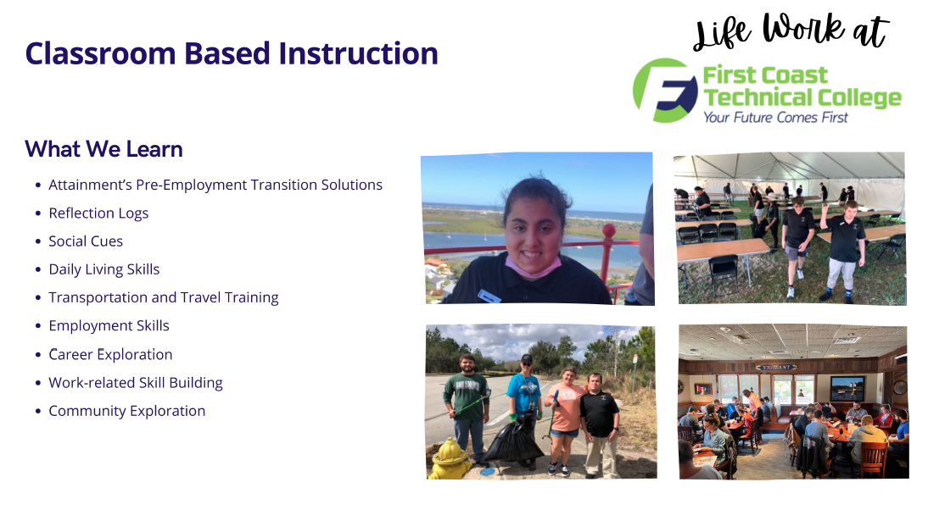

Slide 60
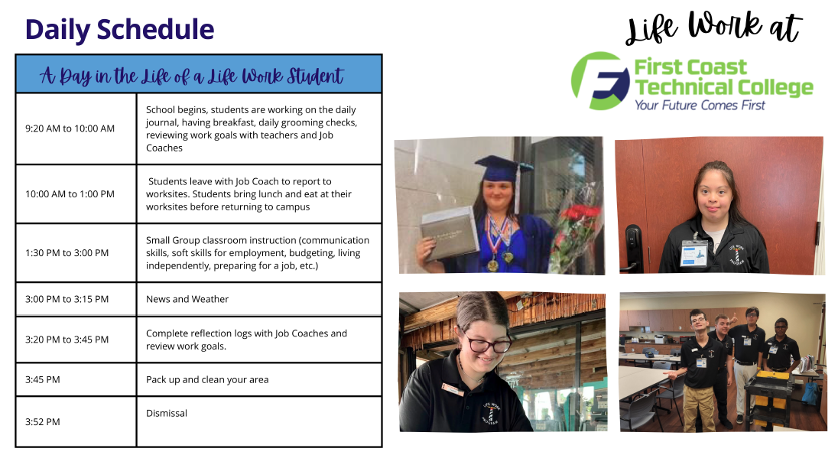

Slide 61
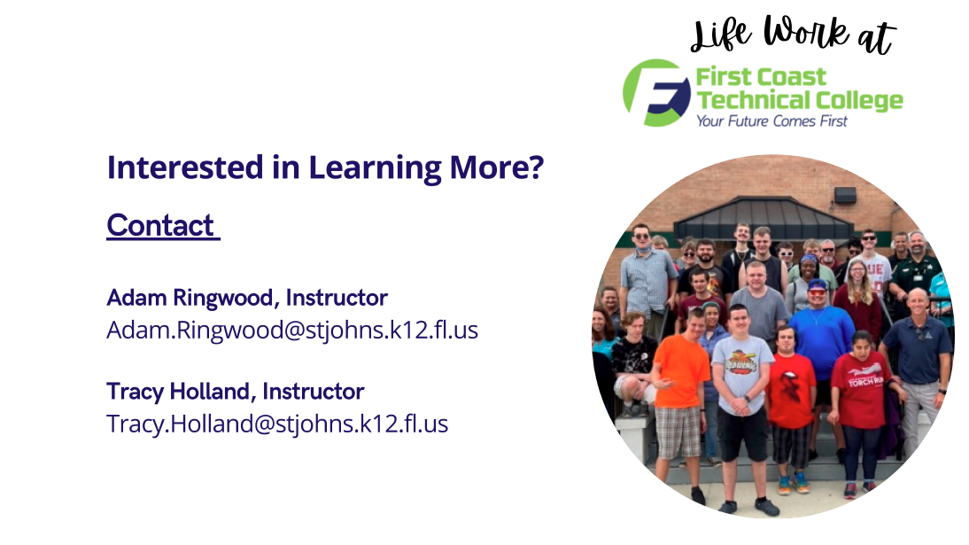

Slide 62


Slide 63


Slide 64
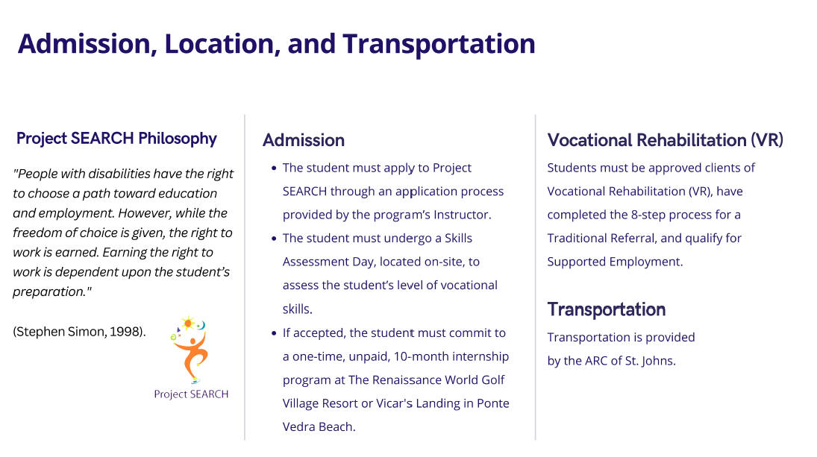

Slide 65
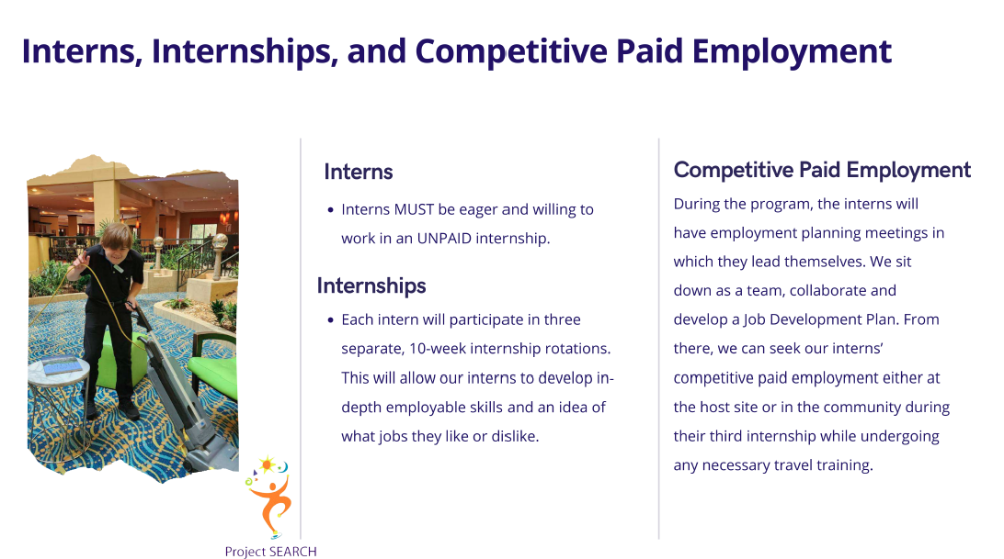

Slide 66
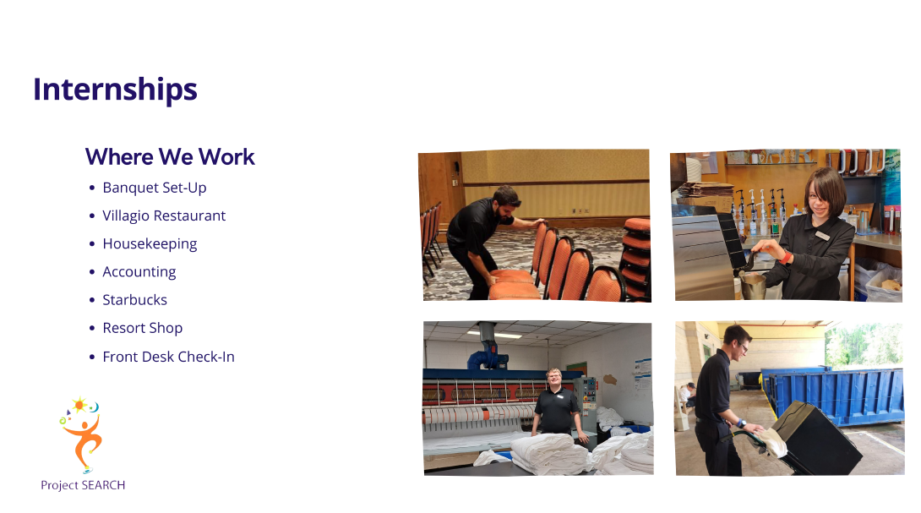

Slide 67


Slide 68


Slide 69


Slide 70


Slide 71

Jillian Patterson- Recruiter

Slide 72

Dual & Secondary Enrollment
Experience hands-on training
Head start to receiving industry
certifications or licensures
Savings on education
Exploration of high skill, high wage jobs

Slide 73


Dual Enrollment Programs
Health Services
  Dental Assisting
  Medical Assisting
Industrial Programs
  Air Conditioning Technology
  Welding Technology
  Automotive Service Technology
  Diesel Technology
  Culinary Arts
  Landscape & Turf Management
  Nursery Management

Slide 74

Elective Programs
  Cosmetology
  Facials Specialty
  Nails Specialty
  Culinary Arts
  Early Childhood Education
  Horticulture

Slide 75

FCTC Student Expectations
Self Motivated
Adapt successfully to a college environment; independent learning
Accountable for their attendance
Self Advocate
Life Work can assist with these skills through consultative services.

Slide 76

FCTC Application
Deadlines
Summer/Fall 2023 - March 10, 2023
Items to remember
Please indicate you are a Life Work student at the top of your application.
Transportation – most students self transport to campus; Life Work students attending classes at FCTC can utilize transportation at the same hours of the high schools.
In person format
Schedule availability – please list on application and consider your transportation needs; FCTC schedule 8 AM to 3 PM; Life Work schedule 9:20 AM to 3:55 PM.

Slide 77


Simple Steps for Students
Meet with HS Counselor and IEP case manager to indicate interest
Submit completed application by deadline
Dual students - watch for an email from FCTC regarding assessment requirements and scheduling
Elective students- watch for your school schedule or communicate with your counselor/IEP case manager.
You will find out in August if you are accepted and taking classes at FCTC.

Slide 78

Dual Enrollment Assessment
Dual programs 450 hours or more require valid CASAS (Math & Reading) scores before enrollment
Visit https://fctc.edu/assessment/
to learn more about each assessment
* Please include a copy of your IEP paperwork with the application.

Slide 79


Slide 80


Course
Progression
to Certifications
And Licensure

Slide 81
Questions?
Dual Enrollment
Tera Upshaw (904) 547-3356
Tera.Upshaw@FCTC.edu
Elective Enrollment
Wakilah Augustus (904) 547-3378
Studentadvising@FCTC.edu

Slide 82

FCTC.edu

Slide 83
Welcome to the Youth & Young Adult Empowerment, Leadership, and Learning (YELL) Lab!
Dr. Jessica Kramer
Elizabeth Kennelly-Smith
Notes:
Hello thank you all so much for joining us today and sharing your Saturday with us we really appreciate The St. John’s County PAC for hosting us and for letting us have this brief time to meet with you. Today we're going to talk about the research that we do to make sure young adults have the tools to support work readiness and prepare for adulthood. This Webinar will introduce families and transition aged youth to research, best practices for the inclusion in research of young people with disabilities, and several research opportunities. Please feel free to drop any questions in the chat or stop me at any point. I might not address them right away but I’ll defiantly get to them!

Slide 84

The YELL Lab develops and evaluates tools and interventions that empower youth and young adults with developmental disabilities.
The YELL Lab partners with and employs youth and young adults with disabilities in development and evaluation to ensure our ideas meet the needs of people with disabilities.
Notes:
Under the direction of Dr. Jessica Kramer, PhD, OTR/L, the YELL Lab develops and evaluates tools and interventions that empower youth and young adults with intellectual and developmental disabilities. The mission of the YELL Lab is to provide a stimulating and encouraging environment that enables the production of high-quality research to support best practices and enhance the lives of children, youth, and adults with disabilities. The YELL Lab partners with and employs youth and young adults with disabilities in the development and evaluation of research to ensure our ideas meet the needs of people with disabilities.

Slide 85

What is research?
“Research is when, out of your curiosity, you find out about something or get information about it.
[Research is used] for your knowledge or other needs.”
Max Barrows,
Outreach Director,
Green Mountain Self- Advocates
Notes:
What is research?
Max Barrows, from Green Mountain Self-Adovactes puts it pretty nicely, “research is when, out of your curiosity, you find out about something or get information about it. Research is used for your knowledge or other needs.”

Slide 86


Your rights in research
You
and your family have the right to say YES or NO to being in a study!
YES
NO
Notes:
It’s important to remember that you have rights when you are thinking about being part of a research study. You have the right to say yes or no, and you should always be asked

Slide 87


Informed Consent
Informed consent provides information about a study.
Informed consent is not just a paper that you sign.
Informed consent is steps that researchers must take to make sure you understand a study.
Notes:
Part of this decision is informed consent. This is a process that you would complete with a researcher, like us. It’s a meeting where you, your student, and the research talk about the study- how long it takes, what risks there are, if any, and how the information will be used. Sometimes people think this is just more paperwork, or it takes too long, but this is an important part of making sure your rights are protected, and you make an informed choice about doing a research study. Any research study in the YELL Lab includes this process, including a teach back where you and your student answer questions about this study

Slide 88
Research at the YELL Lab
Notes:
Dr. Kramer’s research draws upon theoretical concepts and methodologies from occupational therapy, disability studies, education and rehabilitation to:
Partner with youth with intellectual and developmental disabilities (I/DD) in the development and evaluation of rehabilitation products;
Develop community-based interventions that equip youth with I/DD and their families with the skills to identify and resolve environmental barriers to participation; and
Design high quality patient reported outcome measures (PROMs) using contemporary measurement approaches.

Slide 89


What is the PEDI-PRO?
Fosters self-determination through the self-evaluation of abilities
  Support young adults to set their own goals for transition
Accessible for youth who need support for: receptive and expressive language, abstract thinking, visual-perceptual
Designed by and for youth and young adults with disabilities
Notes:
An accessible app designed to be used by transition age youth and young adults with intellectual/developmental disabilities.
Fosters self-determination by giving youth the opportunity to self-evaluate their abilities and identify potential areas of need or skill development.
IT is designed by and for youth with disabilities- 9 young adults with diverse abilities and backgrounds have helped designed the PEDI-PRO from the ground up, along with focus groups and feedback from over 150 additional youth and young adults with developmental disabilities.

Slide 90

What does the PEDI-PRO measure?
Measures ability to complete functional tasks while engaging in familiar everyday life situations important for transition to adulthood.
Notes:
So what does the pedi-pro measure? It measures ability to complete functional task while engaging in familiar everyday life situations. For example, getting ready in the morning, going to a restaurant, working at a job, sports and exercise, cooking a meal, and going to the doctor. These everyday life situations are crucial aspects of transition to adulthood.
More importantly, these situations were identified by the design team and feedback from other young adults as important to them for their independence and well being

Slide 91

Studying what is important to us: Going to the doctor
Elijah Thomas, YELL Lab Team Member
Notes:
Here we can hear from Elijah Thomas who is one of our YELL Lab Team Members talk about why going to the doctor is important to him

Slide 92

Studying what is important to us: Sports & Exercise
Cyril Nonga-Mann, YELL Lab Team Member
Notes:
And Lastly, we have Cryil telling us why sports and exercise is important to him

Slide 93

How does the PEDI-PRO work?
Read aloud text
Interactive response buttons
3d images to support comprehension
Clear navigation
Notes:
Link to full video to see how PEDI-PRO works:
https://yell.ot.phhp.ufl.edu/research/pedi-pro/
So, how does the PEDI-PRO work? You can see here we have read aloud text, 3d images and a few videos to support comprehension, interactive response buttons so when you click on it, it reads aloud, and clear navigation. Again, we worked with young adults with ID to try and create a universally designed tool.
The PEDI-PRO also includes a teaching module to help youth and young adults practice using a response scale to self-evaluate.
Extensive cognitive testing indicating that youth with IDD interpret the items in the intended manner, and use response scales appropriately to describe their functional performance.
We also know that when youth and young adults use this platform to evaluate their functional skills, they give consistent responses- that is, what they say about their abilities is pretty consistent from 1 week to the next week. And that’s really valuable, because it demonstrates that young people with disabilities can be consistent in their evaluation of their abilities.

Slide 94

PEDI PRO Research Opportunity
Scan the QR or use this link: https://redcap.ctsi.ufl.edu/redcap/surveys/?s=A9JKDRTA99F8F8FX
Notes:
Self-screener link: : https://redcap.ctsi.ufl.edu/redcap/surveys/?s=A9JKDRTA99F8F8FX

Slide 95

VocFit Introduction

Slide 96

Vocational Fit Assessment Research
Free 133-item web-based assessment
For individuals with IDD
Strengths-based
Focus on employment skills
Valid and reliable
Job Matching tool
Tele-Health and Tele-Education applications
To what degree does the worker demonstrate the ability to communicate face-to-face with other people?
High ability
Some ability
Low ability

Slide 97

Just Right Challenge
A Just Right Challenge builds on a person’s strengths and interests.
How do you feel when something is too hard?
How do you feel when something is too easy?
Dennis Cleary based on the works of Jean Ayres, Occupational Therapist
Notes:
The Goal of the VocFit is to identify opportunities that fit a person just right.
Select a task that is slightly above a person’s current performance and requires him or her to stretch in order to be successful.
If the task is too complex, s/he can become frustrated.
If the task is too simple, the s/he might lose their motivation.
Your challenge is to select tasks that are just right to help the individual move to a higher level of performance.

Slide 98

”Just Right” Internship Opportunities
https://app.vocfit.com/jmr/Dea4MDjup3817oeJwGiLOL98diXNxYNr
Notes:
This is one of the reports that is generated from doing the VocFit. Its called the Vocational Fingerprint. So if you were looking at this and trying to identify an internship that might be a good fit, some things to consider are…
We have strengths, but during an internship, we want to be challenged to build NEW skills.
So during an internships, we don’t want things that are TOO hard, but we want to work on things that are a LITTLE hard, that we are still learning. That helps us learn NEW skills so we can get even better

Slide 99

“Just Right” Job Opportunities
https://app.vocfit.com/jmr/kGzywxsK3UBC85nMDId9VWoQyIm5wnE6
Notes:
When we are looking for a job, we need to be sure we can be successful and independent as possible right away! So we want to try and identify jobs that have a lot of GREEN but that we are also interested in and match our career interests and goals.

Slide 100

Goal: Explore the work-related experiences of people with intellectual disabilities and improve the Vocational Fit Assessment Tool.
Research Opportunity
Who can participate?
Adults with intellectual disabilities, ages 18-26, currently engaged in work activities A person who knows them well and has been a part of their life (e.g., teacher, parent, job coach, employer)
Interview partners will:
Provide background information on the adult with intellectual disability
Talk about what they are good at or work history
How long with it take?
Each interview will take approximately 2 hours
There will be 3 interviews: now, in 6-12 months, and again in 12-24 months
Questions will be given to participant partners ahead of time to allow more time for reading and preparation
As a thank you gift, each participant partner will receive $40 for each interview (each partner can expect to receive $120)
Notes:
Scan the QR or use this link to find out if you are a good fit for the study: https://redcap.ucdenver.edu/surveys/?s=N8HR33YJJMKDP4MD

Slide 101
Goal: Explore the work-related experiences of people with intellectual disabilities and improve the Vocational Fit Assessment Tool.
Research Opportunity
Transition-age youth with disabilities
Agree to participate in the study.
Answer questions about you and your work during a 1-2 hour interview.
Receive a $40 gift-card after each interview.
Receive a report about your job skills and job matches after the interview.
Notes:
What does the young adult have to do?
Scan the QR or use this link to find out if you are a good fit for the study: https://redcap.ucdenver.edu/surveys/?s=N8HR33YJJMKDP4MD

Slide 102
Research Opportunity
Goal: Explore the work-related experiences of people with intellectual disabilities and improve the Vocational Fit Assessment Tool.
Parent/Legal Guardian
Sign a permission form to allow their youth be in the study.
Possibly participate as a Partner Reporter during a 1-2 hour interview and answer questions about the youth/young adult’s work skills. Partner Reporters will receive a $40 gift-card after each interview.
Scan the QR or use this link to find out if you are a good fit for the study: https://redcap.ucdenver.edu/surveys/?s=N8HR33YJJMKDP4MD
Notes:
https://redcap.ucdenver.edu/surveys/?s=N8HR33YJJMKDP4MD

Slide 103
YELL Lab Contact Info
352-273-9365
yell@phhp.ufl.edu
https://yell.ot.phhp.ufl.edu/
Notes:
https://yell.ot.phhp.ufl.edu/

