Slide 1
Avery
Connecting Families to Community Resources

Slide 2
Julie

Slide 3
Saint Johns County Schools: Student Services https://www.stjohns.k12.fl.us/student/
Jan

Slide 4
Mental Health Resources
Mental Health and Wellness Portal www.stjohns.k12.fl.us/mental-health
Jan

Slide 5
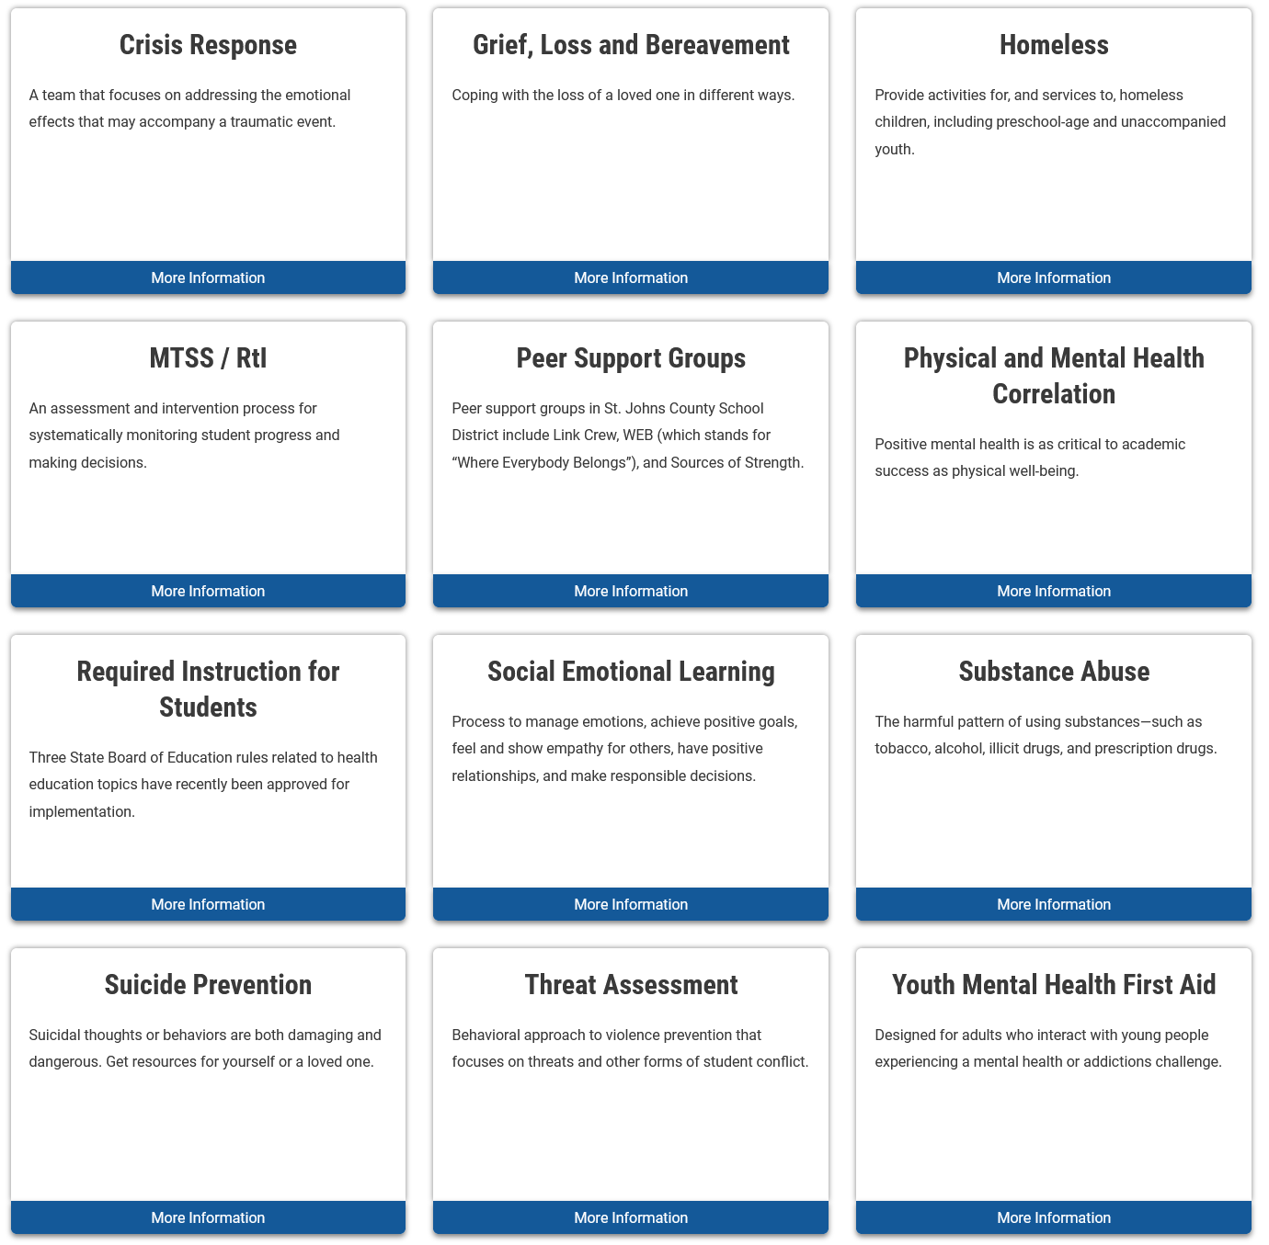
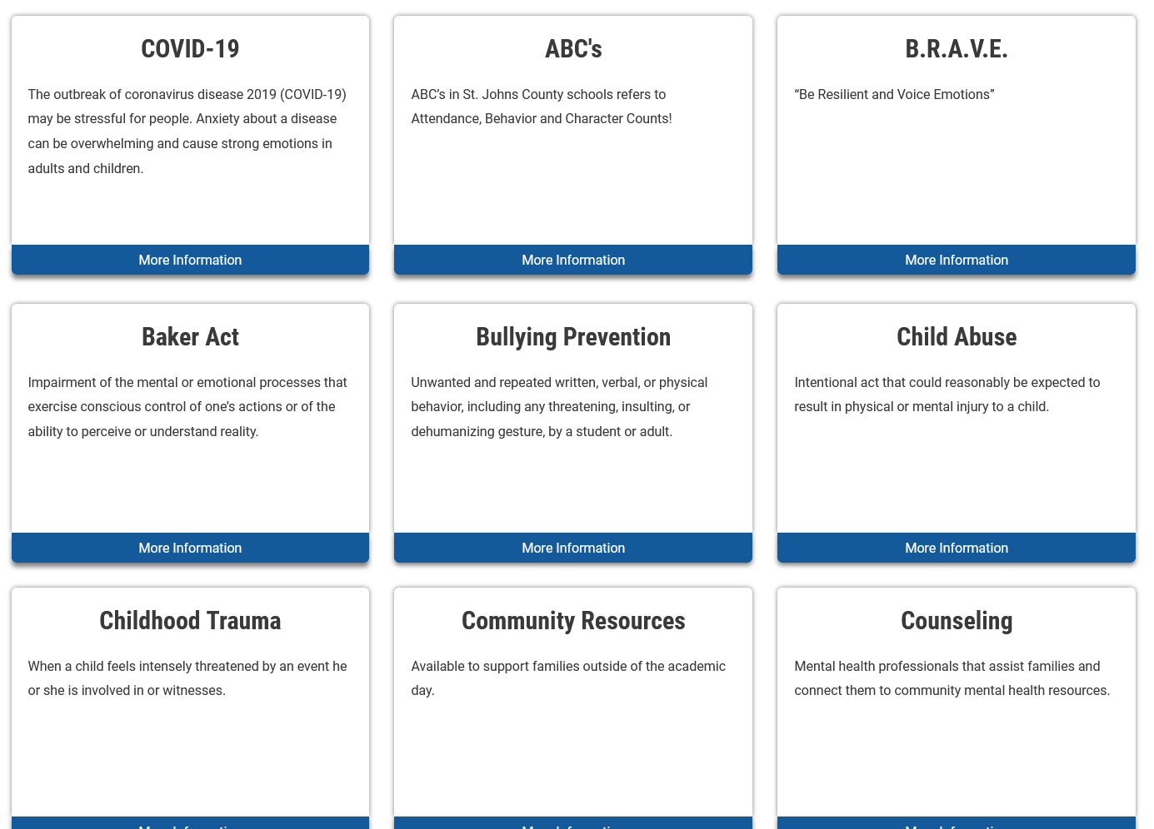
Mental Health and Wellness Portal www.stjohns.k12.fl.us/mental-health
Jan

Slide 6
Concerned About a Student?
Jan
People Who Can Help
School Counselor
School Social Worker
School Administrator
Call
Your School
Student Services – 904-547-7797
Mobile Response Team
2-1-1 or 9-1-1

Slide 7
Other Resources
Jan
Fortify FL - automatically routes your tip report to the appropriate law enforcement agencies and school officials.
- Your School Officials - The tip report goes to your local school officials when submitted.
- Local Law Enforcement - Your local police department or sheriff office receive copies of your tips automatically.
- State-Level Officials - State-level officials also have access to your tips to make sure proper steps are taken.
SJCSD Teen Parent Program – call 904-547-7797

Slide 8

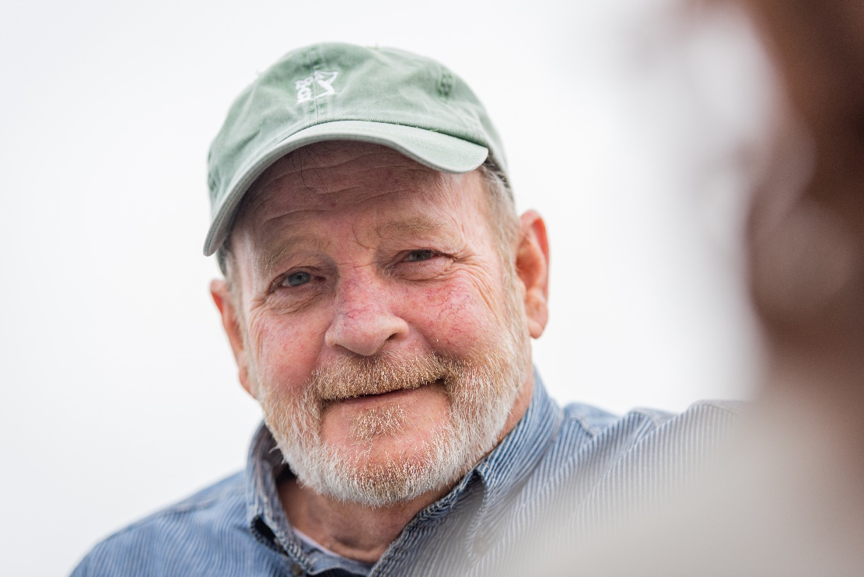
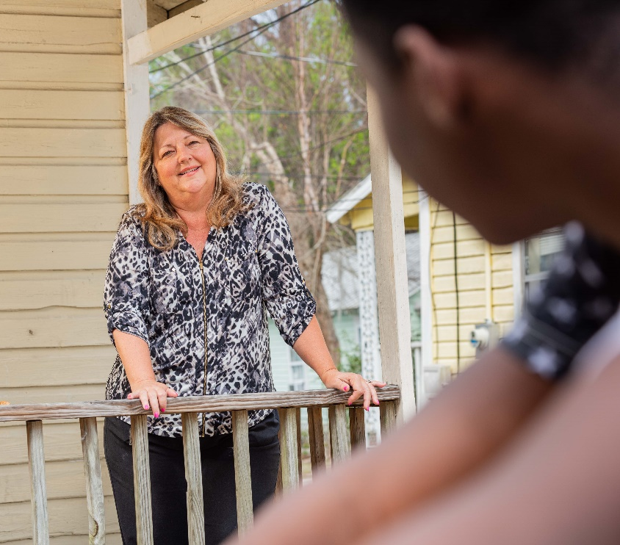
Lindsay
Transforming Community Health

Slide 9

Lindsay
About Care Connect+
Care Connect+ is an outreach program helping area residents connect with the resources they need to live a happy, healthy life. We care about connecting people to the resources they need but might not know where to turn for help.
Healthcare
Dental
Prescriptions
Past Due Rental and utility bill assistance
Transportation
Housing
Food assistance
Mental health
https://www.careconnectplus.com/
(Get Connected Form)

Slide 10
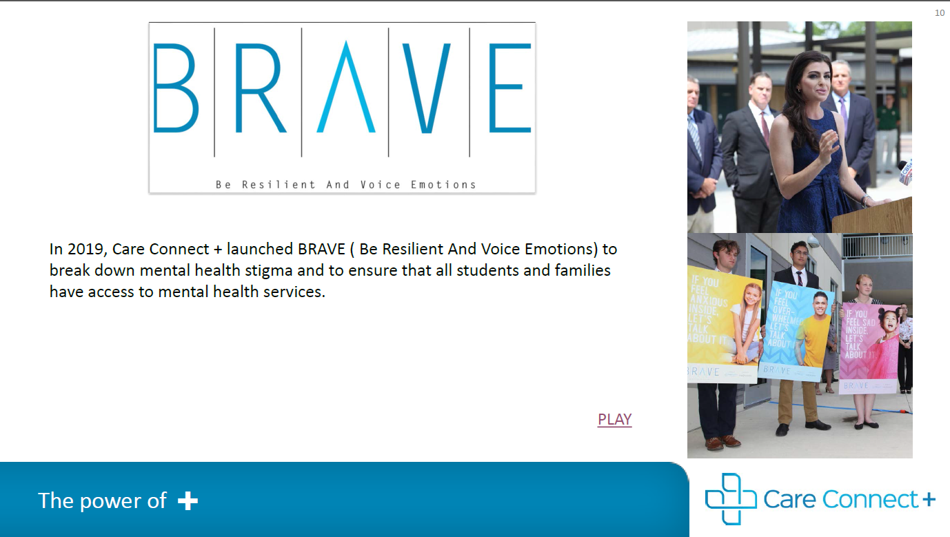
Lindsay
Ways to get Connect with BRAVE:
Speak with you School Counselor or Social Worker to discuss in school supports, which may include a BRAVE referral
BRAVE in the Community: https://www.careconnectplus.com/programs/brave/

Slide 11

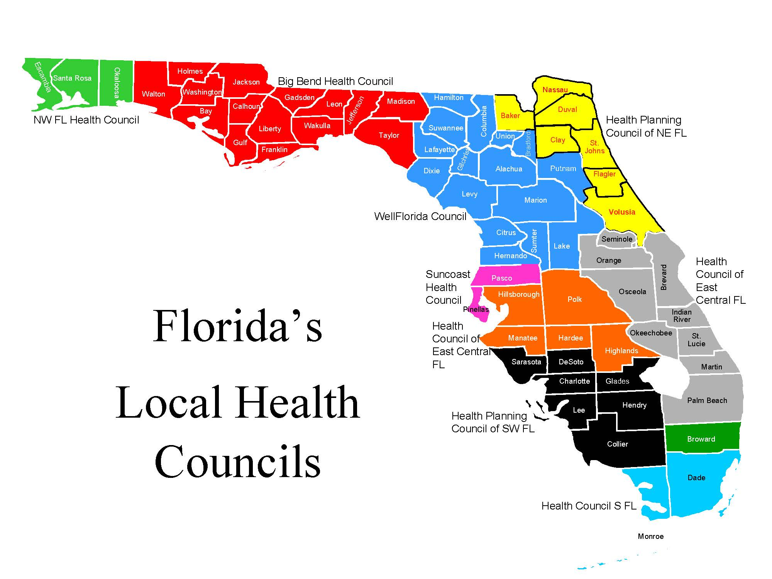
Affordable Care Act and
Medicaid Unwinding
Carey
Presenter: Cary Quinones
Program Manager
(904) 762-5774
cary_quinones@hpcnef.org
NAVIGATOR # FLNAVC1200493
FLORIDA REGISTRATION # 2123763
We service Duval, Nassau, Baker, Clay, Flagler, St Johns and Volusia counties

Slide 12
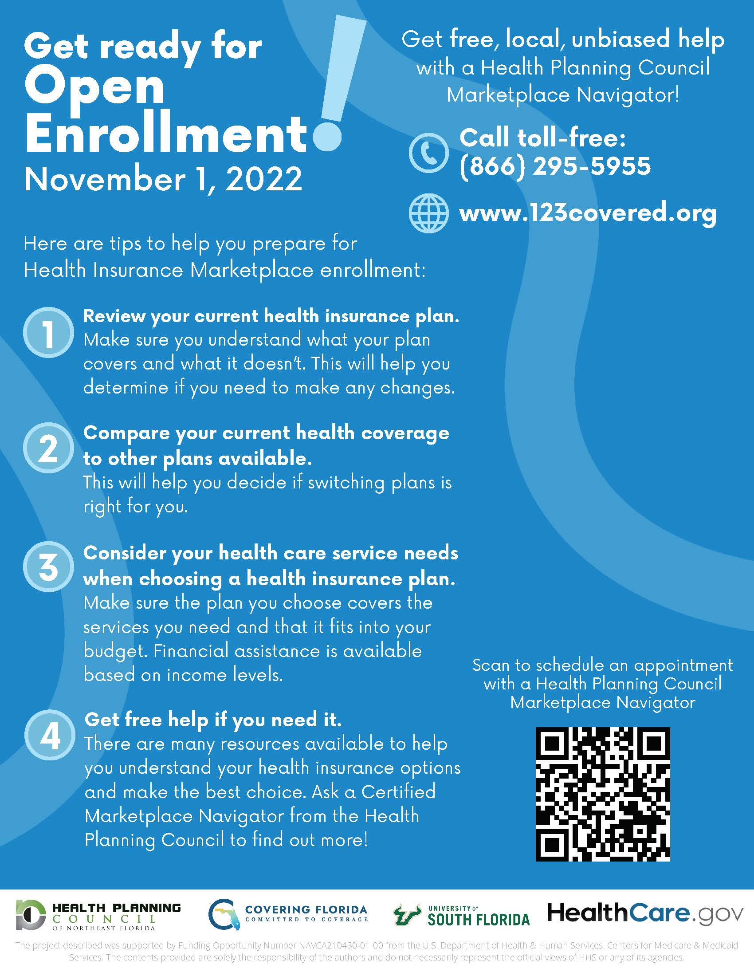
ACA Open Enrollment begins on November 1, 2022 and runs until January 15, 2023
Carey

Slide 13
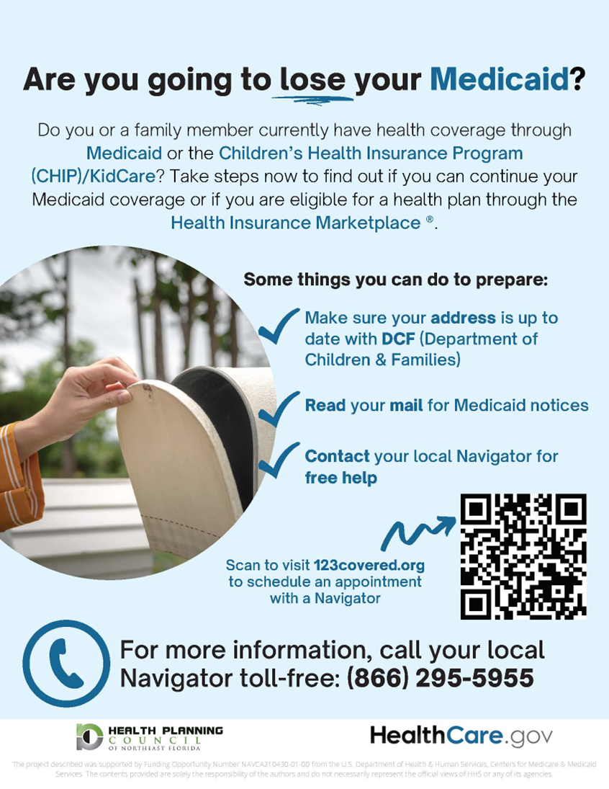
What does Medicaid
“unwinding mean?
Carey
“Unwinding” is the process by which states will resume annual Medicaid eligibility reviews after the Public Health Emergency (PHE) ends.
If enrollees do not respond, for whatever reason, their coverage will end.

Slide 14

Free Navigator Assistance:
Carey
Virtual and
Phone Appointments
(Evenings & Weekends also available)
We help in Duval, Nassau, Baker, Clay, Flagler, St Johns and Volusia counties.
Schedule an appointment Online: www.123covered.org
Call Toll Free line: 866.295.5955

Slide 15

Carey
Cary Quinones
Program Manager
Navigator Registration # FLNAVC1200493
Florida Registration # 2123763
cary_quinones@hpcnef.org
Questions?
The project was supported by Funding Opportunity Number NAVCA190357 from the U.S. Department of Health & Human Services, Centers for Medicare & Medicaid Services. The contents provided are solely the responsibility of the authors and do not necessarily represent the official views of HHS or any of its agencies.

Slide 16

United Way of St. Johns County
Kim
Mobilizing our community to tackle challenges and promote education, health, and financial stability for all generations.

Slide 17
United Way Resources
Your Students. Your Community. Your Friends and Family.
Kim
2-1-1 - 24-hour resource line for all social service needs: shelter, food, mental health, etc. Can call or search website for resources: https://unitedwaynefl.org/get-help/
Free Financial Literacy - RealSense (Tax-Prep Assistance) for families making under $73,000 annually.
SingleCare - Discounted Prescription Program (up to 80%) with no enrollment/activation fees, no age or income restrictions, can be used with or without insurance, and accepted at most pharmacies nationwide. Provides additional monthly resources for healthy living.
Partner - Uniquely collaborate with 32 local nonprofits, in addition to businesses, residents, government and faith community to address pressing needs and to wrap services around our students and families to promote childhood and youth success.
Empty Stocking Fund - Assists children, families, and seniors with funds for food, basic needs, and gifts during the holidays. How to become a recipient: https://unitedway-sjc.org/emptystocking/

Slide 18
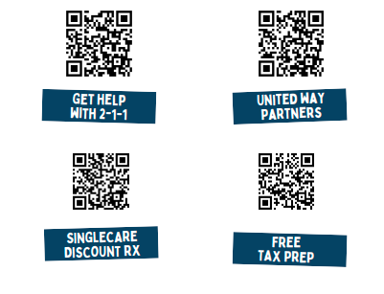
Kim

Slide 19
You Live here. You give here. It stays here.
Kim
$5 per week provides:
Safe and fun afterschool supervision for a child or teen.
2 nourishing meals per week.
10 mental health counseling sessions for an at-risk child over the course of a year.
Financial Impact to our St. Johns Community:
$639,000 – Granted to 31 partner agencies for 32 Community Impact programs
$251,100– Designated by donors to organizations, programs or needs
$73,500 – Given as holiday gifts and meals for seniors and families through the Empty Stocking Fund
$1,050,000 – Secured as matching funds and brought into our community
Actions:
Directed $107,419 of in-kind gifts
Engaged 217 volunteers,1,977 hours
Partnered to facilitate nearly $5,000 in school supply donations
Prepared 566 free tax returns
Coordinated nearly 1,200 holiday meals
Provided SingleCare information, a prescription discount program, saving residents $386,533

Slide 20
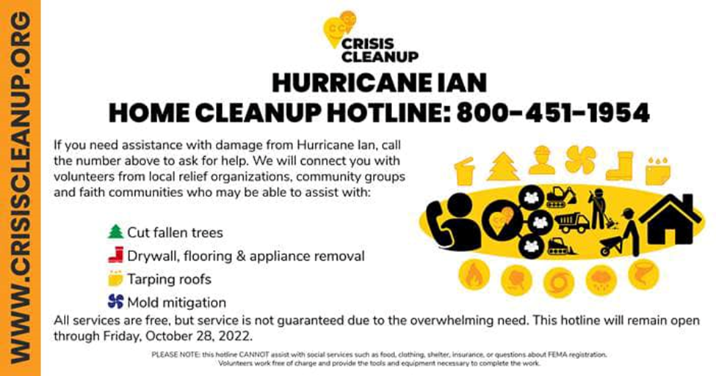
Storm resources
Kim

Slide 21
Storm resources
Kim
Emergency Management reported all utilities restored in our area by FPL and JEA. No boil water notices given.
FEMA assistance for individuals is now open for St. Johns County: https://www.disasterassistance.gov/
SBA low interest loans for businesses: https://www.sba.gov/funding-programs/disaster-assistance/hurricane-ian
Catholic Charities: Reunification Program provides bus tickets to move individuals out of impacted areas. Food assistance is open extra hours to help all week 10 a.m.-3 p.m. through their pantry
Red Cross: focused in Flagler Estates currently. Clean up Kits from Red Cross will be available at Epic Cure, call for details (904) 458-7145
Food for those without transportation: Pie in the Sky (904) 386-9939, Epic Cure https://www.facebook.com/EpicCureCharity/
Drive through distribution: Family Worship Center (904) 819-9970

Slide 22
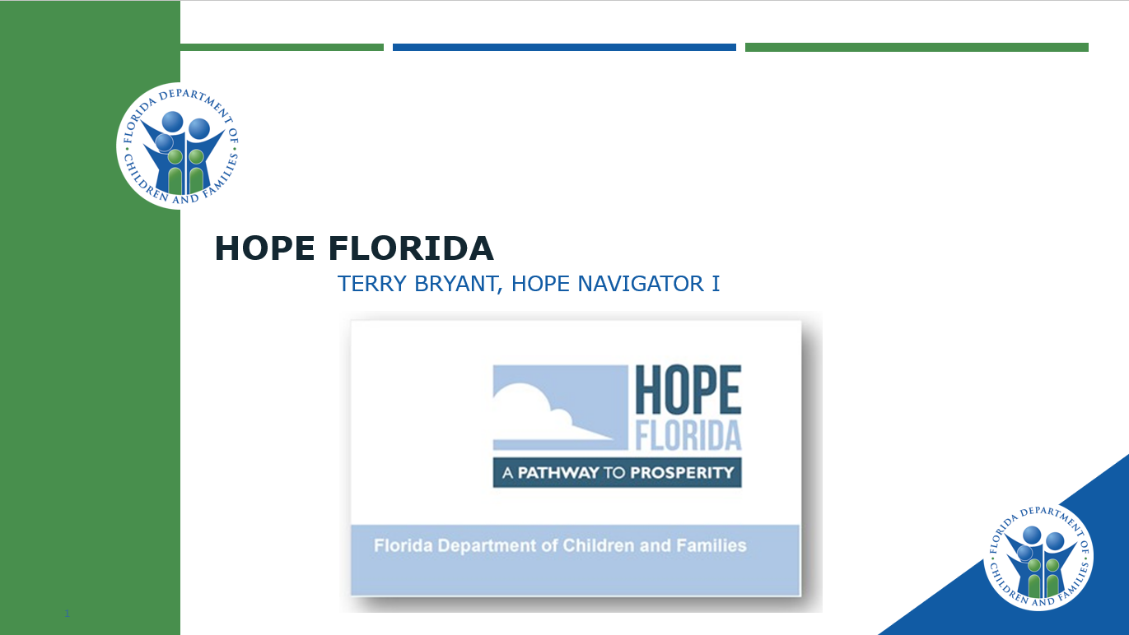
Terry

Slide 23
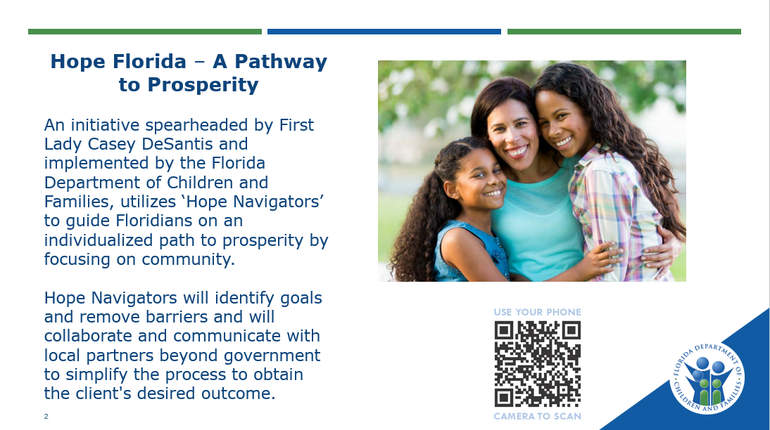
Terry

Slide 24
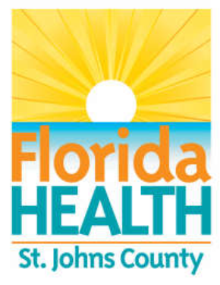
Noreen
Florida Department of Health in St. Johns County
200 San Sebastian View,
Saint Augustine, FL 32084
904-506-6081
www.StJohns.FloridaHealth.gov

Slide 25

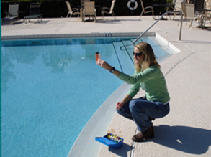
Florida Department of Health in St. Johns County
~ Your County Health Department! ~
Noreen
DOH Mission: Protect, promote, and improve the health of all people through integrated state, county, and community efforts!
Population Health Services include:
  Clinical Services of Public Health Significance
  Epidemiology, Disease Control & Health Protection
  Environmental Public Health
    Food Hygiene & School Kitchen Inspections
    Community Swimming Pools & Healthy Beaches
Notes:
We are…..
One of the sixty-seven County Health Departments that comprise the integrated Florida Department of Health!
Voluntarily accredited through the National Public Health Accreditation Board!
A team of ~60 proud Public Health Professionals working to promote, protect, and improve the health of all Floridians!
Nurses, Nutritionists, Epidemiologists Environmental Specialists, and other public health professionals.
As a public health agency, DOH-St. Johns County provides a variety of direct-care services…. But… we are in the community every day to protect and improve population health!
Did you know that we are in the Community and in Schools are year-round?
Our Epidemiology & Disease Control Team conduct public health surveillance, investigations and contact tracing for over 100+ reportable diseases and conditions!
Our Nurse works directly with the School District through their School Health Services Program!
Our Environmental Specialists conduct sanitary inspections in all the School Districts beautiful facilities and kitchens!
And for after school adventures Our Environmental Health Team also complete inspections of Community Swimming Pools as well as testing and monitoring of Beach Water at various locations!

Slide 26
Public Health Nutrition
Noreen
Women, Infants, and Children (WIC) Program
Nutrition Education and Counseling
Fresh Foods & Farmer’s Market
Breastfeeding Promotion and Support
Referrals to Health Care, Social Services, etc.
www.FloridaWIC.org
Notes:
WIC is the Special Supplemental Nutrition Program for Women, Infants, and Children. The program provides eligible participants a combination of supplemental nutritious foods, nutrition education, breastfeeding promotion and support, and referrals to health care and other social services. In Florida, over 400,000 participants are served by WIC each month! Source: wic-facts.pdf (floridahealth.gov)
Who is eligible for WIC services? To be eligible for WIC, the person must: • be a pregnant or breastfeeding woman, a woman who has recently been pregnant, an infant, or a child under 5 years of age; • currently live in Florida but does not need to be a U.S. citizen; • have a nutrition risk that is determined by WIC staff; and • be income eligible.
WIC provides supplemental foods designed to address the nutritional needs of WIC participants. WIC provides nutrition education Nutrition education is available to all adult WIC participants and, whenever possible, to child participants and other family members. The goals of nutrition education are: to achieve a positive change in the food consumption habits related to the participant’s nutrition risk; to teach the relationship between proper nutrition and good health; to promote the optimal use of WIC supplemental foods and other nutritious foods; and to provide nutrition education within the context of the ethnic and cultural preferences of the participant.
WIC promotes and supports breastfeeding The WIC program recognizes that breastfeeding is the normal way to feed and nurture infants. Breastfeeding promotion and support is an integral part of the WIC program. WIC is striving to increase the number of infants who are breastfed and the length of time an infant is breastfed. WIC agencies have breastfeeding peer counselor programs which provide mother-to-mother support. WIC agencies also provide breastfeeding aids such as breast pumps.
WIC participants receive their wic food benefits by using Electronic Benefits Transfer (EBT) cards at local grocery stores WIC clients receive their WIC food benefits by using a WIC EBT card at local grocery stores.
WIC Farmers’ Market Nutrition Program – DOH-St. Johns County is one of the 15 CHDs in the entire state that offers this program where WIC Participants are provided checks for fresh fruit and vegetable in addition to the food these participants receive with their WIC EBT card. The Farmers’ Market fruit and vegetable checks are used to buy fresh, locally grown fruits and vegetables at authorized farmers’ markets. The goal of this program promotes consumption of fresh fruits and vegetables among families served by WIC and also stimulates sales of the produce offered by local independent farmers.
Research proves that WIC makes a difference Numerous studies have shown that pregnancy outcome, particularly birth weight, is improved for program participants. National evaluations of the WIC program have documented that WIC encourages earlier prenatal care for women and regular medical care for children; improves the dietary intake of pregnant women and children; reduces the incidence of low-birth-weight babies; reduces infant mortality; reduces the incidence of anemia in children; and improves access health care services!
For more information call us at 904-506-6081 to speak with WIC Staff – or visit the Statewide Website: www.FloridaWIC.org

Slide 27
Vital Statistics
Noreen
When occurring in Florida, your local County Health Department can assist you with:
  www.FloridaHealth.gov/Certificates
  Birth Certificates
  Death Certificates
Community Health Statistics
In need of data, reports, or statistics on community health, diseases, or other related topics?
  www.FLHealthCHARTS.gov
Notes:
Birth and Death Certificates are known as Vital Records.
CHARTS stands for Community Health Assessment Resource Tool Set. CHARTS is a single source for health and health‐related data that comes from many different programs and agencies in Florida. FL CHARTS was developed to help counties and communities get the data they need to develop community health plans and issues. The vision is to deliver Community focused Health statistics that are Available to everyone, and which are Relevant, Timely and Statistically sound. There are over 3,500 indicators available through this DOH website – including: Hospitalizations, births, deaths, population behavioral risk factors, health care providers, reportable diseases and more –! CHARTS saves you the trouble of going to many separate web sites to find data and the website offers data tables, charts, graphs, and more.
This is a great tool for any business, healthcare provider, parent, and student in need of Community Health-related data and reports!

Slide 28
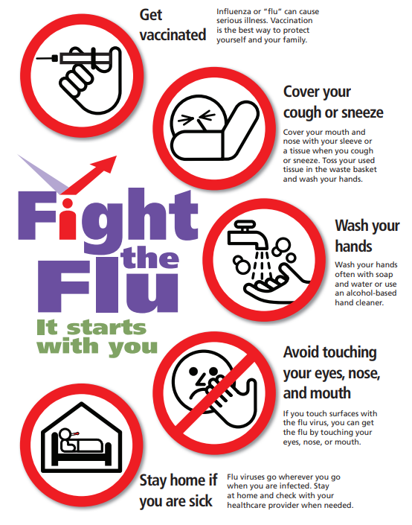

Noreen
Noreen
Vaccine for Children Program
Vaccine for Infants, Children, up to 19 years of age at NO COST to those that qualify.
  Have no health insurance – or
  Have health insurance that does NOT cover immunizations.
CALL US:
  904-506-6081
Website:
  StJohns.FloridaHealth.gov
Notes:
Did You Know Your Child Can Get Free Vaccines? Vaccines for Children Can Help. DOH-St. Johns County is a provider for the federally-funded “Vaccines for Children” (VFC) program which provides free vaccines to children who qualify.
The vaccines available through the VFC are determined by the national Advisory Committee on Immunization Practices (ACIP) for diseases that are preventable by recommended childhood vaccines which includes the following: Diphtheria; Haemophilus influenzae type b (Hib); Hepatitis A; Hepatitis B; Human Papillomavirus (HPV); Influenza (flu); Measles; Meningococcal; Mumps: Pertussis (whooping cough); Pneumococcal; Polio; Rotavirus; Rubella (German Measles); Tetanus (lockjaw); Varicella (chickenpox)

Slide 29
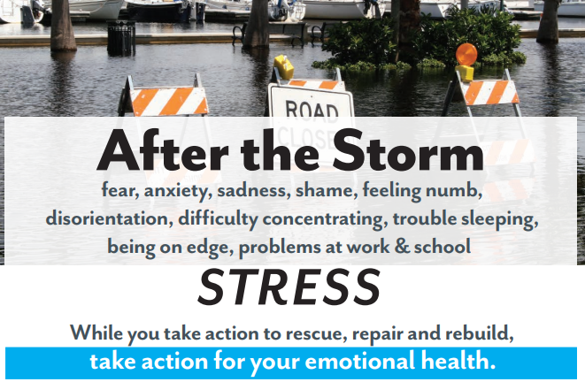
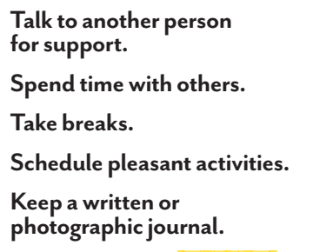
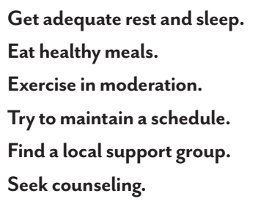
Noreen
LEARN MORE
Disaster Distress Hotline:
1-800-985-5990
cdc.gov/disasters/
ptsd.va.gov
samhsa.gov

Slide 30
Julie
The Multiagency Network for
Students with Emotional/Behavioral
Disabilities (SEDNET)
Julie Barrow
SEDNET Region 12
Volusia, Flagler, Putnam and St Johns
jbbarrow@volusia.k12.fl.us
SEDNET Project Information
www.sednetfl.info
Notes:
My name is Julie Barrow, Thank you for being here today. SEDNET stands for The Multiagency Network for Students with Emotional/Behavioral Disabilities. I am here today to provide you with some information on community resources.

Slide 31
SEDNET
Julie
SEDNET is a regional network of the major child-serving agencies, community-based service providers, and students and their families, focused on developing interagency collaboration and sustaining partnerships:
    Education
    Mental Health
    Substance Abuse
    Juvenile Justice
    Child Welfare
    Families and Youth
Notes:
SEDNET is a regional network of the major child serving agencies, community-based service providers, and students and their families, focused on developing interagency collaboration and sustaining partnerships in Education, Mental Health, Substance Abuse, Juvenile Justice, Child Welfare, and Families and Youth.
Approved Chelsea Strickland 9/8/22

Slide 32
Julie
Families, schools and community partners supporting students with complex Emotional and Behavioral needs can reach out to your SEDNET Manager to help you navigate the system of care.
Julie Barrow
SEDNET
Region 12
jbbarrow@volusia.k12.fl.us

Slide 33
Julie
Insurance Plan Information to assist in seeking Behavioral Health Supports
Parent/Caregiver can apply for: Medicaid or Healthy Kids Contact Lutheran Services FL ACCESS to Care Line 1-877-229-9098 To Switch Plans – Choice Counseling Main Line 1-877-711-3662 (Private Insurance contact your Insurance and ask for Behavioral Health Providers) |  | Please be advised that phone numbers are subject to change. Please visit the MMA Plan’s member handbook
MEDICAID & HEALTHY KIDS PLANS | Behavioral Health Coordination | Transportation
Florida Community Care | 1-833-FCC-PLAN | 1-833- FCC-PLAN
Humana Medical Plan | 1-888-778-4651 | LogistiCare 1-866-779-0565
Staywell - Wellcare | 1-855-606-3622 | Logisiticare/ModivCare 1-877-659-8412
Children’s Medical Services-Wellcare | 1-888-491-5252 | 1-844-399-9469
Sunshine Health | 1-866-796-0530 | LogistiCare 1-877-659-8420
Sunshine Health - Child Welfare Plan | 1-855-463-4100 | LogistiCare Reservations: 1-877-659-8420
UnitedHealthcare | 1-800-791-9233 | LogistiCare 1-866-372-9891
Prestige | 1-855-355-9800 | 1-855-355-9800
Aetna – Healthy Kids | 1-844-513-4954 | Non-ER Not Covered 1-844-528-5815
Magellan Complete Care | 1-800-327-8613 | LogistiCare 1-877-796-5843
Simply Healthcare Plan – Healthy Kids | 1-855-861-2142 | Non-ER Not Covered 1-844-405-4298
ELC of Flagler/Volusia 386-323-2400 Option 2 | ELC of North Florida (St Johns) 904-770-2565
ELC of the North Florida (Putnam) 386-385-3450
Early Childhood Supports:
Early Childhood of North Florida (St Johns) : 904-770-2565 Early Steps Contacts: N. Florida (St Johns) 904-360-7022 x 7261 Healthy Start Home Visiting Referrals (0-3 yr.): 904-616-6097

Slide 34
Julie
Additional St. Johns District Resources
Project 10 Transition Education Network: Transition Education Network is Florida’s statewide discretionary project supporting the secondary transition of youth with disabilities.
Center for Autism and Related Disorders (CARD): Provides information and referral services, advocacy, independent living skills training, peer counseling and support for persons with significant disabilities who seek independence and self-reliance.
Family Network on Disabilities: Network of individuals who may be at-risk, have disabilities, or have special needs and their families, professionals and concerned citizens; programs include Parents of the Panhandle Information Network (POPIN); Parent Education Network (PEN); Transition, Independent Living, Employment & Support (TILES); Florida Parent Information and Resource Center (PIRC); and Parents Educating Parents in the Community (PEP).
Florida Alliance for Assistive Services and Technology (F.A.A.S.T.): Provides advocacy and awareness activities that increase access to and acquisition of assistive services and technology including a loan program to try out assistive technology (AT), assistance with purchasing AT, an emergency AT fund and information on affordable housing.
Florida School for the Deaf and Blind : The Florida School for the Deaf and the Blind is the state's public school for eligible students, pre-school through 12th grade, who are deaf/hard of hearing and blind/low-vision. There is no cost to families for tuition for eligible Florida residents.
Florida Diagnostic and Learning Resources System (FLDRS) – NEFEC : Provides diagnostic and instructional support services to district exceptional student education programs and families of students with exceptionalities statewide
Center for Independent Living of Jacksonville: Provides information and referral services, advocacy, independent living skills training, peer counseling and support for persons with significant disabilities who seek independence and self-reliance.
Special Olympics - St. Johns: Provides year-round sports training and competition in a variety of Olympics-type sports for people with intellectual disabilities
St. Johns County Council on Aging, Inc.: For Mobility Resources and the Sunshine Bus. St. Johns County Council on Aging, Inc. is part of Transportation Disadvantaged, a coordinated statewide effort to provide a shared ride service to medical, life-sustaining, employment and educational locations for those who cannot obtain their own transportation due to a disability, age or income

Slide 35
Julie
Disaster Services: Both St Johns County residents and businesses may be eligible to receive this federal assistance through FEMA, but you should begin the application process today.
Disaster assistance may include financial help with temporary lodging and home repairs, as well as other disaster-related expenses. Money is limited to claims for actual losses sustained during Hurricane Ian that were either uninsured or underinsured.
Residents and businesses should first notify their insurance agents of any damages sustained to their property. You do not have to wait to find out if federal assistance will be available before beginning your clean-up. You will be expected to keep repair receipts and document any damages.
Most insurers in Florida require the insured to mitigate any loss and to stop further property damages whenever possible. FEMA cannot duplicate benefits for Disaster assistance applications can be submitted online at www.disasterassistance.gov or by using the FEMA mobile app.
You can call 800.621.3362 between 7:00 a.m. and 11:00 p.m. Eastern Time to speak to a FEMA representative. If you use a video relay service, captioned telephone service, or others, give FEMA the number for that service.
Notes:
SEDNET is one of many special projects and programs supporting St. Johns Counties and not everyone could join us today for this presentation, so please find attached links to other programs that help connect families to resources and supports.

Slide 36
Julie
The following information is required when applying for assistance:
A current phone number where you can be contacted
Your address at the time of the disaster and the address where you are now staying
Your Social Security number
A general list of damage and losses
Banking information if you choose direct deposit
If insured, the policy number and the name of the company or agent
The St Johns County Chamber of Commerce and Small Business Development Center can provide additional information and resources on the Small Business Administration loan application process. For updates, visit www.sjcchamber.com
For updates on Hurricane Ian recovery efforts in St Johns County, visit www.sjcfl.us/hurricane or call the St Johns County Emergency Management Citizen Information Line at 904.824.5550.
https://historiccity.com/2022/staugustine/news/financial-assistance-available-to-st-johns-county-residents-affected-by-hurricane-ian-138068
Notes:
SEDNET is one of many special projects and programs supporting St. Johns Counties and not everyone could join us today for this presentation, so please find attached links to other programs that help connect families to resources and supports.

Slide 37
Avery
Question and Answer Opportunity

Slide 38


Laura
Our Vision
Peace at home…then in the world.
Our Mission
To help survivors of domestic and sexual violence navigate through their life-changing traumas to live fulfilling lives on their terms.
Our Values
Protect
Educate
Advocate
Collaborate
Empower

Slide 39
Betty griffin center’s Programs & Services:
Laura
24-HOUR HELPLINE 904.824.1555
Advocates are available 24/7 to talk with domestic and/or sexual abuse survivors, their families and friends.
SAFE, SECURE SHELTER
Our confidential shelter is available 24 hours a day for domestic and sexual abuse survivors and their children to provide safe and supportive services.
SEXUAL ASSAULT RECOVERY SERVICES
Whether you are reporting to law enforcement or not, we provide confidential counseling, advocacy and forensic medical exams.
RAPE CARE UNIT
Provides the immediate medical and forensic needs of rape victims including privacy and professional care.

Slide 40
Betty griffin center’s Programs & Services:
Laura
CONFIDENTIAL COUNSELING
Licensed therapists provide free, empowerment-based, trauma-informed counseling services to survivors of domestic and sexual abuse and their families
PEACE CLUB
Teaches children ages 3-17 to identify abuse, build self-esteem, resolve conflicts peacefully, develop and use a safety plan if necessary and to break the silence about violence at home.
TRANSITIONAL HOUSING
Empowerment-based, safe and secure living environment that is for domestic and sexual abuse survivors and their children who need
continued support after their emergency shelter stay.
SUPPORT GROUPS
Strength-based support groups provide a confidential safe place to share experiences and find strategies for coping.

Slide 41
Betty griffin center’s Programs & Services:
Laura
COURT ADVOCACY
Staff and volunteers are available to assist with applying for an Injunction for Protection, court appearance, personal advocacy, domestic violence and sexual assault advocacy and referrals.
COMMUNITY/ PROFESSIONAL EDUCATION
We offer professional trainings in the community and schools on prevention and the dynamics of domestic and sexual abuse.
LEGAL ASSISTANCE
Referrals to a Betty Griffin Center attorney are made on a case-by-case basis for legal representation through the injunction process.
THRIFT STORES
By shopping at and/or donating to the thrift stores, you directly support the program and services while providing survivors the opportunity to shop, using gift certificates for the items needed to rebuild their lives.

Slide 42


If you or someone you know has been abused, please call Betty Griffin Center’s 24-Hour Crisis Helpline.
Laura
904-824-1555
Outreach Administrative Office Social Media
2450 Old Moultrie Rd, Suite 202
St. Augustine, FL 32086
904.808.8544
Thrift Shoppees:
Anastasia Square Julington Square Website: www.BettyGriffinCenter.org
1961 A1A South 445 SR 13
St. Augustine, FL 32080 Fruit Cove, FL 32259
Furniture Pick up, please call 904.495.8216 THANK YOU !

Slide 43



Melissa
We Are Defenders of Potential!

Slide 44


Melissa
VISION
All youth achieve their full potential.
MISSION
Create and support one-to-one mentoring relationships that ignite the power and promise of youth.
OUR PROGRAMS
Site Based – Matches meet for up to 1 hour per week at the child’s school or after school program.
Community Based – Matches meet 2-3 times per month out in the community.
Your child’s safety is important to us! All volunteers
go through an interview and background
screening which includes FBI fingerprinting.
Notes:
What exactly is it that we do?
We unite young people with caring, positive adult role models in professionally supported one-to-one mentoring relationships.
It is our vision that all young people would achieve their full potential and our mission to use mentoring to ignite the power and promise of youth.

Slide 45

Melissa
Our littles
We enroll youth ages 6-12 years old
Reside in St. Johns County
Have need for additional support of a caring adult
Notes:
Being a Big is not a difficult task- and I’m sure many of you are over-qualified.
We don’t ask our mentors to be social workers, therapists, tutors, or superheroes.
We simply ask that they be consistent and supportive friends to the children they are matched with for a minimum of one year.

Slide 46

Melissa
Positive impacts of mentoring
Increases academic performance and social competency
Prepares for post-secondary education to improve economic outcomes
Reduces absenteeism and engaging in risky behavior (i.e. alcohol and drug use)
Notes:
We have two main mentoring programs within Big Brothers Big Sisters…
Each program allows youth to explore new interests, develop positive behaviors, and expand their experience base beyond their current understanding.

Slide 47

Ready to enroll your child?
Call, visit, or click:
1400 Old Dixie Highway
St. Augustine, FL 32084
(904) 829-9986
www.bbbsstjohns.org
Thank You!
Melissa

Slide 48


Branden
Children’s Home Society of Florida
Presenter: Branden Tharp, LCSW
Licensed Clinical Program Director

Slide 49
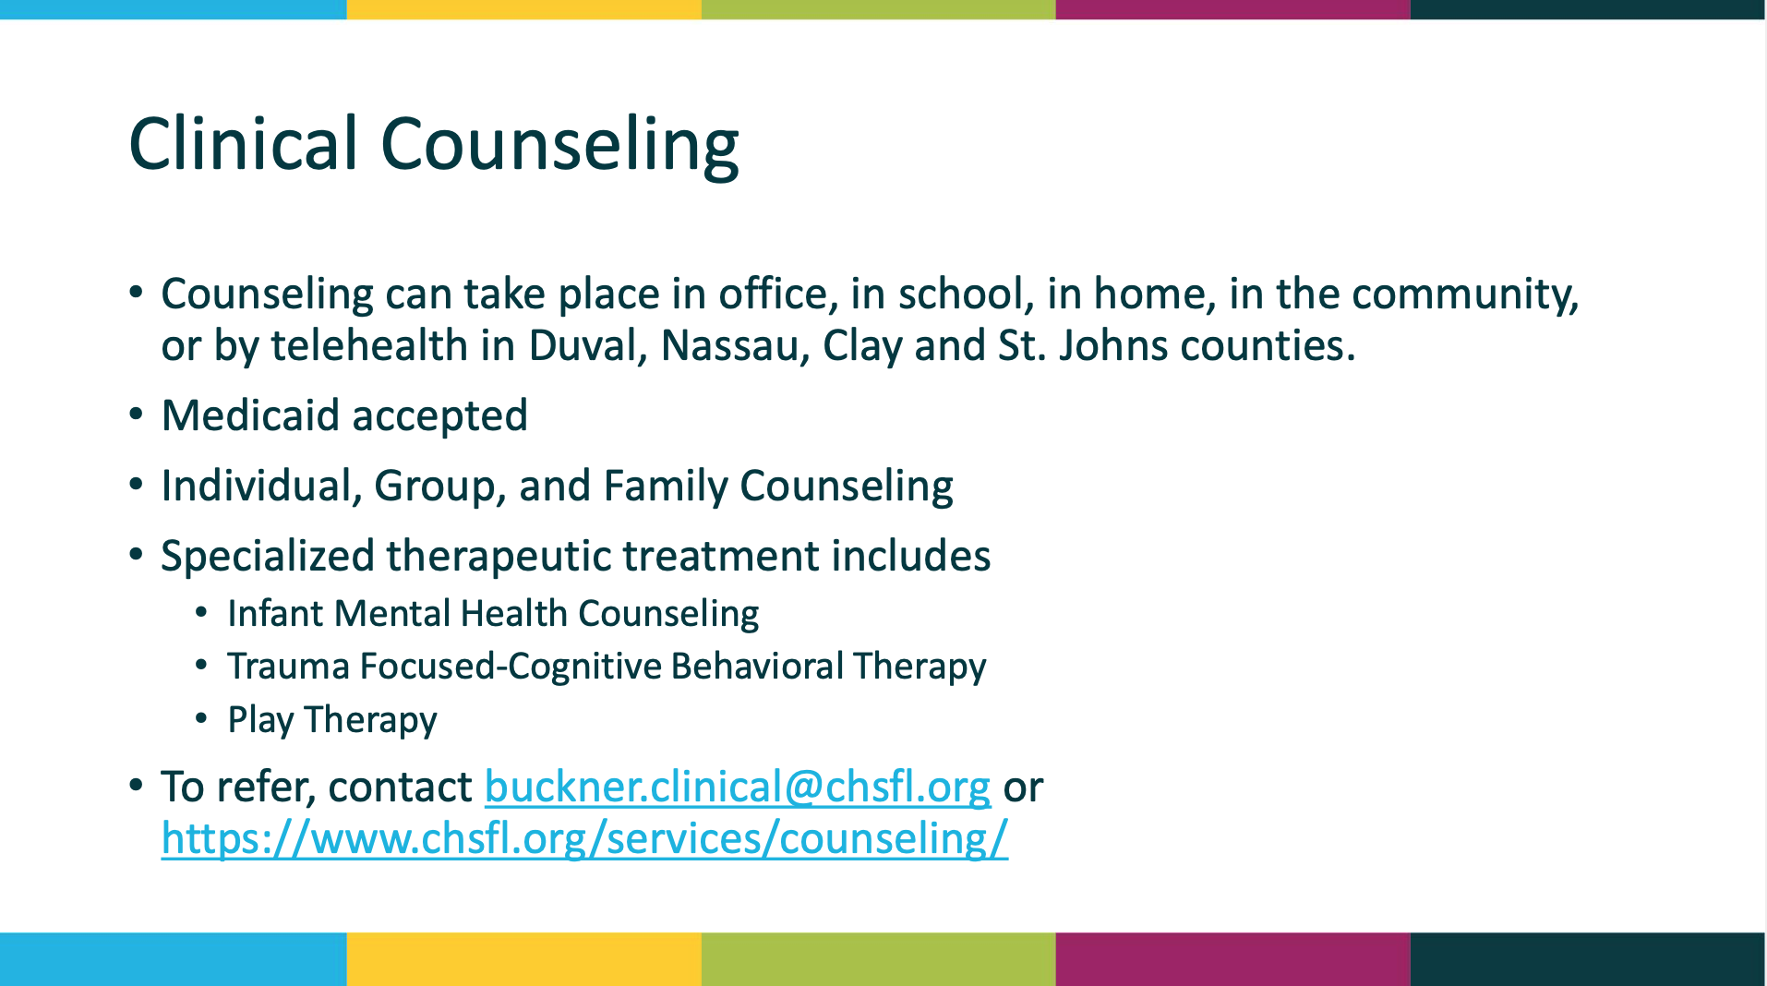
Branden

Slide 50
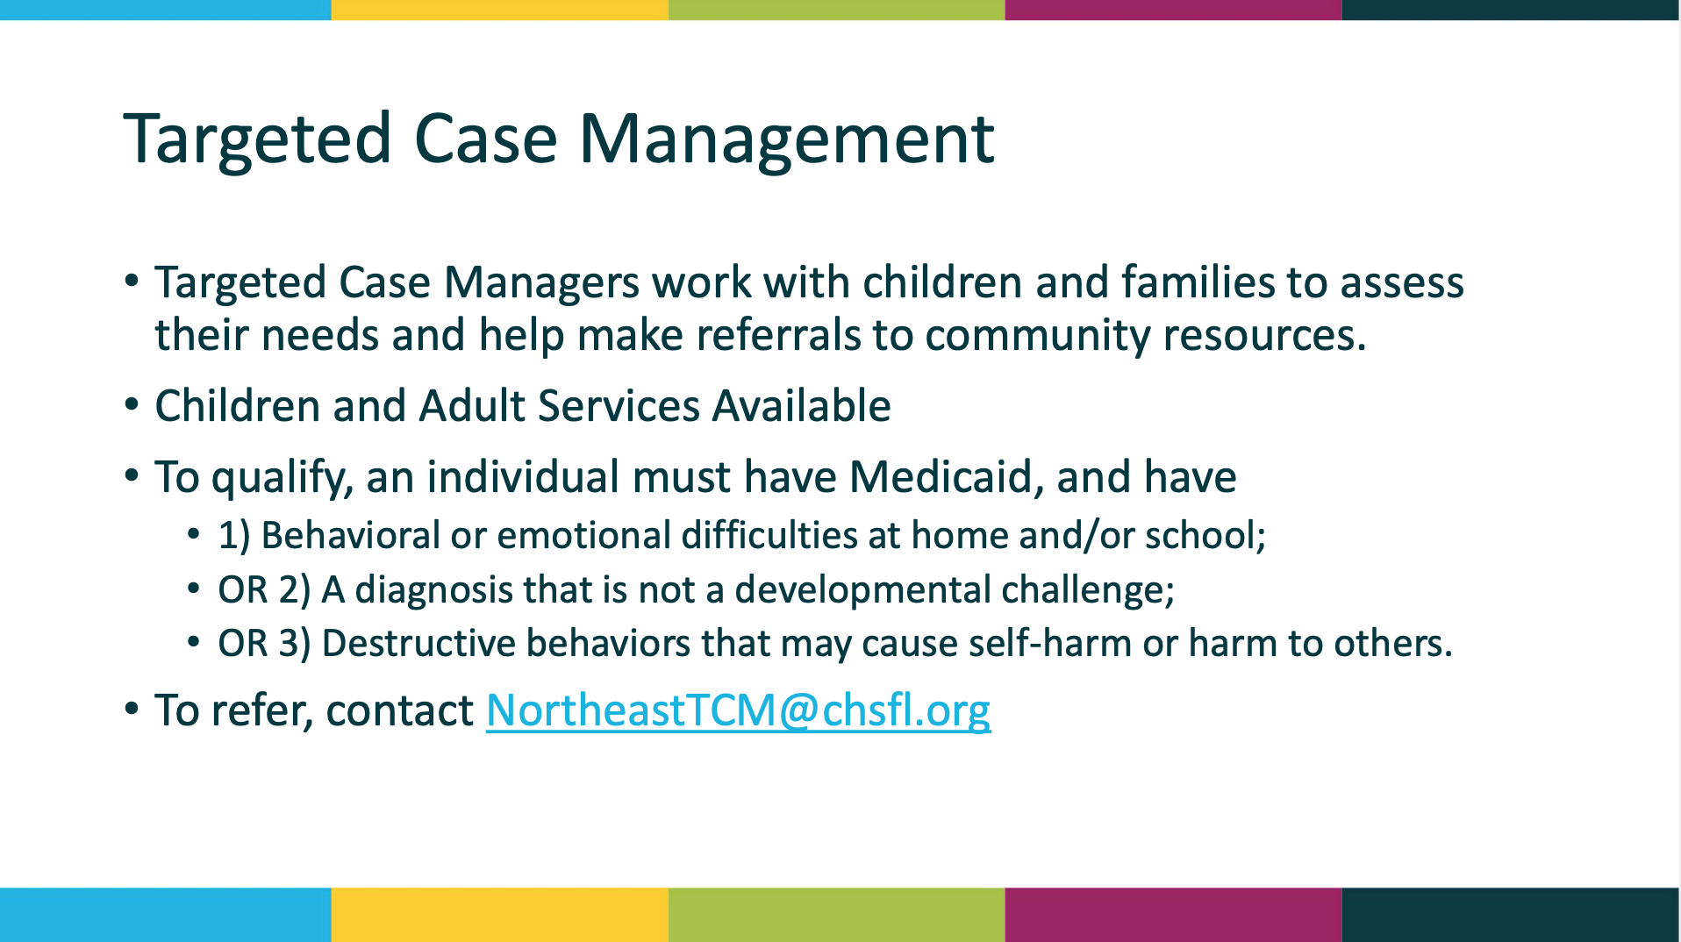
Branden

Slide 51
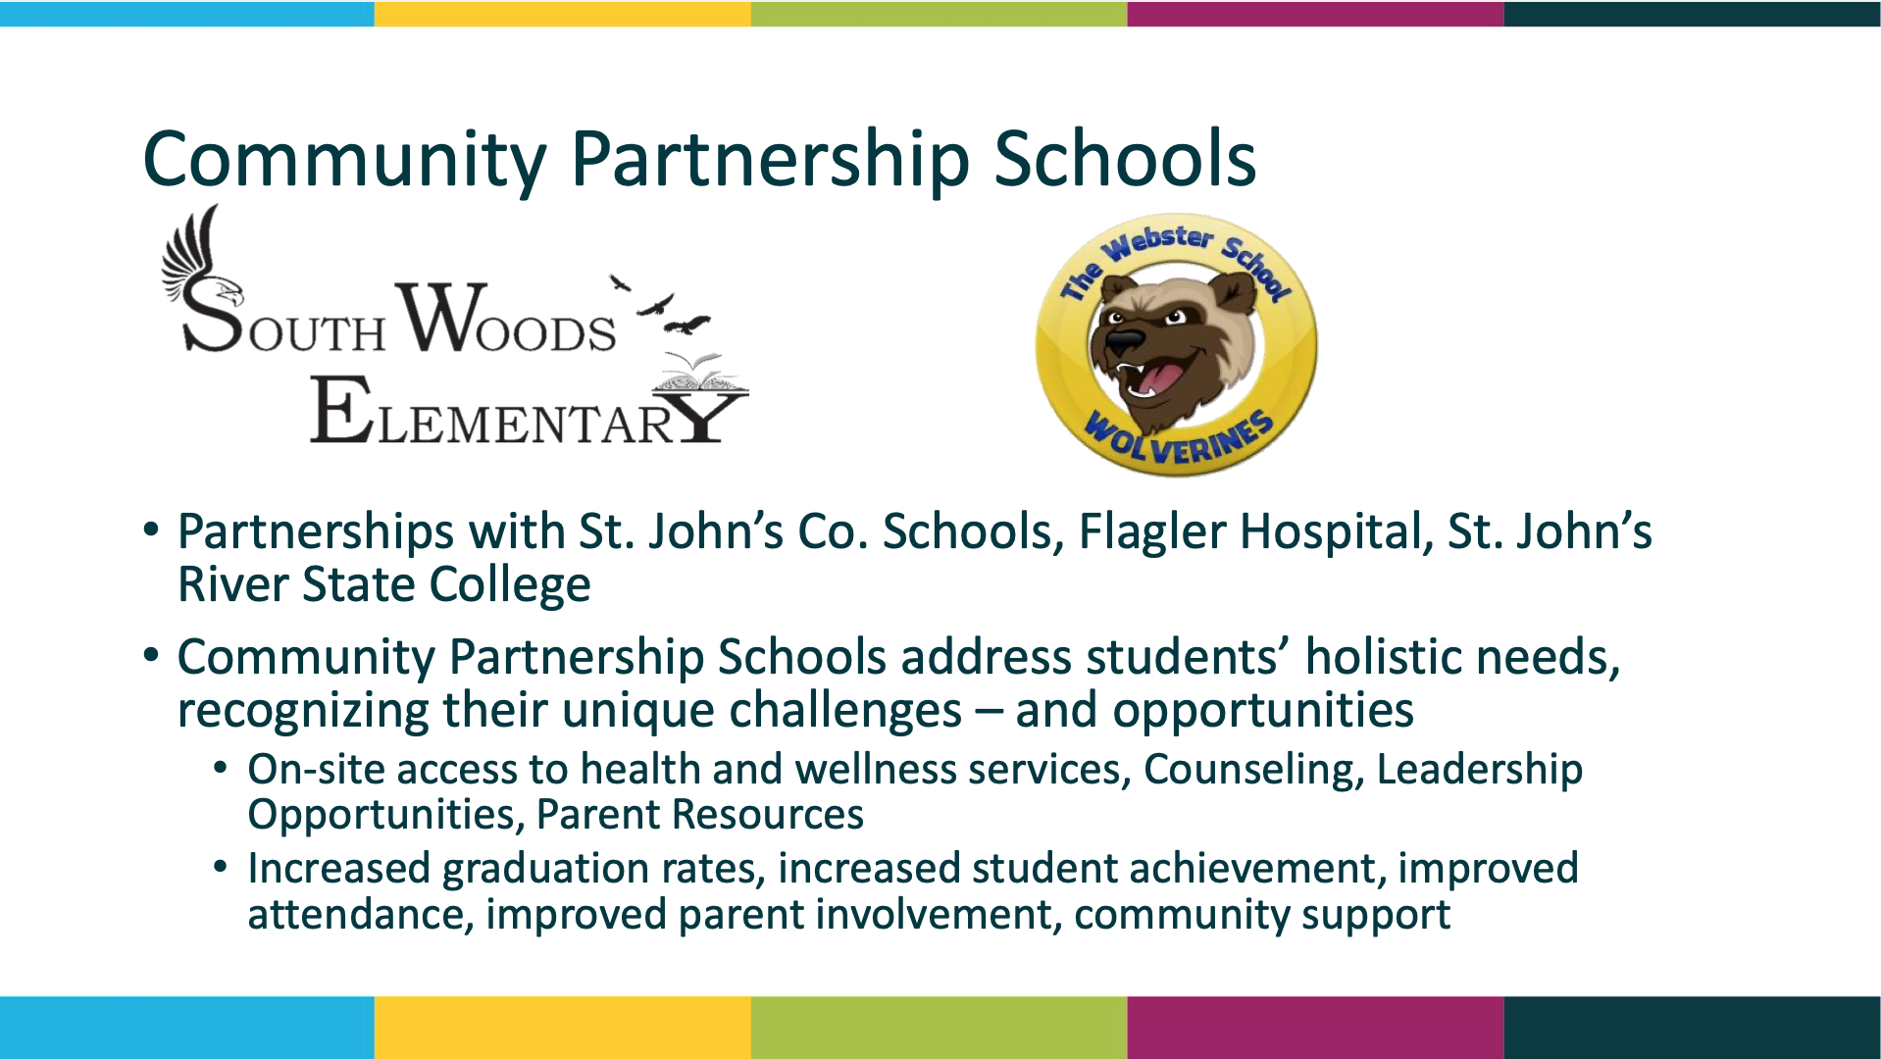
Branden

Slide 52
Branden
Early Childhood Programs
Healthy Start
• Families who are pregnant and/or have a baby under 12 months atrisk for poor health options
• Parenting Education, Breastfeeding Support, Family Planning, Child Development
• To make a referral, contact: Julie Garrity-Whitten (Julie.GarrityWhitten@chsfl.org)
Healthy Families
• Expectant mothers or mother of an infant 3 months old or younger atrisk for child abuse/neglect
• Safety best practice, Safe Sleep, Stress Management, Life Skills, Child Development
• To make a referral, contact: Donna Walsh (Donna.Walsh@chsfl.org)

Slide 53

Branden

Slide 54





Abby
EPIC
Behavioral
Healthcare
Mission: To strengthen our community by providing
person-centered care to individuals and families impacted by substance use and mental health disorders, and other behaviors through a comprehensive system of
Education, Prevention, Intervention, and Counseling.
(904 829-2283 www.epicbh.org

Slide 55





PREVENTION PROGRAMS
Abby
YOUTH PREVENTION
  Think! For SUCCESS - free program for adolescents who are experimenting with drugs and alcohol and who need to learn about the legal, social, and personal implications of their behavior. Conducted in a group setting that includes drug/alcohol and life skills education.
  Anger Management - helps identify stressors and teaches steps to help stay calm along with coping skills to handle tense situations. Group setting with a cost of $150.00.
PARENTING EDUCATION
Active Parenting - evidence-based program designed for parents who
are looking to increase their knowledge and skills. Can be conducted on-line or in person. Three Options:
  Active Parenting: First Five Years
  Active Parenting: Middle Years
  Active Parenting: Teens

Slide 56







TALKABLE COMMUNITIES
Abby
SUICIDE PREVENTION TRAINING
As part of the Talkable Communities Grant Project (along with 4 other Northeast
Florida organizations, EPIC is offering free suicide prevention training to anyone
in our community. Trainings include:
  It's Time to Talk About It! - suicide prevention and intervention training for
families and adults who interact with young people. 2 hours - virtual or
in person.
  QPR (Question, Persuade, Refer) - suicide prevention and intervention training for anyone in the community. 2 hours - virtual or in-person.
  Youth Mental Health First Aid - trains on mental health and substance use
challenges in youth and how to intervene (includes suicide prevention) - for
adults who interact with youth. 2 hours of pre-work and then 4.5 hours of
virtual or in-person training.
www.talkablecommunities.org

Slide 57



ACCESS SUPPORT CENTER
Abby
WALK-IN CENTER - NO APPOINTMENT NEEDED
Monday - Thursday, 9:00 am to 2:00 pm
1400 Old Dixie Hwy., Ste. B, St. Augustine, FL 32084
(904)829-2273, x2202
EPIC is offering walk-in services for all ages for urgent care sessions or to assess the need for mental health or substance use services. No appointment is necessary.
  Arrive between 9am and 2pm, Monday - Thursday
  If you have a specific referral source, please let us know prior to arriving
  Check in directly at the Access Support Center - Ste. B
  Screening, linkages, and urgent care sessions are provided the same day
  Peer support services are also offered
  Payment Options: Self-pay, sliding fees arrangements, and most commercial insurances

Slide 58



OUTPATIENT SERVICES
Abby
Outpatient Mental Health & Substance Use Disorder
Counseling for Children, Adolescents, and Adults
EPIC has three locations offering outpatient services for both mental health and substance use disorders. We provide:
  Mental Health Counseling
  Crisis Counseling
  Child & Adolescent Services
  Family Therapy
  Psychiatric Evaluation & Medication Management
  Alcohol & Drug Treatment Programs
Our locations are:
  Central Campus - 1400 Old Dixie Hwy., St. Augustine, FL 32084
  North Campus - 3910 Lewis Speedway, Ste. 1103, St. Augustine, FL 32084
  Northwest Campus- 175 Hampton Point Dr., Ste. 2, St. Augustine, FL 32092
(904) 829-2273
epicbh.org
EPIC: Saving Lives, Transforming Families since 1973

Slide 59





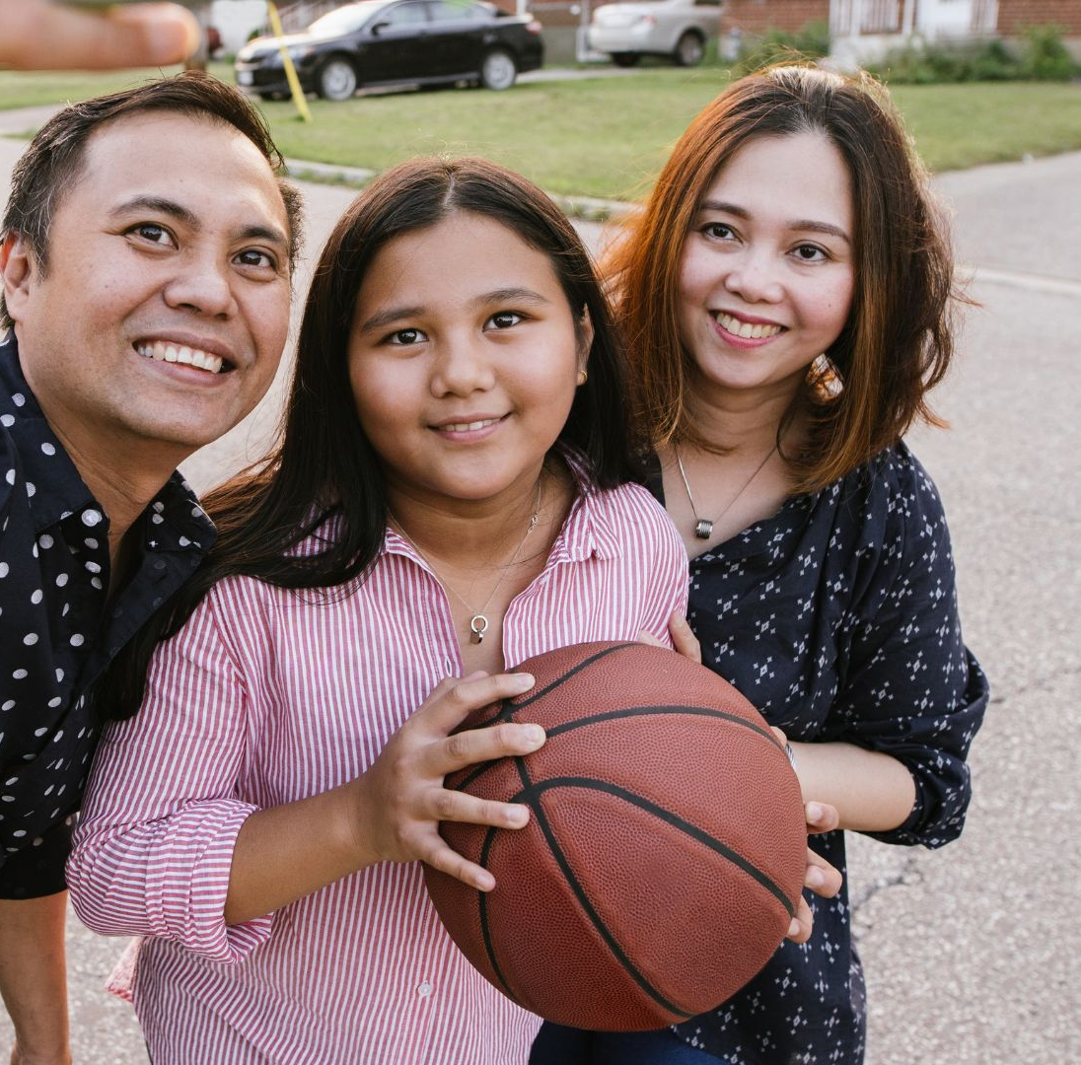
Our Mission
Fred & Karmin
SAYS shapes the future of Florida’s at-risk youth by providing coaching, counseling and
care in family style therapeutic group homes and outpatient community services.
Serving Boys, Girls, & Families.
Residential
Community
Residential Group Homes
Located in St. Johns County.
4 residential group homes.
Serves boys (age 6-17) who have suffered trauma due to abuse and/or neglect.
Provides therapeutic & pre-independent living programs.
Mobile Response Team (MRT)
St. Johns County.
Serves children & youth (age 0-25) experiencing a mental, behavioral or substance abuse-related crisis event.
Provides 24/7 intervention and safety assessments to help reduce involuntary & costly hospitalizations.
Community Action Team (CAT)
St. Johns County.
Serves children & youth (age 11-21) with history of mental illness & multiple treatment failures.
Safe & effective alternative to out-of-home placement.
Delivers mental/behavioral health services through team, collaborative approach.
Coaches
Program
St. Johns, Flagler, Putnam Counties.
Serves children & youth (ages 6-21) diagnosed with serious mental health illness.
Increases access to mental health services, community resources, and social supports.
Targeted Case Management (TCM)
St. Johns County.
Serves children, youth (age 6-21) & families.
Provides mental health assessments, advocating, and monitoring to achieve identified goals.
Assists in navigating mental & behavioral health systems of care in community.
(904) 829-1770
KristinB@sayskids.org
Request MRT Assessment
Call 9-1-1 | 2-1-1 | 9-8-8
904-547-2098
AmandaC@sayskids.org
904-829-1770
FredB@sayskids.org
904-829-1770
FredB@sayskids.org

Slide 60
Fred & Karmin
Residential Programs
3 Therapeutic Group Homes
(Capacity: 30)
Boys age 6 to 17
Children need to be assessed by a Qualified Evaluator or a Psychiatrist to determine need this level of treatment.
Have a mental health diagnosis
Approved by the MDT/FSPT process and the CBC/ME
Completed referral packet submitted to SAYS to review to determine if the youth would benefit from treatment at SAYS.
Pre-Independent Living Group Home (Capacity: 10)
Boys age 13 to 17
Have a mental health diagnosis
Experienced trauma, such as abuse, neglect, and/or maltreatment, and presents with one or more of the accompanying risk factors:
      History of running away and/or homelessness.
      History of sexual abuse
      Inappropriate interpersonal and/or social media boundaries.
      Family history of or exposure to human trafficking.
      Out-of-home placement instability demonstrated by repeated moves from less restrictive levels of care.
    Completed referral packet submitted to SAYS to review to determine if the youth would benefit from treatment at SAYS.
Launched 1989
Located in St. Johns County
Team: Child/Adolescent Psychiatrist, Licensed Mental Health Counselors, Registered Nurse, Targeted Case Manager, house parents
Staff trained & certified in evidence-based Wraparound Model, Trauma Focused Cognitive Behavior Therapy, Redirecting Children’s Behavior/Parenting
FY 21-22 Impact
44 of Youth Served
2 Youth Graduated High School
Residential Services Include
Trauma Related Care
Homelike Therapeutic Environment
Therapy (Individual, Group, Family)
Engagement & Recreational Activities
Independent Living Skills Training
Social Skills & Readiness Training
Psychological & Psychiatric Services
Employment Readiness
Contact: Kristin Beil, Program Director | KristinB@sayskids.org | 904-829-1770 | More Info, Referral Form: SAYSkids.org/residential

Slide 61
Fred & Karmin
Mobile Response Team (MRT)
Serving Children, Youth, Families
24/7, 7 Days a Week
Boys, girls LGBTQ
Age 0 – 25
Experiencing behavioral health crisis event
Crisis Event Intervention &
Safety Assessment
MRT can be notified of crisis event by school district, law enforcement, agencies, 2-1-1, 9-1-1,
9-8-8, parent/guardian, community.
Onsite assessment if child’s/young adult safety (or others) at immediate risk.
Make a determination for the need of a crisis stabilization hospitalization (Baker Act) or refer children or young adult (and family) to community resources.
Post Crisis Event
MRT coordinates family-centered & evidence-based Wraparound Services.
Links clients to resources based on assessed needs:
  Help with access to counseling services for child/youth and/or family
  Medication & outpatient care (primary health, oral health, etc.)
  Behavioral health services
  Financial, employment, housing, etc.
Develops safety plan to serve family beyond initial crisis and into long-term recovery.
Launched 2015
Serving St. Johns County
Team: Licensed Mental Health Counselors, Registered Nurse, Targeted Case Manager
Staff trained & certified in evidence-based Wraparound Model, crisis intervention, trauma-informed care
FY 21-22 Impact
445 assessments conducted on children and youth
83% not Baker Acted
$1,602,900 estimated community savings
Request MRT Assessment: Call: 9-8-8 | 9-1-1 | 2-1-1 | More Info: SAYSkids.org/mrt

Slide 62
Fred & Karmin
Community Action Team (CAT)
Serving Children, Youth, Families
24/7, 7 Days a Week
Age 11 – 21
Boys, girls, LGBTQ-Identified
History of mental illness, substance abuse, and multiple treatment failures.
At risk of out-of-home placement or at risk to return to out-of-home placement.
Benefits
CAT is a safe and effective alternative to out-of-home placement for children and youth with serious behavioral health conditions.
Upon successful completion, the family should have the skills and natural support system needed to maintain improvements made during services.
Services
Crisis Intervention 24/7 for supportive counseling
Coordinating care with community providers
Advocating for families
Assistance for access to services such as medical, dental, tutoring, housing, transportation, employment, legal service, and other behavioral services
Psychiatric services
Respite care services
Counseling, therapeutic mentoring, related therapeutic interventions
Transition services
Transportation assistance, parenting skills, behavioral modification, family education, and independent living skills
Launched 2018
Serving St. Johns County
Team: Team Leader, Mental Health Clinicians, Psychiatrist, Registered Nurse, Therapeutic Mentors, Case Manager
Staff trained & certified in evidence-based Wraparound Model, trauma-informed care, life skills, mentoring, peer support
FY 21-22 Impact
80 children & youth served
100% diverted from child welfare and juvenile justice
$5,085,073 estimated community savings
For Referrals, Contact: Amanda Callahan | Amandac@sayskids.org | 904-547-2098 | More Info, Referral Form: SAYSkids.org/catteam

Slide 63
Fred & Karmin
Coaches Program
Serving Children, Youth, Families
Age 6 – 21
Boys, girls, LGBTQ-Identified
Diagnosed with serious mental health illness,
Demonstrating risky behaviors
Teen parent with little to no support
100% clients have potential to enter costly Statewide Inpatient Psychiatric Program (SIPP).
Benefits
Increases access to mental health services, community resources, social supports.
Alleviates waitlists to mental health services
Lessens risks of substance abuse, school disruptions, unemployment, delinquency, homelessness, suicide.
Fills variety of roles: case management, life coach, mentor, job coach, and education liaison.
Services
Designs & coordinates 6 to 9-month collaborative care plan incorporating Wraparound Services.
Resources may include:
  Mental health services & primary care physicians
  Employment assistance, education services, housing providers
  Social support services (Peer Support Specialist, Peer-Led My Life groups) & natural supports (family, friends, teachers, etc.)
Clients empowered to build long-term sustainable change with support systems & skills to manage mental health challenges and life obstacles.
Launched 2017
Serving St. Johns , Putnam, Flagler Counties
Team: Behavioral Health Case Managers
Staff trained & certified in evidence-based Wraparound Model, life skills, mentoring, peer support
FY 21-22 Impact
(with Targeted Case Management)
117 children & youth served
92% not Baker Acted
97% not arrested
95% found stable housing
91% diverted from SIPP
$2,237,227 estimated community savings
For Referrals, Contact: Fred Baker | FredB@sayskids.org | 904-829-1770 | More Info, Referral Form: SAYSkids.org/coaches

Slide 64
Fred & Karmin
Targeted Case Management (TCM)
Serving Children, Youth, Families
Age 6-21
Boys, girls, LGBTQ-Identified
Diagnosed with mental health illness
Benefits
Assists children, youth, and families in navigating & accessing mental and behavioral health services, community resources, social supports.
Alleviates waitlists to mental health services.
Lessens risks of substance abuse, school disruptions, unemployment, delinquency, homelessness, suicide.
Works with the family to develop a team of helpers who will form a support network that will care on after formal services have concluded.
Services
  Guardian ad Litem (GAL)
Designs & coordinates collaborative care plan incorporating Wraparound Services.
Resources may include:
  Family
  Mental health services & primary care physicians
  Case worker, Dependency case manager, St. Johns School System, Department of Juvenile Justice
  SAYS team
Advocates on behalf of family to help them reach their service goals.
Launched 2017
Serving St. Johns County
Staff: Behavioral Health Case Managers
Staff trained, certified and/or skilled in evidence-based Wraparound Model, life skills, mentoring, advocating
FY 21-22 Impact
(with Coaches Program)
117 children & youth served
92% not Baker Acted
97% not arrested
95% found stable housing
91% diverted from SIPP
$2,237,227 estimated community savings
For Referrals, Contact: Fred Baker | FredB@sayskids.org | 904-829-1770 | More Info & Referral Form: SAYSkids.org/tcm

Slide 65
Ana

Slide 66
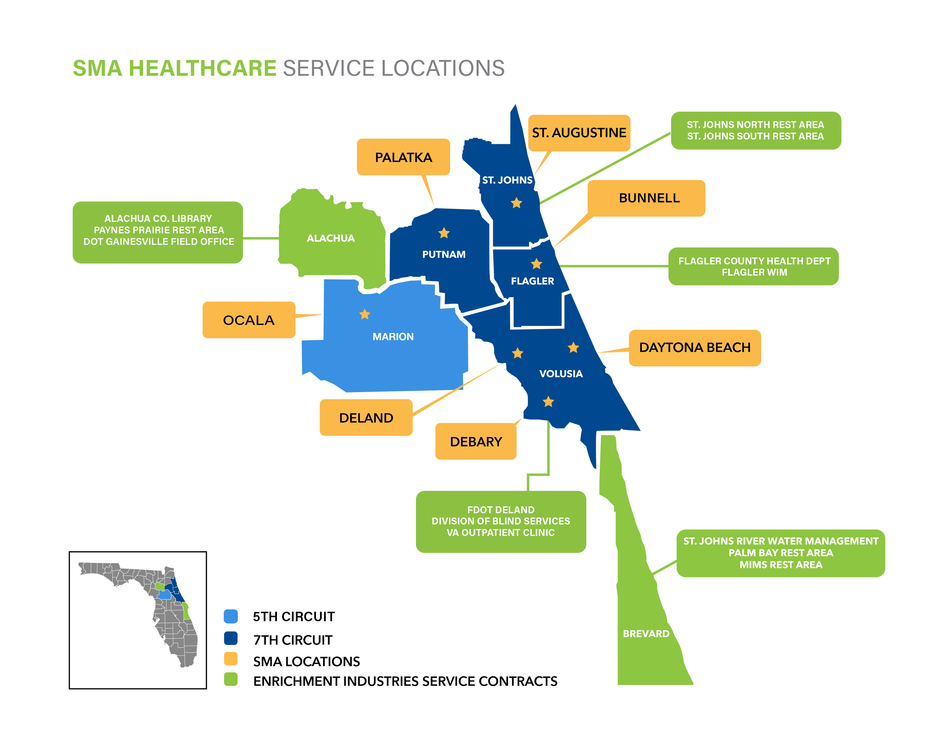
Transforming Lives Through Hope and Healing
Ana
SMA Healthcare is proud to be the leader of behav­ioral healthcare services in our communities. With more than 60 years of experience in the industry, SMA Healthcare provides a full continuum of exceptional and compre­hensive services for individuals suffering from mental illness and/or addiction in Citrus, Flagler, Marion, Putnam, St. Johns, and Volusia Coun­ties.
Our Mission: Transform lives through exceptional mental health, substance abuse, and primary care services.

Slide 67
Services Offered by SMA Healthcare
Ana
  Walk-in Crisis Counseling, Screening and Triage
  Family Counseling
  Individual Counseling for Mental Health or Substance Use
  Residential services for adolescents at our RAP Program
  Care Coordination
  Community Outreach
  Psychiatric Medication Management for ALL ages
  No Wait List for Counseling for Children and Adolescents
  Family and Patient Education Program
  Linkage and Referral to Primary Care Providers

Slide 68
Transforming Lives Through Hope and Healing
Ana
Are you, your child, or someone you care about experiencing……
  Depression
  Trouble focusing
  Family conflict
  School Struggles
  Impulsive behaviors
  Anxiety or Panic Attacks
  Trauma
  Suicidal Thoughts/Attempts
  Alcohol or other Drug Use
  Legal or Court Issues
  Child Welfare/DCF Involvement
Not sure what to do?
Call SMA Healthcare and make an appointment, or stop in and see us at one of our locations and we will support you to come up with a plan that works best for you.
SMA Healthcare Locations: https://smahealthcare.org/locations-contact/

Slide 69
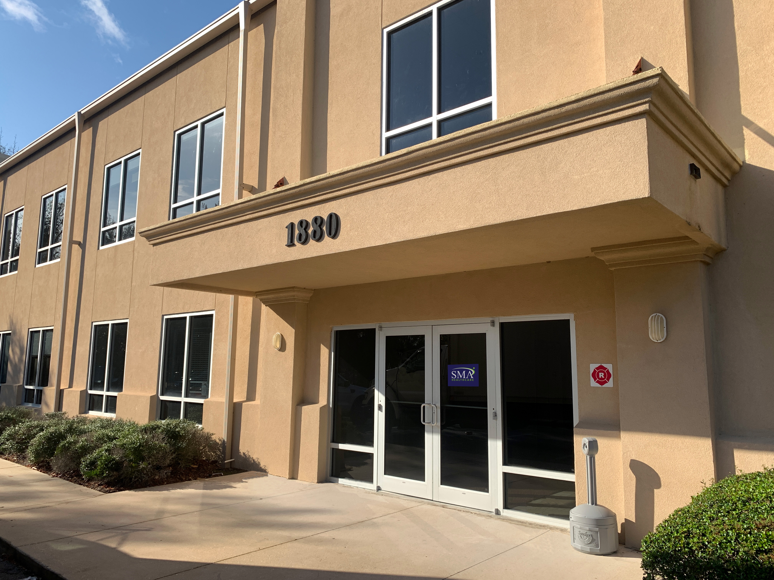
St. Johns County
Ana
We can provide services anywhere! Whether it is at our office or through eCare, our telehealth services, we can meet your needs!
Outpatient Center
1880 San Sebastian View
St Augustine, FL 32084

Slide 70
Get Connected
Ana
For more info on SMA Healthcare, visit: smahealthcare.org
For info on eCare/Telehealth, visit: https://yoursma.org/
or email ecare@smahealthcare.org
Business Hours Phone Number:
904-209-6200
24/7 Access Center Hotline:
800-539-4228
SMA Healthcare Social Media
SMAHealthcare
smahealthcare
SMAHealthcare
SMAHealthcare
SMAHealthcare

Slide 71
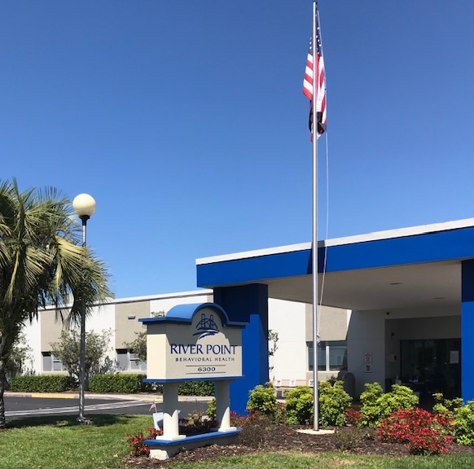
RIVER POINT BEHAVIORAL HEALTH
Sarah
Admissions: 904-724-9202
Riverpointbehavioral.com
Your Bridge to Hope and Healing
6300 Beach Blvd., Jacksonville, FL 32216

Slide 72
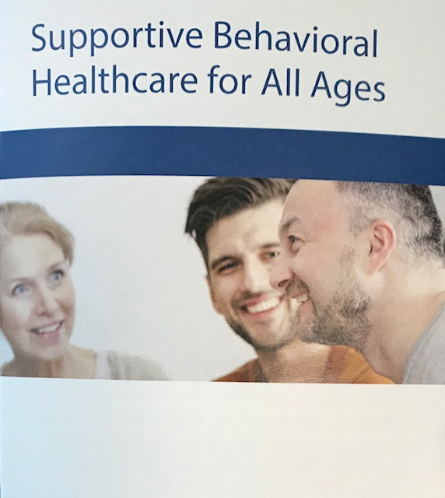

Inpatient Services
Sarah
Inpatient Mental Health Services for ALL AGES
  Children/Adolescent Unit
  Adult Units
Co-occurring Mental Health and Substance Use Services

Slide 73
Inpatient Experience
Sarah
  Full H&P is provided
  Therapy 7 Days
  Strict curriculum for each day that focuses on engagement, therapy, and activity.
  Physical and outdoor time daily
  Practice CBT, DBT, Trauma Informed Care
  Patient is the center of all treatment and discharge plans
Activity Therapy
  Art Therapist
  Certified Yoga Instructor
  CTRS – Certified Therapeutic Recreation Specialist

Slide 74
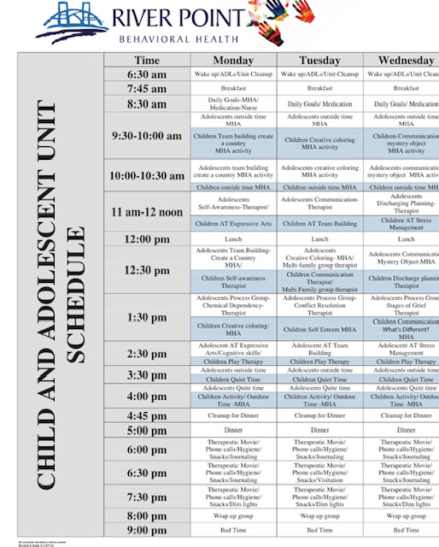
Sample Adult & Adolescent Schedules
Sarah

Slide 75
Important Details
Sarah
River Point has 84 licensed beds.
  22 Children/Adolescent
  The largest inpatient child/adolescent unit in the greater Jacksonville community
BOTH voluntary and involuntary patients receive treatment at our facility.
Serving those needing psychiatric as well as co-occurring services (mental health and substance misuse).
We are a Baker Act receiving facility.
No-cost assessments are available 24/7.
Walk-ins welcome 24/7.
All insurances are accepted.
We do not use mechanical restraints.
Every component of our inpatient unit is designed for safety.
Each patient is checked on every 15 minutes.

Slide 76
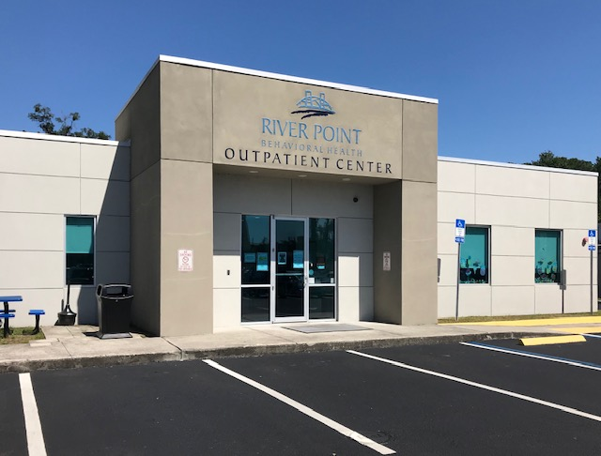
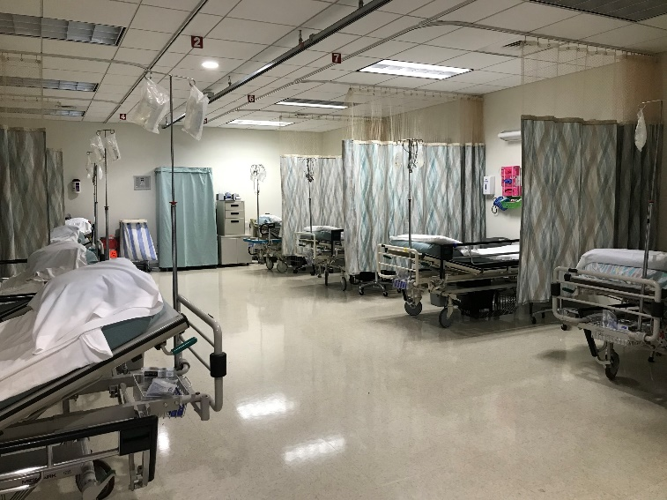
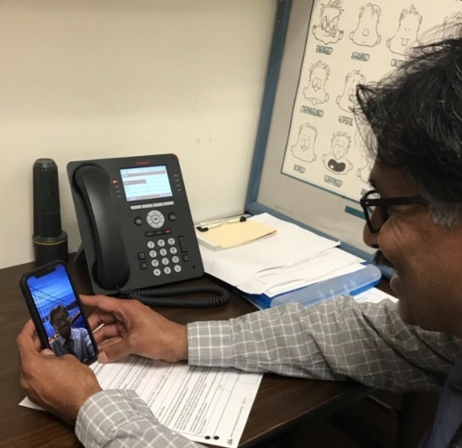
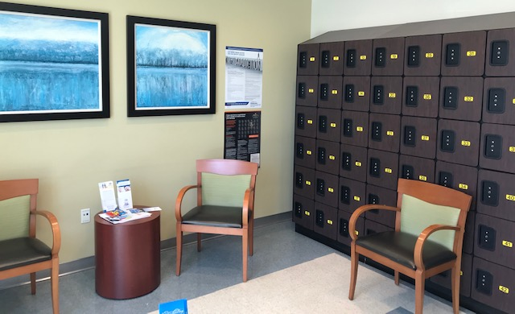
Outpatient Services for Adults
Sarah
Intensive Outpatient Program (IOP)
Partial Hospitalization (PHP)
IOP/PHP offered virtually – great for those who are immunocompromised, outside of local community, etc
Tele-assessments available in comfort of professional’s office or patient’s home.
Electroconvulsive Therapy (ECT)
Transcranial Magnetic Stimulation (TMS)

Slide 77

Francesca
Pediatric & Adolescent Mental Health:
Awareness, Education, and Prevention Efforts — On Our Sleeves
Dr. Francesca Varallo Sims
Director of Education and Training, Behavioral Health
Baptist Medical Center/Wolfson Children’s Hospital

Slide 78


Francesca

Slide 79
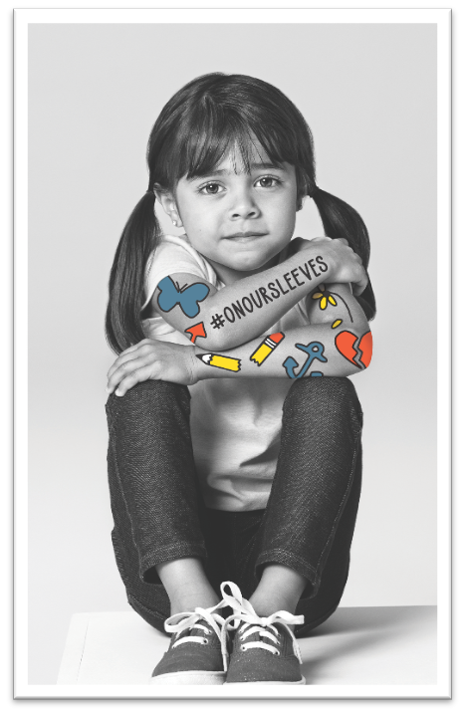

What is On Our Sleeves?
Francesca
“The movement for children’s mental health.”
Kids don’t wear their thoughts on their sleeves, so it can be difficult to tell when they are struggling with their mental health. On Our Sleeves helps give children a voice.
Goals:
  Break stigmas
  Start conversations
  Prevent crises (early intervention)
Notes:
To truly make a difference, we have to reach outside the walls of the hospital and clinics, and into the communities we serve, intervening before a child reaches a mental health crisis and requires our emergency care. That’s the goal of On Our Sleeves.
On Our Sleeves is the movement to transform children’s mental health. The campaign will provide resources and educational materials that help adults understand mental illnesses and talk with children and teens about their thoughts and feelings. With these resources, parents and caregivers can intervene before a child reaches a mental health crisis.
By equipping all of us to support the children in our lives, we will eliminate stigma and prevent crises.
On Our Sleeves is a national movement for children’s mental health that we are bringing here to Northeast Florida and Southeast Georgia.
The concept is simple: Kids don’t wear their thoughts on their sleeves, so it can be difficult to tell when they are struggling with their mental health.
On Our Sleeves helps give children a voice.
We have several goals:
• Break stigmas associated with children’s mental health conditions.
• Start conversations with kids and teens about mental health.
• Prevent mental health crises by focusing on wellness and early intervention.

Slide 80












Icons
Francesca
Each icon represents a feeling and serves as the gateway to potentially lifesaving conversations with kids and teens.
Notes:
Emphasize NOT TATTOOS (stickers, icons)
You’ve probably noticed these icons – hearts, anchors, stars, flowers, and many others.
Each icon represents a feeling and serves as the gateway to potentially life-saving conversations with kids and teens.
We refrain from calling these icons “tattoos,” instead it’s preferred to say stickers, pictures, image, or icon

Slide 81
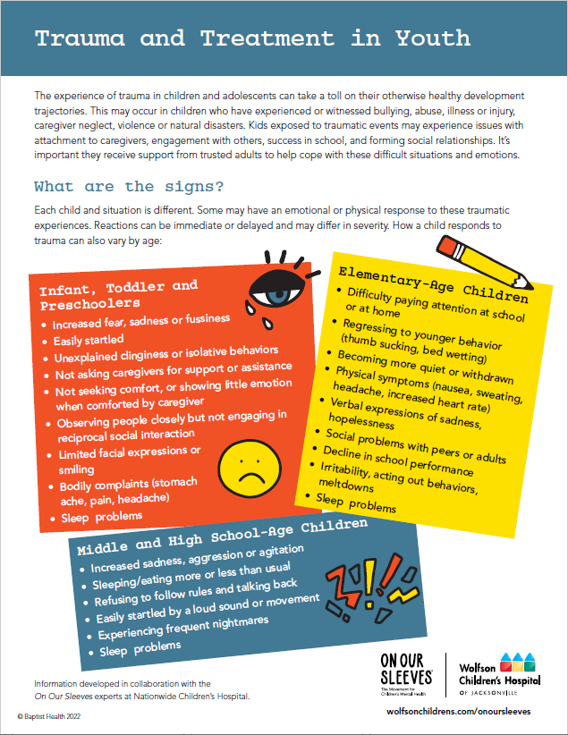
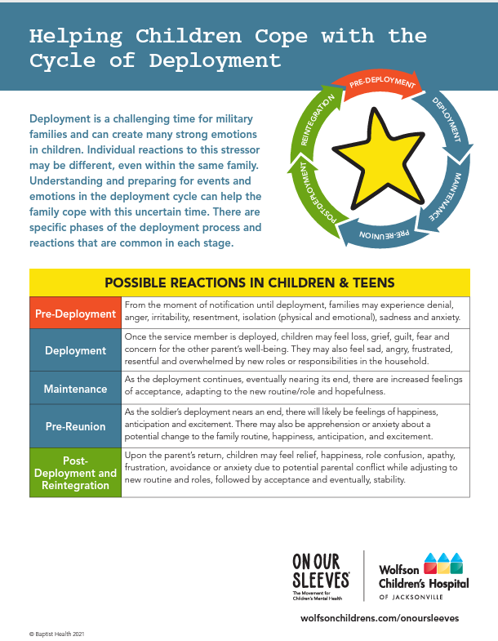
Educational Materials
Francesca
To help parents, caregivers and other adults start conversations with kids and teens. (several WCH resources have been translated into Spanish)
The mission of On Our Sleeves is to provide access to educational resources related to mental health for parents, teachers, health care professionals, and the community.
These free materials are available on Wolfson Children's Hospital website.
Notes:
FVS
The mission of On Our Sleeves is to provide access to educational resources related to mental health for parents, teachers, health care professionals, and the community.
These materials are immediately available on Wolfson Children’s Hospital’s website and the national On Our Sleeves website.
Examples of an educational resource include:
Growing Our Gratitude (activity to further conversations with children about what they value and are thankful for; engaging in the activity can increase a sense of wellbeing and interconnectedness.)
Healthy Habits Checklist (help form wellness habits such as eating a nutritious diet, maintaining self-care/hygiene practices, engaging in social or experiential activities, getting a good night’s rest and more)
Conversation starters (Children don’t wear their thoughts on their sleeves, we need to give them a voice and foster open communication about their mental health; Open-ended questions 1. What was the best thing that happened today? What didn’t go so well? What might you try to make yourself feel better?)
Importance of the educational materials
Without education and early/consistent intervention, the mental health of our community is likely to deteriorate overtime. This is why preventative educational resources are so vital. In my opinion, as a clinician, a professor, and foremost, a mother, the quality of these materials is unmatched.

Slide 82
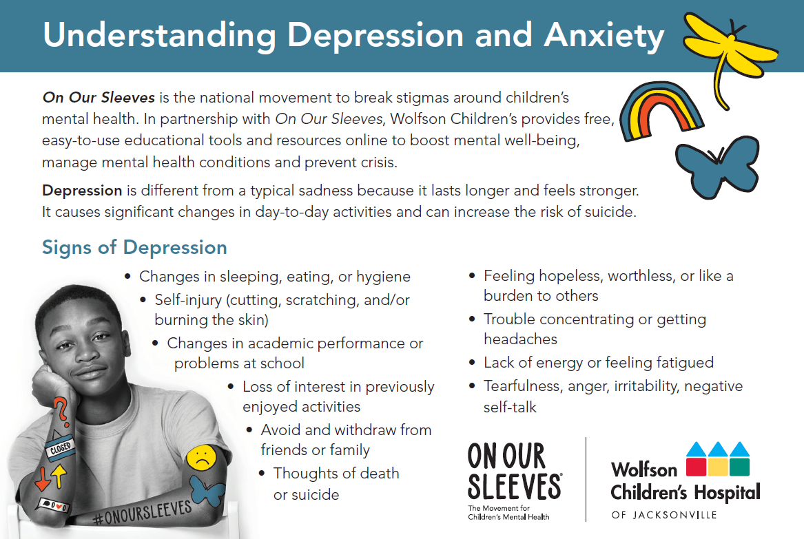
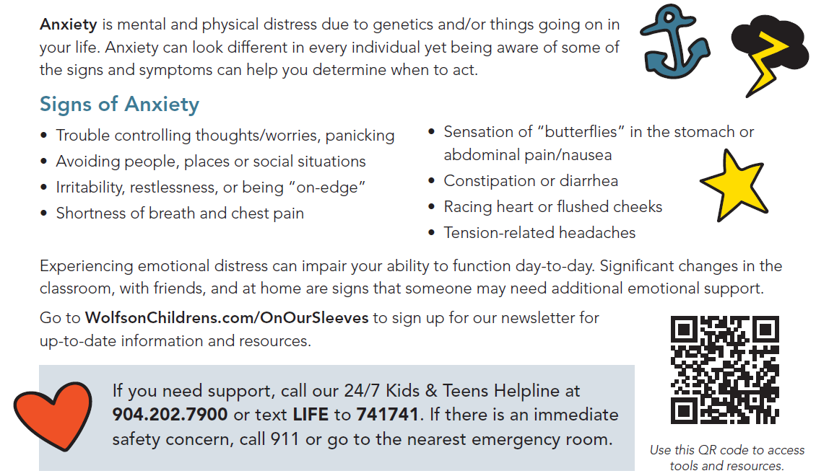
Providing Education:
Signs to Keep in Mind
Francesca
Informational postcards
(child and teen versions)
Notes:
Warning signs
The fundamental goals of providing educational materials are to promote open dialogue about mental health and increase well-being, yet also recognize signs of significant emotional distress in youth.
How do we know when they need help?
Behavioral Indicators – There are various behavioral, or directly observable actions/patterns, a child/adolescent might display.
It is important to be observant of changes to their overall day-to-day activities, like differences in:
Appetite (increase/decrease)
Sleep/energy level
Social interaction (isolation/truancy)
Risk-taking behavior
Somatic (bodily) symptoms (e.g., headaches, upset stomach)
Observable emotions (e.g., crying)
Performance in school/extracurricular activities
It is our hope to prevent severe mental health crises by sharing this knowledge.

Slide 83
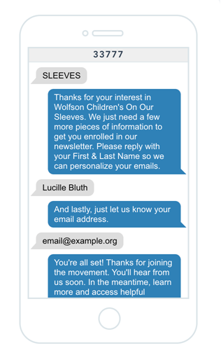
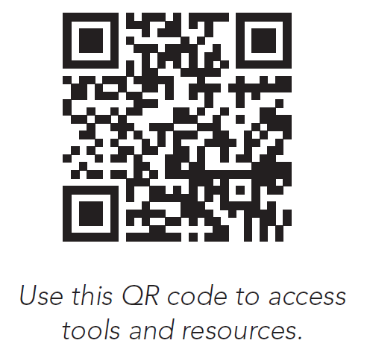
Get Involved
Francesca
  Scan the QR Code or Text SLEEVES to 33777:
  Sign up for e-newsletter
  Download tips and tools to help facilitate conversations
  Learn how to recognize and respond to children in or at risk of crisis
  Access mental health support services 24/7 (Kids & Teen Helpline) [call 904.202.7900 or text LIFE to 741741]
Notes:
There are several ways the community can get involved. All of them start by visiting our website, Wolfson Children’s dot com slash On Our Sleeves.
From there, you can:
• Sign up for our monthly e-newsletter, which features actionable, timely mental health information
• Download tips and tools to help facilitate conversations with kids and teens
• Learn how to recognize and respond to children in or at risk of crisis by signing up for Youth Mental Health First Aid
• Access mental health support services, such as Wolfson Children’s 24/7 Kids & Teens Helpline and our Crisis Text Line.
We also encourage you to spread the word to local businesses and encourage them to join the movement. The more people who are receiving and using the educational materials, we will eliminate stigma and get our young people to help before they have a crisis.
We look forward to working together to ensure healthy futures for our community’s children.

Slide 84
Contact Us
Francesca
Have questions or need information about On Our Sleeves at Wolfson Children’s?
Email Sarah Clark Sarah.Clark@bmcjax.com (On Our Sleeves Project Manager) for general inquiries, materials, and events.
Email Dr. Varallo Sims (Director of Education and Training, Behavioral Health Administration) fvara001@bmcjax.com for information on OOS educational tools and PDF resources.
Visit the website: https://www.wolfsonchildrens.com/about/on-our-sleeves-mental-health
Email OnOurSleeves@bmcjax.com

Slide 85

Logan
www.youthcrisiscenter.org
(904) 725-6662
24/7/365 referral hotline
Mission
  To build a healthier community by empowering young people and families to rise above adversity.

Slide 86
Residential Crisis Care
Logan
YCC’s Residential Crisis Care program provides short-term residential services and counseling to children and teens ages 10-17.
  These youth have either run away or are at-risk of running away, been locked out of their homes, are habitually truant from school, or have exhibited ungovernable behavior. Our program is here to provide a safety net to young people and their families when they need it most.
  Our residential therapists work with youth and their families to address the immediate crisis and help provide long-term solutions to handle future concerns once the child or teen returns home. Our goal is to re-unite families by providing assistance and support with a clear plan for continued stabilization.
  During their stay at YCC, youth receive:
    Food, clothing and a safe, comfortable place to sleep
    A positive, productive and healthy living environment
    Individual, group and family counseling
    On-campus school provided by Duval County Public Schools
    Youth development programs
    Supervised recreation
    Life management and social skills counseling

Slide 87
Family Link
Logan
The Family Link program provides professional and compassionate short-term outpatient counseling services to families with children ages 6 – 17
  Youth are experiencing any concern that disrupts the health and stability of the family.
  Services are at no charge to the family.
  Family Link services are provided in Baker, Clay, Duval, St Johns, and Nassau counties.
  Family Link therapists have master’s degrees and extensive experience in a wide range of family and youth concerns including running away, poor academic performance, truancy, homelessness, depression, anxiety, Attention Deficit Hyperactivity Disorder (ADHD), and chronic behavior problems.
  Our therapists provide counseling services in the child’s school, in the community, or on our campus.
  Family Link provide short term therapy services for 3-6 months. In addition to individual therapy sessions with the youth, Family Link therapist also provide family sessions once a month and group therapy sessions in the schools as well as in the community.

Slide 88
Stop Now and Plan (SNAP)
Logan
SNAP (Stop Now and Plan) is an Evidence-Based, Skills-Based Program that helps children ages 6-11, and their parents learn how to effectively manage their emotions and “keep problems small”. This gender-specific program is 13 weeks long, during the evening, with meals and sibling care provided at no cost. This program is designed for children who are engaging in aggressive, anti-social behavior and/or have come into problematic contact with authority figures at school or in the community.
SNAP for Schools (SNAP-S) is based on SNAP, CDI’s award-winning early intervention model. This well-developed program is delivered to students ages 6-11, focusing on developing SNAP skills to promote a positive change in behavior. The 13-week in-class program covers topics such as managing anger, handling group/peer pressure and dealing with bullying. The program also offers classroom interventions for all students who will benefit from the universal skills learned in the SNAP classroom sessions.
SNAP in Schools

Slide 89
18+ Housing
Logan
Touchstone Village operates on YCC’s campus located in Duval County. Touchstone Village provides transitional living services to young adults, ages 18-21, who may be homeless, aging out of foster care or in a variety of other situations which limit self-sufficiency. Residents receive life skills training, education planning, career development, vocational training, counseling, financial literacy, social & personal skills training, life coaching, case management.
House of Hope (HOH) provides emergency housing services to homeless young adults ages 18-24, including the LGBTQ community. This program provides safe emergency housing with 24-7 supportive care services, life skills training, recreational activities, academic support and monitoring, and mental health counseling. The goal of the program is to stabilize the crisis and transition the client to permanent safe housing.

Slide 90
Avery
Thank You!
Questions?

