Slide 1

Anxiety & Stress Coping- The Natural Approach
Dr. Alexis Romero, DC Dr. Thomas Romero, DC

Slide 2

Who we are
Dr. Lexie Romero, DC
Functional Medicine Physician
Board Certified Clinical Nutrition
Certified Autism Specialist
Dr. Thomas Romero, DC
Clinical Neurology Specialist
Certified Autism Specialist
Optimal You Wellness Center - PVB

Slide 3

Dr. Lexie Romero
Dr. Lexie Romero is a Chiropractic Physician with a passion for functional medicine and women’s health. Born and raised in Gainesville, Florida, Dr. Romero attended The Florida State University and graduated with a Bachelor of Science in Psychology, with a minor in Biology. She continued her education earning a Doctorate in Chiropractic Medicine from Palmer College of Chiropractic in Port Orange, Florida. Palmer College is highly regarded as the leader in chiropractic education.
Using in-depth analysis, Dr. Lexie approaches each patient holistically treating all aspects of health. To obtain optimal results Dr. Lexie combines various low-force techniques, functional medicine, and post-graduate training in clinical nutrition, pre- post- Natal care, and pediatrics. Dr. Lexie is certified in Webster Technique, physiotherapy, Activator technique, and Interactive Metronome. Dr. Lexie is an active member of the ICPA, International Chiropractic Pediatric Association. Her passion for nutrition and wellness contributes to her holistic approach.

Slide 4

Dr. Tommy Romero
Dr. Thomas is a Chiropractic Physician from Jacksonville, Florida. He graduated from Florida State University where he completed his pre-medical track earning a Bachelor of Science in Exercise Medicine with a minor in both Biology and Chemistry. He continued to earn his Doctor of Chiropractic Medicine from the prestigious Palmer College of Chiropractic.
Dr. Thomas is an active member of the International Academy of Chiropractic Neurology and has 450 hours of Neurology training through the Clinical Neuroscience Institute and Palmer College of Chiropractic. Thomas is passionate about providing the best care possible for his patients, which stems from his extensive and continuous education. He is certified in physiotherapy, activator method, and interactive metronome. He is passionate about his work with special needs patients and their families.

Slide 5
What creates stress?
Internal and external stressors
Internal Stressors
Inflammation- poor nutrition, illness,
Emotions- anger, fear, unforgivness, negative self talk, perfectionism
Sleep
External Stressors
Environment
Lifestyle- movement or lack of, relationships, social interactions
Habits- Screen time
Life Changes
Unforeseen Events

Slide 6
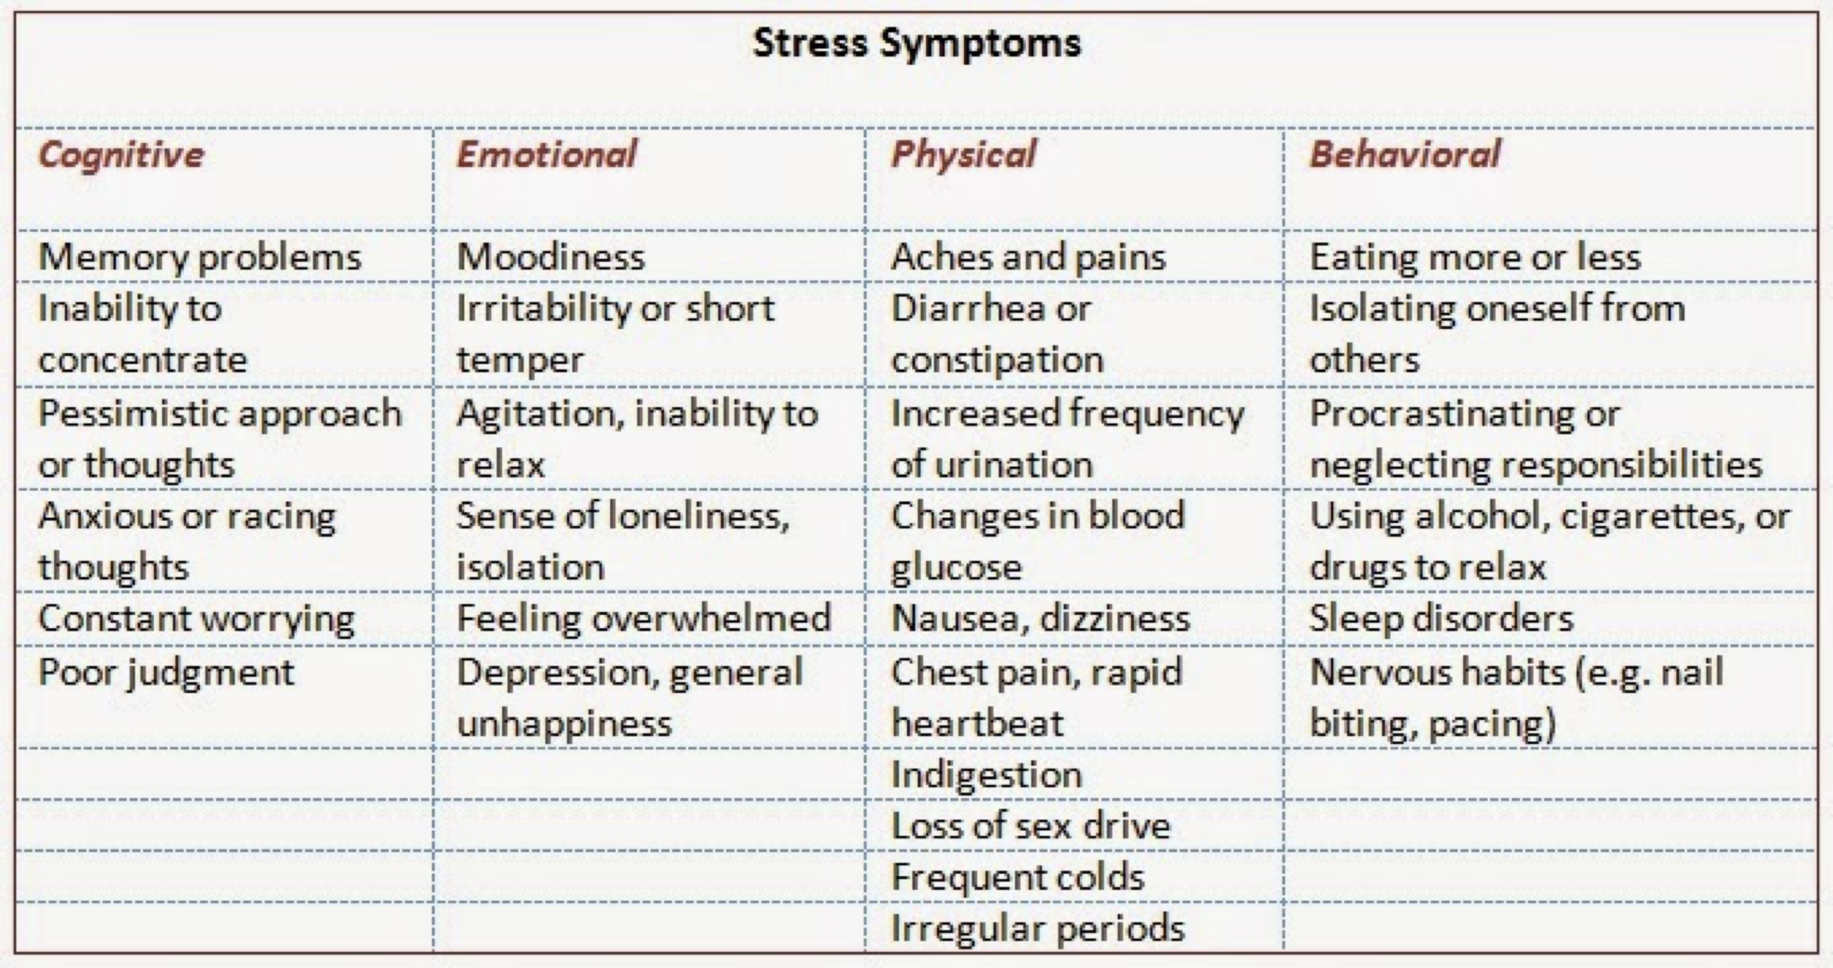

Slide 7
Why is it important to reduce stress?
HPA Axis Dysfunction
Gut Dysbiosis
Immune System Compromise
Inflammatory Disease

Slide 8
Adrenal Dysfunction – HPA Axis
Constant hyperstimulation of the adrenal glands ultimately results in adrenal exhaustion.
This is the result of being in a prolonged state of stress.
Evaluating both clinical and subclinical sources of chronic stress is paramount to clinical success.
Positive lifestyle practices along with specific hormonal and nutritional support protocols will enhance recovery.
Failure to properly diagnose and treat the cause (source) of chronic stress will result in further adrenal exhaustion, and over time, hormone, immune and metabolic systems breakdown.

Slide 9
The Immune System
A recent study examined whether chronic stress impairs the immune system's capacity to respond to hormonal signals that terminate inflammation.
Fifty healthy adults were studied; half were parents of cancer patients, and half were parents of healthy children. Parents of cancer patients reported more psychological distress than parents of healthy children.
They also had flatter diurnal slopes of cortisol secretion, primarily because of reduced output during the morning hours. There was also evidence that chronic stress impaired the immune system's response to anti-inflammatory signals: The capacity of a synthetic glucocorticoid hormone to suppress in vitro production of the pro-inflammatory cytokine interleukin-6was diminished among parents of cancer patients.
Findings suggest a novel pathway by which chronic stress might alter the course of inflammatory disease.

Slide 10
In other words…
chronic stress dysregulates innate and adaptive immune responses by changing the type 1-type 2 cytokine balance and suppresses immunity by decreasing leukocyte numbers, trafficking, and function. ... Psychological stress is known to suppress immune function and increase susceptibility to infections and cancer.

Slide 11
Easy ways to support immune health
Vit C
  Kiwi
  Citrus
Zinc
  Lamb and grass fed beef
  Chick Peas
Vit D
  Beef Liver
  Eggs
  Salmon
Hydration

Slide 12
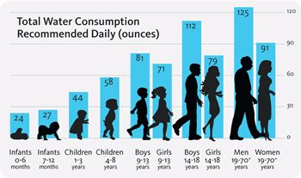
WATER
WATER
WATER
Water helps to carry oxygen to your body cells, which results in properly functioning systems. It also works in removing toxins from the body, so drinking more of it could help prevent toxins from building up and having a negative impact on your immune system.

Slide 13
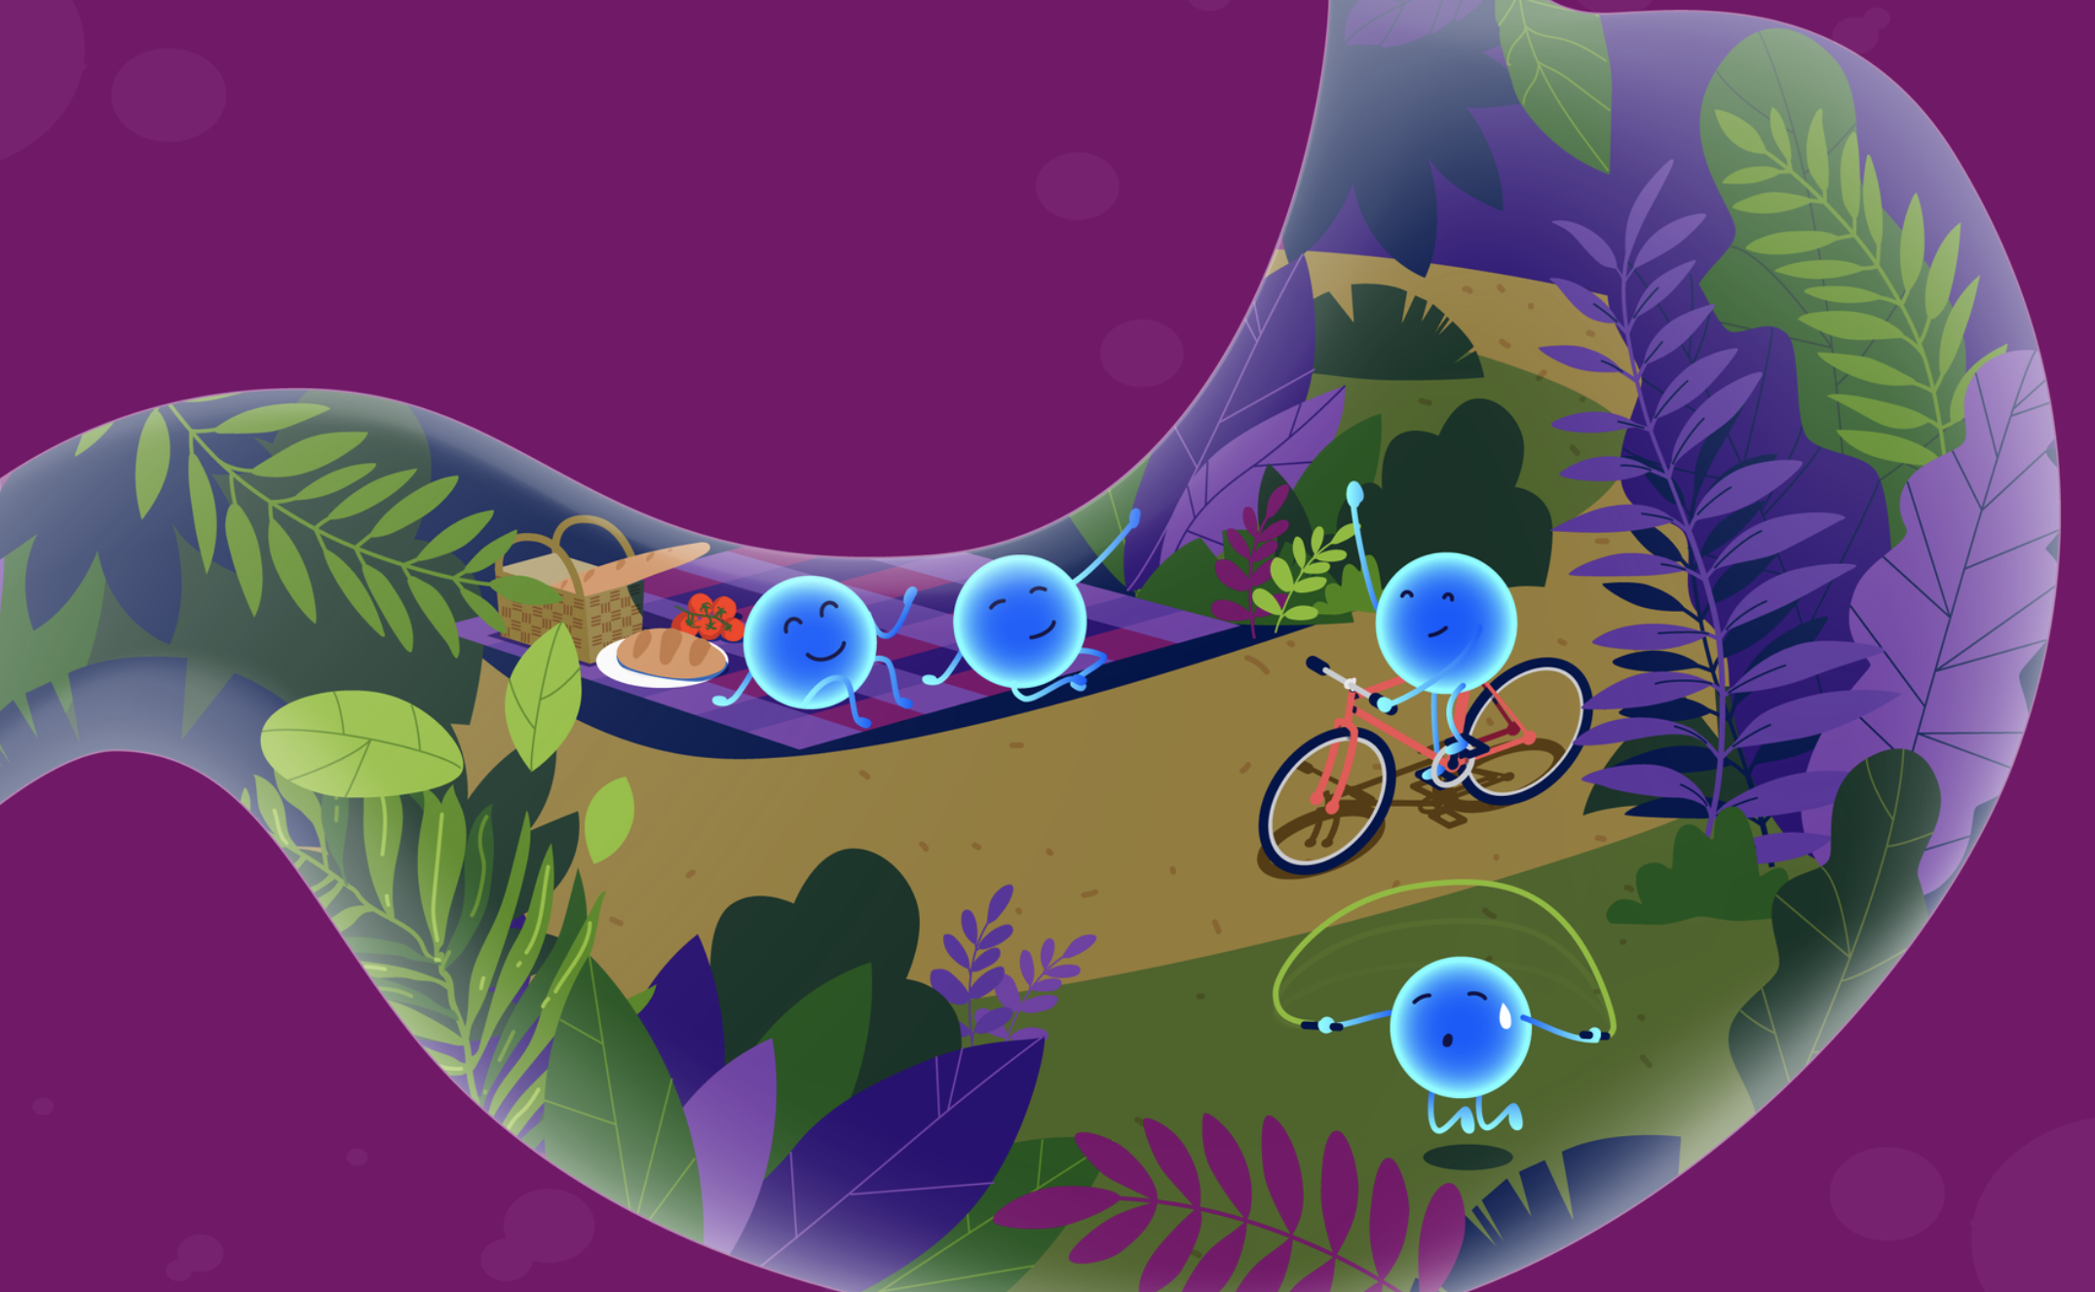
SUPPORTING YOUR STRESS REPSONSE THROUGH THE MICROBIOME

Slide 14
Our MicroBiome
Our bodies are far from a microbe-free environment. Rather, the reality is our bodies are full of caverns rich in microscopic organisms that help us maintain internal homeostasis and immunostasis – often by interacting with our immune cells. These “conversations” have been shown to affect autoimmunity, inflammation, cancer, and our susceptibility to infection.
The gut microbiome aids in orchestrating these communications. Depending on the balance and fitness of the gut flora, our immune response can prove to be strong and resilient, or weak and late to the game. Nurturing our gut ecosystem can be one of the most profound ways we can beef up our immune response.
When dysfunctional, your gut microbiome can cause unintentional harm when performing its normal tasks, like a dull knife. However, when kept in fit condition, it performs seamlessly and precisely with less risk to surrounding areas. In this manner, a healthy gut microbiome functions well and is less likely to harm your intestinal lining - the thin barrier that keeps microbes safe and sound in their preferred environment - your gut - and keeps them from exploring other areas we don’t want – like in your blood!

Slide 15
The Gut and Serotonin
90% of serotonin is produced and stored in the gut. 10% is produced by neurons in the central nervous system.
Serotonin is plays a viral role in mood, hunger, appetite, influencing learning memory reward happiness physiological processes like sleep, behavior and appetite .

Slide 16
Diet
High protein, low carbs (including fruits), eliminate processed foods, dairy-free, high fat (saturated)
Pro Biotic
Multi Vitamin
Vit D
WATER WATER WATER

Slide 17
FOODS TO AVOID
Sugary food. Diets with high sugar content enable unhealthy bacteria to thrive inside the gut, causing weight gain and other health conditions.
Artificial sweeteners like saccharin or aspartame, reduce good bacteria in your gut and can lead to high levels of blood sugar.
Unhealthy fats. While fats like Omega 3 help the good gut bacteria, saturated fats can cause bad bacteria to thrive.
Processed or cured meats contain not only high amounts of sodium, but also flavorings, preservatives, and chemicals, including nitrites that are known to be unhealthy.

Slide 18
THE BRAIN
Frontal Lobe- flexor inhibition, executive function, sympathetic nervous system activation, our decision maker.
Temporal Lobe- emotional brain
GET MOVING

Slide 19
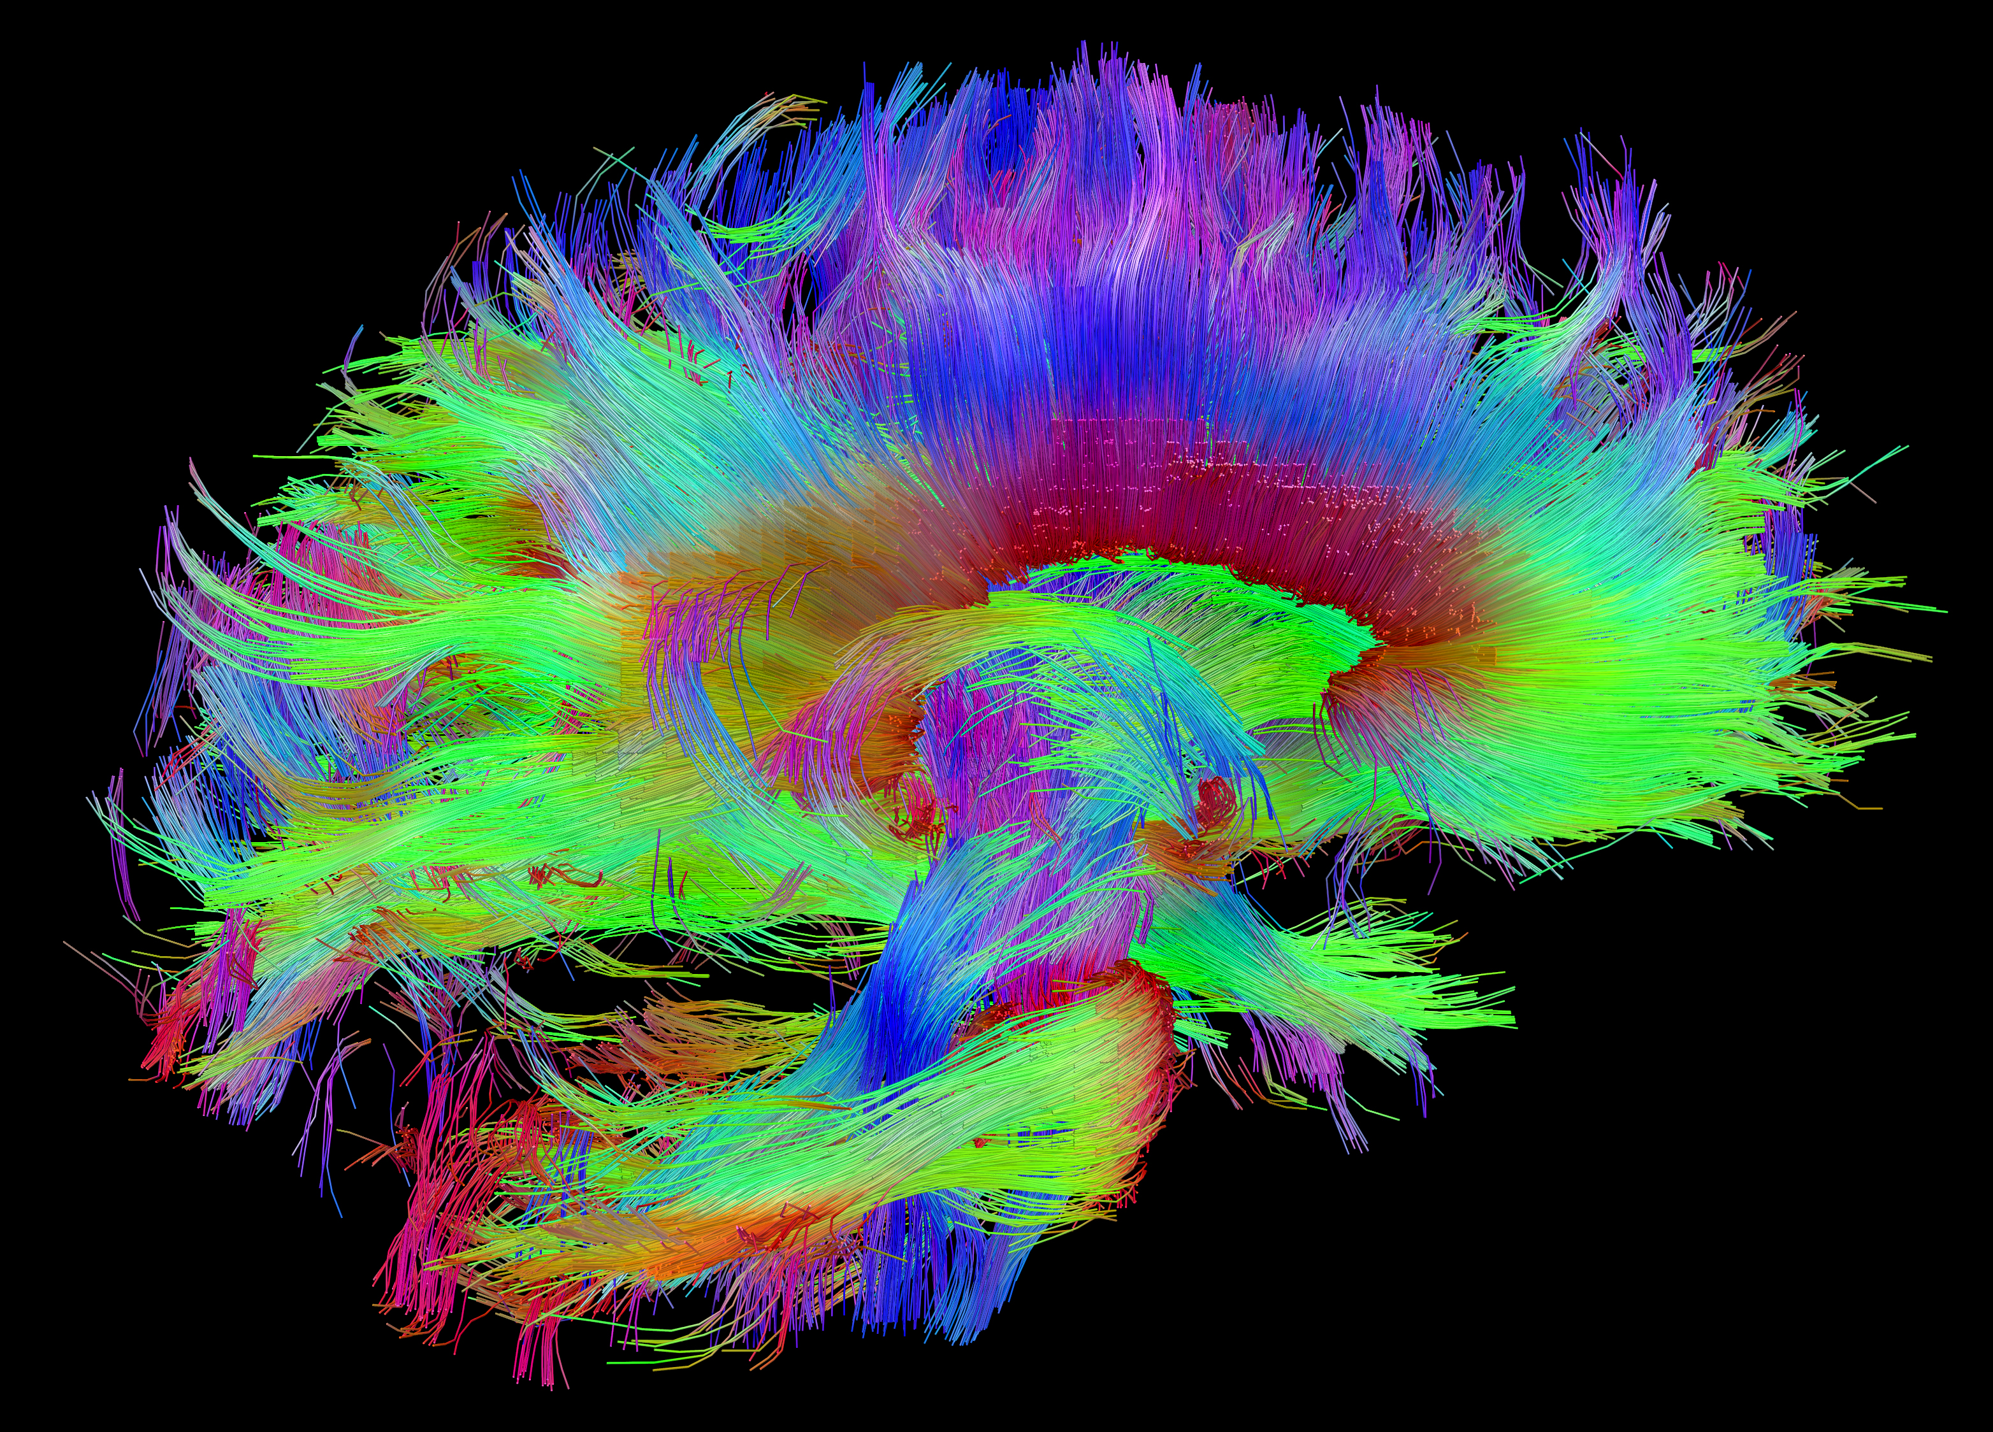
The Connectome

Slide 20
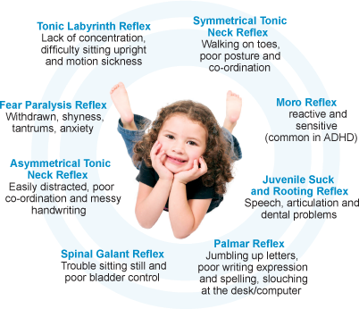
Primitive Reflexes
Primary reflexes are the epi genetic code for subcortical pathways which regulate neurotransmitters.
Sometimes they are not integrated properly leading to dysfunction
Proper evaluation is key to integrating and restoring proper function

Slide 21
Stop moving to listen
STNR
Cat Cow exercise
Hold each for 10 seconds
7-10 sets daily

Slide 22
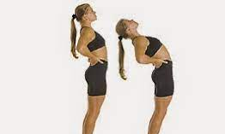
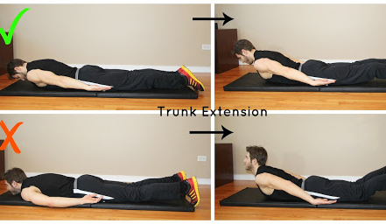
Extension
Trunk Extension
In moments of reaction or stress practice trunk extension

Slide 23

Peripheral Vision Activation
Wiggle your fingers while moving your arms up and down forward and back until your fingers go out of your vision range then come back in. Repeat this exercise two or 3 times, repeating often.

Slide 24

Spine Rotations
Activate the Hippocampus
Spine Rotations Daily
Help to improve Memory

Slide 25
Dry Brushing
Beneficial with stress, anxiety, PTSD, self harm, and ASD
Use a natural fiber brush, start in the mornings and evenings before showering
Teach kids to perform on themselves and use in moments of response
HOW TO
Dry skin brushing is done when the skin is dry, not wet. Always sweep in the direction of the heart. Begin at one of the feet and in long strokes sweep up the front of the leg, calf to thigh, then reach around back and sweep up the back of the calf, thigh, and buttocks to the lower back.
Do a set of 3 fully complete sweeps in each area. Now do this on the opposite side of the body. When the legs have been done, lift one arm over your head and sweep down from the wrist, moving down the inner arm and gently passing over the underarm and the breast tissue, being careful not to touch the nipple. Then sweep the outside of the arm and up over the shoulders toward the neck.
Cover all areas on the arm three times, then repeat on the other arm. Now gently, brush from the bottom of the neck over the chest and sternum in the direction of the heart, and, next, sweep up along the abdomen in the direction of the heart.
When you are finished, take a moment to close your eyes and feel the various sensations you are experiencing, breathing rhythmically and allowing the experience to bring you into body awareness.

Slide 26

Aromatherapy
Never give essential oils orally to kids unless if you’re working with a qualified and expert practitioner. Like all chemical substances, essential oils should be kept out of reach of kids.
Methods safe for kids- Diffusion, baths, massage, rollers, and sprays

Slide 27
OILS
Lavender (Lavandula angustifolia)
Lavender has a calming effect and has also been proven to induce relaxation and sleep. A word of caution: Children with ADD, ADHD or autism may react negatively to lavender essential oil so it is important to carry out a test first to determine whether or not this oil has a sedative effect or not.
A word of caution: Children with ADD, ADHD or autism may react negatively to lavender essential oil so it is important to carry out a test first to determine whether or not to avoid it.
Mandarin orange (Citrus Reticulata)
Mandarin orange essential oil has been found to have relaxing qualities. It is also known as tangerine essential oil. This oil calms stress and anxiety and has also been found to be effective in reducing hysteria.
Vetiver (Vetiveria zizanioides)
Vetiver has been found to help calm kids’ anxiety, anger, and hyperactivity. It fights against stress and has also been found to calm sleep.
Frankincense (Boswellia carterii)
Frankincense has been around for years. It was used in ancient Egypt and is still used in several religious ceremonies today. Frankincense has been found to induce feelings of peace and relaxation. It has a calming effect that can help calm kids’ anger and anxiety.
Cedarwood (Cedrus atlantica)
Cedarwood is an essential oil extracted from the cedar tree. Some of the benefits of Cedarwood oil include reduced tension, stress, and anxiety. This oil can also help kids with sleeping problems.
Ylang Ylang (Cananga odorata)
Ylang Ylang acts as an antidepressant. It has been associated with reduced stress and anxiety and with improved moods.

Slide 28
QUESTIONS????
drlexie@oybcs.com
Drtommy@oybcs.com
Optimalyou.health

Slide 29
Works Cited
Miller GE1, Cohen S,Ritchey AK. Chronic psychological stress and the regulation of pro-inflammatorycytokines: a glucocorticoid-resistance model. Health Psychol. 2002Nov;21(6):531-41.
https://www.ncbi.nlm.nih.gov/books/NBK560856/

