Slide 1
Leveraging Your Child’s Neuroplasticity for Deep Work
Craig A. Davis, PhD
St. Johns County School District

Slide 2
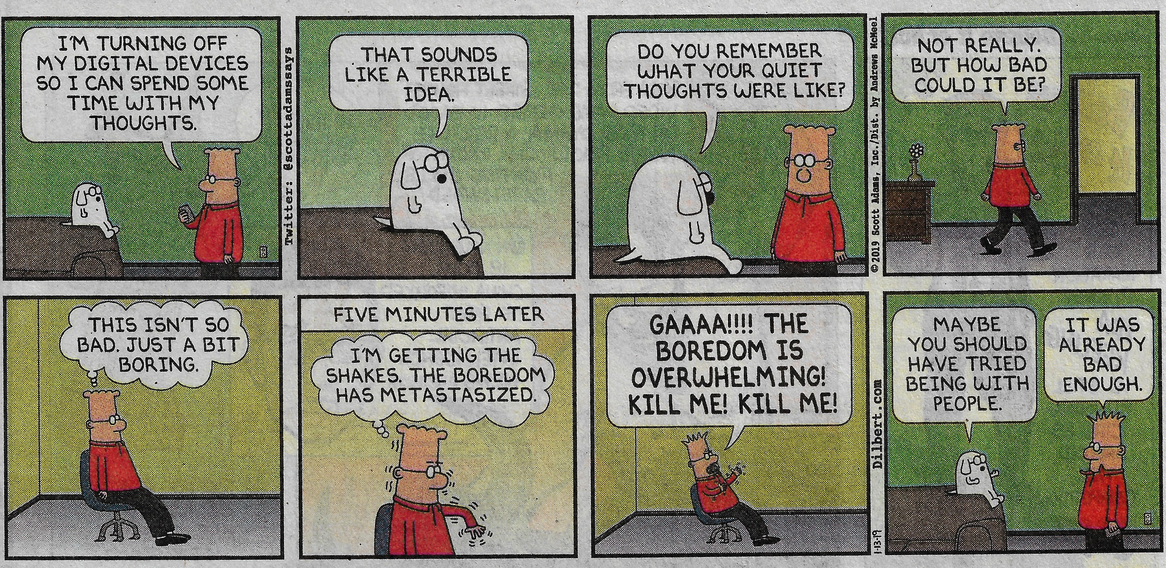

Slide 3
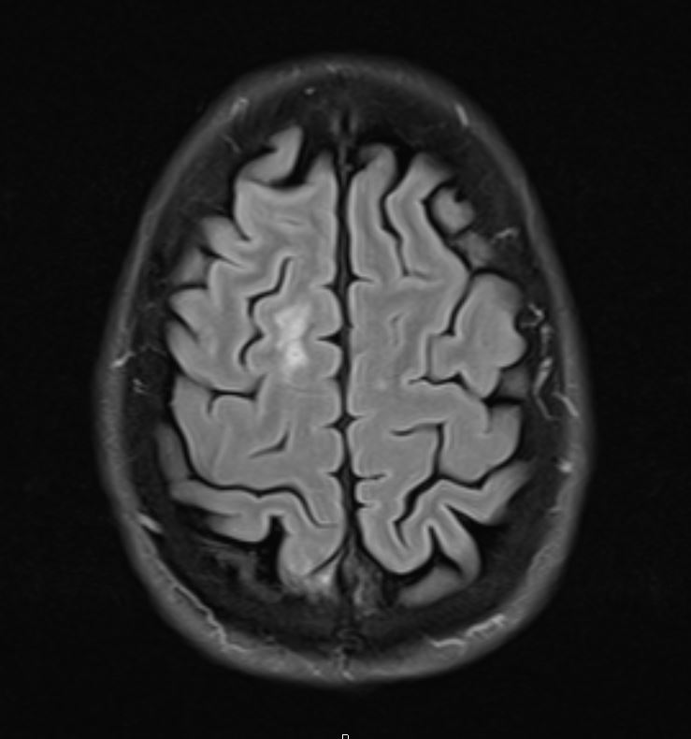
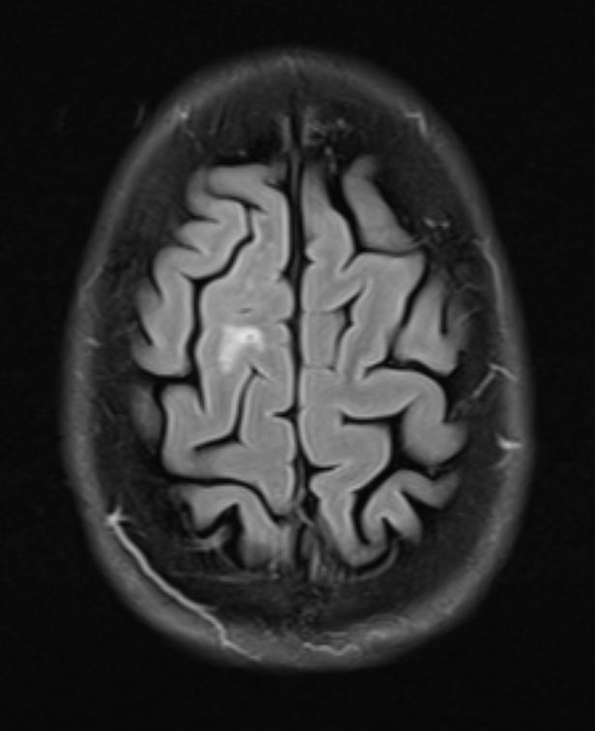

Slide 4
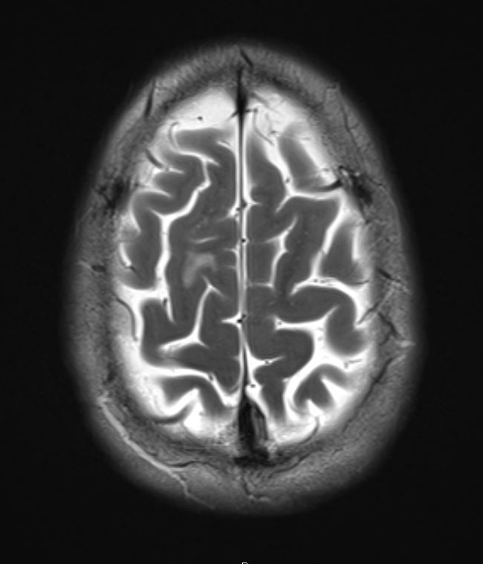
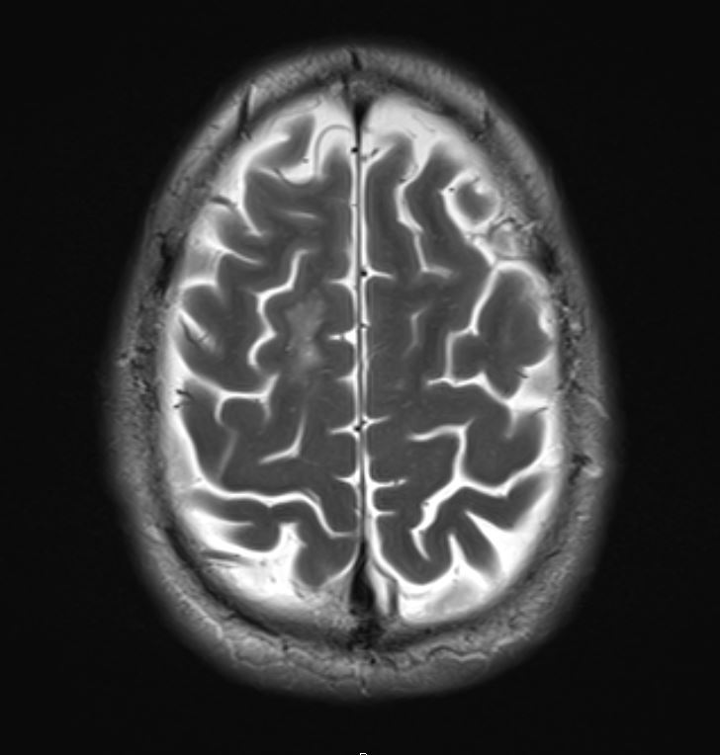

Slide 5
Healthy Digital Engagement
Focus/Stamina
Growth Mindset
(I am what I choose to be.)
G R I T
Internal Locus of Control
Ability to Delay Gratification
Self-Compassion
Hedonistic Adaptation
Notes:
Hedonic adaptation involves the observed human tendency to return quickly to a relatively stable level of happiness despite major positive or negative life experiences.

Slide 6
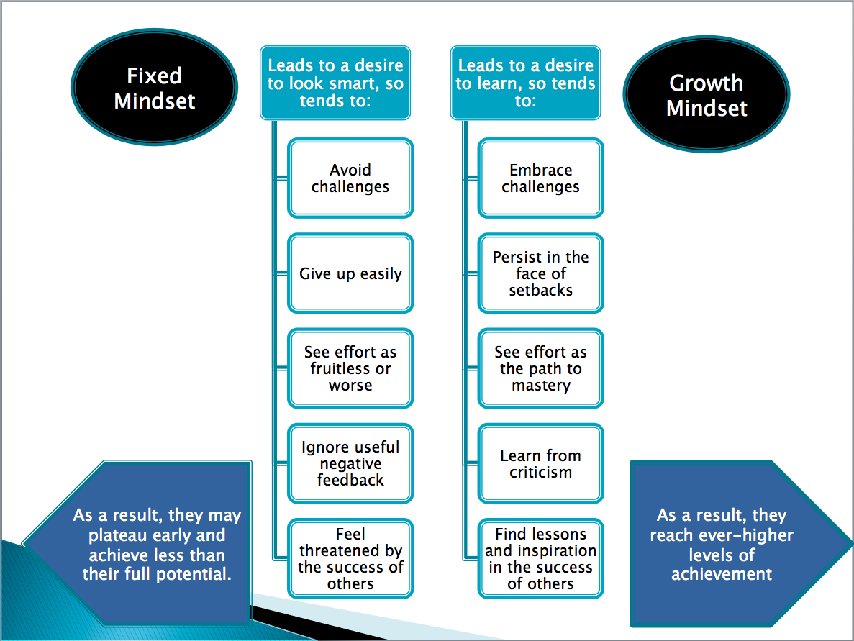

Slide 7
Digital Distraction
Attention Deficit / Lack of Stamina
Fixed Mindset
(I am what I am.)
RETREAT
External Locus of Control
Inability to Delay Gratification
Self-Condemnation
Notes:
Intolerance for Discomfort (related to inability to delay gratification)
External locus of control: a disturbing trend—the alarming rise in an external locus of control (LOC) among our young people, who feel that powerful others or a quirk of fate controls their lives (Twenge et al., 2004). Feeling helpless and dependent upon external authorities, these young people have poorer health and high levels of anxiety and depression, while those with an internal LOC get better grades, cope more effectively with stress, and are mentally and physically healthier (Chorpita, 2001, Peterson, 1979; Peterson & Stunkard, 1989; Twenge, 2000; Twenge et al., 2004). “Why Are so Many American Children Anxious and Insecure?” Dreher, 10/18/19

Slide 8
Neuroplasticity
How we think affects the structure of our brains.
Our ability to initiate and sustain concentration can atrophy.
Once changed, the brain resists a reversal (plasticity versus elasticity).
“If we stop exercising our mental skills, we do not just forget them: the brain map space for those skills is turned over to the skills we practice instead.”
Norman Doidge (2007), The Brain that Changes Itself

Slide 9
https://www.youtube.com/watch?v=MFzDaBzBlL0
Notes:
Backwards Brain Bicycle

Slide 10
https://www.youtube.com/watch?v=ELpfYCZa87g
Notes:
Neuroplasticity

Slide 11
The Onslaught
1995: Widespread use of the Internet
1999: BlackBerry e-mail pager
2001: iPod (“1,000 songs in your pocket”)
2002: Video streaming format standardized
2002: Ashley Madison site launched (60 million members as of 2/2019)
2003: BlackBerry smartphone
2003: MySpace
2004: Facebook
2005: YouTube
2007: iPhone
2010: iPad
2010: Instagram
2011: Snapchat

Slide 12
The Onslaught (cont.)
2012: Tinder (STD diagnoses rise sharply)
2013: Google Glass
2013: Apple Watch
2014: Nearly half of all U.S. households subscribe to Netflix, Amazon Prime, or Hulu Plus via Internet-access devices, including Apple TV, Google Chromecast, Roku (binge-watching accelerates)
2014: Over 10 million iPhone 6 / 6 Plus units sold within 3 days after release on 9/22—a new record (the 5s was released only 1year before, on 9/20)
2014: Amazon Echo introduced (widespread access to AI)
2014: Apple CarPlay released
2015: Over 13 million iPhone 6S / 6S Plus units sold through first weekend after release on 9/25—another new record

Slide 13
The Onslaught (cont.)
2016: Oculus Rift releases VR unit
2016: Sophia, a female humanoid companion robot, introduced (Westworld?)
2017: TikTok
2018: Market saturation—iPhone sales begin to decline
2018: MIT introduces AlterEgo
2019: Echo Auto
2019: Echo Buds
2019: Echo Frames
2019: Echo Loop

Slide 14
https://www.youtube.com/watch?v=RuUSc53Xpeg
Notes:
AlterEgo device

Slide 15
The Digital Invasion Chart
In 2000 |  |  |  | In 2013
Spent 2.7 hours per week online |  |  |  | Spent more than 30 hours per week online
100 million daily Google searches |  |  |  | 4.7 billion daily Google searches
14 billion text messages sent daily |  |  |  | 188 billion text messages sent daily
0 apps downloaded |  |  |  | 25 billion apps downloaded
0 YouTube video monthly views |  |  |  | Over 800 million YouTube monthly views
0 people on Facebook |  |  |  | 1 billion people on Facebook
0 Tweets on Twitter |  |  |  | 400 million tweets per day on Twitter
Hart & Frejd, 2013

Slide 16
Every 20 seconds….
11 Hours per Day
Notes:
Every 20 seconds: “Two researchers realized that people switched content on their screens every 20 seconds on average, and Screenomics was born.” Amanda Capritto, “What's Your Screenome? It May Be More Important than Screen Time” (7/25/19); 11 hours per day on screens, up from 9 hours and 32 minutes, 4 years ago—per Nielsen data: Nicole Lyn Pesce, “Are you a ‘zombie eater’? It could be bad for your health” (7/25/19)

Slide 17
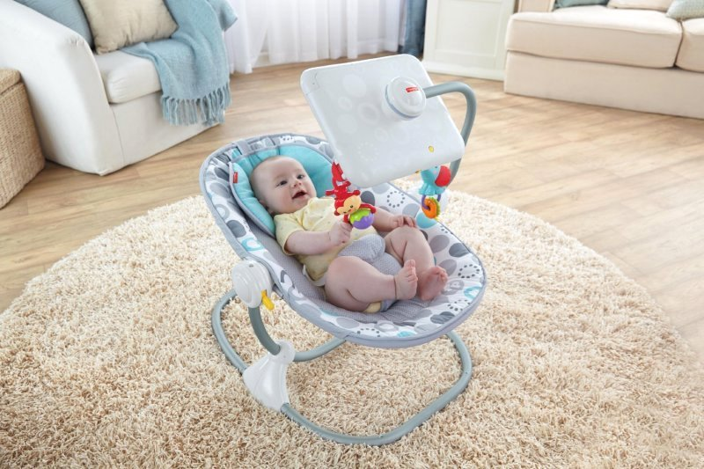
Notes:
PTO Board meeting at LPA in July, 2015: attending board members who brought their children provided them with phones and tablets to occupy them during the meeting. According to LPAs SLP, she is seeing an increasing number of students who appear to present speech challenges that may have been avoided with more frequent, more involved parent interaction at home. “Children with Short Attention Spans Failing to Read Books” (The Telegraph, 6/20/12). Life as a drop-down menu, clicking around obstacles….

Slide 18
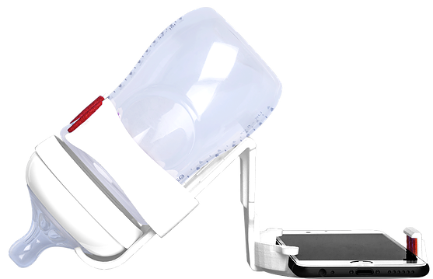
The Swipe and Feed

Slide 19
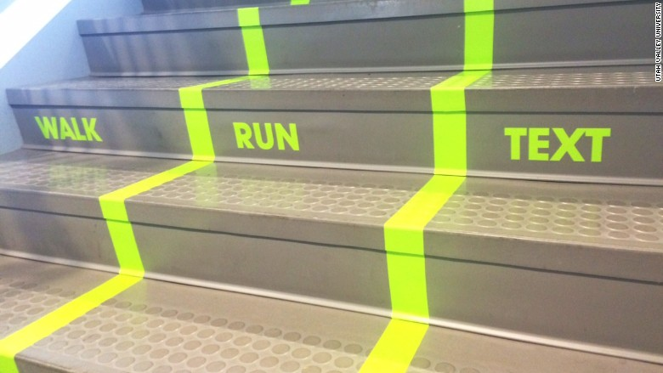
Meanwhile at Utah State University . . .

Slide 20
Headlines
“Are Teenagers Replacing Drugs with Smartphones?”
      The New York Times, 3/13/17
“Has Dopamine Got Us Hooked on Tech?”
      The Guardian, 3/4/18
“Kids Unable to Hold Pencils Due to Excessive Touchscreen Use:
Experts”
      New Indian Express, 2/26/18
“The Follower Factory”
      The New York Times, 1/27/18
“Facebook’s Greatest Weapon: Endless Comparison of Ourselves to
Others”
      The Guardian, 1/20/19
“In Appeal to Young Catholics, Vatican Unveils the ‘eRosary’ — an Electronic Way to Pray”
      The Washington Post, 10/17/19
“Your Phone Has 18 Times More Bacteria than a Public Restroom — this Clever Device Sanitizes It for You”
      Businessinsider.com, 10/7/19

Slide 21
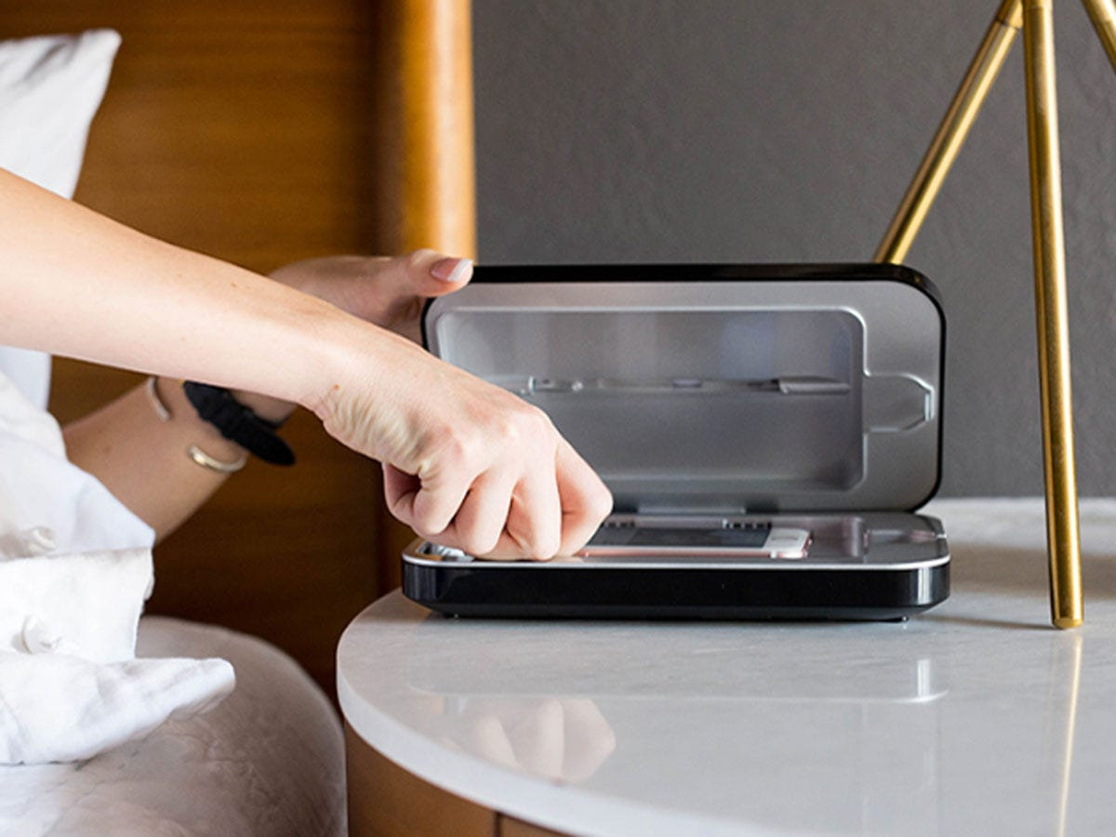
PhoneSoap

Slide 22
“It’s Time for Apple to Build a Less Addictive Phone”
      The New York Times, 1/17/18
“What Controls Your Attention Controls Your Life”
      HBR.org, 6/5/12
“Formula 2 Racer Handed Suspension for Deliberately Hitting Teammate, Texting While Driving”
      Jalopnik.com, 7/8/18
“Statistics Show Nearly Half of Kids Entering Kindergarten in Florida not Prepared”
      News4jax.com, 7/9/18
“13 Philadelphia Officers Expected to Be Fired for Social Media Posts”
      CNN, 7/18/19
“Mooresville Teacher Shames Special Needs Student on Social Media”
      Fox46charlotte.com, 8/30/19
“Fortnite Video Game 'as Addictive as Cocaine,' According to Lawsuit”
      News4jax.com, 10/8/19

Slide 23
“ADHD Study Links Teens’ Symptoms with Digital Media Use”
      CNN, 7/17/18
“Skim Reading is the New Normal: The Effect on Society Is Profound”
      Ideas for America, 8/25/18
“Study: Nearly Half of Parents Use Cellphone While Driving”
      News4jax.com, 9/20/18
“Early Screen Exposure Linked to Cognitive and Developmental Problems in Children”
      Lifestyle, 2/9/19
“Inattentive Children Will Earn Less Money at 35”
      Medical Press, 6/19/19
“Researchers Say Shifting Body Posture Due to Phone Use Is Causing Hornlike Bone Spurs”
      The Hill, 6/20/19
“New LEGO Sets Are Designed for People Who Are Always Glued to Their Smartphones”
      Techradar.com, 10/28/19

Slide 24
“Pampers Is Making a ‘Smart’ Diaper, Yes Really”
      CNN, 7/24/19
“Viral Video of Girl Licking Tongue Depressor Lands Mom in Jail”
      News4jax.com, 7/11/19
“Officers Guard Freezer to Prevent Others from Licking Ice Cream Containers”
      News4jax.com, 7/7/19
“Cops Pose as Utility Workers to Catch Distracted Drivers”
      Actionnewsjax.com, 6/20/19
“‘Zombie Eating’: 88% Of Adults Dine While Staring At A Screen, Survey Finds”
      StudyFinds.com, 7/24/19
“Now Some Families Are Hiring Coaches to Help Them Raise Phone-Free Children”
      The New York Times, 7/6/19
“Rates of ADHD Diagnosis Among US Adults Are on the Rise, Study Suggests” [43% Increase from 2007 – 2016]
      CNN, 11/1/19
Notes:
“Cops Pose as Utility Workers”: 170 tickets issued primarily for “hands free” driving violations in approximately 2 hours, near the Big Chicken (KFC) in Marietta, Georgia

Slide 25
“Early Screen Exposure Linked to Cognitive and Developmental Problems in Children” (Lifestyle, 2/9/19)
  France, from 2010, children ages 2 – 11
  Intellectual and cognitive disorders increased 24%
  Psychological disorders increased 54%
  Speech / language disorders increased 94%

Slide 26
Digital Engagement Survey Results

Slide 27
Lose track of time with devices: 68%
Extend restroom visits: 28%
Smartphone / tablet use in bed, just prior to sleep: 60%
Sleep with smartphone on, near bed: 84%
Check phone while someone is talking to you: 75%
Respond to smartphone messages while driving: 53%
Trouble remaining asleep: 43%
Keep smartphone next to your meals: 41%
Feel uncomfortable without phone/service: 57%
Ability to concentrate diminished last 5-10 years: 51%

Slide 28
Have read at least one book during last year: 61%
Device-free silent reflection for at least 15 minutes: 80%
Binge-watch streaming content: 44%
Number of times you check phone in 24 hours: 1-200
When concentrating, keep phone close to monitor: 38%
Disappointed when little / no reaction to posting: 13%
Number of social media posts during a week: 0-100
Couple / family simultaneously looking at phones: 71%

Slide 29
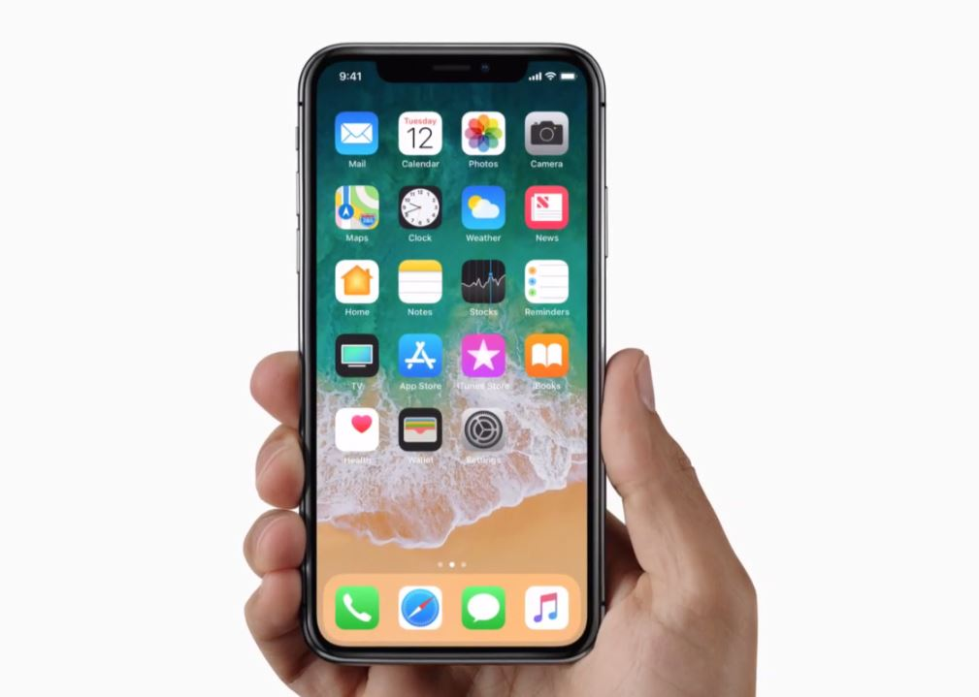
A Dopamine Delivery System
“Convenience weaponizes temptation.” Adam Alter

Slide 30
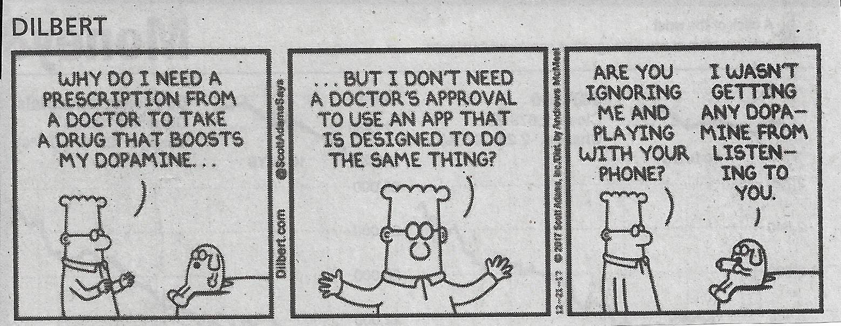

Slide 31
The Attention Economy
Attention Engineers

Slide 32
Global Community
Attention Economy
(driven by distraction)
Knowledge Economy
(driven by focus)
To be immersed in one economy is to be excluded from the other.

Slide 33
Deep work:
Professional activities performed in a state of distraction-free concentration that push your cognitive capacities to their limit. These efforts create new value, improve your skill, and are hard to replicate.

Slide 34
Shallow work:
Noncognitively demanding, logistical-style tasks, often performed while distracted. These efforts tend not to create much new value in the world and are easy to replicate.

Slide 35
The Opportunity Cost of Shallow Work = Deep Work

Slide 36
“One of the main obstacles to going deep: the urge to turn your attention toward something more superficial.”
Cal Newport
“The trivial as tranquilizer.”
Kierkegaard

Slide 37
District e-Mail Activity: 3/18 - 4/6/18 (20 days)
Total e-mails sent: 251,870
Total e-mails read: 771,791
Total e-mails received: 1,783,486
Notes:
This time period includes spring break.

Slide 38
Weekend Days (5)
Total e-mails sent: 5,425
Total e-mails read: 26,610
Total e-mails received: 168,734

Slide 39
Spring Break (M-F)
Total e-mails sent: 19,951
Total e-mails read: 87,241
Total e-mails received: 404,396

Slide 40
Total e-Mail Received, per Employee
(excluding food service, transportation, custodial, maintenance)
20-Day Period, including weekends and spring break:
437

Slide 41
The American Management Association reports that employees spend an average of 107 minutes on e-mail per day.
The average employee gets interrupted from their work every 11 minutes, and in each case loses about the same amount of time recovering from the interruption.
The Happiness Advantage, Shawn Achor

Slide 42
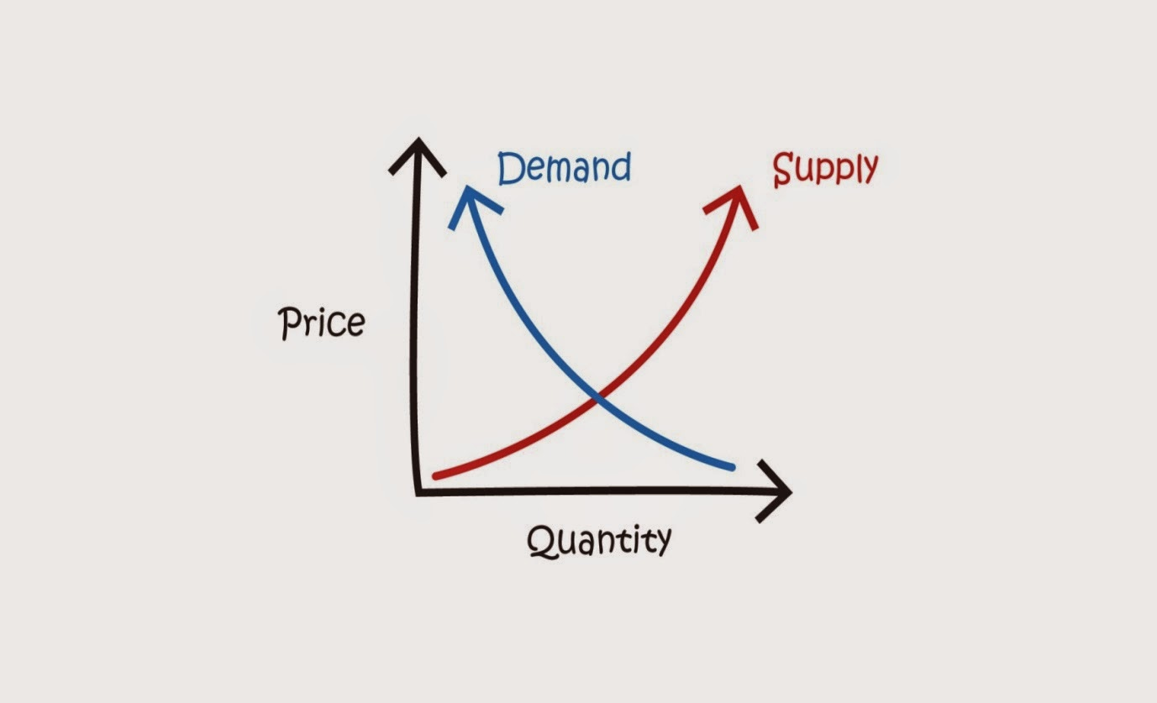
Deep Work Is Rare.

Slide 43
High-Quality Work Produced =
(Time Spent) X (Intensity of Focus)

Slide 44
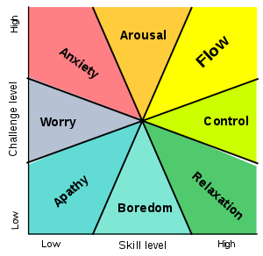
Flow: A mental state of complete absorption in the current experience.

Slide 45
The Rhythmic Method of Deep Work

Slide 46
The Craftsman Approach to Tool Selection
“Identify the core factors that determine success and happiness in your professional and personal life. Adopt a tool only if its positive impacts on these factors substantially outweigh its negative impacts [as opposed to the ‘any-benefit approach’]”.
Notes:
Does this activity, the use of this particular tool, contribute value—is this use of my time consistent with my core values?

Slide 47
Attention Residue:
The effectiveness of multitasking is a myth.

Slide 48
Willpower is like a muscle—it fatigues through use.

Slide 49
Unconscious Thought Theory
Attention Restoration Theory
Notes:
Great ideas come to us in the shower—why? We take no distractions with us—our brains have an opportunity to idle. Apply this concept to your commute—do not use your radio. Travel in silence.

Slide 50
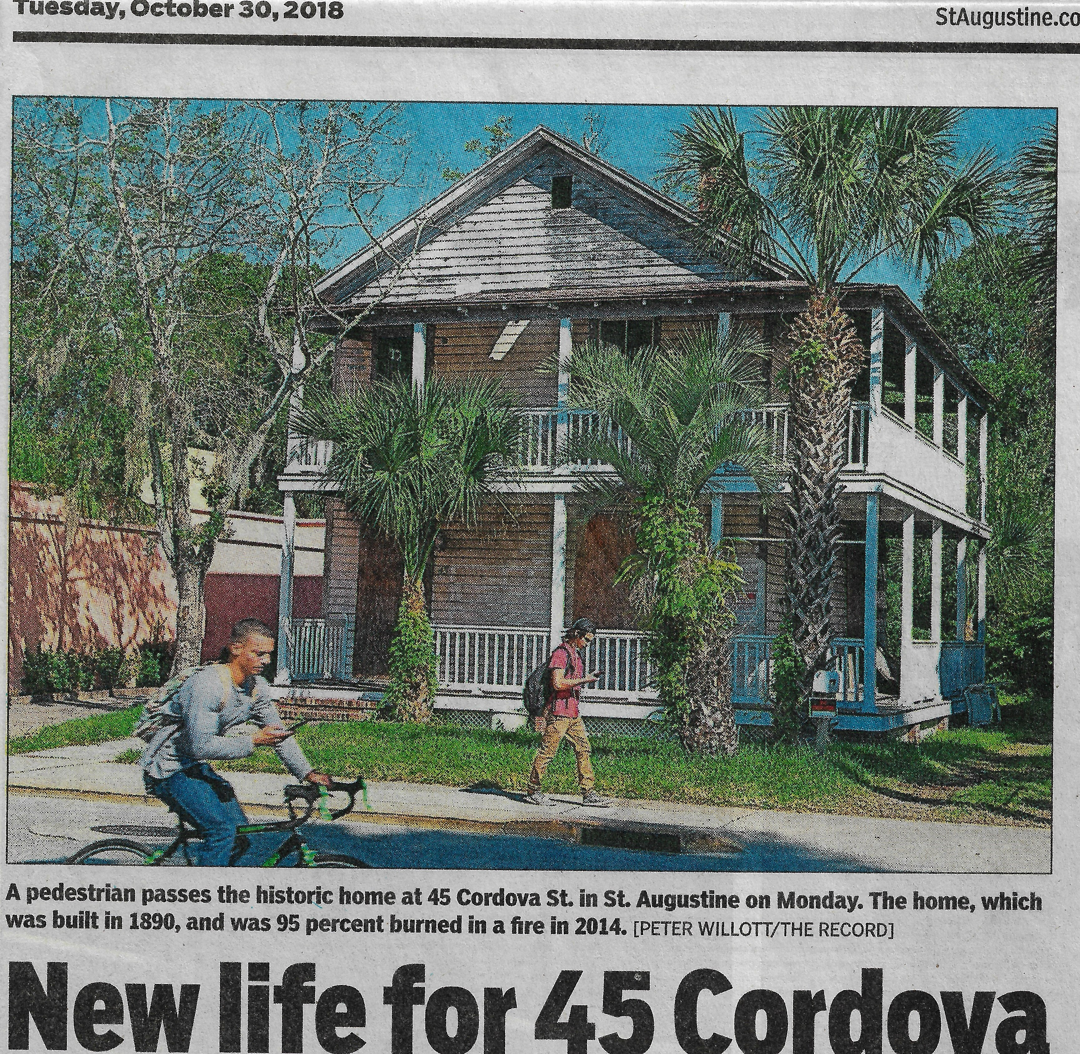

Slide 51
Distraction as a “Cognitive Crutch”
“You’ll struggle to achieve the deepest levels of concentration if you spend the rest of your time fleeing the slightest hint of boredom . . . . or cognitive challenge . . . . [Learn] to tolerate an absence of novelty.”
Cal Newport

Slide 52
The Traffic Light Prayer

Slide 53
“Research has shown that distracted diners often consume more calories [15% on average] or overeat compared to those who are more present with what’s on their plates.”
“Are You a ‘Zombie Eater’? It Could Be Bad for Your Health,” Nicole Lyn Pesce, Market Watch, 7/25/19

Slide 54
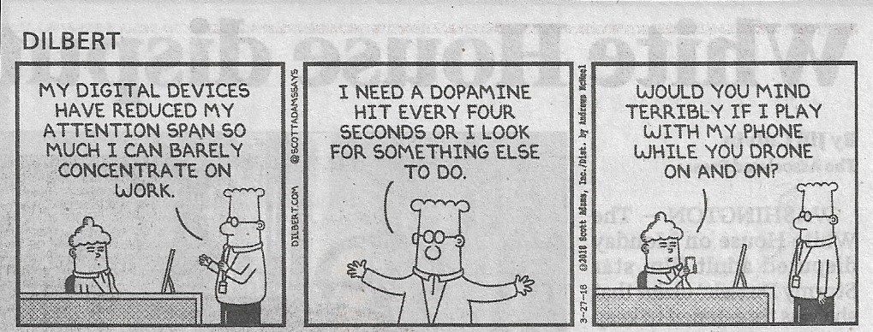

Slide 55
Digital Distraction
Attention Deficit / Lack of Stamina
Fixed Mindset
RETREAT
(Shallow Work)
External Locus of Control
Inability to Delay Gratification
Self-Condemnation
Notes:
Intolerance for Discomfort (related to inability to delay gratification)

Slide 56
Healthy Digital Engagement
Focus/Stamina
Growth Mindset
(I am what I choose to be.)
G R I T
(Deep Work)
Internal Locus of Control
Ability to Delay Gratification
Self-Compassion
Hedonistic Adaptation
Notes:
Hedonic adaptation involves the observed human tendency to return quickly to a relatively stable level of happiness despite major positive or negative life experiences.

Slide 57
To produce at your peak level you need to work for extended periods with full concentration on a single task free from distraction . . . . If you’re not comfortable going deep for extended periods of time, it’ll be difficult to get your performance to the peak levels of quality and quantity increasingly necessary to thrive professionally. Unless your talent and skills absolutely dwarf those of your competition, the deep workers among them will outproduce you.
Cal Newport

Slide 58
What can we do?
“Devote your best thinking time for tasks that most need your creativity and focused attention. And don’t allow interruptions.” Linda Naiman
Control your context:
  Reduce your phone / watch notifications (keep only the essential).
  Silence your computer notifications.
  Separate from your phone (put it in a drawer).
  Quiet your environment—minimize distractions (visual and aural).
  Minimize the contents of your environment.
Contain e-mail use to specific times of day (morning, midday, late day).
Minimize multitasking (including simultaneous use of multiple screens).
Practice sleep hygiene.
Create daily periods of quiet.
Notes:
Sleep hygiene: do not drink caffeine after 12:00 PM, do not eat late in the evening, do not use screens (blue light) within an hour before bed, do not use a TV in your bedroom, keep the room at a cooler temperature, keep the room completely dark, use white noise if you are a light sleeper, do not work in your bedroom.

Slide 59
What can we do? (cont.)
Allow your brain to idle (stop gadget fidgeting).
Read and write (journal) daily.
Practice presence.
Have a shutdown ritual.
Continually question the value of what you are doing.
Protect the neuroplasticity of children.
If you have found yourself stuck in the shallows, you can still move to deeper levels of work—your brain will respond.

Slide 60


Slide 61
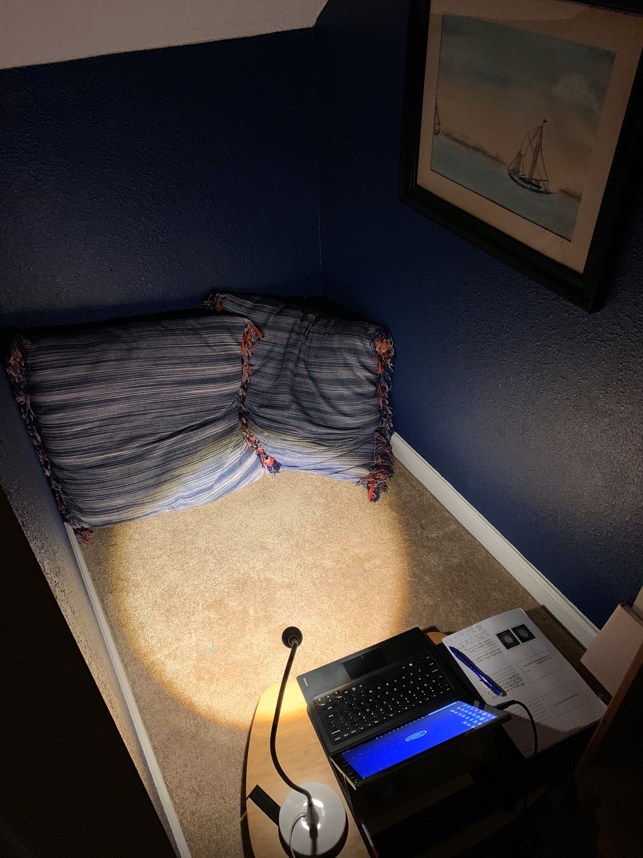

Slide 62
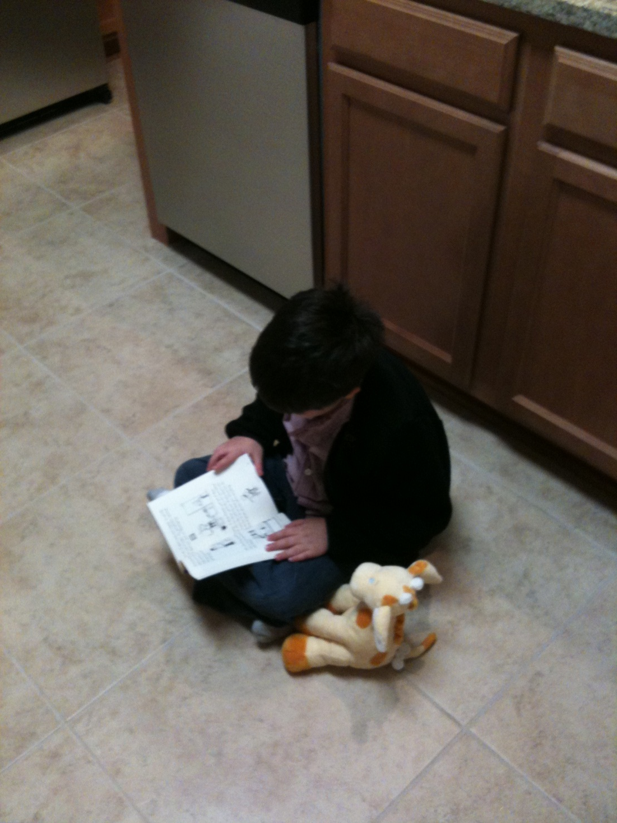

Slide 63
If battles are won and lost within our minds, how can we possibly cope with challenge or adversity if our minds have been hijacked?

Slide 66
When is the last time that you gave something your cognitive best?
Can you?

Slide 67
“Deep work is the superpower of the 21st century.”
Cal Newport

Slide 68
The Ultimate Form of Deep Work:
The Spiritual Life

Slide 69
Book Recommendations
Deep Work (2016), Cal Newport
Digital Minimalism (2019), Cal Newport
Irresistible: The Rise of Addictive Technology and the Business of Keeping Us Hooked (2017), Adam Alter
Lead Yourself First: Inspiring Leadership Through Solitude (2017), Raymond M. Kethledge & Michael S. Erwin
Presence: Bringing Your Boldest Self to Your Biggest Challenges (2015), Amy Cuddy
The Power of Habit (2014), Charles Duhigg
The Shallows (2011), Nicholas Carr
  (finalist for the Pullitzer Prize)
Willpower: Rediscovering the Greatest Human Strength (2012), Roy F. Baumister & John Tierney

Slide 70
Craig.Davis@stjohns.k12.fl.us

