Slide 1
raising Gritty kids
Edward C. Taylor, PhD
Child and Adolescent Psychologist
thelearningspecialists.com
ectaylorphd.com

Slide 2
The parents’ manual
Thou Shalt Worry About Your Children
Page 306, Paragraph 4
Notes:
Parents worry about their children
I bet her parents worry a bit less after this race because she has shown them she can bounce back from adversity. She can cope. So, they can sleep better at night.

Slide 3
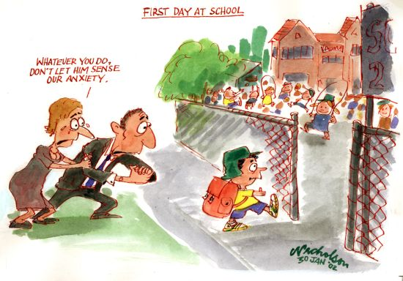
Notes:
So, there is reason to worry about that transition from the safety of your home to the adult world.

Slide 4
Transitions are tough
Developmentally or chronologically pressed to do something
Which the child has no experience doing
A guaranteed nail biter

Slide 5
The Transitions
Every six months, birth to 6
Home to PreK
K to 1st
Elementary to Middle School
Middle School to High School
High School to College
College to Adulthood
Adult to Parent
Parent to Grandparent
Grandparent to Indulgent Party Animal

Slide 6
% of students graduating in 4 years
Flagship Research Universities 36 %
Non-Flagship 18 %
86 % of first time full time students at a 4 year college with acceptance rate < 25 % receive a degree within 6 years of enrolling
Notes:
Fun facts your financial advisor hasn’t told you.

Slide 7
The Challenge to you
Super Duper parents love their kids, keep them safe, and help them become expert at a variety of skills.
That would be you.
But, if you want to be the Super Duperest of them all…
Help your kids learn to manage the transitions.
And, if you are successful, what might the end product look like ?

Slide 8
Is what she did
Hard Wired
Learned
Or Both ?

Slide 9
Looking for an explanation
Gifted Education vs ODP
Notes:
But, if we can understand what goes awry for some kids, maybe we can do something to help them prepare.
I believe we can begin to understand by looking at two different programs: Gifted Education and the Soccer ODP

Slide 10
GIFTED EDUCATION PROCESS
Early identification with IQ 130+
Early identification with behavioral characteristics of Giftedness
Specialized school-driven education
Parent-driven enrichment
Duke TIP, etc.
Once Gifted, Always Gifted
i.e. “I am smart and well educated so life will be OK”
Notes:
The premise is talent and training are enough

Slide 11
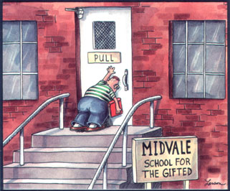
The Golden Child
Notes:
We all know someone like this

Slide 12
intelligence ( talent ) is not enough
It is not sufficient to be intelligent, one must have the capacity to act intelligently
David Wechsler, PhD

Slide 13

Soccer ODP

Slide 14
THE ODP PROCESS
THE ELITE
RE-QUALIFY
TRAINING AND COACHING
RE-QUALIFY
TRAINING AND COACHING
TALENT IDENTIFICATION
Notes:
All start with exceptional athletic talent and receive exceptional training. What makes the difference at the re-qualifying points ?

Slide 15
Gifted Education vs ODP Process
Gifted: Talent and Excellent Education are Sufficient
ODP: Talent Plus Excellent Coaching Are Not Sufficient
There Must Be “Something Else”

Slide 16
% of students graduating in 4 years
Flagship Research Universities 36 %
Non-Flagship 18 %
86 % of first time full time students at a 4 year college with acceptance rate < 25 % receive a degree within 6 years of enrolling
Notes:
Fun facts your financial advisor hasn’t told you.

Slide 17
Three questions
What is the “Something Else” ?
Is it hard wired or can it be learned ?
If it can be learned, how is it taught ?

Slide 18
Three questions
What is the “Something Else” ?
Is it wired or can it be learned ?
If it can be learned, how is it taught ?

Slide 19
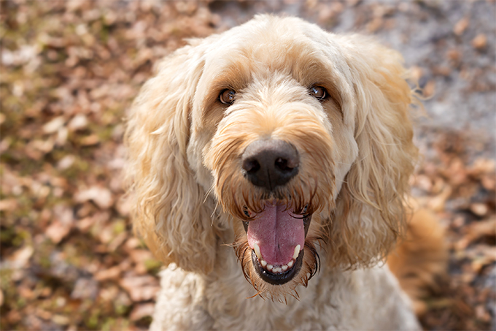
In search of the “something else”

Slide 20
Dog Adjectives
Persistent
Energetic
Clever
Smart
Creative
Willing to take a risk
Wants to succeed
Fast
Strong

Slide 21
Three questions
What is the “Something Else” ?
Is it wired or can it be learned ?
If it can be learned, how is it taught ?

Slide 22
Success attitudes
GRIT ( Angela Duckworth, PhD )
Growth Mindset ( Carol Dwecki, PhD )
Notes:
Two terms being bandied about lately for these success attitudes are GRIT and a Growth Mindset

Slide 23

What is grit ?

Slide 24
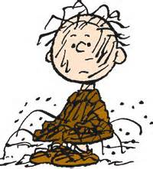
Not That

Slide 25
Constant dripping hollows out a stone
Titus Lucretius Carus
99 BC-55 BC

Slide 26

The only summer reading book I read

Slide 27
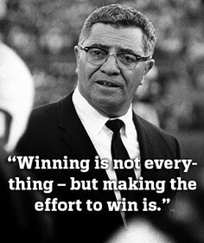

Slide 28
Being gritty
Achieving success is hard and slow…. because it is hard and slow
So, performing as if it is a marathon, not a sprint
Seeking excellence, not perfection or winning
Embracing the idea of iPhone 1,2,3,4,5,6,7,8,X
Never quitting , Bouncing back
Having courage in the face of failure
While maintaining a sense of humor about it all
Notes:
Expound

Slide 29

What is the growth mindset ?

Slide 30
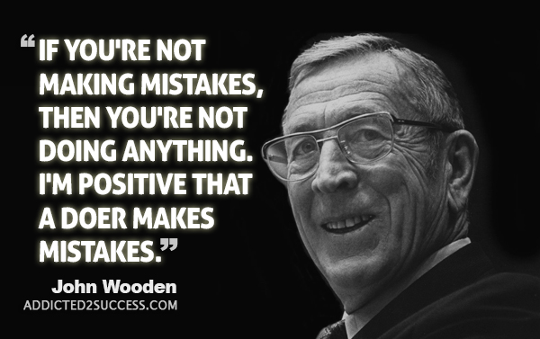

Slide 31
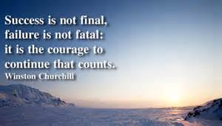
Churchill On Success

Slide 32
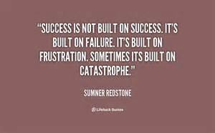
Redstone on Failure

Slide 33
The fixed mindset
The Fixed Mindset: When You Fail You Are A Failure
If I am a failure, inherently, my plight cannot change.
Control over my life is external to me
Notes:
Expound. Do I see it as trait driven or attitude driven ?

Slide 34
The growth mindset
The Growth Mindset: When You Fail You Are Learning
I Can Grow, I Am Not Stuck In This Place
Control over my life is internal to me

Slide 35
Three questions
What is the “Something Else” ?
Is it innate or can it be learned ?
If it can be learned, how is it taught ?

Slide 36
Dog Traits vs Attitudes
Traits ( Hard Wired )
  Smart
  Fast
  Strong
  Big paws
  Not shaggy
Success Attitude ( Hard Wired or Teachable ?)
  Persistent
  Clever
  Really wants it
  Creative
Notes:
We can re-group these adjectives into innate traits versus Success Attitudes
No control over traits.

Slide 37
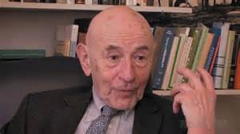
Walter Mischel, PhD

Slide 38
The Marshmallow Test
Notes:
Intro the scenario
After: Ask for adjectives

Slide 39
Marshmallow Test Winner Attitudes
Persistent
Deals with frustration
Can postpone
Clever
Values long term gain over short term pleasure
Notes:
Similar to the dog

Slide 40
12 Years Later
Better grades
Better test scores
Many friends and well liked
Better performers in sports

Slide 41
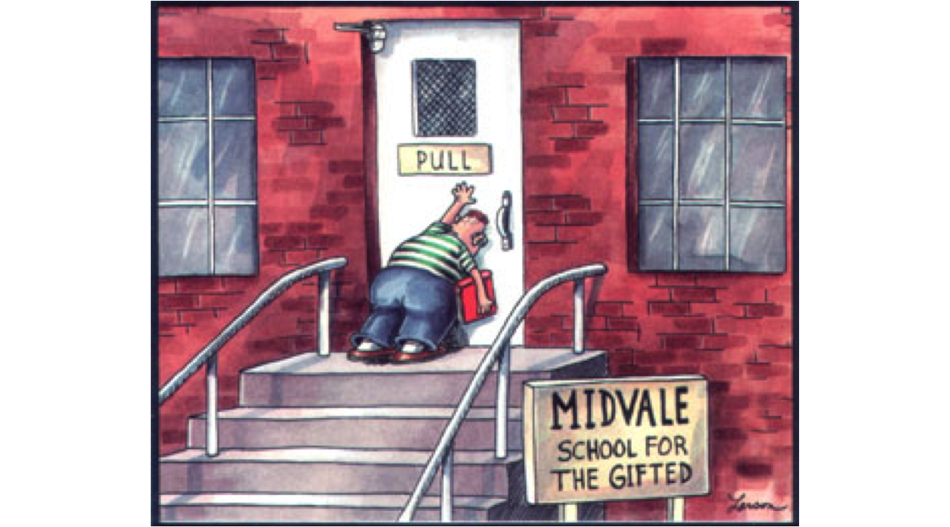
The Traits of Being Smart fast, strong, good looking Were Not relevant

Slide 42
Mischel’s conclusion
Success attitudes can be seen in very young children and are stable over time
Therefore, they must be innate

Slide 43
But, can their expression be influenced ?
The Tar Heel Reprise, aka “Liar, Liar, Pants on Fire”
Notes:
Describe the alternative scenario

Slide 44
The conclusion
If the child believes the environment is rational and their efforts have a reasonable probability of success, the child will exhibit a success attitude (Belief in Internal Control & Use of Active Voice )
If the child believes the environment is arbitrary and their efforts lack influence, the child will not exhibit a success attitude ( Belief in External Control & Use of Passive Voice )
Therefore, success attitudes, whether innate or acquired, are shaped by experiences that affect the children’s beliefs about their ability to control their lives and influence their environments, i.e. Their Sense of Personal Power

Slide 45
The good news and the bad news
Success Attitudes Can Be Weakened Or Strengthened Through Parenting

Slide 46
Three questions
What is the “Something Else” ?
Is it innate or can it be learned ?
If it can be learned, how is it taught ?

Slide 47
The solution
Teach and Parent “The Something Else”
The Something Else Is
Grit and Growth Mindset

Slide 48
Step 1: Adopt it
Establish The Growth Mindset in a GRITTY Home
Create an environment in which the child feels safe to take risks and valued for taking the risk even if they fail
Make the objective becoming grittier, not succeeding

Slide 49
Step 2: model it
Embrace GRITTINESS and the Growth Mindset For Yourself
Model GRIT

Slide 50
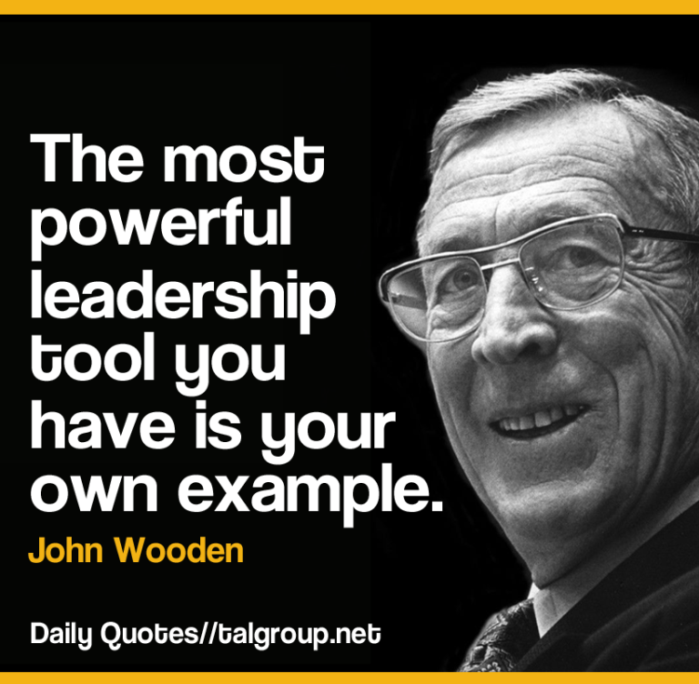
The model

Slide 51
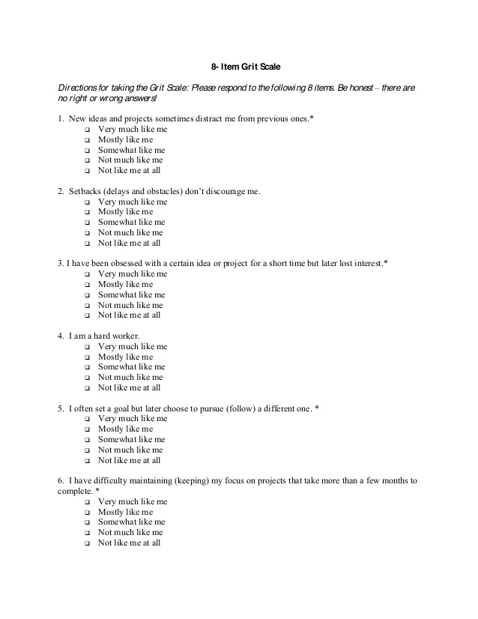
How gritty are you ?

Slide 52
Good News Bad News
If you have ever been gritty, it is within you
But, being gritty is hard so you are not always gritty
But, if gritty is within you, you can always choose to be grittier.
Therefore, you have absolute control over whether or not you become grittier
And knowing how hard it can be makes you a more empathic parent and teacher

Slide 53
The stages of taking on a life demand
An event
An appraisal of the demands presented by the event
An appraisal of the personal tools available to meet these demands
An appraisal of the probability of success and the cost of failure
A physiological stress response that provides physical resources to meet the demands
An emotional label for that stress response
A behavioral response

Slide 54
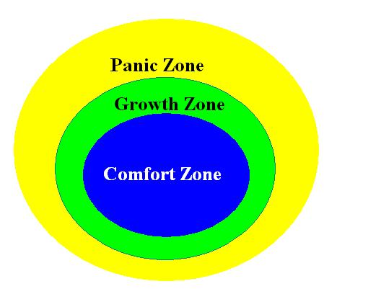
Step 3: move the child into the growth zone

Slide 55

The Growth Zone stretches you

Slide 56
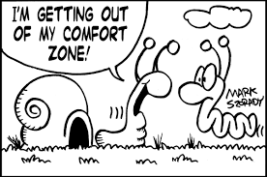
Step 4: Support the child emotionally
Notes:
All growth involves some discomfort. This feeling of discomfort must be normalized, re-defined as an impending opportunity to grow, and addressed as a hurdle to clear.

Slide 57
In The Growth Zone You Feel
Frustration
Uncertainty
Lost
Confused
Anxious
And these are Good Feelings
Normalize the Discomfort

Slide 58
You will be safe
The process will be frustrating
I won’t let you drown
You will participate in your own survival

Slide 59
The stages of taking on a life demand
An event
An appraisal of the demands presented by the event
An appraisal of the personal tools available to meet these demands
An appraisal of the probability of success and the cost of failure
A physiological stress response that provides physical resources to meet the demands
An emotional label for that stress response
A behavioral response

Slide 60

Lost or exploring ?

Slide 61
Step 5: Re-define failure
In the Growth Zone you may Fail
Failure is the only way to know what you need to do to get to the next level
Failure is painful in a good way
The Love-Hate relationship with failure leads to success

Slide 62
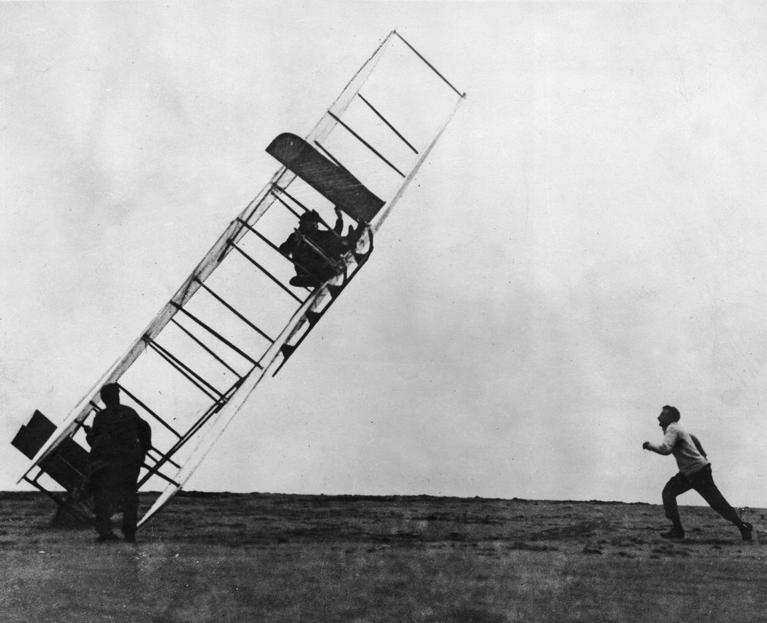
Well orville, time for plan g

Slide 63
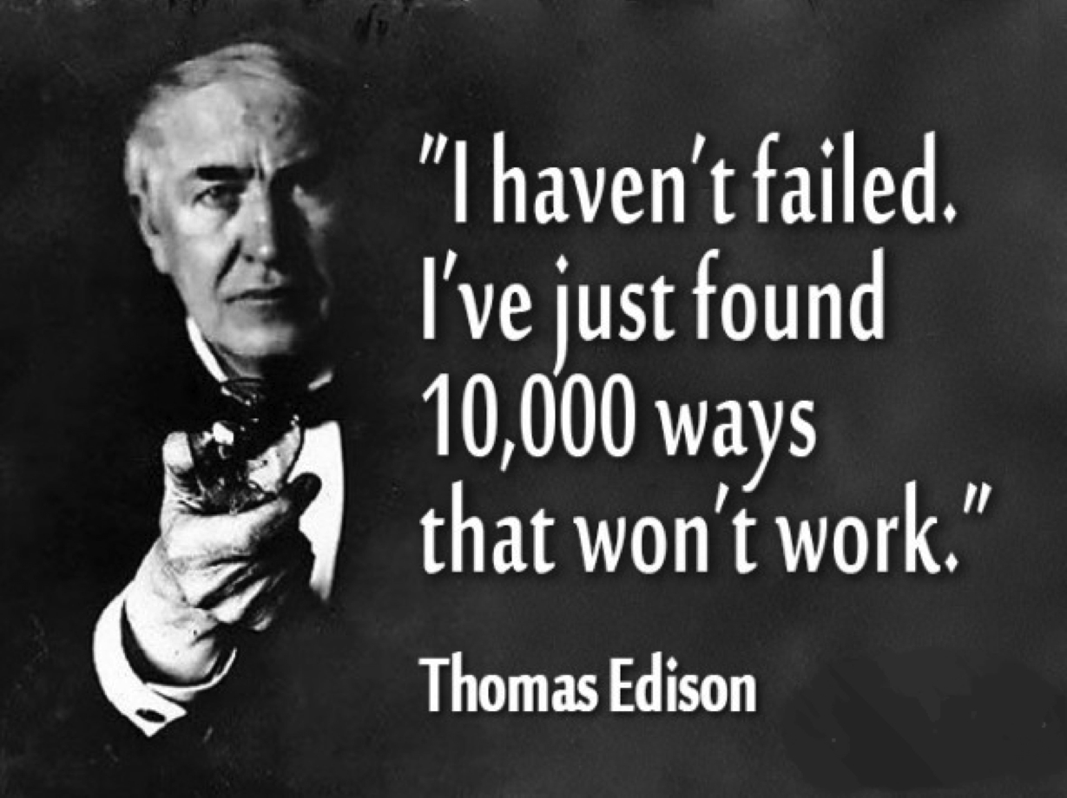

Slide 64
The stages of taking on a life demand
An event
An appraisal of the demands presented by the event
An appraisal of the personal tools available to meet these demands
An appraisal of the probability of success and the cost of failure
A physiological stress response that provides physical resources to meet the demands
An emotional label for that stress response
A behavioral response

Slide 65
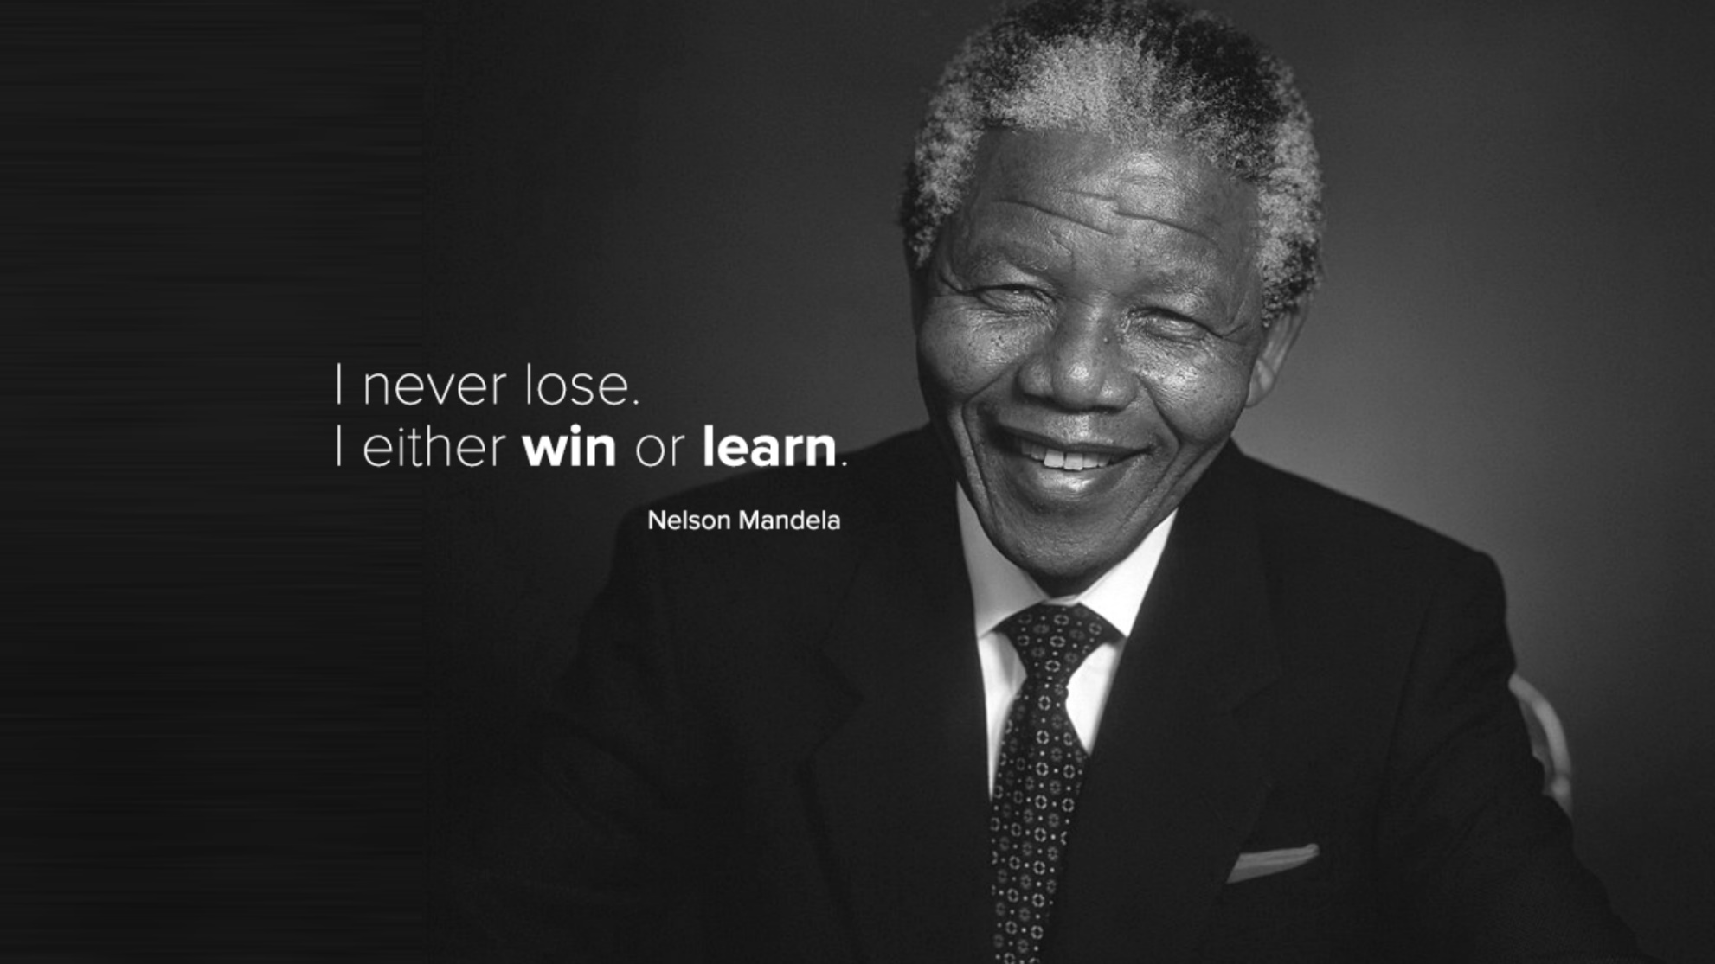

Slide 66
Step 6: Redefine success
I have beaten my personal best
I have added to my skills
I have grown from the failure
It does not mean I accomplished 100 % of what I set out to do.
It does not mean I achieved perfection

Slide 67
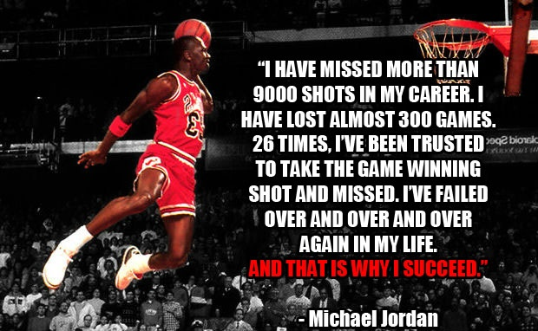
A Gritty guy with a growth mindset

Slide 68
The best in nba history
50 %

Slide 69
Step 7: Provide the child space to have experiences

Slide 70
A Sweater is ….
What the child has to put on when the mother feels cold
The Kidictionary, 2016

Slide 71
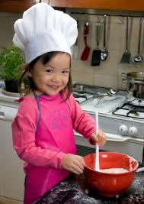
You are the Boss of the Soup
Notes:
The child must see themselves as an agent of influence
What do you want ot ask the doctor today
How would you do that ?
What is your plan ?
What is your opinion about that ?

Slide 72
Embrace experience: a Source of Internalized Controls
Where Does Good Judgment Come From ?
Experience.
Where Does Experience Come From ?
Bad Judgment, Examined.

Slide 73
Allow experience to happen
Do Not Rescue The Student From A Growth Zone Experience.
Facilitate The Processing Of It.
Notes:
Even if it doesn’t work, they have had an experience

Slide 74
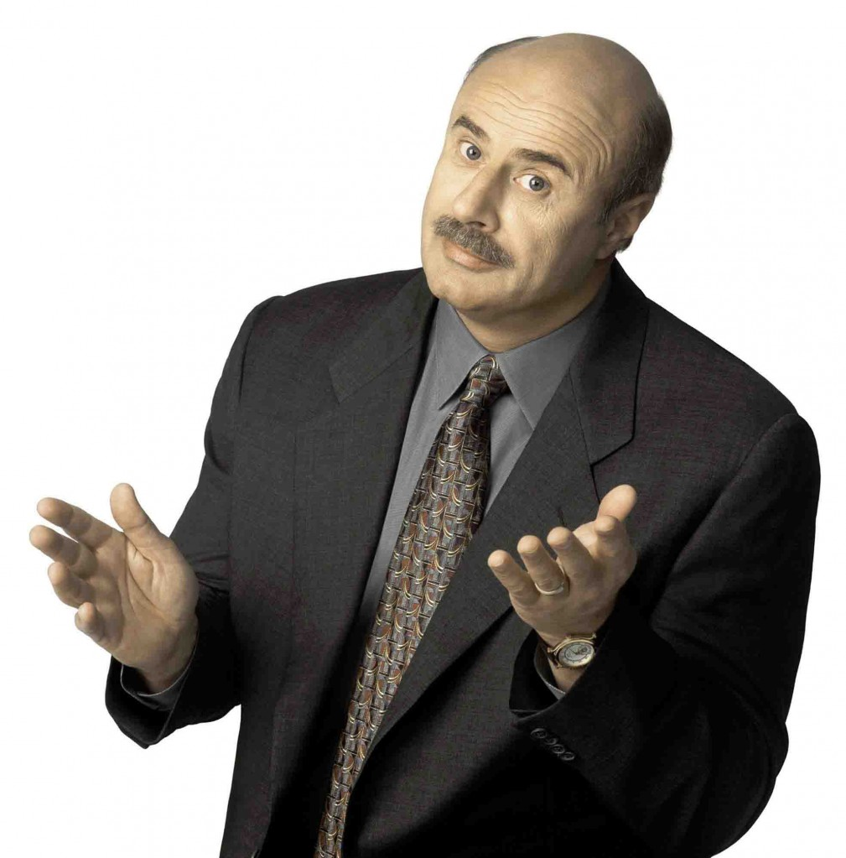
Step 8: Become a process junkie
Notes:
Turn the experience into a learning event by processing it.

Slide 75
Uncover the child’s
An event
An appraisal of the demands presented by the event
An appraisal of the personal tools available to meet these demands
An appraisal of the probability of success and the cost of failure
A physiological stress response that provides physical resources to meet the demands
An emotional label for that stress response
A behavioral response

Slide 76
What to process
The failures: How do you make your F’s ?
The successes: What about the A’s ?
It is all about the decisions you make
Decisions = Control
The goal is Internalized Control

Slide 77

How do you make your f’s ?

Slide 78

How do you make your a’s ?

Slide 79

Time is on my side, yes it is
The Stones

Slide 80

The current milieu

Slide 81
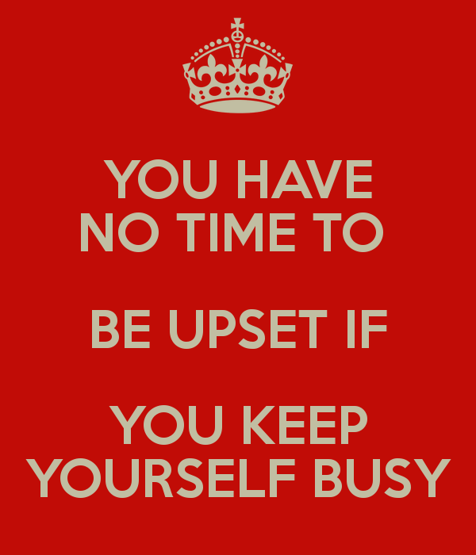
Double edged sword

Slide 82
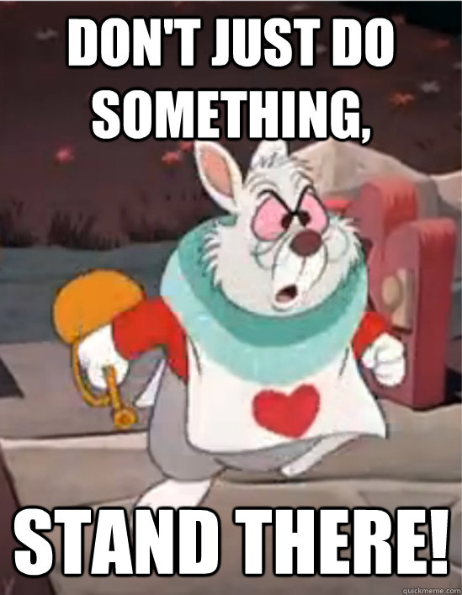

Slide 83
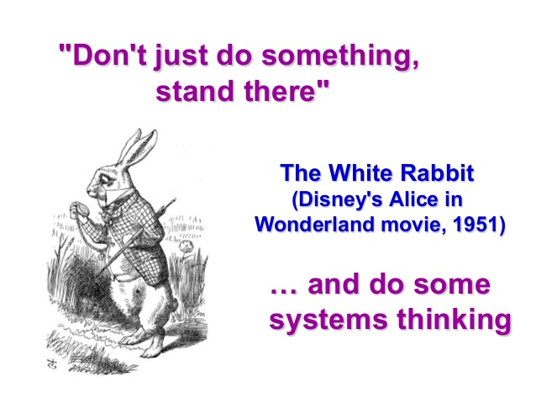

Slide 84
The outcome of processing
Because I Have Processed My Experiences
I Know What I Do That Creates and Limits Success
Therefore, I Have A Choice As To What I Do
I Can Achieve Even When Stressed
Therefore, I Have Control
Control is Power

Slide 85
The stages of taking on a life demand
An event
An accurate appraisal of the demands presented by the event based on my experiences
An accurate appraisal of the personal tools available to meet these demands based on my experiences
An accurate appraisal of the probability of success and the cost of failure based on experiennce
A well modulated physiological stress response that provides physical resources to meet the demands
An effective emotional label for that stress response
An Active Voice behavioral response

Slide 86
Step 9: How do you measure and celebrate success ?

Slide 87

The outcome ?

Slide 88
Or the process ?

Slide 89


Slide 90
The Little Engine That did

Slide 91
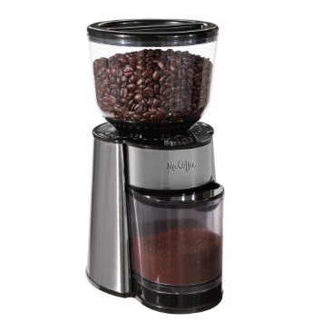
The grinder

Slide 92

B, S, & T

Slide 93
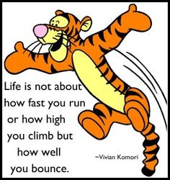
Bounces back

Slide 94

Need I say more ?

Slide 95
Step 10: Yes You can say more
Develop a list of synonyms and symbols for Grit
Say its name, a lot
Represent it around the house

Slide 96
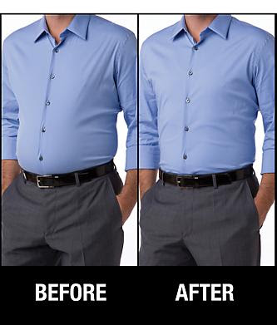
The spanx process

Slide 97

The Golden Child vs the scarred child

Slide 98
Step 11: What will be your parenting style ?

Slide 99
The parents’ manual
Thou Shalt Worry About Your Children
Page 306, Paragraph 4
Notes:
Parents worry about their children
I bet her parents worry a bit less after this race because she has shown them she can bounce back from adversity. She can cope. So, they can sleep better at night.

Slide 100
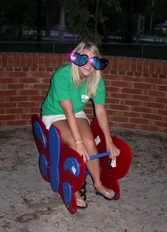
watch your language
Notes:
Do not undercut the child’s confidence though your help.

Slide 101
Parenting styles
The Warrior
The Repair(wo)man
The Director
The DI
The Coach
Notes:
So, now you have four options for your parenting style. One will facilitate GRIT and Growth Mindset and three will not.

Slide 102
The warrior
Super advocate
Fights every battle for the child
With an Army like mine, who needs to fight for myself
Nuke ‘em Mom !
The Message: You Are Not Capable

Slide 103
The repair (wo)man
Automatically fix the consequences of or fill in the gaps caused by the child’s behavior
Asking if homework is done
Checking the grade portal
Editing assignments
The Message: Experience doesn’t matter

Slide 104
The Director
Expert at recognizing problem situations or red flags
Quickly jumps in with suggestions for assignments, solving interpersonal conflicts, etc.
The Message: You do not have to practice leading or solving problems to become proficient at leading or solving problems because it is easy.

Slide 105
The DI
Just Do It !
You could if you wanted to, you just don’t want to.

Slide 106
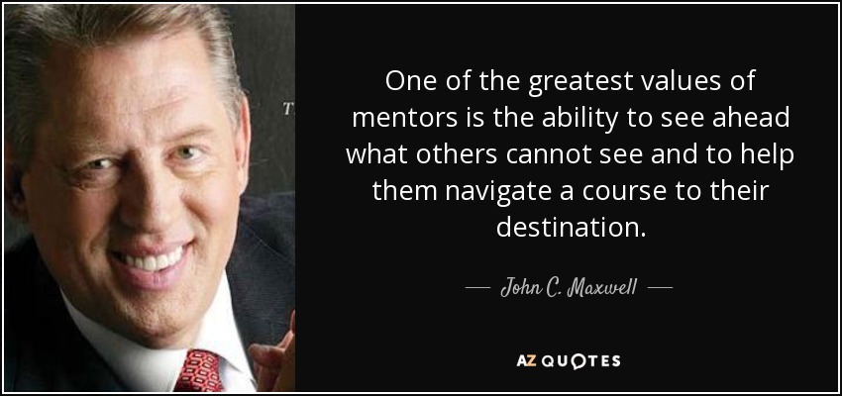
A coach is a mentor
Notes:
I think of coaching as mentoring. Facilitating someone’s development and growth.

Slide 107
The coach’s objective
How do I help him or her find a pathway to success and do so in a way s/he is stronger for taking the journey

Slide 108
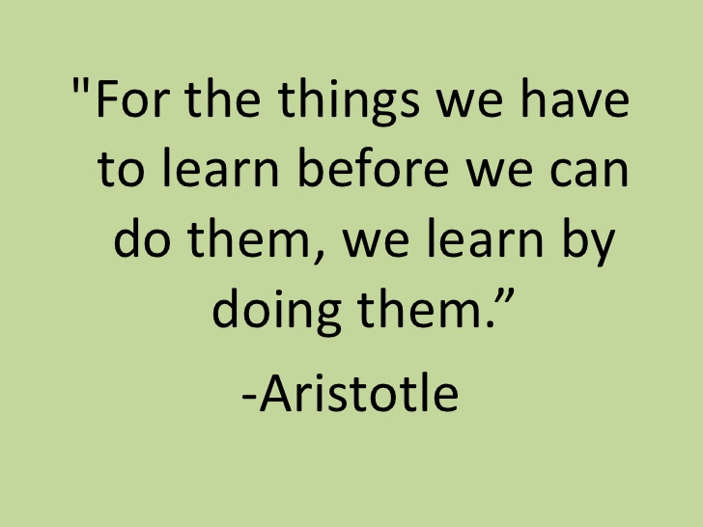
The Guide on the Side, not The Sage on the Stage

Slide 109
The stages of taking on a life demand
An event
An appraisal of the demands presented by the event
An appraisal of the personal tools available to meet these demands
A appraisal of the probability of success and the cost of failure
A physiological stress response that provides physical resources to meet the demands
An emotional label for that stress response
An Active Voice Behavioral Response

Slide 110
The parents’ manual
Thou Shalt Worry About Your Children
Page 306, Paragraph 4
Notes:
Parents worry about their children
I bet her parents worry a bit less after this race because she has shown them she can bounce back from adversity. She can cope. So, they can sleep better at night.

Slide 111
To coach or not ?
A problem I need to solve for the child ( or myself ), or
A teachable moment
Your anxiety can cause you to over-parent, e.g. I have no idea what to do so I just start saying stuff.

Slide 112
The objective
Is not to create easily managed children
Rather, it is to develop self-managed children
Because college is like being in the candy store with no adult supervision

Slide 113


What is your goal ?

Slide 114
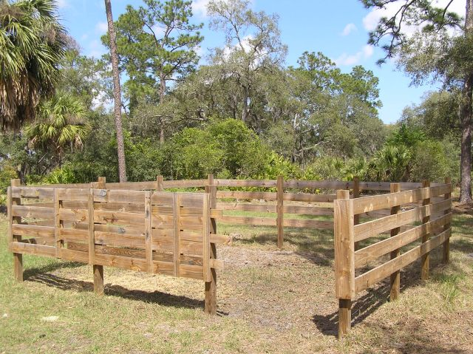
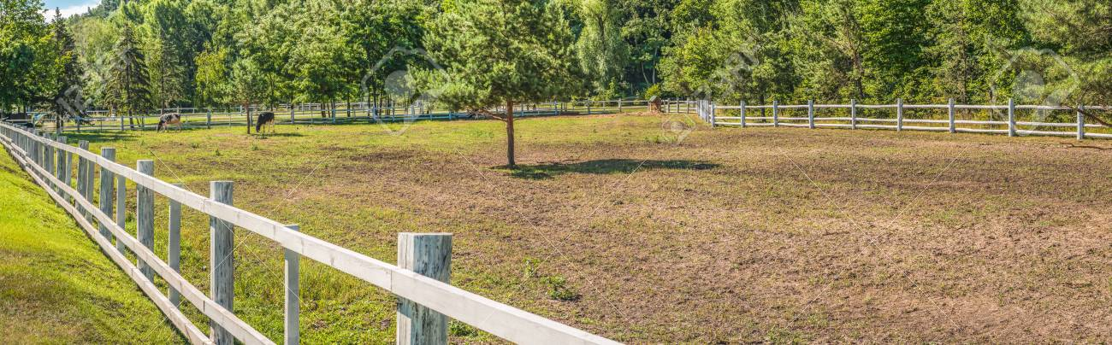
The corral

Slide 115
Are you saying just “let them Fail” ?
If they are trying, they will fail.
A failure well examined and processed is more valuable than a success created without thought.
So, yes, let them fail and then create a strength out it by processing it.

Slide 116
Resources
Fostering Grit, Thomas R. Hoerr
Mindset, Carol Dweck, PhD
TED Talk, Angela Duckworth, PhD
The Wright Brothers, David McCullough
Ready For Take-Off, Theresa Maitland PhD and Patricia Quinn, MD

