Slide 1



disorders and symptoms in students
Easy to implement strategies for parents and caregivers
Marlena Jenkins, M.S., BCaBA
St. Johns County Public Schools, January 8, 2019
University of Florida—Jacksonville FDLRS-MDC

Slide 2
UF Health Developmental pediatric center
Grant-Funded |  | Insurance-Based Self-Pay
Center for Autism and Related Disabilities (CARD) Dr. Childers Jeannie Potthast Elise Summa Various Providers | Florida Diagnostic Learning and Resource System Multidisciplinary Center (FDLRS) Marlena Jenkins Various Providers | Developmental Pediatrics Dr. Childers Dr. Dial | Neurology Dr. Tardo | Pediatric Assessment and Intervention Program (PAIP) Marlena Jenkins Various Providers
Works with children and adults with an autism spectrum disorder, dual sensory impairment or sensory impairment combined with another disabling condition. Parent and teacher consultation and training. Serving families in Duval, Clay, St. Johns, Nassau, Baker and Flagler counties. | Psychoeducational, psychological, speech and/or language, and neurodevelopmental evaluations for children 3 to 22 years, providing they are still in high school, who are struggling in school due to complicated medical, behavioral, developmental and/or social histories. Serving families in Duval, Clay, St. johns, Nassau, Baker and Flagler counties | Neurodevelopmental pediatrician This division brings together various specialists to work with children at risk for learning, behavioral or developmental delays. They serve children with a variety of disorders, ranging from developmental delays that may be overcome with early care and treatment to lifelong conditions that may be alleviated with ongoing support and appropriate care regimens. | Child Neurology Our child neurology services include Cerebral Palsy; Neurodegenerative conditions; Neuromuscular conditions; Hypotonia; Premature follow-up; Autistic Disorders; Developmental Delays; Headaches and Movement Disorders | Educational Assessment Educational / Behavioral Consultations Food Over-Selectivity Clinic Intensive Academic Intervention Targeted Parent Training Adaptive / Behavior Clinic Study and Organizational Strategies Thematic Social Skills Groups

Slide 3

Training agenda
Defining anxiety
Types of anxiety and related disorders
Anxiety related symptoms across childhood and adolescence
Making referrals
Strategies
Questions
  When you see this image
  Think deeper about the concept

Slide 4

What is anxiety?
a feeling of worry, nervousness, or unease, typically about an imminent event or something with an uncertain outcome.
desire to do something, typically accompanied by unease.
                What does the uncertainty of outcomes
                have to do with anxiety related symptoms
                If there is a desire to do something why are
                behavioral manifestations of anxiety labeled
                as noncompliance

Slide 5
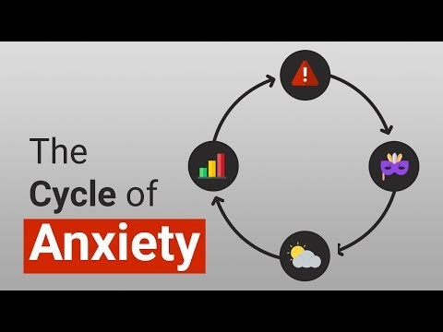
Cycle of Anxiety

Slide 6

Anxiety disorders
-The Stats-
#1 mental health disorder in America
Only 1 in 5 teenagers receive treatment
what are the barriers
Today’s pressures trigger anxiety further
are the triggers within our control
Must cause clinically significant distress or impairment in social, academic, occupational, or other important areas of functioning to meet diagnosis.
The symptoms cannot be better accounted for by another mental disorder or be caused by substances, medications, or medical illness.

Slide 7
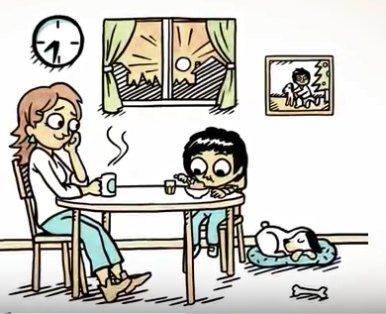
First Day of Kindergarten

Slide 8

Separation Anxiety Disorder
-clinical description-
Developmentally inappropriate and excessive fear or anxiety concerning separation from those to whom the individual is attached.
Symptoms last at least 4 weeks in children and adolescents.
-symptoms-
Recurrent excessive distress when separation from home or major attachment figures occurs (or is anticipated)
Persistent and excessive worry that something traumatic will lead to separation from a major attachment figure (e.g., being kidnapped)
Persistent reluctance or refusal to go to school or other places because of fear of separation
Persistent or excessive fear or reluctance to be alone or without major attachment figures at home or in other settings
Persistent reluctance or refusal to go to sleep without being near a near a major attachment figure (or to sleep away from home)
Repeated complaints of physical symptoms (e.g. headaches, stomachaches, vomiting) when separated from major attachment figures (or separation is anticipated)

Slide 9
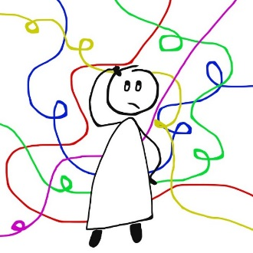
Generalized Anxiety Disorder
-clinical description-
Excessive anxiety and worry about a variety of events or activities, even when nothing is wrong or when the worry is disproportionate to actual risk.
The worry is difficult to control.
Symptoms last at least 6 months.
-symptoms-
The worry is associated with at least three (in adults) or one (in children) of the following physical or cognitive symptoms:
  Restlessness
  Fatigue
  Impaired concentration or feeling that mind is going blank
  Irritability
  Increased muscle aches or soreness
  Difficulty sleeping (trouble falling asleep or staying asleep)
Sometimes associated with other physical symptoms such as nausea or diarrhea.

Slide 10
Specific Phobias
-clinical description-
Marked and persistent fear that is excessive or unreasonable, cued by the presence or anticipation of a specific object or situation.
The phobic object/situation is actively avoided or endured with intense fear or distress.
  Will almost always provoke an immediate anxiety response
Fear is recognized as being excessive or unreasonable.
Symptoms last at least 6 months.

Slide 11
Specific Phobias
-gender differences
Boys Fears – Free Option
Girls Fears – Free Option
Spiders
Predators
Being hit by a car
Snakes
Burglar
Frightening movies
The dark
Being teased
Frightening dreams
Medical operations
Spiders
Being kidnapped
Parents dying
The dark
Frightening movies
Thunderstorms
Being teased
Bats
Bats/ghosts/spooky things
Sleeping in the dark/Making a mistake
Source: Muris, P., Merckelbach, H., & Collaris, R. (1997).
Common childhood fears and their origins.
Behavior Research and Therapy, 35(10), 929-937

Slide 12
Obsessive-Compulsive Disorder
Characterized by obsessive, intrusive thoughts (e.g. constantly worrying about staying clean, or about one's body size) that trigger related, compulsive behaviors (e.g. repeated hand-washing, or excessive exercise).
These behaviors are performed to alleviate the anxiety associated with the obsessive thoughts.
Obsessions/compulsions interfere with social or work interactions.
The symptoms are not triggered by a) the physiological effects of a substance (i.e. drugs or alcohol) or b) another medical condition (e.g., excoriation or hoarding).

Slide 13
Obsessions and Compulsions
Obsessions:
  Recurrent & persistent thoughts/urges/images that are experienced as intrusive & unwanted
  Individual attempts to ignore or suppress thoughts/urges/images, or tries to neutralize them with some other thought or action (i.e., performing a compulsion)
Compulsions:
  Repetitive behaviors (e.g., hand washing, ordering, checking) or mental acts (e.g., counting, repeating words silently) that individual feels driven to perform in response to an obsession or according to rules that must be applied rigidly.
  Behaviors or mental acts are aimed at preventing/reducing anxiety/distress, or preventing some dreaded event/situation.
Obsessions or compulsions are time-consuming (e.g., take >1 hour/day) or cause distress/impairment in functioning

Slide 14
Panic Disorder
Recurrent expected or unexpected panic attacks AND one or more of the following symptoms for at least one month:
  Pounding heart
  Sweatiness
  Feeling of weakness
  Faintness
  Dizziness
  Tingling or numbness in hands
  Feeling flushed
  Sense of unreality
  Feeling of loss of control or losing one's mind
  Fear of dying or something physically wrong (e.g., heart attack, stroke)
At least 1 of the attacks has been followed by 1 month (or more) of one or both of the following:
  Persistent concern or worry about future/additional panic attacks or their consequences
  A significant change in behavior related to the attacks (e.g., behaviors designed to avoid panic attacks)

Slide 15

Social Anxiety Disorder
-clinical definition-
Marked fear or anxiety about 1 or more social situations in which the individual is exposed to possible scrutiny (embarrassment or criticism) by others.
The individual fears that he or she will act in a way or show anxiety symptoms that will be negatively evaluated.
The social situations almost always provoke fear or anxiety.
Symptoms last at least 6 months in children and adolescents.
Generalized – fear is present across any social situations
Specific – eating in public, public speaking, talking with certain roles

Slide 16

Social anxiety disorder
-symptoms-
Significant and persistent fear of one (or more) social or performance situations in which the individual is exposed to unfamiliar people, or to possible scrutiny by others due to fear of humiliation or embarrassment. Note: In children, the anxiety must be present in peer situations and not only in interactions with adults.
Exposure to the feared social or performance situation provokes significant anxiety.
The person recognizes that the fear is excessive or unreasonable.
why does development matter
The feared social or performance situations are avoided or else are endured with intense anxiety or distress

Slide 17

Selective Mutism
-clinical definition-
Consistent failure to speak in specific social situations in which there is an expectation for speaking (e.g., at school) despite speaking in other situations.
The failure to speak is not attributable to a lack of knowledge of, or comfort with, the spoken language required in the social situation.
The duration is at least 1 month.
Symptoms cannot be better accounted for by another mental disorder or be caused by substances, medications, or medical illness.

Slide 18
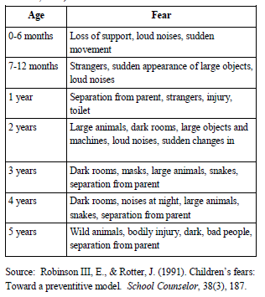
Anxiety Across the Ages
-childhood-

Slide 19
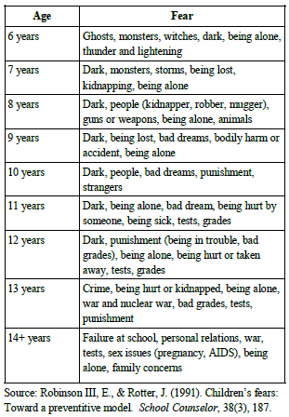
Anxiety Across the Ages
-childhood & adolescence-

Slide 20
Is it time to be concerned?
Worry that lasts for months
Worry that causes physical distress
Refuses to go to school or participate in activities
  Trouble concentrating in class
Seems unusually gloomy/pessimistic
Asks for a lot of reassurances
  Becomes upset if reassurances are considered inadequate
Seems irritable & angry
  Sleep deprivation
Is excessively self-critical
Suicidal ideation
  Self-harm
Fears are significantly interfering with your family, educational, work, daily life

Slide 21
Restructuring Thoughts
Anxious Thought | Evidence that thought is TRUE | Evidence that thought is FALSE | New Thought
The storm might cause lightning to strike our school and hurt me. | Lightning can strike buildings. Lightning can strike people who are not under shelter. | Chances are lightning won’t strike our school. The school is built to handle storms and keep people safe. If lightning strikes the school, the roof will protect me. IF the roof catches on fire, I will evacuate *I have an emergency plan. | Even if lightning strikes the building, I will remain safe. * I will follow the emergency plan.

Slide 22
Questions to ask
-false thoughts-
Do I know for sure that ______ will happen?
What evidence do I have that _______ will happen?
How likely is it really?
Has _______ ever happened before?
Even if _______ happens, can I live through it?
What is the worst possible outcome? (Rate how bad it is)
Could I cope? Do I have the coping mechanisms or do I need help?
Do I know anyone else who has been in this situation? What did they do?
Have I been able to cope with ______ in the past?

Slide 23

So…now what do we do?
Define the behavioral manifestation and Collect data
  Step 1 if the effects of anxiety related symptoms are impacting the student’s learning and school based relationships
  Observable and Measureable
Peer Modeling (select a peer that is similar to the target child/teen)
  Arrange for frequent learning opportunities and taper off over time
  Use pivoting technique in the natural environment
Maintain open lines of communication
Develop a plan and stick to the script
  Practice, practice, practice
Never use the child/teen’s fear during times of discipline

Slide 24
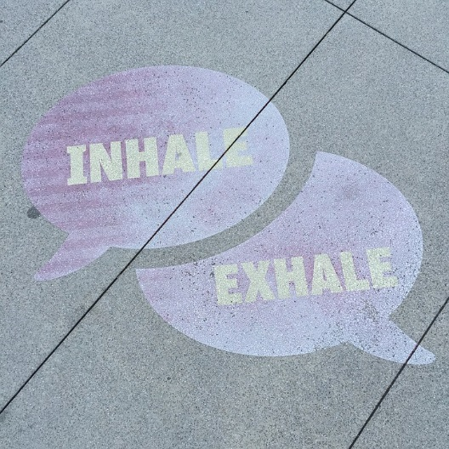
Targeting Physical Feelings
Slow breathing
Deep abdominal breathing
Body scan
Imagery breathing
Quick 5-4-3-2-1
Grounding Activity

Slide 25
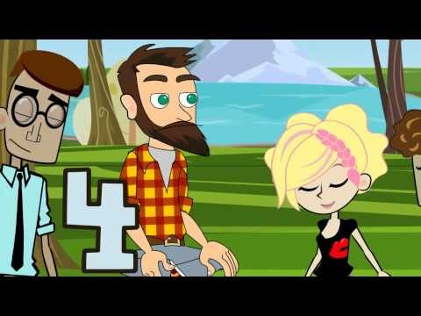
4-7-8 Breathing

Slide 26
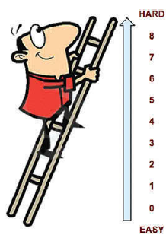
Bravery Ladder
Hardest behavior at top, easiest behavior at bottom
Take (emotional, physiological) temperature along way
Earn Bravery Dollars
Use labeled praise

Slide 27
In school
-Social Situations-
[Hardest] I went to the lunchroom and sat at a table with some kids I know and joined a conversation.
I went to the lunchroom and sat at a table with some kids I know.
I started a conversation with somebody in my class.
I said hi to a kid in my class who I usually don’t talk to, even though he didn’t say hi first.
I tried to speak up more loudly when I answered a question in class.
I answered a question in class when the teacher called on me. It was a question that she did not prepare me for answering ahead of time.
I answered a question in class when the teacher called on me. It was a question she prepared me for answering ahead of time.
I remembered to face somebody I was talking to and not turn in the other direction.
[Easiest] I practiced making eye contact with the teacher when she was talking to me.
Notes:
Stay in situation until anxiety decreases by half.

Slide 28
Going to School
[Hardest] I left for school on time, had no reminders, and I entered the school building all by myself with no fussing. I changed my worry thoughts and noticed that I can still go to school even when I am anxious about it.
I did number 3 on ladder and got to school on time.
I did number 4, but this time I walked into school by myself, not with my parents.
I accomplished all of the things on my morning routine with 1 or no reminders and got into the car without any fussing or fighting.
I was able to change my worry thoughts when I felt anxious this morning and then did 2 of the things on my morning routine with only 1 reminder.
I woke up on time and also did 1 of the things on my morning routine with only 1 reminder from my parents.
[Easiest] I woke up on time this morning.

Slide 29
Coping cards
Palm-sized, colorful cards that have pre-printed positive "self-statements" that have been designed specifically for children. Children can read the statements on the cards anytime, and can store them easily in a backpack or pocket for quick, easy reminders of their ability to cope with whatever comes their way.
Coping Cards include several blank cards in addition to the pre-printed cards for your child to personally tailor specific cards to his or her fears or concerns.
Appropriate for children between the ages of approximately 5-14 years, Coping Cards are a great tool for boosting youngsters' confidence in their ability to cope with stress and anxiety.
  Donna Pincus, Ph.D., The Child Anxiety Network, 2001

Slide 30
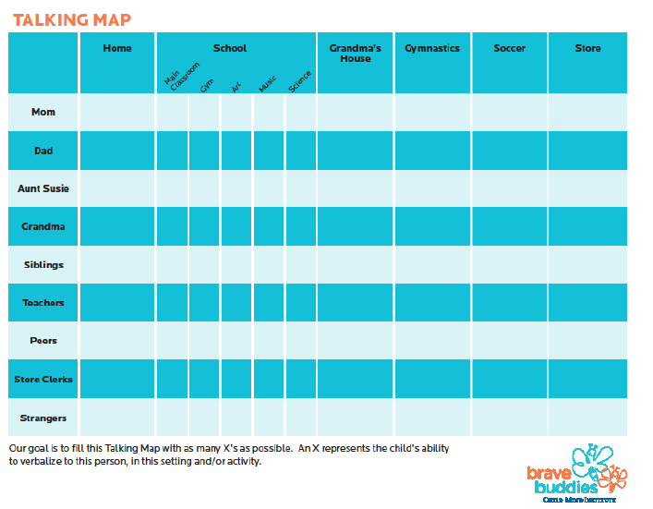
Talking map

Slide 31
Behavioral Approach
-what is the function-
Any technique or process that is meant to alter a dimension or the effects of behavior.
  Examples of behavioral strategies are planned ignoring, redirection, reinforcement, and punishment, etc.
Function based
  Escape/Avoidance: to get away from or eliminate contact with something, some place, or someone
  Access: to gain initial or more access to something, some place, or someone
  Automatic: internally driven desire to fulfill a need (measured by the student himself)
  Attention Maintained: meant to gain initial or continued access to attention from something in the environment
  Power/Control: desire to have things “my way” or to overpower something in the environment

Slide 32

Changing behavior
Reinforcement
Punishment
Positive and Negative
Increases the likelihood that the behavior will occur again
Positive and Negative
Decreases the likelihood that the behavior will occur again
Behavioral Approach
Although you have a functionally equivalent replacement behavior you may have missed the anxiety provoking trigger.
SHAPE up the target behavior
  Reinforcement small steps moving toward the larger goal/behavior

Slide 33
Post - crisis
Reflective journaling
  Written, drawing or audio recording
Buddy check time (using peer model)
Self evaluation (rating scale)
  How well did I use the rehearsed coping skills?
  Was I more or less independent than the last time?
Gratitude journal
  Puts negative thoughts in perspective
A nap
  Some panic attacks can be so physically and mentally exhausting that a little rest is needed
    Monitor for escape or avoidance based behaviors

Slide 34
DO | DON’T
It’s okay to allow your student to experience anxiety-provoking situations | Bend over backwards to avoid anxiety-provoking situations
Validate your student’s feelings | Minimize your student’s feelings or tell them how they should feel instead
Encourage your student to “BE BRAVE!” and/or to “BEAT THE WORRY MONSTER!” | Overly reassure your student or try to remove your student from the anxious situation

Slide 35
It takes a village
-but let’s start with you-
Select an accountability partner.
Someone the child/teen is comfortable talking with in an open fashion.
    Discuss strengths and weaknesses
    Assist with advocating on behalf of the child/teen
    Available to talk through ideas, trouble shoot and provide feedback on progress/regression
  Responsible for helping to redirect the child/teen back to the task at hand.
  Responsible for verbally and tangibly reinforcing the child/teen.
  Someone who is easily accessible.

Slide 36
Seeking Professional Help
Cognitive-Behavioral Therapy (CBT)
Consult with your child’s/adolescent’s PCP
https://www.clinicalchildpsychology.org/ Society of Clinical Child and Adolescent Psychology (online presentations by psychologists)
http://www.adaa.org/ Anxiety and Depression Association of America
www.childanxiety.net Child Anxiety Network

Slide 37
References & Recommended Reading
Pincus, D. B. (2012). Growing Up Brave: Expert Strategies for Helping Your Child Overcome Fear, Stress, and Anxiety. Little, Brown, and Company, New York, NY.
Resources and exercises/toolkits for home and school:
Anxiety BC: www.AnxietyBC.com
https://www.youtube.com/watch?v=r_5eiYIo1XM
WayAhead: Mental Health Association NSW: www.WayAhead.org.au
Rethinking Thinking – Trevor Maber (TED ED): https://youtu.be/KJLqOclPqis
Children’s Fears: Developmental or Disorder?: What Educators Should Know
Sacha N. Matthews
University of Pittsburgh, School of Educational, 2010
Gratitude Journal: www.Amazon.com
various religious and non-religious themed journals
www.Therapistaid.com
www.Merakilane.com
www.thechaosandtheclutter.com
www.gozen.com

Slide 38

What are your final questions, deeper take away thoughts and things to continue working through in the days or months ahead?
Feel free to contact our UF JAX FDLRS-MDC for continued conversation or to schedule consultative support!
Marlena Jenkins, M.S., BCaBA
Marlena.Jenkins@jax.ufl.edu
904-633-4332

