Slide 1
School-based evaluations
Anna Martin, Ed.S.
Melissa Gullo, M.S.

Slide 2
When do we evaluate?
Initial Evaluations:
When a school-based team or parent suspects a student has a disability, it is the school’s obligation to evaluate. The referral to evaluate is usually generated through the school-based MTSS team.
Evaluations at the school are completed to consider eligibility for ESE services. Once consent for evaluation is signed, schools have 60 calendar days to complete an evaluation.

Slide 3
When do we evaluate?
Re-evaluations:
ESE students must be re-evaluated every three years.
Most often, re-evaluation includes review of existing data. No additional testing is typically required.
Re-evaluation testing may be completed if more information is needed to modify the student’s IEP
Re-evaluation is necessary to add additional exceptionalities to IEP
District policy is for re-evaluations to be completed within 90 school days.

Slide 4
ESE Exceptionality Categories
  Students can be eligible for ESE services under several different categories, known as “exceptionalities:”
  Specific Learning Disability (SLD)
  Emotional/Behavioral Disability (EBD)
  Language Impaired (LI)
  Speech Impaired (SI)
  Intellectual Disability (InD)
  Autism Spectrum Disorder (ASD)
  Developmentally Delay (DD)
  Other Health Impaired (OHI)
  Deaf/Hard-of-Hearing (DHH)
  Visually Impaired (VI)
  Traumatic Brain Injury (TBI)
  Orthopedically Impaired (OI)
  Dual-Sensory Impairment
  Hospital Homebound (HH)
  Gifted
  Occupational Therapy (OT) – (Related Service)
  Physical Therapy (PT) – (Related Service)
If a student is already ESE, full evaluation criteria must be met before adding an additional exceptionality. This may involve going through MTSS process.
Exceptionality does not drive services. ESE services are based on student need.

Slide 5
Specific Learning Disability Criteria
To be eligible for SLD, students must complete the MTSS process at Tiers 1, 2, and 3
If a student is unresponsive to interventions at Tier 3, he may be referred for formal evaluation.
Formal evaluation for SLD typically involves a summary report of existing data. No additional testing is necessary.
Team may request additional testing if needed. Test scores may provide information regarding the child’s strengths and weaknesses. However, this information is not used to determine eligibility for services.
Schools are unable to diagnose dyslexia; however, we can address characteristics commonly associated with dyslexia

Slide 6
Standardized Testing in Evaluations
Several exceptionalities require formal testing (ASD, InD, DHH, etc.)
Types of assessments often involved in psychoeducational evaluations:
IQ and Nonverbal IQ
Cognitive Processing
Academic Achievement
Adaptive Rating Scales
Behavior Rating Scales
Autism Spectrum Rating Scales
Social/Developmental History
Speech/Language Assessment
Evaluations completed outside of school will be reviewed and considered by school-based teams. However, school-based evaluation is still required for eligibility.

Slide 7
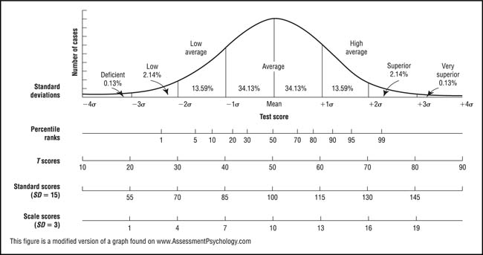
Interpreting Scores
Standard Scores
Set of scores with same mean and standard deviation so they can be compared
Mean/Average = 100
Average Range = 85-115
  68.2% of population score within this range
Standard score of 70 is NOT the same as 70% on a classroom test
Percentiles
Value determined by the percentage of values smaller than it
Average percentile = 50th
50th percentile= Student scored the same or higher than 50% of children his age
NOT the same as 50% correct

Slide 8
What happens after the evaluation is complete?
Initial eligibility:
Eligibility meeting is scheduled to review results
Team reviews criteria and determines eligibility
If eligible, draft IEP is reviewed with parent with parent input
Schools provide services to students in the least restrictive environment. Most students will remain in their same general education classroom while receiving services rather than receiving services in a separate ESE class
Parents can decide whether or not to give consent after IEP is drafted
Re-evaluation only:
IEP team meets to review results and close out re-evaluation. IEP is amended.

Slide 9
What to do if you have concerns with your child’s services
Parents have the right to request an IEP team meeting at any time. Please meet with you child’s IEP team to discuss your concerns and problem-solve solutions
Parents have the right to withdraw consent for ESE services at any time. If consent is revoked, student must complete intervention process, complete full evaluation, and meet eligibility criteria before receiving services again in the future.
If consent is withdrawn, that includes ALL services.
Please refer to your procedural safeguards and/or contact the school-based LEA for more information

