Slide 1
Helping Your Child Thrive with ADHD
Lisa D. Bailey, Ph.D.
Licensed Psychologist
Nautilus Behavioral Health, PLLC

Slide 2
What is ADHD?
DSM-5 Diagnostic Criteria:
  A persistent pattern of inattention and/or hyperactivity-impulsivity that interferes with functioning or development, as characterized by (1) and/or (2):
  Inattention: Six (or more) of the following symptoms have persisted for at least 6 months to a degree that is inconsistent with developmental level and that negatively impacts directly on social and academic/occupational activities:
    Poor attention to detail/makes careless mistakes
    Difficulty sustaining attention
    Seems not to listen when spoken to directly
    Difficulty with follow-through on tasks or activities
    Difficulty with planning and organization
    Prefers not to engage in tasks that require sustained mental effort
    Frequently loses things or is easily distracted (by external stimuli or by own thoughts)
    Forgetfulness for daily activities

Slide 3
What is ADHD?
DSM-5 Diagnostic Criteria (cont.):
  Hyperactivity and impulsivity: Six (or more) of the following symptoms have persisted for at least 6 months to a degree that is inconsistent with developmental level and that negatively impacts directly on social and academic/occupational activities:
    Fidgetiness
    Difficulty remaining seated when expected to do so
    Runs around or climbs when it is inappropriate. (Adolescents may feel restless)
    Difficulty playing/relaxing quietly
    Uncomfortable being still (“on the go,” seems “driven by a motor”) or difficult to keep up with
    Excessive talking
    Blurts out answers
    Difficulty waiting for turn
    Interrupts or intrudes on others, takes over what others are doing

Slide 4
What is ADHD?
DSM-5 Diagnostic Criteria (cont.):
  Several inattentive or hyperactive-impulsive symptoms were present prior to age 12 years.
  Several inattentive or hyperactive-impulsive symptoms are present in two or more settings (e.g., at home, school, or work; with friends or relatives; in other activities).
  There is clear evidence that the symptoms interfere with, or reduce the quality of, social, academic, or occupational functioning.
  The symptoms do not occur exclusively during the course of schizophrenia or another psychotic disorder and are not better explained by another mental disorder (e.g., mood disorder, anxiety disorder, dissociative disorder, personality disorder, substance intoxication or withdrawal).
Notes:
Why is the last criteria important?
There are people with a diagnosis of ADHD that actually have something else
Symptoms of other disorders can mimic those of ADHD

Slide 5
What Looks Like ADHD?
Anxiety
Depression
Specific Learning Disorder/Disability
Oppositional Defiant Disorder
Autism Spectrum Disorder
PTSD
Medical condition/medication
Substance abuse
Sensory impairment (vision, hearing)
Adapted from Hallowell & Ratey (1994)
Notes:
That brings us to the question of what else could it be?
Here is a sample of common conditions that have overlapping symptoms with ADHD
Sometimes this is what actually explains the symptoms
Other times, these diagnoses co-occur with ADHD

Slide 6
Executive Functions
Brain-based skills needed to effectively complete tasks
Many people learn them naturally, but people with ADHD have difficulty “picking up” these skills
Types of executive functioning skills:
Response inhibition
Working memory
Emotional control
Flexibility
Sustained attention
Task initiation
Planning and prioritization
Organization
Time management
Goal-directed persistence
Metacognition

Slide 7
Myths About ADHD
Myth #1: ADHD is not a real medical condition
Myth #2: ADHD is a result of bad parenting
Myth #3: Children with ADHD cannot pay attention to anything
Myth #4: Children with ADHD are all hyperactive
Myth #5: Children outgrow ADHD
Myth #6: Children who take ADHD medications are more likely to use drugs and alcohol
Myth #7: Children with ADHD will not grow up to be successful/productive adults
Adapted from understood.org, additudemag.com & chadd.org

Slide 8
Difficulties at Home
Completing tasks/chores
Struggling with homework
Following directions
Keeping track of belongings
Requiring frequent reminders
Interrupting family activities
Winding down
Regulating emotions

Slide 9
School-Related Difficulties
Keeping track of school materials
Adjusting to school schedule (e.g., A days and B days)
Turning in homework assignments
Recording homework assignments
Bringing home materials needed to complete homework
Communicating when having more trouble
Planning and completing long-term assignments/projects
Focusing on lectures
Coping with transitions and “down time”
Notes:
Here are examples of things a child with executive functioning difficulties may have trouble with related to school

Slide 10
Social Difficulties
Reading and responding to social cues
Peer rejection/isolation
Arguments or misunderstandings with peers
Coping with peer pressure
Repairing relationships
Dating
Navigating social media
Notes:
ADHD and executive functioning difficulties also negatively affect social relationships, both with adults and peers

Slide 11
Benefits of ADHD
Ability to hyperfocus
Ingenuity/Creativity
Perceptiveness
Curiosity
Risk-taking
Energetic
Intelligence
Resilience

Slide 12
How Do I Help?
Play to your child’s strengths
Teach, not punish
Involve your child in problem solving
Remember the positives

Slide 13
How Do I Help?
Effective intervention occurs on two levels:
  Environment (external)
  Individual (internal)
Parents/caregivers play a role in both levels of intervention

Slide 14
Environmental Strategies
As parents/caregivers, you have the ability to set up your home and daily routines to assist children with executive functioning deficits
Daily routine
  Consistent from day to day
  Mealtimes
  Sleep/wake times
  Rituals and routines

Slide 15
Environmental Strategies
Physical environment
  Reduce distractions
  Minimize clutter
  Decrease opportunities for dangerous behavior
Social environment
  Organized activities
  Play dates
  Time-limited activities

Slide 16
Environmental Strategies
Advance preparation is key
  Modify task expectations
  Rehearse a situation beforehand
  Coaching
  Verbal prompting
  Reminders
Use mistakes to teach
  Praise for success (or partial success)
  Get feedback from others (a second opinion)
  Use debriefing sparingly
Notes:
For some tasks there is more flexibility than others, but allowing flexibility helps students figure out their learning styles and how to approach tasks
Choice: student decides order of task completions or format of responding
Lecture notes/outlines: some students will legitimately need this throughout the year, perhaps as part of their IEPs. But, for the entire class, you can start doing this at the beginning of the year and then fade it out – full out line to start and then have them fill in more and more on their own
Transparency: let students know how they’re being graded – scoring rubrics

Slide 17
Teaching Executive Functioning Skills
Formal teaching
  Problem-solve around difficult situations
  Help your child set goals for behavior
  Help your child learn steps of task completion/problem solving
  Provide direct feedback and praise
  Set up reward system
Informal teaching
  Model using these skills for your child
  Play games
  Ask for child’s input/analysis
  Allow your child to make real decisions

Slide 18
Supporting Internal Executive Functioning
Parents/caregivers can help children internalize the executive functioning skills that adults have been modeling or directly teaching
  Teach routines
  Help children learn scripts for problem-solving and self-regulation
  Seek children’s input on their own strengths and weakness and on what is helpful or unhelpful
  Motivate children to practice and use their executive functioning skills
    Praise
    Incentives/Rewards

Slide 19
Formal Intervention: Medication
What medication does:
  Increase ability to filter out extraneous information and focus on one thing
  Decrease impulsivity
  Increase ability to self-regulate
  Makes it easier for child to learn skills
What medication does not:
  Increase focus on things adults think are important
  Automatically improve social knowledge and skills
  Teach skills

Slide 20
Formal Intervention: Therapy
Benefits of therapy:
  Teaches skills
  Helps child and parents/caregivers develop intervention plan
  Helps child and parents/caregivers with problem-solving around pitfalls
  Provides lasting benefits
What to look for in therapy:
  Structured/focused
  Skills-based
  Parents/caregivers and child should be involved

Slide 21
Things to Remember
Do the minimum necessary to help your child be successful and fade supports over time
  Goal is for children to have enough support to be successful, while not overfunctioning for the student
Collaborate with teachers and other caregivers to support children’s development of executive functioning skills
The most important thing is to attend to your child’s strengths and their efforts to internalize executive functioning skills

Slide 22
“If a child doesn’t know how to read, we teach.”
“If a child doesn’t know how to swim, we teach.”
“If a child doesn’t know how to multiply, we teach.”
“If a child doesn’t know how to drive, we teach.”
“If a child doesn’t know how to behave, we... teach? …punish?”
Why can’t we finish the last sentence as automatically as
we do the others?
Tom Herner, 1998.
Notes:
Former president of the National Association of State Directors of Special Education (NASDE)

Slide 23
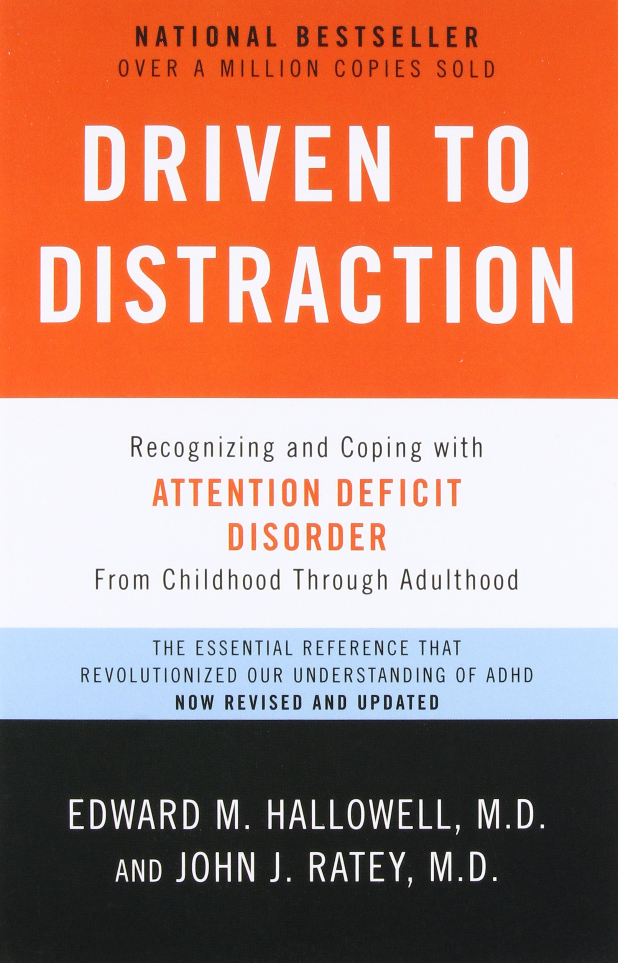

Slide 24


Slide 25


Slide 26


Slide 27


Slide 28


Slide 29


Slide 30
Contact Information:
Lisa D. Bailey, Ph.D.
Nautilus Behavioral Health l.bailey@nautilusbehavioralhealth.com www.nautilusbehavioralhealth.com

Slide 31
Questions?

