Slide 1
Response to Intervention/Instruction for Parents and the Community
Kimberly Miller and Todd Watson

Slide 2
Read excerpt from The Boarding House by james joyce
Mrs. Mooney was bachelor’s daughter. She was a woman who was quite able to keep things to her self; a determined woman. She had married her father’s fireman and opened a bachelor’s shop near spring Gardens. But as soon as here father-in-law was dead Mr. Mooney began to go the deeper. He drank, pludered the till, ran headlong into bed. It was no use making him take the plan; he was ssure to break out again a few days after. By fighting his wife in te pressure of customers and buying bad meat he royed his business.

Slide 3
QUESTIONS
What kind of business did the Mooney’s have?
What did Mr. Mooney do before he married Mrs. Mooney?
Why did they not have much money?
What did Mrs. Mooney do to try to stop Mr. Mooney of his devilish ways?
Your score __________% on reading comprehension

Slide 4
The Boarding House by James Joyce
Mrs. Mooney was a butcher’s daughter. She was a woman who was quite able to keep things to herself. She had married her father’s foreman and opened a butcher shop near Spring Gardens. But as soon as his father-in-law was dead, Mr. Mooney began to go to the devil. He drank, plundered the till and ran headlong into debt. It was no use making him take the pledge—he was sure to break it again a few days after. By fighting with his wife in the presence of customers and buying bad meat, he ruined his business.

Slide 5
What is MTSS/RtI?
MTSS (Multi-Tiered System of Supports) is a term used to describe an evidence-based model of schooling that uses data-based problem-solving to integrate academic and behavioral instruction and intervention. The integrated instruction and intervention is provided to students at varying levels of intensity based on student need. The goal is to prevent problems and intervene early so that students can be successful.

Slide 6
Does RtI have anything to do with Special Education?
Every student in the school, from Kindergarten to graduation, is involved in RtI.
Interventions are provided through general education resources so that all students can be successful.
For students who need ongoing intensive or individualized help to maintain progress, special education resources may be accessed by the school.

Slide 7
Does RtI have anything to do with Special Education (cont’d)?
Information gained through on-going problem-solving about what your child needs helps the school make a decision about your child’s need for special education resources.
The problem-solving process and RtI continues even if your child receives help through special education resources.
Behavior
Academic Struggles
Social/Emotional
Attendance

Slide 8
3-tiered system
Tier I: Core Academic and Behavioral Curriculum
Academic and Behavior: high quality core instruction provided to all students
Tier II: Supplemental Instruction/Intervention
Academic: at least 3 days per week in addition to core instruction
Behavior: additional behavior instruction in addition to core (i.e. counseling
1x/week, behavior chart w/teaching component)
Tier III: Intensive Instruction/Intervention
Academic and Behavior: daily instruction/intervention in addition to core
and supplemental instruction

Slide 9
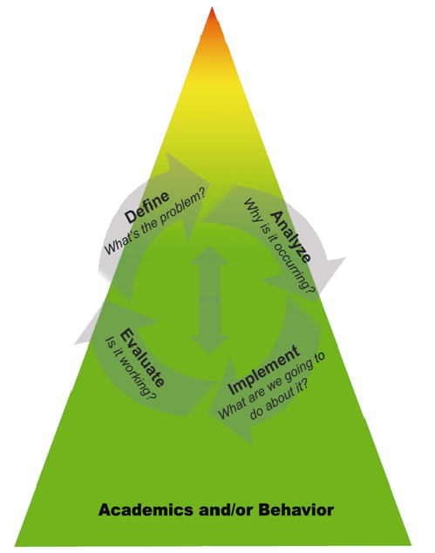

Slide 10
Questions?

