Slide 1
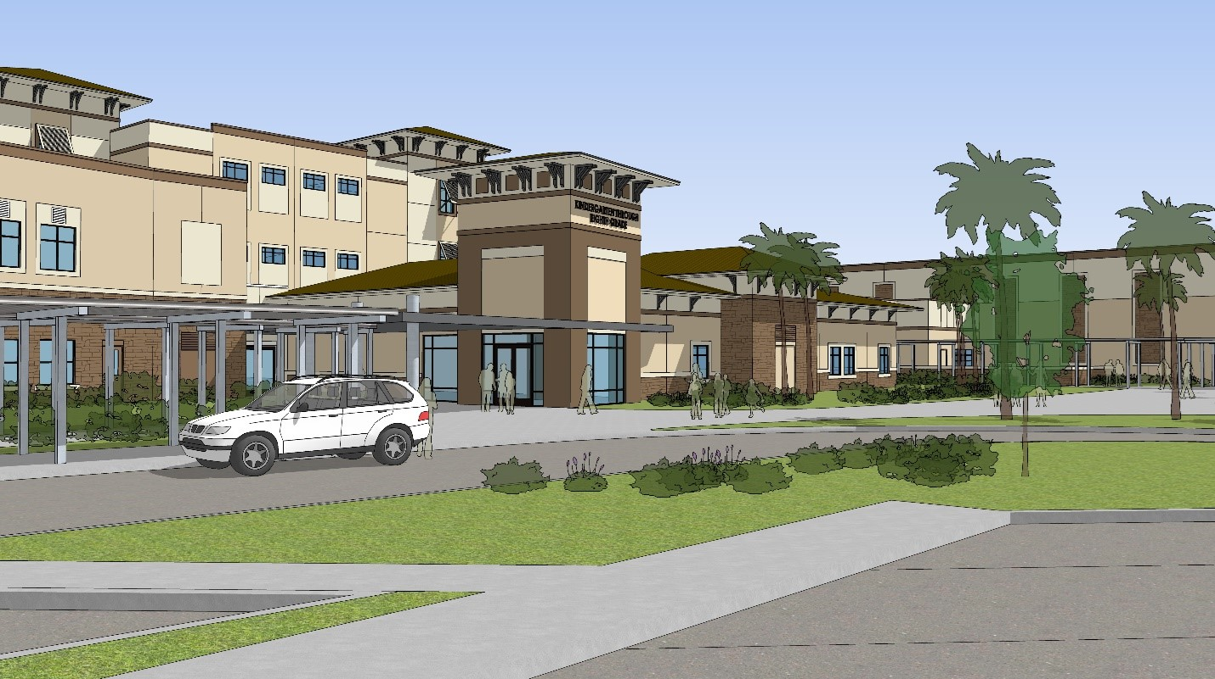
ST. JOHNS COUNTY SCHOOL DISTRICT
Notes:
Welcome
Introductions
It’s great to be here and we thank you for the privilege of you time and attention this morning/afternoon/evening
As you may know, the School Board will have two funding referendums on the November 5 ballot.
One is the continuation of the current half-cent sales tax for capital outlay purposes
The second is an additional one mill of property millage for operating purposes
Both of which we will get into detail in a few minutes

Slide 2
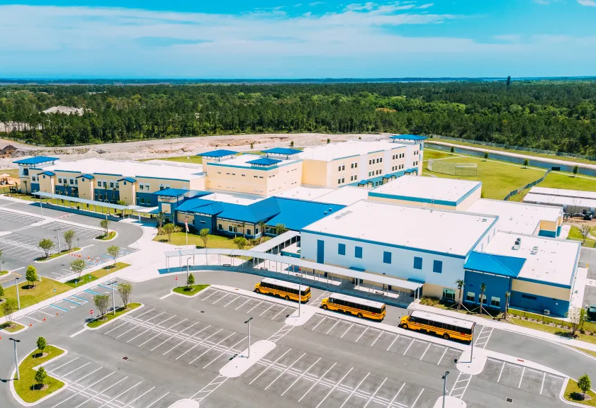
AGENDA
School District Accolades
St. Johns County Growth
School Funding
November Referendums
  Half-Cent Sales Tax
  School Millage
Freedom Crossing Academy, opened 2018
Notes:
Run through the agenda
We’re going to talk about the:
school district’s accomplishments
review the growth we have experienced
have a “primer” on school funding
discuss both the half-cent and the school millage
discuss the referendums in November

Slide 3


St. Johns County School District
“A” grade since 2004
ACT & SAT scores above state & national level
94% graduation rate
Certificate of Excellence in financial reporting 2016 – 2023
97% of ALL funds are spent in schools
$77M cost avoidance with comprehensive energy management plan
Returned children to in person learning quickly and safely during COVID
Keep Our Children Safe
Notes:
Since 2004 we have had an “A” grade from FDOE
1998-2010 FCAT, 2011-2014 FCAT 2.0, 2015-2022 FSA, 2023-Present FAST
District grades came into being in 2004, just school grades prior to that
Grad rate is 8th place in state, highest grad rate is 98% in Wakulla --- 5 of the top 8 are less than 10K students.
Wakulla 5,164
Calhoun 2,025
Walton 12,089
Indian River 17,692
Lafayette 1,152
Levy 5,718
Sumter 9,635

Slide 4
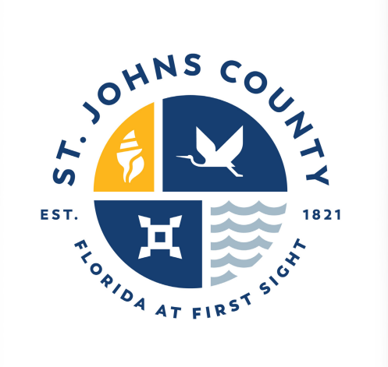
St. Johns County has DOUBLED in population
over the last 18 years.
Residents
160,266 in 2005
320,110 in 2023
Students
23,273 in 2005
51,826 in 2023
So have the number of students in our schools.
Notes:
Residents right at 100% increase
Students more than 123% increase

Slide 5
There are TWO school funding silos
Capital Outlay Budget
Operating Budget
  New Construction
  Security Improvements
  Maintenance
  Technology
  Salaries & Benefits
  Utilities
  Instructional Materials
  Consumable Supplies
Supported by Half-Cent
Supported by School Millage
In 2015, Voters Approved a Half-Cent Sales Tax for Capital Outlay
Notes:
This is our “primer” on school funding – although very complex, it basically boils down to these two silos ---
Growth
Safety of students and employees
Maintaining our existing buildings
Keeping up with the 21st century classroom
Salaries and benefits (approx. 83% on average of the budget
Other than S&B, utilities and instructional materials are typically our single biggest costs of doing business, which is the education of our future!!

Slide 6

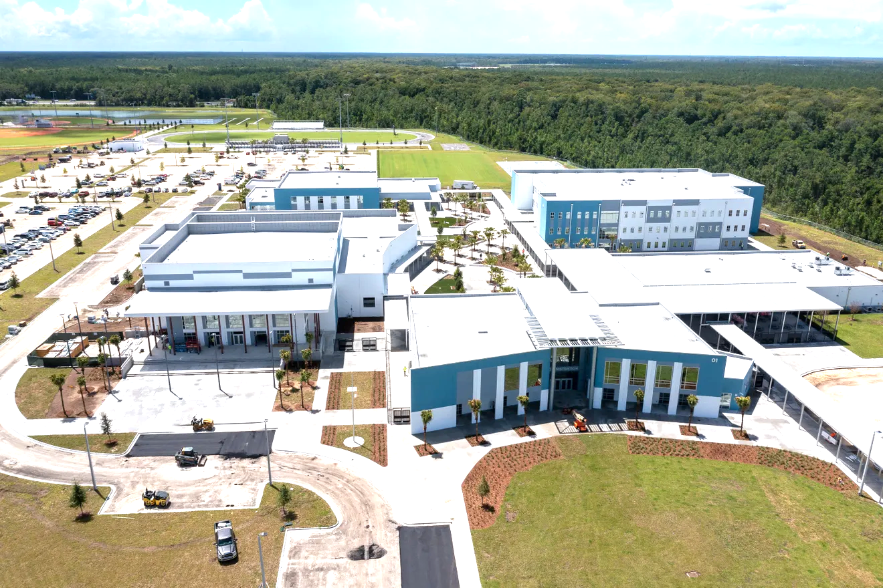
“Promises Made, Promises Kept”
Safety
Growth
Mobile Panic Alarm Systems
Single Point of Entry Improvements
One New Elementary
One New K-8 School
Partially Funded Two K-8s
Maintenance
Technology
13 Roof Replacements
Covered PE Areas, Restrooms and other site improvements
12,000 Computers
1,420 LED Panels
Wi-Fi upgrades in Schools
HALFCENTSUCCESS.COM
Notes:
Our original four buckets:
1) Safety & Security – we have the best Mobile Panic Alarm system in Centegix, the Board did not want a cheap/unproven system for our students and staffs’ safety
2) New construction & expansions
Picolata, Freedom Crossing (PVA and VRA)
3) Maintaining / upgrading our existing facilities
as an example, the roof replacement at an elementary school can run as much as $1M 4) Keeping up with the 21st century classroom

Slide 7
Half-Cent SUNSETS in 2025
$37M Annual Revenue Loss
Growth Continues
  Still one of the fastest growing counties in Florida
  Projected to add 13,600 students by 2033
  600 portables for 13,000 students - Not a long-term solution
  Construction costs are up 63%
Keeping our children safe remains #1 priority
Must maintain, replace and upgrade critical systems
Technology continues to rapidly advance
We Can’t Afford to Lose the Half-Cent!
Notes:
Need to “sandwich” the top and bottom borders – “the half-cent sunsets in 2025” and “we can’t afford to lose access to $37 million” and here are the reasons why:
Projected to add 13,600 students – that is more students than 33 other Florida counties/districts have as a whole population
600 portables for 13,000 students is approx. 16 elementary schools (13,000/750)
63% increase in cost of construction
PIA (2021) approx. $38 million
TCA/LA (2024) approx. $62 million

Slide 8




Half-Cent RENEWAL will be on the November ‘24 ballot
    Sales tax STAYS at 6.5%
    Lowest sales tax in Northeast FL
    Half-cent sales tax collected stays in St. Johns County
    Up to 38% paid for by out-of-county visitors
    Citizens Advisory Committee will continue to monitor and advise
Safety
Growth
Maintenance
Technology
Notes:
Finish with “as a reminder, this is NOT a tax increase, rather a continuation of the current sales tax of 6.5%”
NO additional cost to county residents

Slide 9


“TWO Votes, ONE Decision”
Capital Outlay Budget
Operating Budget
Supported by Half-Cent
Supported by School Millage
“For Our STUDENTS”
Notes:
Transition slide to wrap up discussion on infrastructure constraints and the half-cent renewal, and transition to operational challenges and one mill for teacher pay.

Slide 10

School district is facing operational challenges
Largest employer in St. Johns County – 6,438 employees
St. Johns has a higher cost of living
Historic vacancy levels for both instructional and support positions
Duval, Clay & Nassau have passed millage increases
  Avg. Teacher Salary
Flagler | $58,369
Duval | $55,282
Putnam | $55,000
St. Johns | $53,484
We must offer competitive compensation!
Notes:
Our operating millage has decreased over the last 10 years – set by the FEFP formula (Legislature)
“Lion’s share” of the TSIA went to the younger, less experienced teachers, thereby compressing the more veteran teachers
$15/hour minimum wage also placed downward pressure on the budget as well as compressing educational support veterans
We are larger than the next 3 largest employers in the County put together
SJC, UF/Flagler and Northop/Grumman
We see employees going to Duval, Clay, Putnam and Flagler because COL is far less expensive…not because of the difference in salary
Current starting salary is $48,642, it was at $39,000 just a few years ago.

Slide 11
Millage increase for TEACHER and STAFF pay will be on the November ‘24 ballot
What is Millage?
One mill equals $1 per $1,000 of assessed value, less homestead
What does it cost?
Avg. tax value in St. Johns County is $360,000 which means $1 day, per household
How will it be spent?
Recruit and retain high-quality teachers and staff, invest in school safety and student welfare, and preserve and enhance educational programs, including science, technology, art, music and athletics
Recruit & Retain
School Safety
Student Welfare
Enhanced Programs
Notes:
Four major buckets:
Retain and recruit high-quality teachers and educational support staff
Invest in continued school safety
Invest in continued student welfare (nurses, SLPs and others professional services)
Preserve and enhance educational programs at ALL schools: SEE ABOVE LIST
Each school has its own unique culture and climate and therefore, its own unique needs. This will give our schools the flexibility to do what they need to do to help our students succeed.
Because when our students succeed, our community succeeds!! (SMILE and BREATHE you're almost done!!)

Slide 12
“TWO Votes, ONE Decision”
Half-Cent for Schools
One Mill for Teachers & Staff
  Growth, Safety, Maintenance & Technology
No additional cost to residents
  Up to 38% paid by visitors
  100% of half-cent stays in St. Johns
  Citizens Advisory Committee
  Recruit and retain high-quality teachers and staff in a safe and secure learning environment, with enhanced student programs
  $1/day for average household
  100% of one-mill stays in St. Johns
  Citizens Advisory Committee
10 Years
4 Years
For our STUDENTS!
Notes:
Just recapping the two initiatives
Great schools, make great communities
Strong workforce
Strong property values
Drives local economy
Provides an overall greater quality of life for the entire community!!
Thank you again for your time and attention!
We would love to entertain any questions you may have!! 8>)

